Slide 1
Skew correction
Image Processing Course Project

Slide 2
Agenda
What is it?
Where do we use it?
How do we do it?
Why do we use it?

Slide 3
What is it?
Defining Skewedness

Slide 4
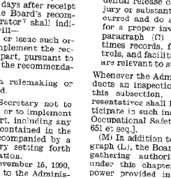
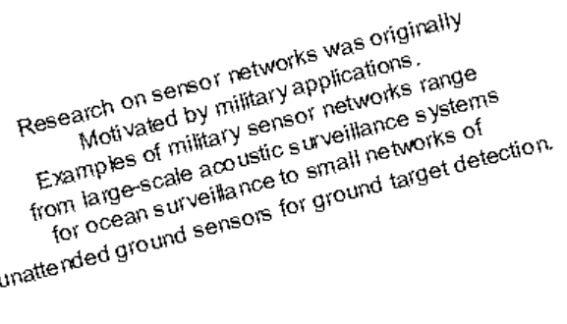
Skewed Documents
While working with the document data in CV, the performance of any machine learning system is always impacted by the skewness of the documents. If the document skewness is not properly corrected before feeding the document to the model, then accurate predictions cannot be expected from the model.

Slide 5
Hough Line transform
The Hough Line Transform is a fundamental technique in image processing and computer vision, primarily used for detecting straight lines in images. Introduced by Paul Hough in 1962, this method has undergone various enhancements and adaptations to improve its efficiency and accuracy.
The Hough Line Transform works by transforming points in the image space into a parameter space, where each point in the image space corresponds to a line in the parameter space. The most common parameterization is the polar coordinate system, where a line is represented by the parameters (ρ, θ). Here, (ρ) is the perpendicular distance from the origin to the line, and (θ) is the angle between the x-axis and the line’s normal.

Slide 6
WHERE DO we use it?
Optical character recognition

Slide 7
Skew Correction in Text Images for OCR
Skew correction is a critical preprocessing step in Optical Character Recognition (OCR) systems. It involves detecting and correcting the angular deviation of text lines in scanned or photographed document images. This process ensures that the text lines are horizontally aligned, which significantly improves the accuracy of subsequent OCR processes.
Importance in OCR Improved Accuracy:
Skewed text lines can lead to misinterpretation of characters by OCR algorithms, resulting in errors. Correcting skew enhances the readability and accuracy of text recognition.
Preprocessing Necessity: Skew correction is often a prerequisite for other preprocessing steps like binarization, noise removal, and segmentation, which are essential for effective OCR.

Slide 8
How do we do it?
Detecting and correcting skewedness

Slide 9
methodology
Find the Hough lines: Using the Probabilistic Hough line transform
3
Process the Hough Lines:
Finding the rotation angles
4
Find the Rotation Matrix
5
Apply the Affine Transform
6
Image Acquisition: Capturing or obtaining images from various sources
1
Pre-processing: Grayscale Image Blur Image Threshold Image Erode Image Dilate Image
2

Slide 10
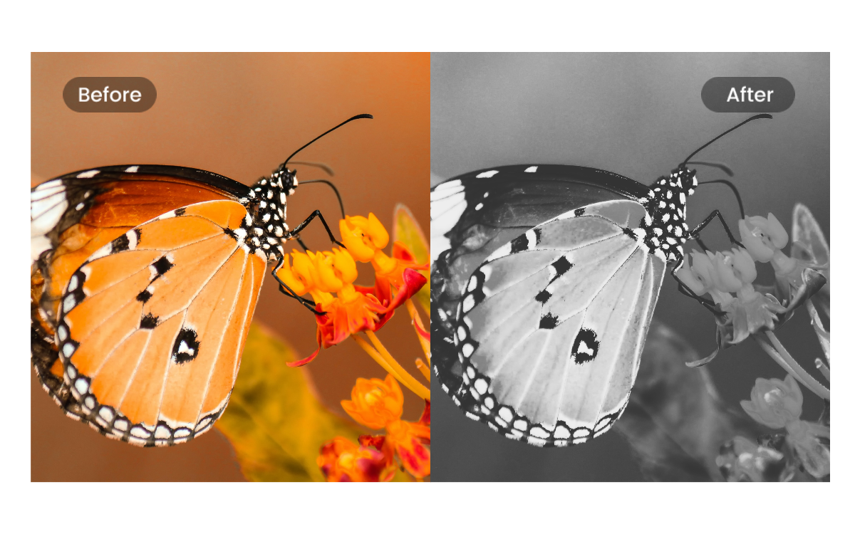
Converting Image to Grayscale
Purpose: Simplifies the image by reducing it to shades of gray, which eliminates the complexity of color information.
Reason: In the context of the Hough Line Transform, we are interested in the structural elements of the image (i.e., edges and lines) rather than color. Converting to grayscale is a crucial step because it reduces computational complexity and ensures that subsequent edge detection algorithms operate effectively.

Slide 11
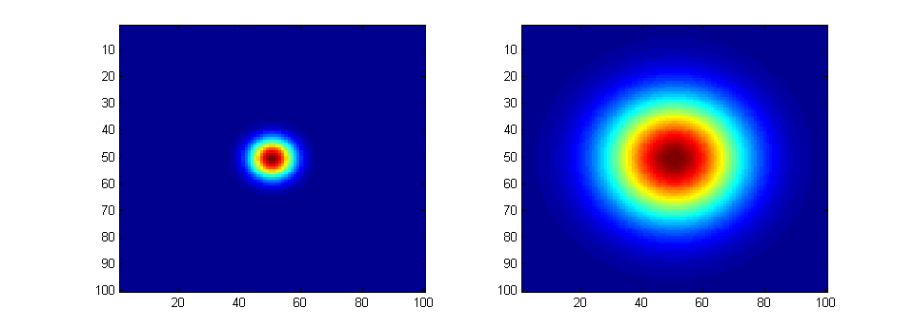
Blur Image
Purpose: Smooths the image by averaging pixel values, which helps in reducing noise and detail.
Reason: Blurring is essential in preprocessing to minimize the effect of noise, which can lead to false edges in edge detection. By applying a blur filter, we can ensure that the edges detected are more accurate and represent significant structural features, rather than random noise.

Slide 12
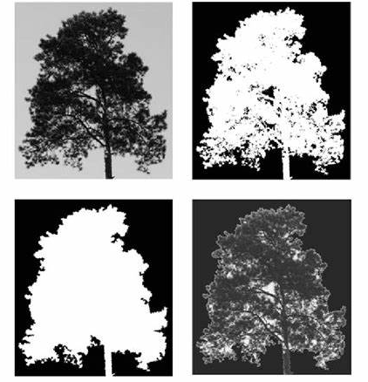
Threshold Image
Purpose: Converts the image to a binary format, distinguishing objects from the background.
Reason: Thresholding helps in isolating the regions of interest (potential line segments) from the rest of the image. By converting to binary, we enhance the contrast between the objects and the background, making it easier for the Hough Line Transform to identify and focus on the prominent lines in the image.

Slide 13


Erode Image
Purpose: Removes small noise by shrinking the white regions in a binary image.
Reason: Erosion is used to eliminate tiny, irrelevant details that might have been captured during the thresholding process. This step refines the edges by stripping away small noise elements, ensuring that what remains are the most significant structural components needed for line detection.
Initial Image
Eroded Image

Slide 14

Dialate Image
Purpose: Expands the white regions in a binary image, filling in small holes and gaps.
Reason: Dilation is often used after erosion to restore the size of objects that might have been slightly reduced during erosion. It helps in connecting broken lines and filling small gaps, making the lines more continuous and easier to detect using the Hough Line Transform.
Initial Image
Dilated Image

Slide 15
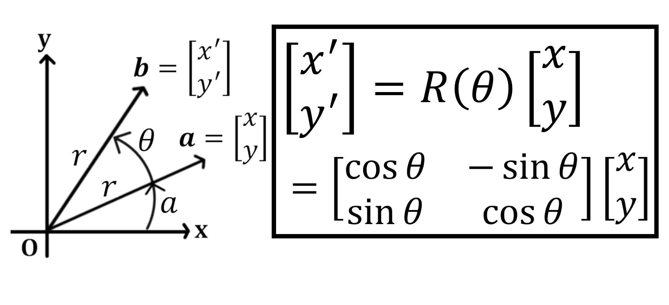
Rotation Matrix
A rotation matrix is a mathematical tool used to perform rotations in Euclidean space.

Slide 16
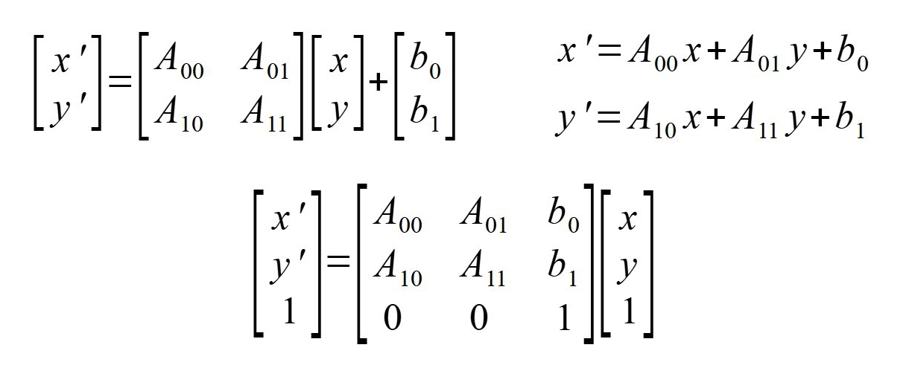
Rotation Matrix
Affine Transformation
An affine transform is a type of linear mapping method that preserves points, straight lines, and planes. In computer graphics and image processing, affine transformations are used to perform operations such as rotation, translation, scaling, and shearing. The transformation can be represented as a combination of these basic operations.

Slide 17
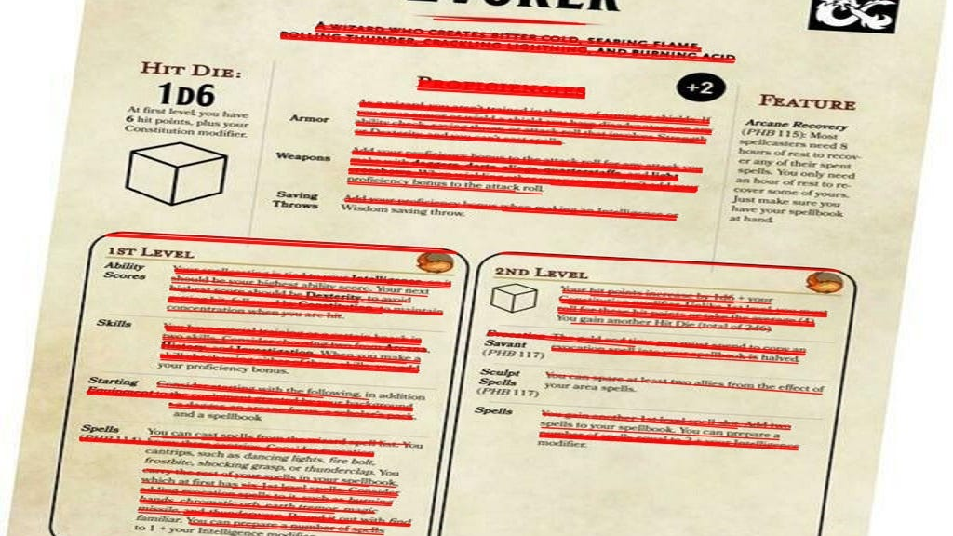
Probabilistic Hough Line Transform (PHT)
The Probabilistic Hough Line Transform (PHT) is an optimized version of the standard Hough Line Transform used to detect lines in an image. Unlike the standard method, which considers all edge points, PHT randomly selects a subset of edge points to reduce computational complexity. This makes it more efficient, especially for large images or real-time applications.

Slide 18
Demo
link

Slide 19
Why do we do it?
Why Houghline Transform?

Slide 20
alternatives
Radon Transform
Projection Profile Analysis
More Complex and Computationally Intensive: Radon Transform is powerful but can be overkill for simple document skew correction, making it less efficient for this specific task.
Quick and too Simple: Projection Profile Analysis is efficient but might struggle with documents that don’t have evenly spaced, well-defined text lines, reducing accuracy in more complex or noisy images.

Slide 21
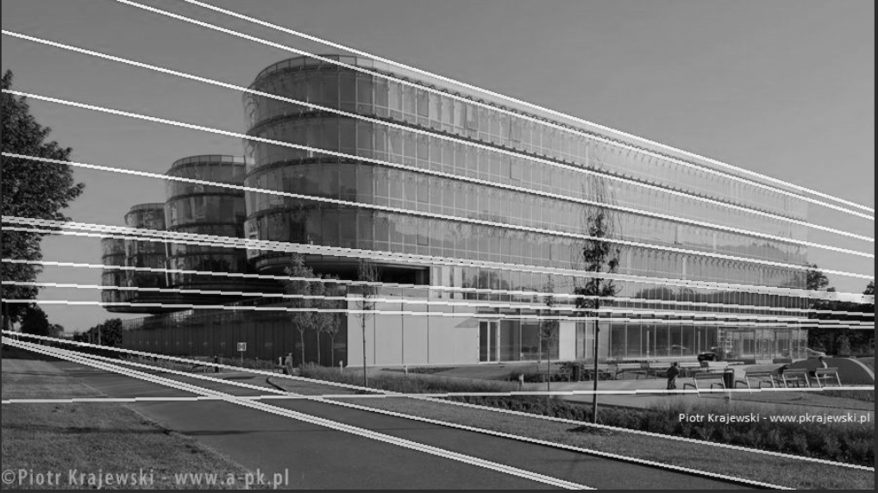
Summary
The Hough Line Transform offers a sweet spot: It’s more robust and accurate for a variety of document types compared to Projection Profile Analysis, and less complex than Radon Transform, making it our preferred approach for skew correction of document images.

Slide 22
Thank YOU
Praval Pattam – CS04 – B220057CS
Pranav Sai Sarvepalli - CS04 – B220055CS
Potluri Theenesh - CS04 – B221121CS

