Slide 1
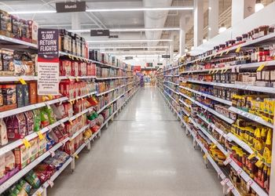
Business Analytics with SQL and Python - RMIT Online
Final Project
SuperFoodsMax Company
14.08.2022 Pravalika Kalla

Slide 2
Business Question
SuperFoodsMax decision-makers ask the data team to provide insights that can support a strategy to lift sales revenue by 5% over the next two years.
Sub questions:
What is the customer purchasing behavior?
How can Promiscuous customers be turned into loyalists?
Who are the revenue drivers?
How to boost retail foot traffic?

Slide 3
Justification for the chosen Data set to answer the business question
In order to help increase the revenue growth, I am using the dataset provided by SuperfoodsMax which has the customer transaction details made at SuperfoodsMax stores from January 2017 to June 2020 with the details like customer id, basket id, customer loyalty type, customer household type, customer age band, commodity, department of the product, price and transaction date of the customer transactions. This Dataset is chosen as it has all the necessary information required to understand the customer spending behavior and a concrete analysis can be made of the revenue trends and revenue forecast with the help of visualization can be performed appropriately.

Slide 4
Privacy, Ethical and Legal considerations
Identity: No names and addresses were used in the data. When shared we cannot identify the individuals with the data provided.
Shared data: It is assumed that customers are informed about provisions and restrictions on how data shared with the third parties
Transparency: This analysis is based on the assumption that individuals are being informed about the usage of data.
Predictions: The decisions and predictions made from this Data will have a beneficial outcome and do not violate legal and ethical regulations.
Bias: The analysis made using this data is not biased by any person/group or social categories like race/gender/disability.
Honesty: There is no part of my analysis that is dishonest or misleading intentionally or unintentionally.
Legislation: The analysis of the data is abided by:
The Privacy Act 1988:
Legislation.gov.au. 2022. Federal Register of Legislation - Australian Government. [online] Available at: <https://www.legislation.gov.au/Series/C2004A03712> [Accessed 7 August 2022].
General Data Protection Regulation:
General Data Protection Regulation (GDPR). 2022. Imprint & Privacy Policy - General Data Protection Regulation (GDPR). [online] Available at: <https://gdpr-info.eu/imprint-privacy-policy/> [Accessed 3 July 2022].

Slide 5
Cleaning, formatting, and exporting the data
Validity: 1633 duplicate records found and deleted using pandas.DataFrame.drop_duplicates() method.
Accuracy: Dropped the 19 inaccurate entries using pandas methods from the dataset whose customer_id and basket_id are 7 digits against the usual 5-digit entries with an extra trailing ‘00’.
Completeness: Customers over 19 are grouped into different age bands but the dataset doesn’t cater to 65-year-old. ‘Greater than 65’ is renamed to ’65 and above’ to bring completeness.
Consistency: Transaction dates have been reset to the start of the month to make the data consistent for analysis & forecast.
Uniformity: A non-uniformity was observed with the 19-24 age band (with 6 years range) against the other age bands (with 10 years range) don’t seem to impact analysis.
I exported the cleaned data as dataset_2017_2020_clean and used it for the project.

Slide 6
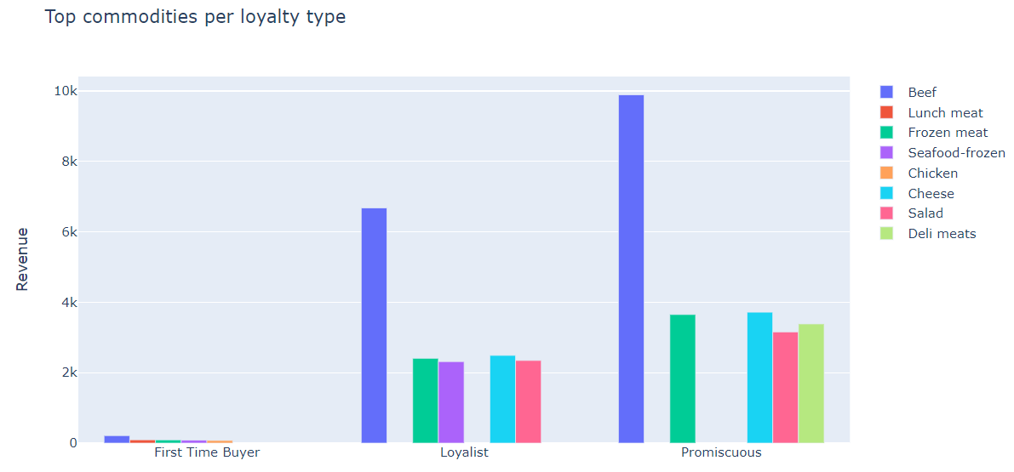
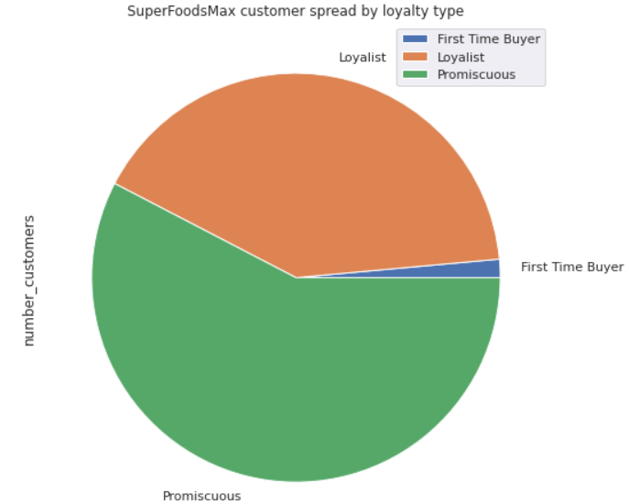
The majority of the customer base is Promiscuous and Loyalists, while Beef and Cheese are the highest selling commodities among them followed by other meat products.
Scope to provide markdowns and special discounts for Beef in conjunction with Cheese as they are the commonly sold commodities among promiscuous customers by encouraging them to convert to loyalists and also increasing the revenue.

Slide 7
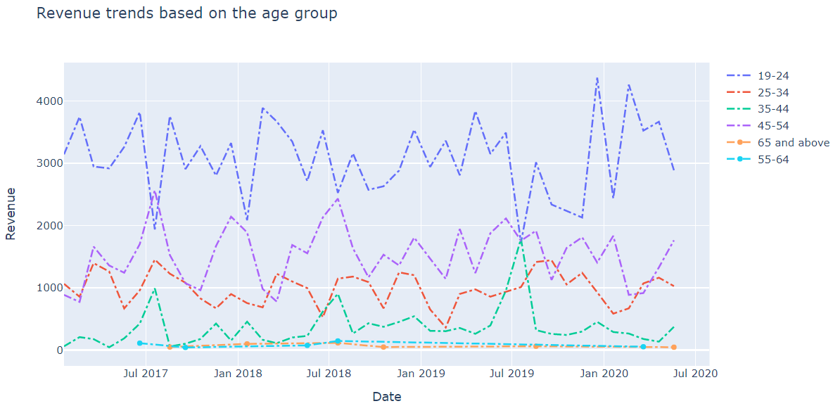
Which age group customers are the highest revenue generators?

Slide 8
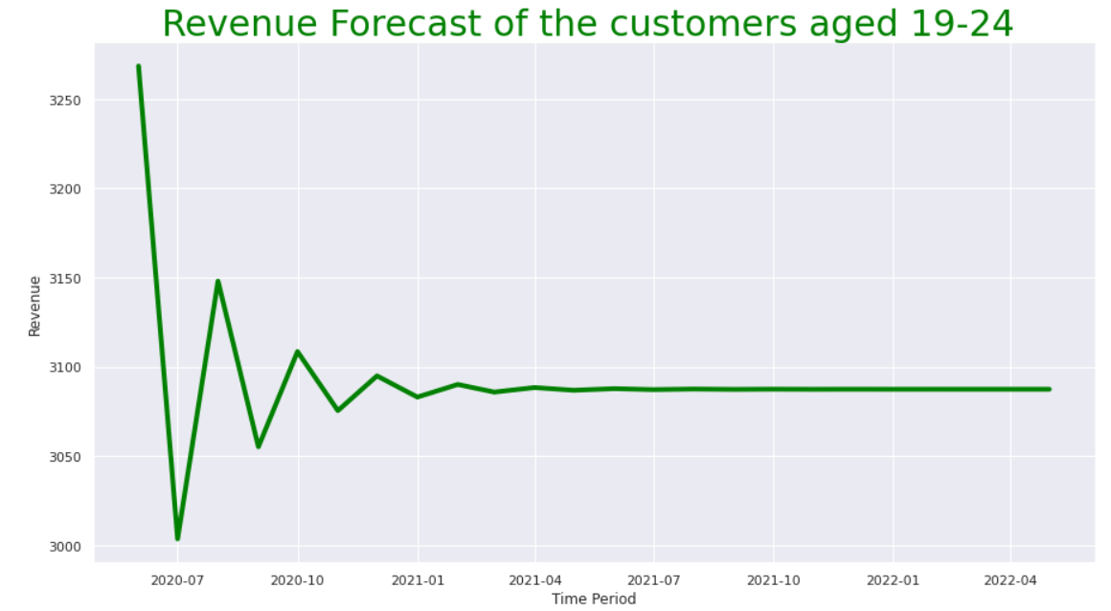
Surprisingly a linear forecast is observed for the highest revenue generating customers
Special focus is needed to withhold the 19-24 aged customer base with reward programs and targeted discounts.

Slide 9
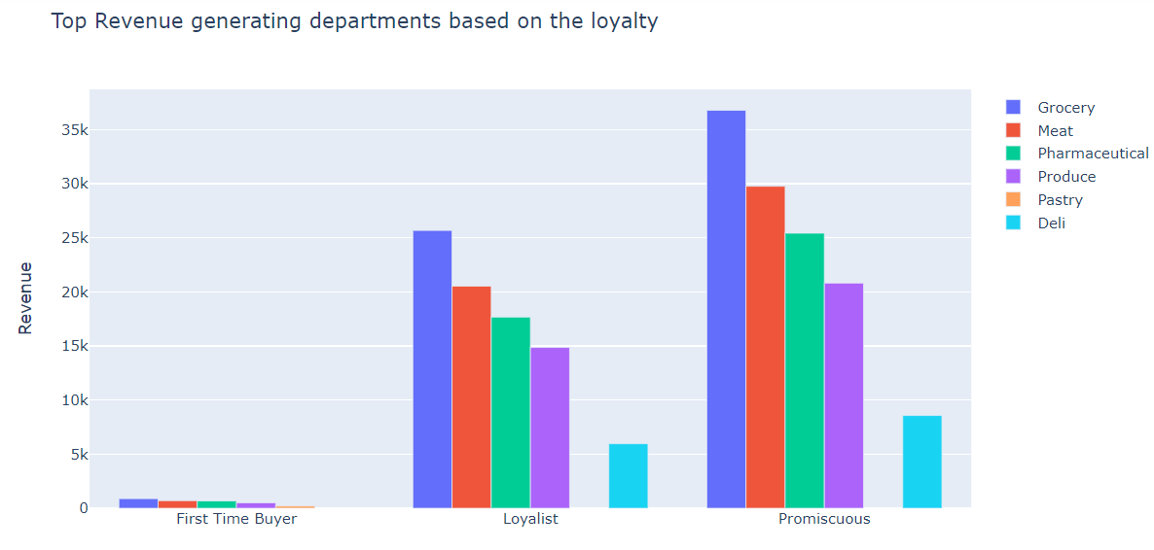
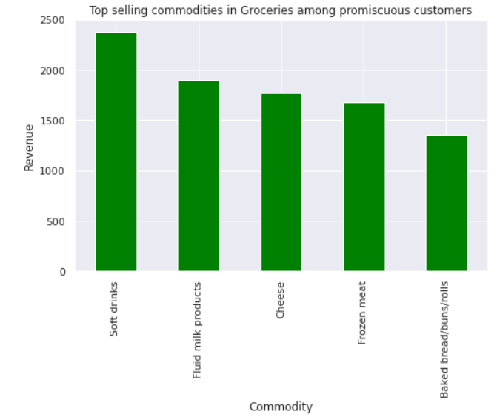
The highest revenue is generated from the grocery department by promiscuous customers. Soft drinks, milk products, and cheese are the specific commodities contributing more in this area.
Including soft drinks and milk products in the groceries section on special discount days and bulk buy days along with the other highest selling commodities like beef and cheese helps turn promiscuous customers into more frequent visitors and also double the groceries revenue.

Slide 10
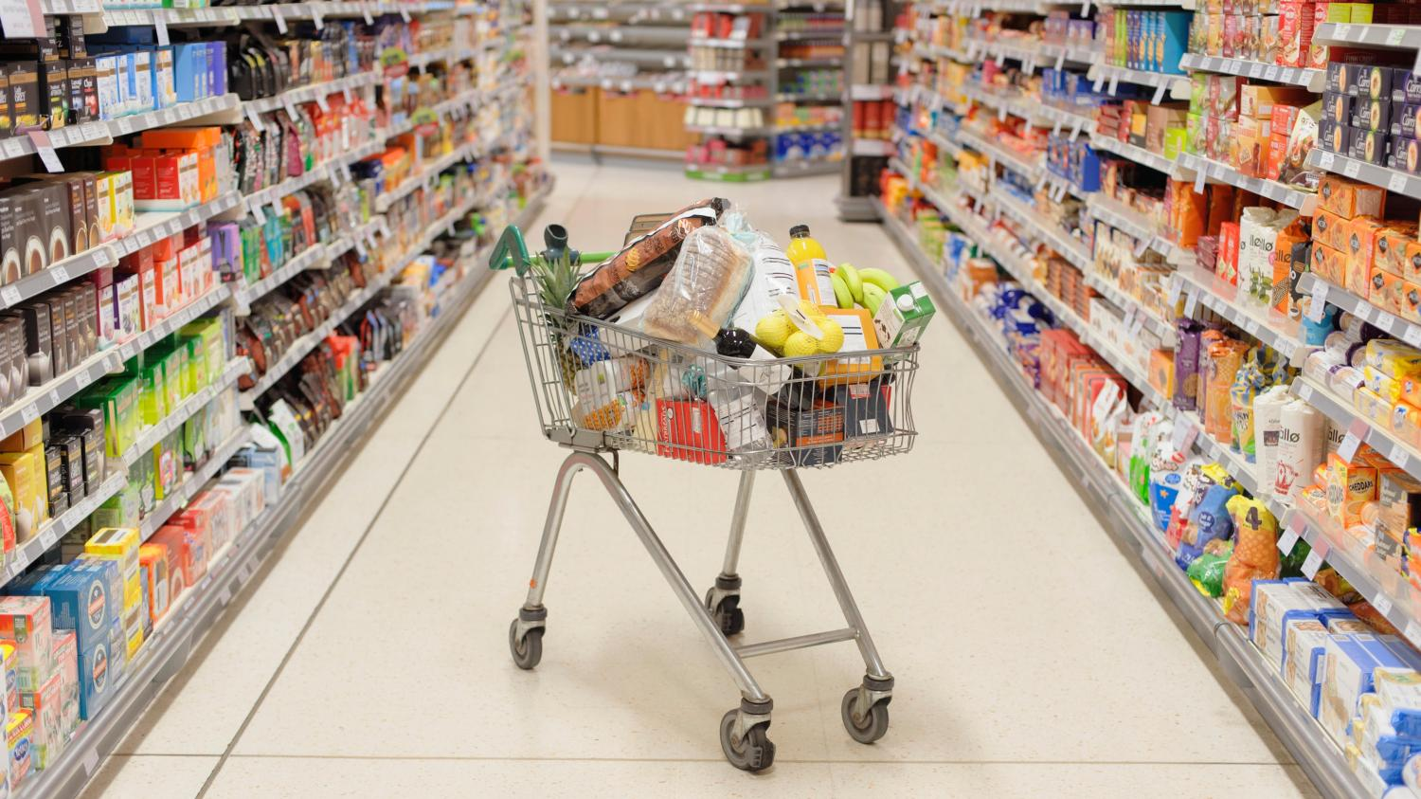
Conclusions
Markdowns and special discounts on the same days for commonly bought products like Beef and Cheese could attract promiscuous customers to regularly buy the same brand products and turn them into loyalists, also increasing the revenue for specific commodities.
Including soft drinks and milk products in the groceries section on special discount days and bulk buy days along with the other highest selling commodities like Beef and Cheese helps turn promiscuous customers into more frequent visitors and also spike the department revenue.
Targeting the highest spending age group of 19-24 with birthday offers and additional reward points. Also, encourage them to try out the free samples of private brand products for product reviews, etc.
Additionally, offer loyalty/reward points for weekly/monthly spending to encourage promiscuous customers to shop more frequently and thereby increase the foot traffic.
Furthermore, analyzing the individual customer purchase trends and creating customized promotional offers for the products they frequently purchase will help in boosting the revenue.
At least 10% revenue growth is anticipated in the next 24 months by targeting all the above.

