Slide 1
Business Analytics and Visualisation – RMIT Online Final Project Data Science Job Salaries

Slide 2
About the Data Set
My project is about “Data Science Job Salaries”.
Data Science is one of the popular industries in the digital space. My main business question is:
Why would someone want to become a Data Scientist?
My analysis is around finding answers to the questions like
What are the opportunities in Data Science?
Are they really growing?
How much a data scientist earns on average?
What factors affect the salaries?
Does someone need to be an expert to earn more?
Are there any specific roles in demand and which countries are quickly progressing in this field?
I have found this data set from Kaggle which seems to be the closest to answering my questions. A quick note on the limitations of using this data set that has been discussed and approved by my Mentor.
Though this data set has all the information needed for interpretation with various parameters and covers over 50 Countries globally, it does not include the salary information of each and every Data Science employee worldwide and is considered a sample.
The predictive analysis could not be used in the visualization as this data is limited to only 3 years and Tableau Desktop considers the time series is too short to forecast as it expects at least 4 years of data.

Slide 3


Slide 4
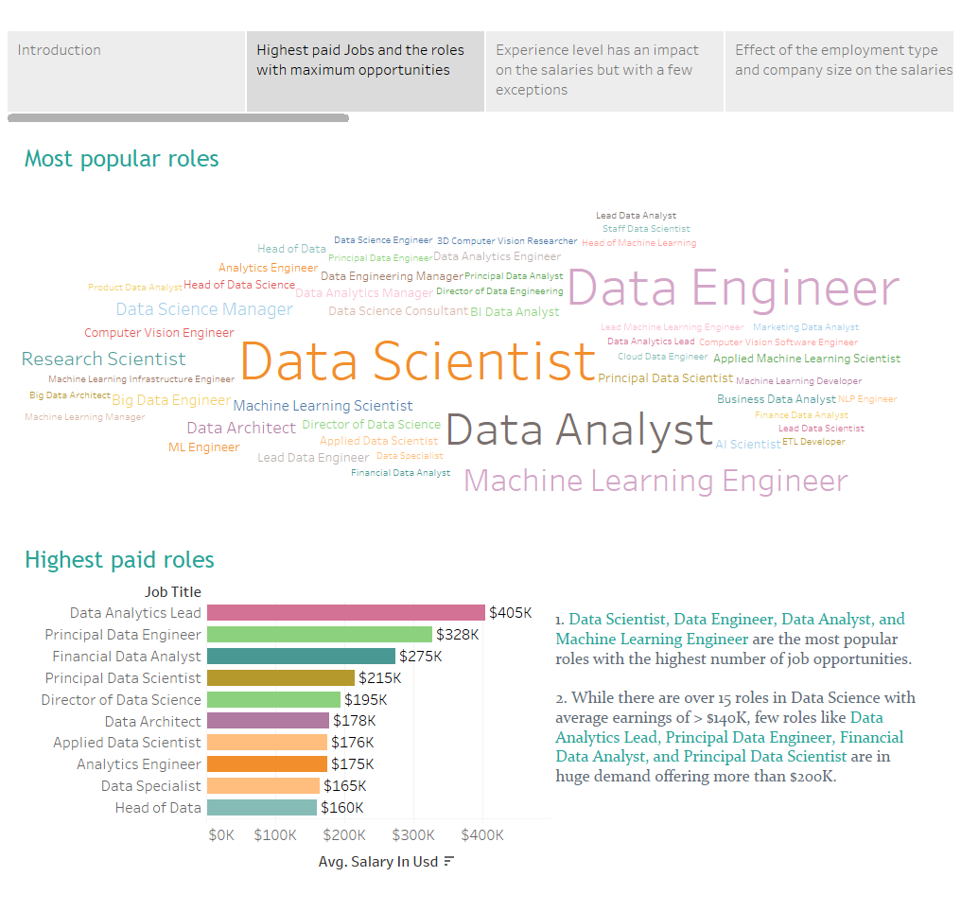

Slide 5
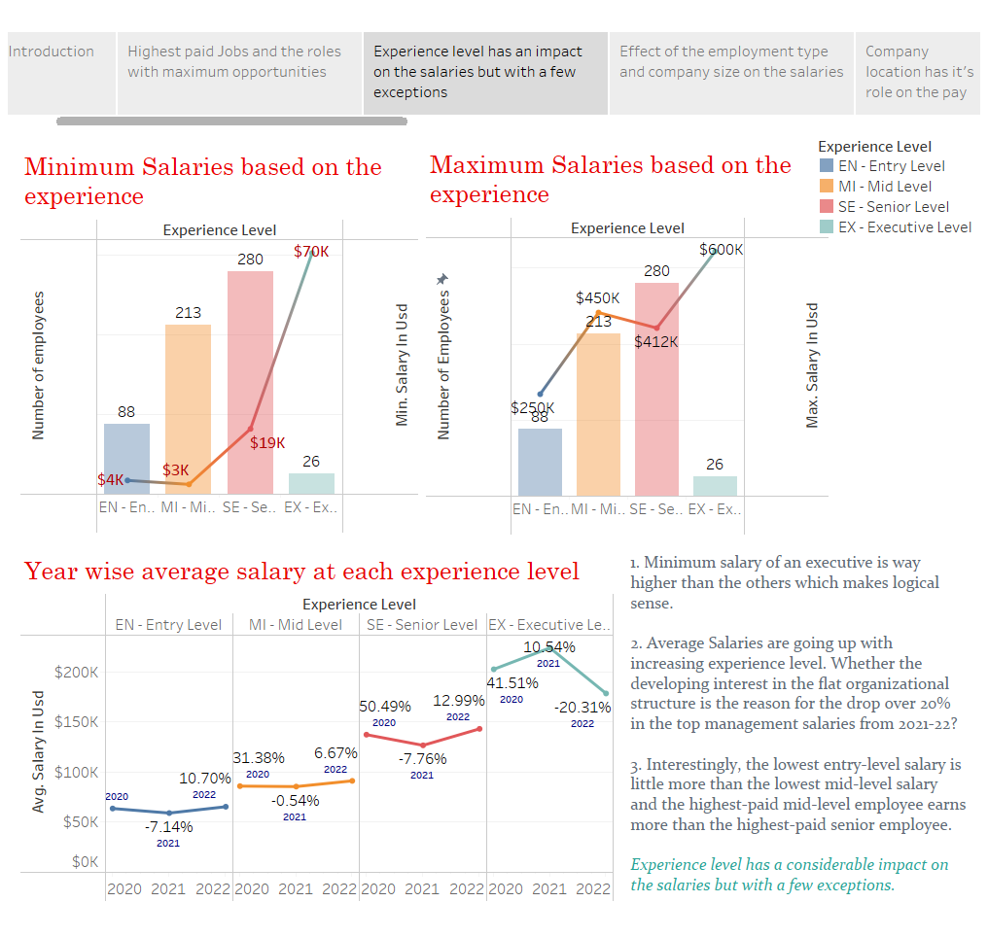

Slide 6
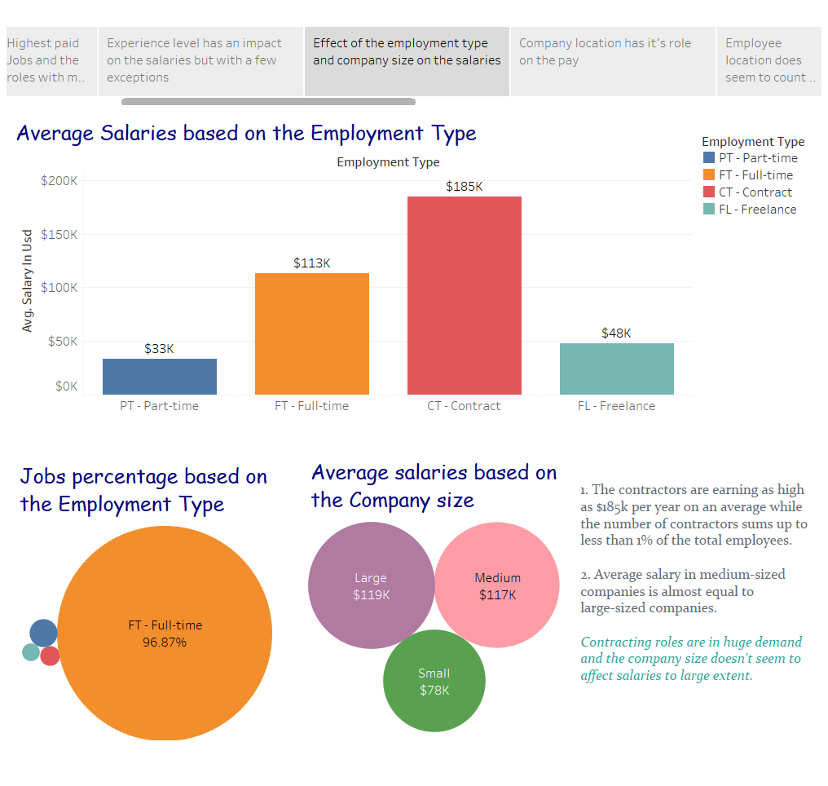

Slide 7
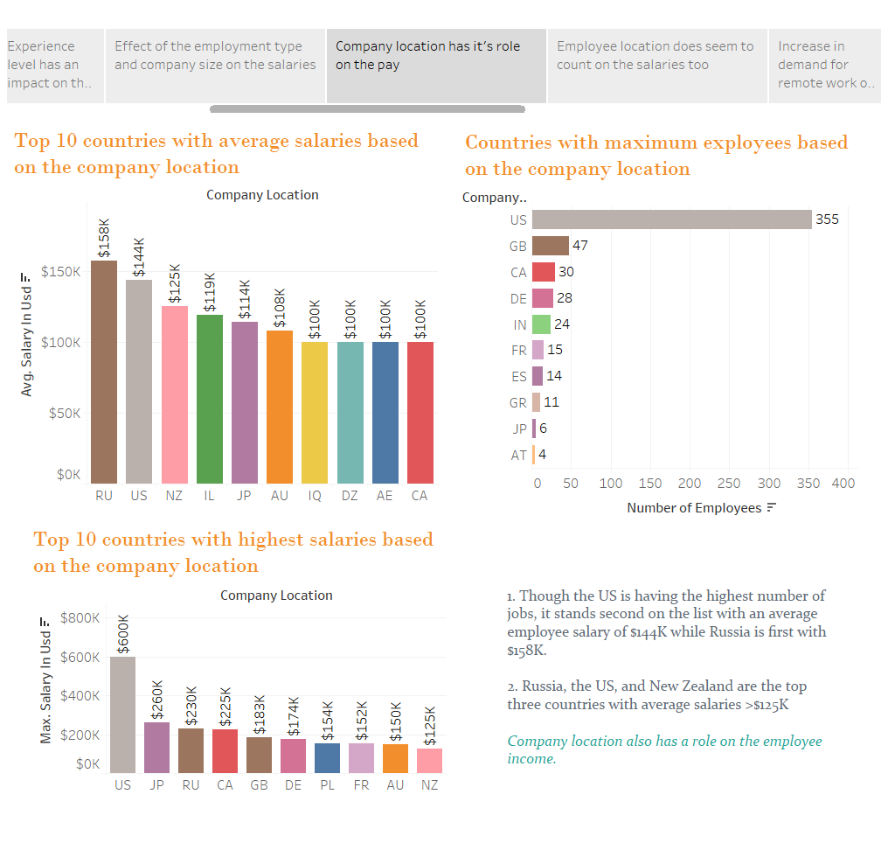

Slide 8
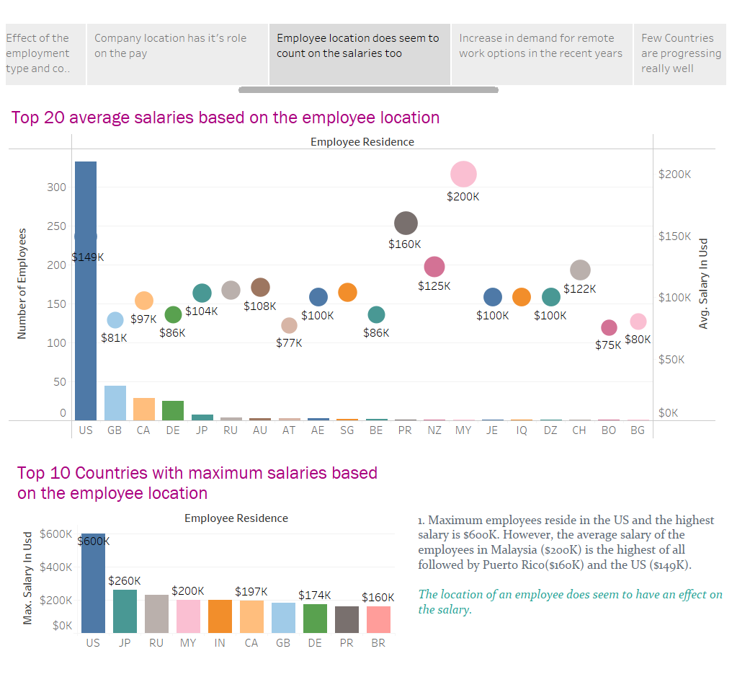

Slide 9
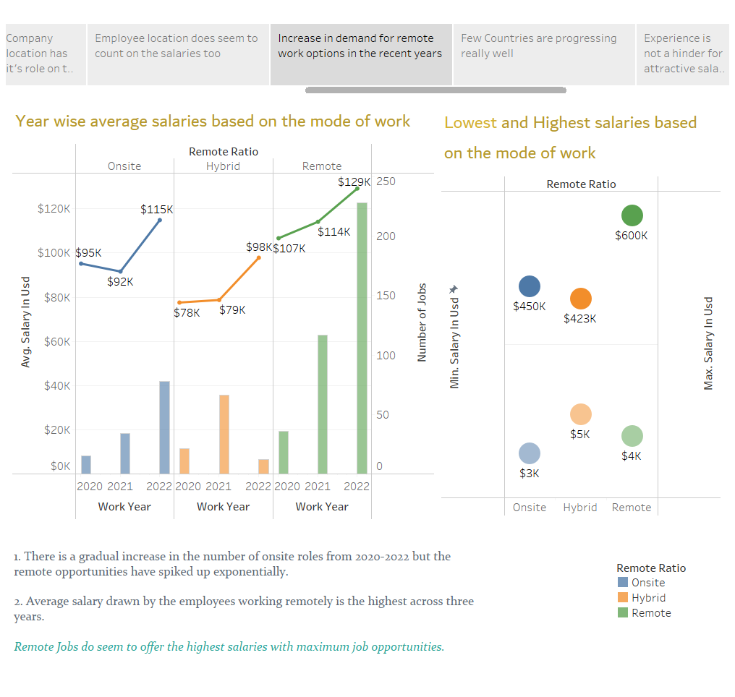

Slide 10
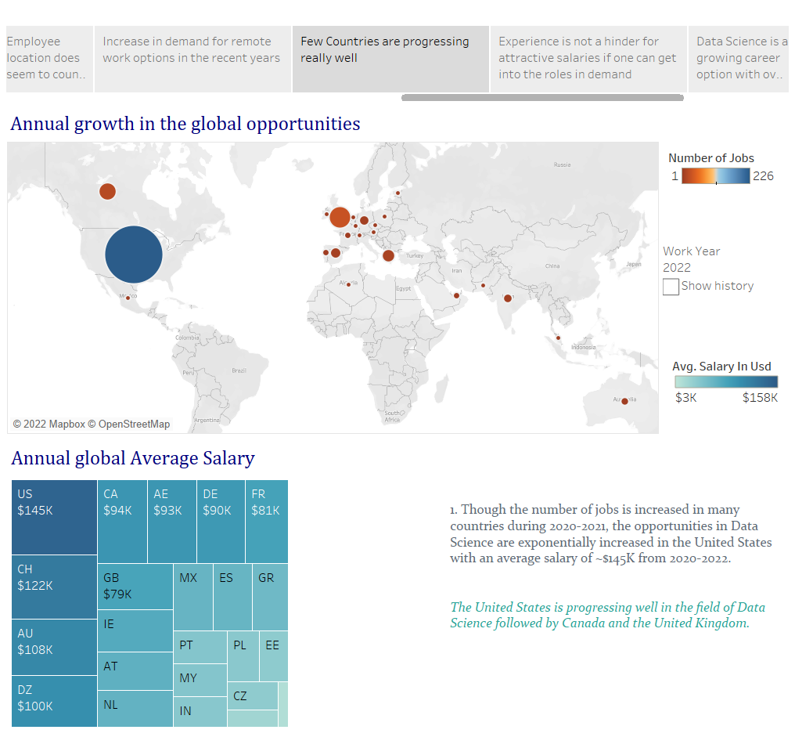

Slide 11
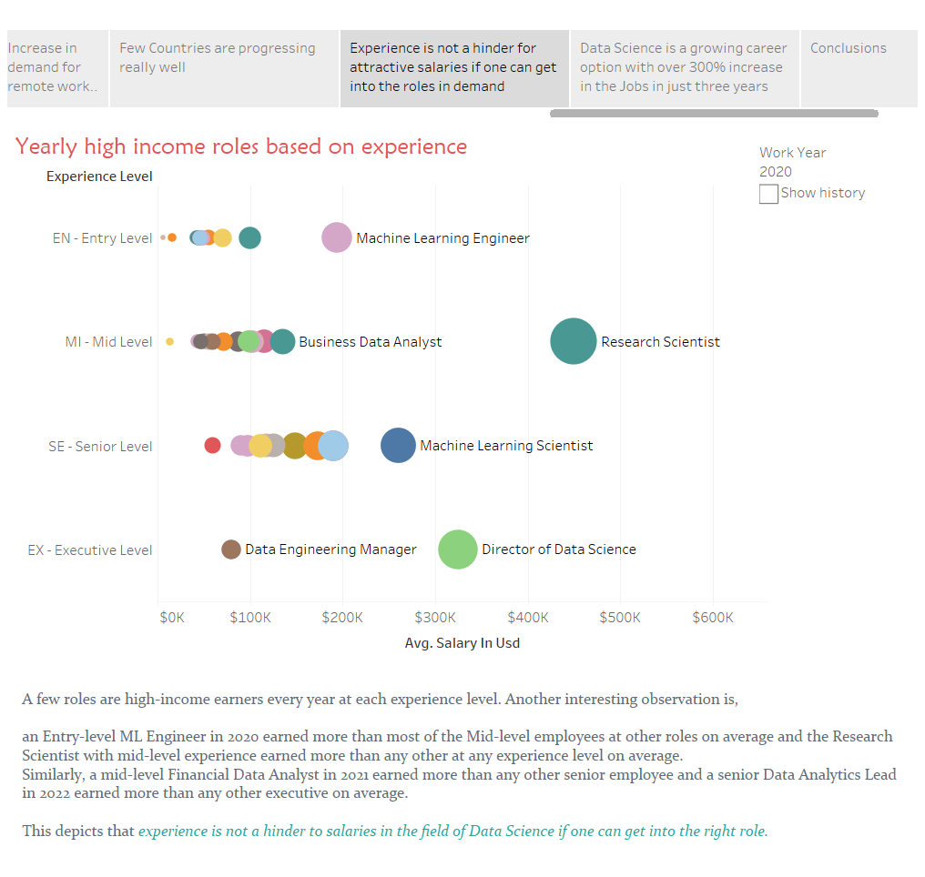

Slide 12
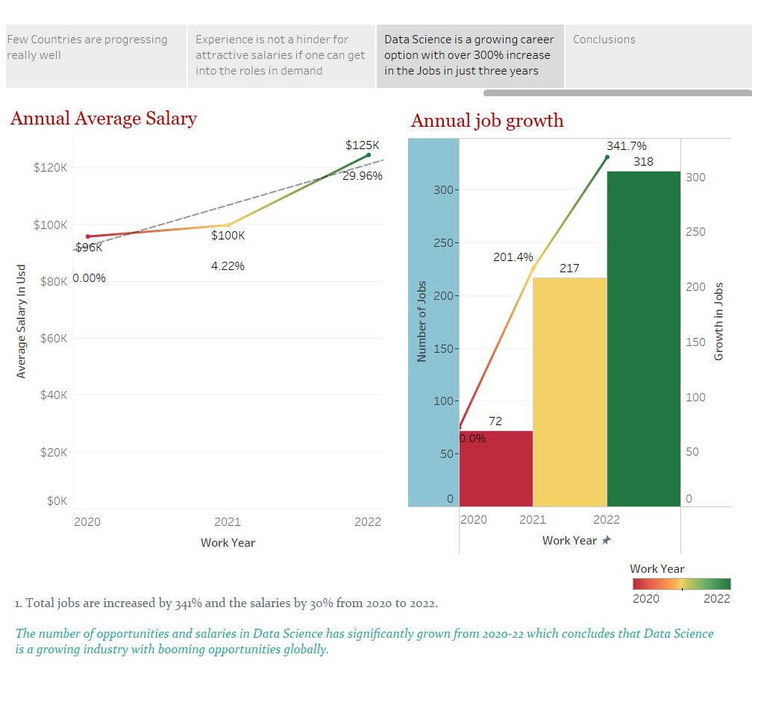

Slide 13
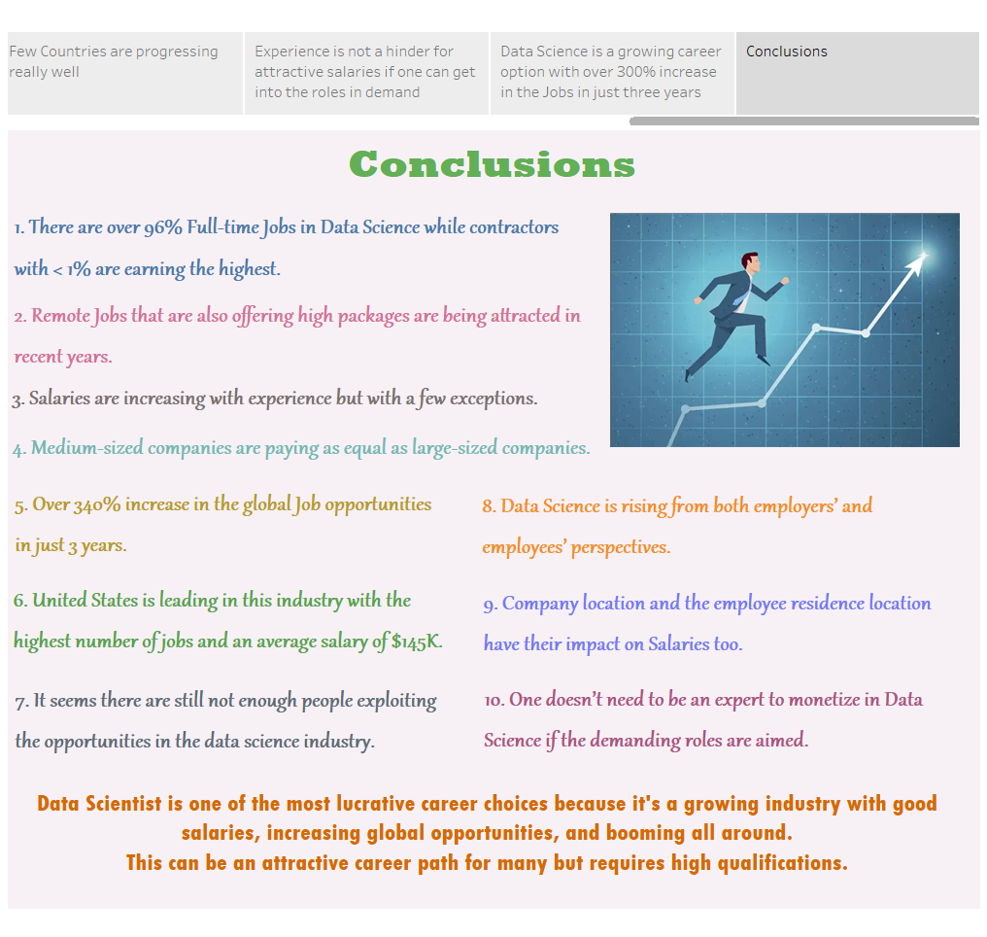

Slide 14
Thank You

