Slide 1

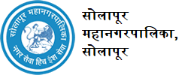
“SAMVED” HACKATHON 2026
Problem Statement ID – 01
Problem Statement Title- Smart Road Damage Reporting & Rapid Response System for Solapur Municipal Corporation
Theme- Software
Team Name - BOLT

Slide 2
BOLT
Proposed Solution
Problem Repeated potholes due to rain, traffic load, weak base, poor drainage No real-time reporting & monitoring Same locations get damaged again and again | Our Idea A two-part solution: AI system to detect, report, monitor road damage Smart multi-layer plastic road design to prevent potholes permanently | Innovation Not just reporting potholes — preventing them from forming

Slide 3
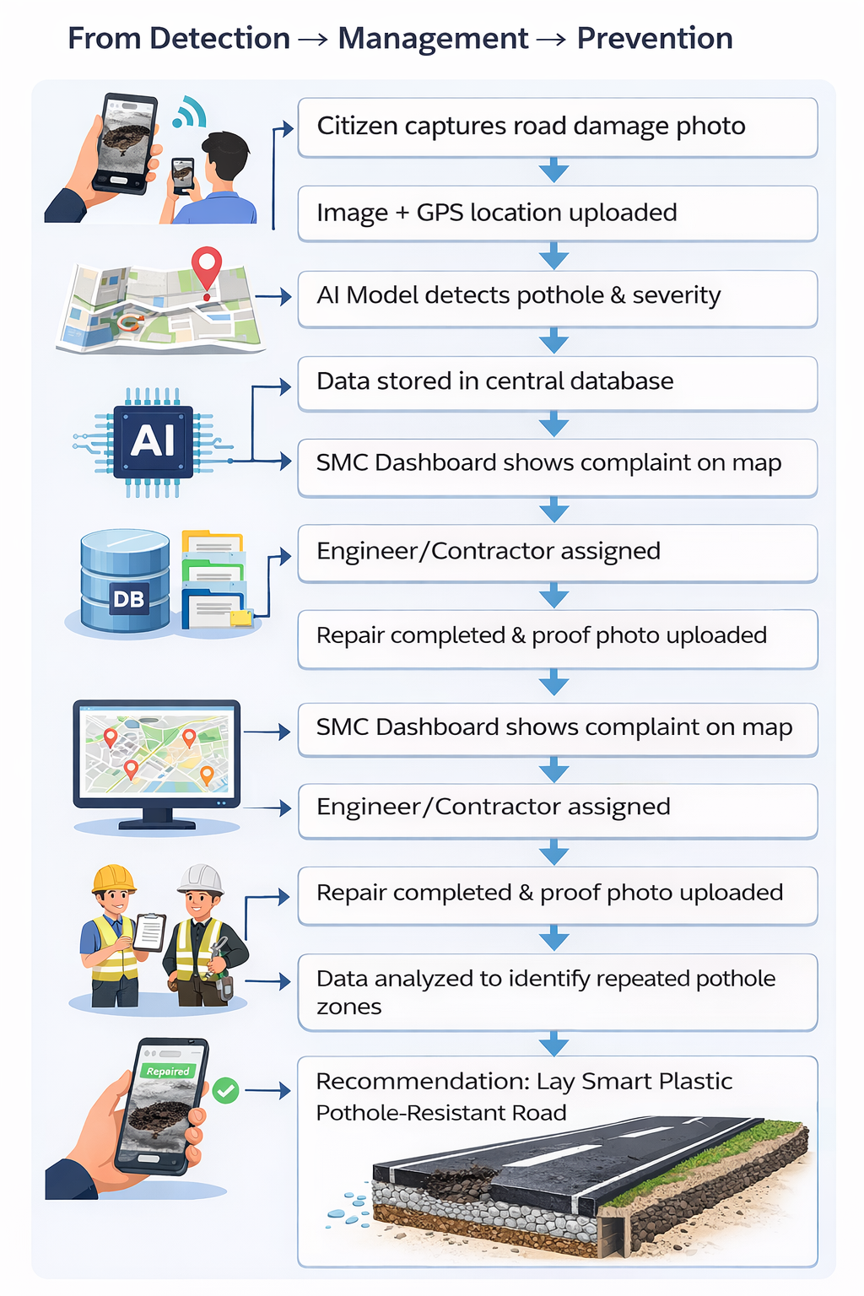
TECHNICAL APPROACH
BOLT
Component | Technology Used
Mobile/Web App | Flutter / React
Backend Server | Node.js / Django
Database | PostgreSQL / MongoDB
AI Image Detection | Python, OpenCV, TensorFlow/Keras
Maps & Geo-tagging | Google Maps API
Notifications | Firebase / SMS API
Dashboard | React Admin Panel
Hosting | Cloud (AWS / Firebase)

Slide 4
FEASIBILITY AND VIABILITY
BOLT
Citizen captures road damage photo using mobile app
Image is automatically geo-tagged with GPS location and time
Image and details uploaded to central system
AI model analyzes image and detects pothole/crack severity
Complaint data stored in centralized database
SMC dashboard displays the issue on live map view
Engineer / contractor is assigned for repair
Repair work completed on site
After-repair proof image uploaded for verification
System analyzes complaint history to find repeated pothole zones
Recommendation generated to construct smart plastic pothole-resistant road in those areas.

Slide 5
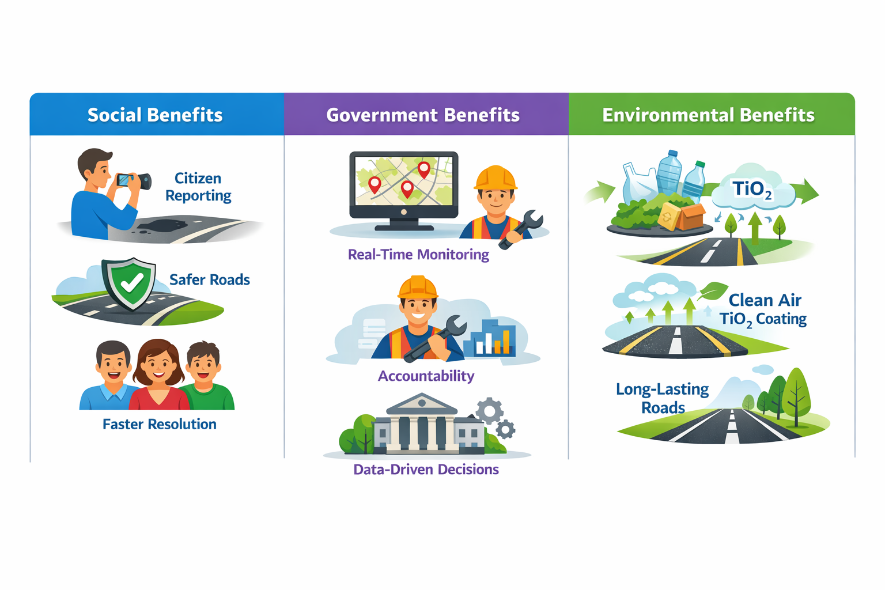
IMPACT AND BENEFITS
BOLT
Social | Government | Environmental
Safer roads → fewer accidents | Real-time monitoring & dashboards | Recycles plastic waste
Faster complaint resolution | Accountability of departments | Long-lasting roads → less maintenance cost
Citizen satisfaction | Data-driven repair prioritization | TiO₂ coating reduces pollution

Slide 6
RESEARCH AND REFERENCES
BOLT
Plastic Roads / Pothole-Resistant Materials
Vasudevan, R., et al. (2008). Use of waste plastics in road construction. Indian Roads Congress (IRC).
→ Standard methodology for plastic-modified bitumen roads.
TiO₂ Air-Purifying Roads
Colangelo, F., et al. (2016). Photocatalytic TiO₂ for NOx abatement on roads: Field application review. Environmental Science and Pollution Research, 23, 17821–17835.
AI & Pothole Detection
Moghimi, A., et al. (2020). Automatic pothole detection from road images using deep learning. Transportation Research Part C, 115, 102618.
→ Shows AI models (CNNs) can detect potholes automatically from images.

