Slide 1


Major Project Presentation (Phase I)
Project Review 2 On
An Explainable Deep Learning Framework For Diabetic Retinopathy Severity Grading
23R21A66F3 | - J Pravalika
23R21A66F0 | - G Bala Sainath Reddy
23R21A66F7 | - K Angel
23R21A66H6 | - R Ram Charan
23R21A66K1 | -Y Karthik
Under the Guidance of
Mr. P. Babu
Assistant Professor
Department of Computer Science & Engineering-Artificial Intelligence and Machine Learning
Batch No. C1
Slide 1

Slide 2
Contents
Work Division
Introduction
Abstract
Literature Survey
Objectives
Existing Systems
Disadvantages of the Existing Systems
Proposed Methodology
Advantages of Proposed Methodology
Datasets
Hardware & Software Requirements
Implementation and Results
References
Batch No. C1
Slide 2

Slide 3
Team Work Division
Member | Area | Main Responsibilities
R. Ram Charan (23R21A66H6) | Research & Dataset collection | Literature survey, research gap, clinical dataset study and dataset organization
K. Angel (23R21A66F7) | Image data Processing | Fundus image collection, image cleaning, resizing, noise removal, and normalization
J. Pravalika (23R21A66F3) | Deep Learning Model | EfficientNet-B0, transfer learning, feature extraction, model training and DR classification
G. Sainath (23R21A66F0) | Explainable AI | Grad-CAM, heatmap generation, lesion visualization and prediction explanation
K. Karthik (23R21A66K1) | Evaluation & System Integration | Accuracy, Precision, Recall, F1-Score, QWK, confidence scores and result analysis
Batch No. C1
Slide 3

Slide 4
Introduction
Diabetic Retinopathy (DR) is one of the leading causes of preventable blindness among people with diabetes. Early detection is essential to prevent vision loss, but manual screening of retinal fundus images is time-consuming and depends on the availability of experienced ophthalmologists, especially in underserved regions. Although deep learning models have demonstrated high accuracy in automated DR severity grading, their lack of interpretability limits clinical trust and adoption. This project proposes an Explainable Deep Learning Framework for Diabetic Retinopathy Severity Grading that automatically classifies DR severity while employing Explainable AI techniques, such as Grad-CAM, to highlight retinal lesions including microaneurysms, hemorrhages, and exudates that influence the model's predictions. This enhances transparency, assists clinicians in validating AI decisions, and supports reliable, scalable, and early diabetic retinopathy screening.
Batch No. C1
Slide 4

Slide 5
Abstract
Diabetic Retinopathy (DR) is one of the leading causes of preventable blindness among people with diabetes. Early detection is crucial, but manual screening of retinal fundus images is time-consuming and depends on expert ophthalmologists. This project presents an Explainable Deep Learning Framework for Automated Diabetic Retinopathy Severity Grading using EfficientNet-B0 and Grad-CAM. The proposed model classifies retinal images into five DR severity levels and highlights the retinal regions influencing its predictions, improving transparency and clinical trust. The framework is trained on the retinal funds image dataset and evaluated using Accuracy, Precision, Recall, F1-Score, and Quadratic Weighted Kappa(QWK). The proposed system supports accurate, efficient, and explainable diabetic retinopathy screening.
Keywords: Diabetic Retinopathy, Deep Learning, Explainable AI (XAI), EfficientNet-B0,Grad-CAM,Retinal Fundus Images, Severity Grading
Batch No. C1
Slide 5

Slide 6
Literature Survey
No | Title | Author | Journal Name & Year | Methodology Adapted | Key Findings | Gaps
1 | A Clinically Interpretable Deep Learning Pipeline for Diabetic Retinopathy Classification Using EfficientNetand GradCAM | K. K. Ghadai, S. K. Nayak, B. R. Senapati | BMC Ophthalmology, 2026 | EfficientNet-based feature extraction, combined with data augmentation and Grad-CAM, will be incorporated into our framework for DR severity grading. | Combines DR classification with visual explanations of important retinal regions. | Class imbalance and differences between adjacent DR stages remain challenging.
2 | A Clinically Interpretable Deep Learning Pipeline for Diabetic Retinopathy Classification Using EfficientNet, Advanced Data Augmentation and GradCAM | Rashid Ali, Fiaz Gul Khan, Zia Ur Rehman, Daehan Kwak, Farman Ali | IEEE Journal of Biomedical and Health Informatics, 2025 | The project takes the Explainable AI approach from this work to make model predictions more understandable and transparent. | Uses unlabeled data and Grad-CAM to improve DR detection and interpretability. | Unreliable pseudo-labels and imbalanced data can affect model learning
Batch No. C1 Research_papers_20
Slide 6

Slide 7
Literature Survey
No | Title | Author | Journal Name & Year | Methodology Adapted | Key Findings | Gaps
3 | Diabetic Retinopathy Assessment through Multitask Learning Approach on Heterogeneous Fundus Image Datasets | Hongkang Wu, Kai Jin, Yiyang Jing, Wenyue Shen, Yih Chung Tham, Xiangji Pan | Ophthalmology Science, 2025 | Clinical fundus image analysis and multitask learning concepts are considered to support training with real-world retinal images. | Uses clinical fundus images with ophthalmologist annotations and external validation. | Small sample size for some lesion types and limited representation across countries/ethnic groups.
4 | Smart Grading of Diabetic Retinopathy: An Intelligent Recommendation-Based Fine-Tuned EfficientNetB0 Framework | Vatsala Anand, Deepika Koundal, Wael Y. Alghamdi, Bayan M. Alsharbi | Frontiers in Artificial Intelligence, 2024 | Transfer learning using EfficientNet-B0 forms the basis of our deep learning model for five-level DR classification. | Shows the effectiveness of EfficientNet-B0 for automated DR grading. | Performance can vary across datasets; large-scale validation and fine-tuning are required.
Batch No. C1 Research_Papers_20
Slide 7

Slide 8
Objectives
To develop an automated deep learning model using EfficientNet-B0 with transfer learning for classifying retinal fundus images into five diabetic retinopathy severity levels.
To improve the interpretability of the model by integrating Grad-CAM to visualize retinal regions influencing the classification.
To develop an accurate and explainable clinical decision-support system for early diabetic retinopathy screening and severity grading.
Batch No. C1
Slide 8

Slide 9
Existing Systems
CNN-Based Diabetic Retinopathy Detection : A widely used deep learning approach that analyzes retinal fundus images using CNNs to detect diabetic retinopathy. It automatically learns important retinal features, but the predictions are often difficult to interpret.
Transfer Learning-Based DR Grading : A deep learning approach using pre-trained models such as ResNet, DenseNet, EfficientNet, and Inception to classify diabetic retinopathy into different severity levels. However, these systems may struggle with distinguishing between similar severity stages.
Explainable AI-Based DR Classification : An approach that combines deep learning with techniques such as Grad-CAM and Grad-CAM++ to highlight regions responsible for predictions. However, the explanations may be coarse and may not always provide clinically meaningful reasoning.
Batch No. C1
Slide 9

Slide 10
Disadvantages of Existing Systems
Limited Interpretability of Deep Learning Models: Most existing diabetic retinopathy grading systems use complex deep learning models that provide accurate predictions but do not clearly explain the reasons behind their decisions. This makes it difficult for ophthalmologists to understand and trust the model's predictions.
Difficulty in Distinguishing DR Severity Levels: Existing systems may struggle to differentiate between adjacent stages such as Mild, Moderate, and Severe diabetic retinopathy because the visual differences between these stages can be subtle. This can lead to incorrect severity grading.
Dependence on Dataset Quality and Class Imbalance: Existing models are highly dependent on the quality and diversity of retinal fundus images used for training. Imbalanced datasets, poor-quality images, and variations in lighting or imaging devices can reduce the reliability and generalization of the predictions.
Batch No. C1
Slide 10

Slide 11
Proposed Methodology
The proposed system uses an explainable deep learning framework to automatically grade diabetic retinopathy severity from retinal fundus images. The input image is first preprocessed using resizing, noise removal, contrast enhancement, and normalization to improve image quality. The processed image is then provided to a transfer-learning-based deep learning model such as EfficientNet or ResNet, which extracts important retinal features and classifies the image into five severity levels: No DR, Mild, Moderate, Severe, and Proliferative DR. To make the prediction interpretable, Explainable AI techniques such as Grad-CAM or Grad-CAM++ are applied to generate heatmaps highlighting the retinal regions that influenced the model's decision. The system finally combines the predicted severity, confidence score, and visual explanation into an understandable report, helping medical professionals interpret and verify the automated prediction.
Batch No. C1
Slide 11

Slide 12
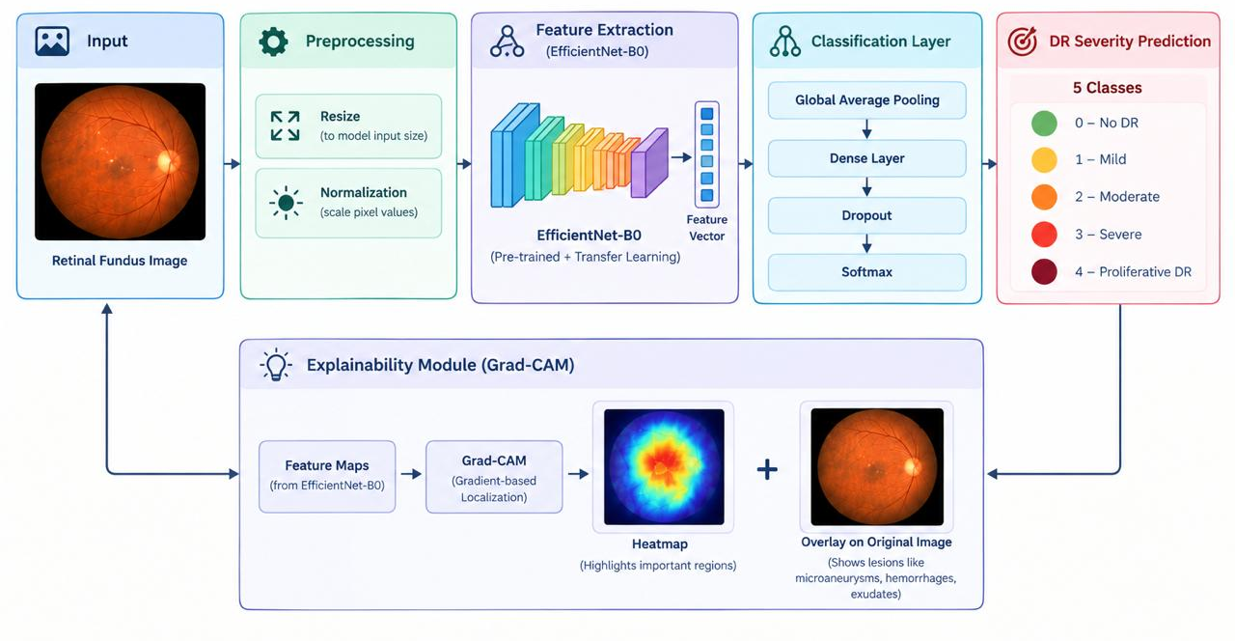
Proposed Architecture
Proposed Architecture of An Explainable Deep Learning Framework for Diabetic Retinopathy Severity Grading
Batch No. C1
Slide 12

Slide 13
Advantages of Proposed Methodology
Provides accurate severity grading by classifying retinal fundus images into five stages: No DR, Mild, Moderate, Severe, and Proliferative DR.
Provides explainable predictions using Grad-CAM or Grad-CAM++ to highlight the retinal regions that contribute to the model's decision, improving transparency for medical professionals.
Improves reliability of diagnosis by combining deep learning predictions with confidence scores, helping identify uncertain or difficult cases.
Reduces manual screening effort by automatically analyzing fundus images and generating a structured severity assessment, supporting faster and more consistent diabetic retinopathy screening.
Batch No. C1
Slide 13

Slide 14
Datasets
EyePACS Dataset: Large collection of retinal fundus images with diabetic retinopathy severity labels.
APTOS 2019 Dataset: Retinal images categorized into five diabetic retinopathy severity levels.
Messidor Dataset: Annotated retinal fundus images used for diabetic retinopathy detection and grading.
IDRiD Dataset: Retinal images containing diabetic retinopathy grades and annotations for retinal lesions.
Hardware Requirement
Processor: Intel Core i5 / AMD Ryzen 5 or above
RAM: 8 GB minimum, 16 GB recommended
GPU: NVIDIA GPU with 4 GB+ VRAM recommended for deep learning training
Operating System: Windows / Linux / macOS
Batch No. C1
Slide 14

Slide 15
Software Requirements
Category | Technology
Programming Language | Python
Deep Learning Framework | TensorFlow, Keras, PyTorch
Image Processing | OpenCV, PIL
Deep Learning Models | EfficientNet, ResNet, DenseNet
Explainable AI | Grad-CAM, Grad-CAM++
Data Processing | Pandas, NumPy
Data Visualization | Matplotlib, Seaborn
Backend / Deployment | Flask / Streamlit
Development Tools | Git, GitHub
Batch No. C1
Slide 15

Slide 16
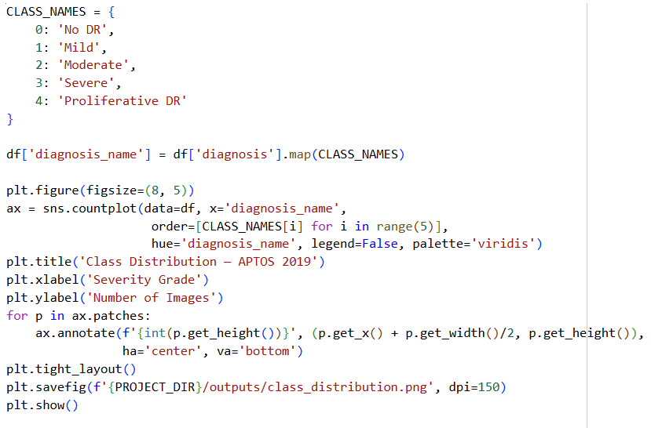
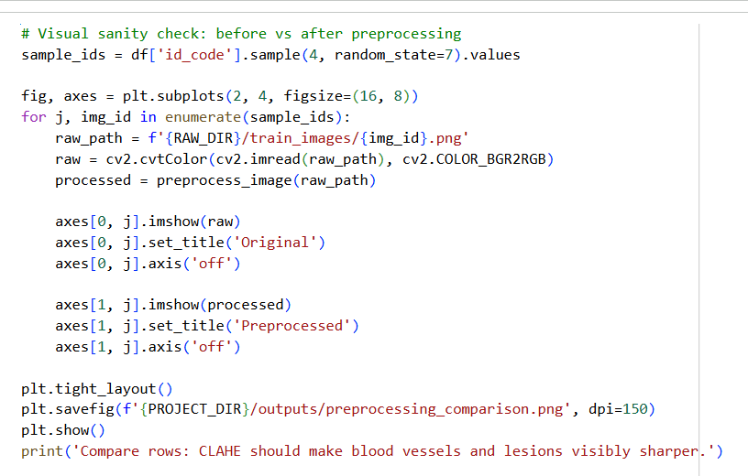
Implementation
Batch No. C1
Slide 16

Slide 17
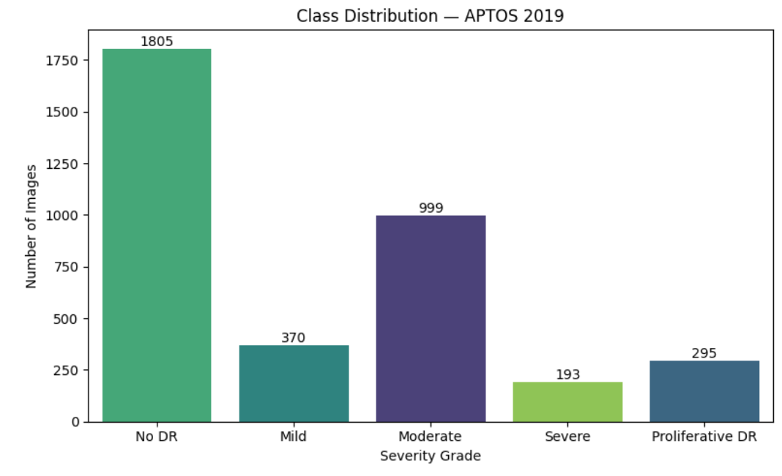
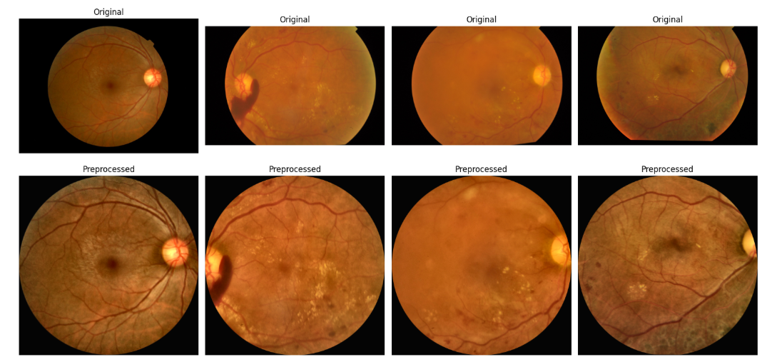
Results
Fig: Class Distribution
Fig : sample images from each class
Batch No. C1
Slide 17

Slide 18
References
Gulshan, V., Peng, L., Coram, M., et al. “Development and Validation of a Deep Learning Algorithm for Detection of Diabetic Retinopathy in Retinal Fundus Photographs.” JAMA, Vol. 316, No. 22, pp. 2402–2410, 2016. doi:10.1001/jama.2016.17216.
Ting, D. S. W., Cheung, C. Y. L., Lim, G., et al. “Development and Validation of a Deep Learning System for Diabetic Retinopathy and Related Eye Diseases Using Retinal Images From Multiethnic Populations With Diabetes.” JAMA, Vol. 318, No. 22, pp. 2211–2223, 2017. doi:10.1001/jama.2017.18152.
Quellec, G., Al Hajj, H., Lamard, M., Conze, P.-H., Massin, P., and Cochener, B. “ExplAIn: Explanatory Artificial Intelligence for Diabetic Retinopathy Diagnosis.” arXiv preprint arXiv:2008.05731, 2020.
Ghadai, K. K., Nayak, S. K., and Senapati, B. R. “A Clinically Interpretable Deep Learning Pipeline for Diabetic Retinopathy Classification Using EfficientNet, Advanced Data Augmentation and GradCAM.” BMC Ophthalmology, Vol. 26, Article 406, 2026.
Batch No. C1
Slide 18

Slide 19

Any Queries?
Batch No. C1
Slide 19

