Slide 1

Note: The data and information in this document is reflective of a hypothetical situation and client. This document is to be used for KPMG Virtual Internship purposes only.
Sprocket Central Pty Ltd
Data analytics approach
[Division Name] - [Engagement Manager], [Senior Consultant], [Junior Consultant]

Slide 2
Note: The data and information in this document is reflective of a hypothetical situation and client. This document is to be used for KPMG Virtual Internship purposes only.
Agenda
Introduction
Data Exploration
Model Development
Interpretation

Slide 3
Note: The data and information in this document is reflective of a hypothetical situation and client. This document is to be used for KPMG Virtual Internship purposes only.
Introduction
New Customers Analysis
Look into the below factors in new customers
Age distributions
Number of bike purchases in 3 years / percentage purchases
Job industry category
Wealth segments
Number of cars own on each states

Slide 4
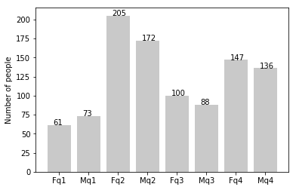
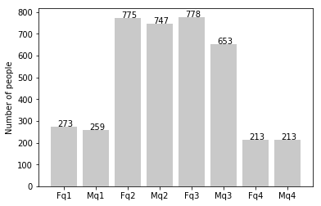
Note: The data and information in this document is reflective of a hypothetical situation and client. This document is to be used for KPMG Virtual Internship purposes only.
Data Exploration
Customer’s age distribution
New
As we can see, mostly our new customers are between 25 to 48 years
Number of customers from 48 to 59 years has big drop on percentages
There is slight increase in number of customers over 59 years in term of percentages
The percentages of under 25 years do not differ much
q1: Under 25; q2: 25 to 48; q3: 48 to 59; q4: Over 59
Old

Slide 5
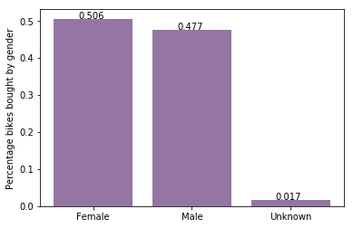
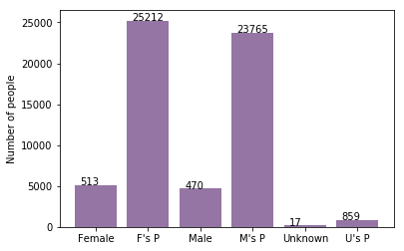
Note: The data and information in this document is reflective of a hypothetical situation and client. This document is to be used for KPMG Virtual Internship purposes only.
Model Development
Bike purchases last 3 years
According to observations, our new customers are mostly female with total purchase of 25,212 bikes which contributes to 50.6%.
Male contributed to 47.7% purchases with 23,765 bikes.
So we should focus on advertise on female customers more.

Slide 6
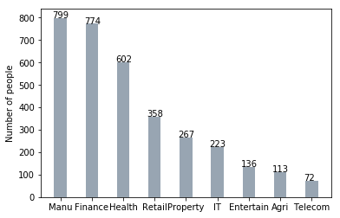
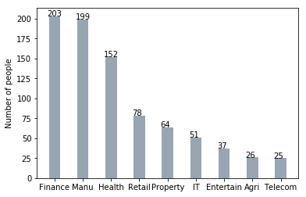
Note: The data and information in this document is reflective of a hypothetical situation and client. This document is to be used for KPMG Virtual Internship purposes only.
Interpretation
Job industry category
Mostly our new customers are from Finance and Manufacturing which occupy the top 2 positions
There is no difference in rest of industries

Slide 7
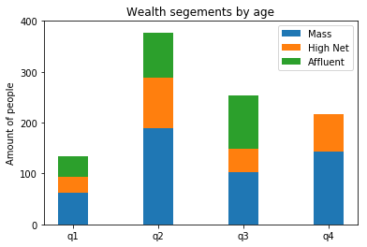
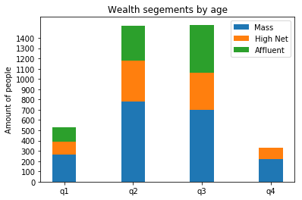
Note: The data and information in this document is reflective of a hypothetical situation and client. This document is to be used for KPMG Virtual Internship purposes only.
Interpretation
Wealth segments
In all ages Mass customers contribute the highest.
The focus should be on Mass customers followed by High Net Customers

Slide 8
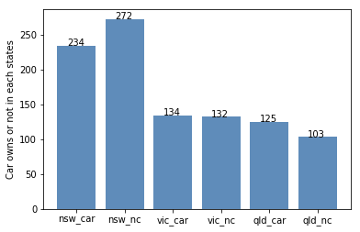
Note: The data and information in this document is reflective of a hypothetical situation and client. This document is to be used for KPMG Virtual Internship purposes only.
Interpretation
Number of cars owned
The major number of customers who do not own cars are from NSW which will be our main concentration.
VIC and QLD has more customers that own car that who don’t but we can try to have something so that those owns car will buy bikes.

Slide 9
Note: The data and information in this document is reflective of a hypothetical situation and client. This document is to be used for KPMG Virtual Internship purposes only.
Appendix

Slide 10
Note: The data and information in this document is reflective of a hypothetical situation and client. This document is to be used for KPMG Virtual Internship purposes only.
Appendix

