Slide 1
🛡️ SentinelGPT
Autonomous Cyber Defense Platform
Real-time AI Security Monitoring • Heuristic Anomaly Analysis • Autonomous Quarantine
🌐 Live Demo: https://sentinelgpt-ai.vercel.app | 📁 GitHub: Pravallika2025/sentigraud-ai-

Slide 2
SENTINELGPT CYBER DEFENSE
Problem Statement & Proposed Solution
🔴 Traditional SOC Challenges:
• High alert volume causing security analyst fatigue.
• Delayed manual intervention leading to breach escalation.
• Fragmented tools lacking unified MITRE ATT&CK correlation.
• Lack of real-time automated quarantine response.
🟢 SentinelGPT Solution:
• Autonomous heuristic engine running 24/7 background telemetry.
• Instant visual triage via dynamic glassmorphism dashboard.
• Automated IP quarantine with 1-click revoke controls.
• AI assistant generating instant mitigation recommendations.

Slide 3
SENTINELGPT CYBER DEFENSE
System Architecture & Technology Stack
🔹 React 19 + Vite 5.4 SPA:
Delivers ultra-responsive glassmorphism SOC interface with dark theme neon accents.
🔹 FastAPI Python Backend:
Asynchronous microservices handling REST API, OpenAPI docs, and WebSockets.
🔹 SQLAlchemy & SQLite DB:
Persistent threat logs, blocked IPs quarantine list, and user profiles.
🔹 JWT Authentication:
Secure 8-hour expiring HS256 tokens with SHA-256 hashed user credentials.
🔹 Vercel Serverless Platform:
Full-stack serverless cloud deployment serving static SPA build + Python functions.

Slide 4
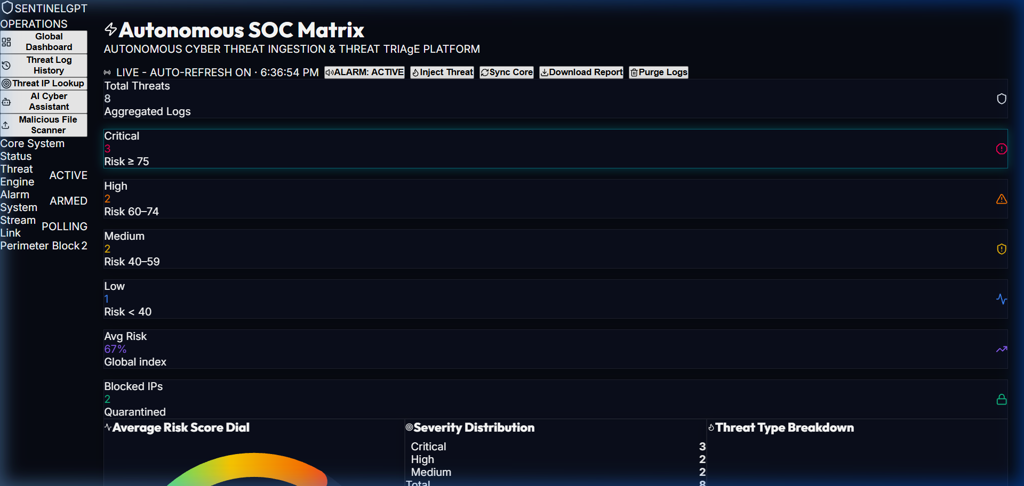
SENTINELGPT CYBER DEFENSE
Real-Time SOC Operations Dashboard

Slide 5
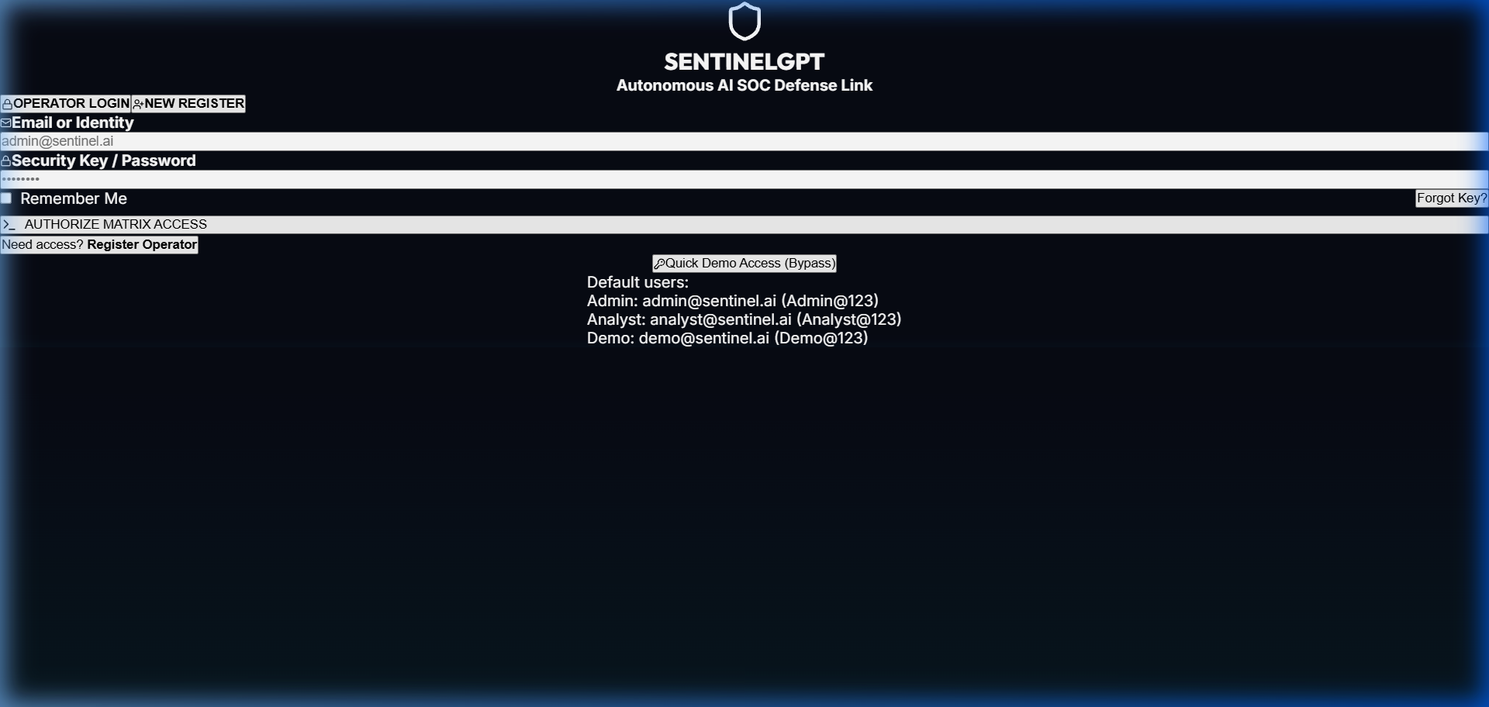
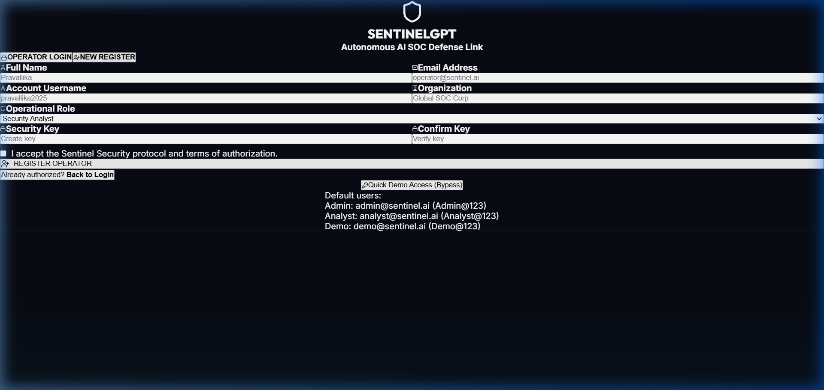
SENTINELGPT CYBER DEFENSE
Authentication & Operator Onboarding

Slide 6
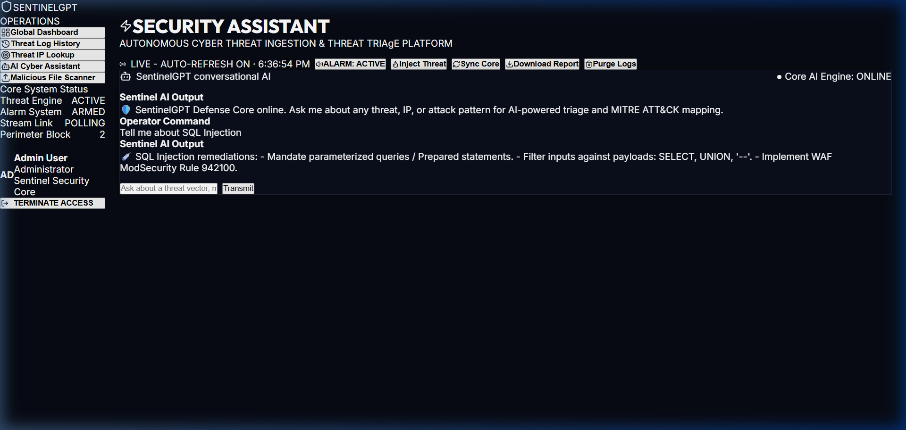
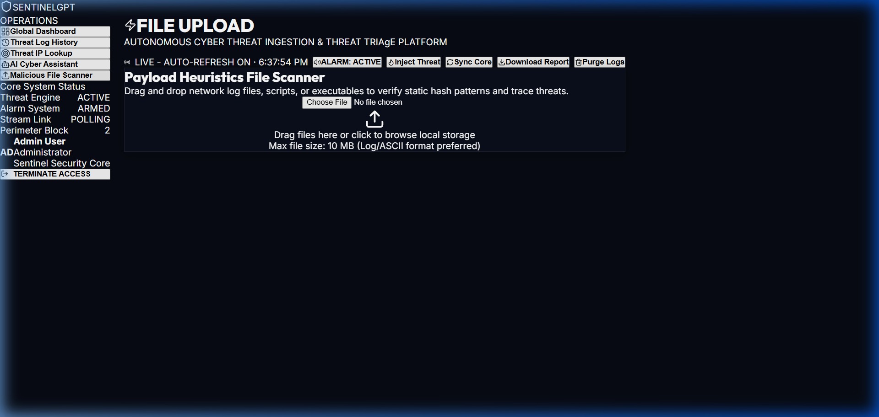
SENTINELGPT CYBER DEFENSE
AI Threat Triage & Payload File Scanner

Slide 7
SENTINELGPT CYBER DEFENSE
Project Submission & Access Links
🌐 Official Live Web Deployment:
👉 https://sentinelgpt-ai.vercel.app
📡 Live Server Health Status:
👉 https://sentinelgpt-ai.vercel.app/health
📖 Interactive Swagger API Docs:
👉 https://sentinelgpt-ai.vercel.app/docs
📁 Official GitHub Repository:
👉 https://github.com/Pravallika2025/sentigraud-ai-.git

