Slide 1



Smart Ambulance
State Level Hackathon
Dharani_aus[Surampalem]
Domain: Healthcare / Emergency Medical Services
Critical alerts never wait behind routine telemetry
Deterministic processing on QNX Neutrino RTOS
GPS and routine data keep flowing in the background

Slide 2
Problem Synthesis & Scenario
Design and Execution
The Scenario:
Ambulance streams HR, SpO2, temp, GPS, severity
Routine updates can delay a life-threatening reading
ER loses preparation time
Criticality:
Critical alert must be handled first, every time
Late alert means late treatment
Success Metric:
100% of critical alerts served before routine work
Routine job yields within 100 ms
Acknowledged as INTERRUPTED
Triage rules applied by the transmitter
Parameter | CRITICAL if | Routine
Severity | 4 or 5 | 1 to 3
Heartbeat | < 50 or > 130 BPM | 50 to 130
SpO2 | < 90 % | 90 % or more
Temperature | > 39 or < 35 C | 35 to 39 C
GPS | never | always
Critical readings go to the critical channel; everything else to the routine channel.

Slide 3
QNX Architectural Approach
Design and Execution
Microkernel Strategy:
Separate processes: transmitter and hospital receiver
Native QNX message passing: MsgSend, MsgReceive, MsgReply
Reply doubles as the ACK
Resource Isolation:
Two channels, one thread each
Critical traffic never queues behind routine
CPU sets and affinity not used in this build
Priority Setup:
Critical thread: SCHED_RR 30
Routine thread: SCHED_RR 10
_NTO_CHF_FIXED_PRIORITY on both channels
Thread priorities (SCHED_RR)
Critical receiver thread: 30
Routine: 10
Reply codes carried back to the ambulance
1
CRITICAL
2
ROUTINE
3
INTERRUPTED
-1
REJECTED

Slide 4
Technical Execution (Logic)
Design and Execution
Critical channel > Critical thread (SCHED_RR 30)
Prints alert at once, increments critical_count, replies CRITICAL
MsgSend
Ambulance Transmitter
Reads HR, SpO2, temp, GPS, severity. Validates ranges, then classifies each reading.
shared critical_count (mutex)
Routine channel > Routine thread (SCHED_RR 10)
5 s job (50 x 100 ms). Aborts if critical_count changes, replies INTERRUPTED
MsgSend
Interfaces
No GPIO in this build
Vitals entered at the console
QNX IPC channels are the interface
Real sensors can use the same message format
The Logic
Validate ranges, drop bad input
Send each reading to critical or routine channel
Critical arrival bumps the counter
Routine job checks every 100 ms, yields if changed

Slide 5
Resilience & "The Hack" Response
Design and Execution
The Vulnerability:
Critical alert lands during a 5 s routine job
Several ambulances may transmit at once
Mitigation Strategy:
Dedicated high-priority critical thread and channel
Routine work aborts and is ACKed as INTERRUPTED
Wrong-priority messages rejected (-1); transmitter range-checks every reading
Recovery Data:
Routine yields within 100 ms of a critical alert; measured value on profiler slide
1 Routine job running
50 x 100 ms steps at priority 10
2 Critical alert arrives
Priority 30 thread runs at once
3 Routine yields
Sees counter change, replies INTERRUPTED

Slide 6
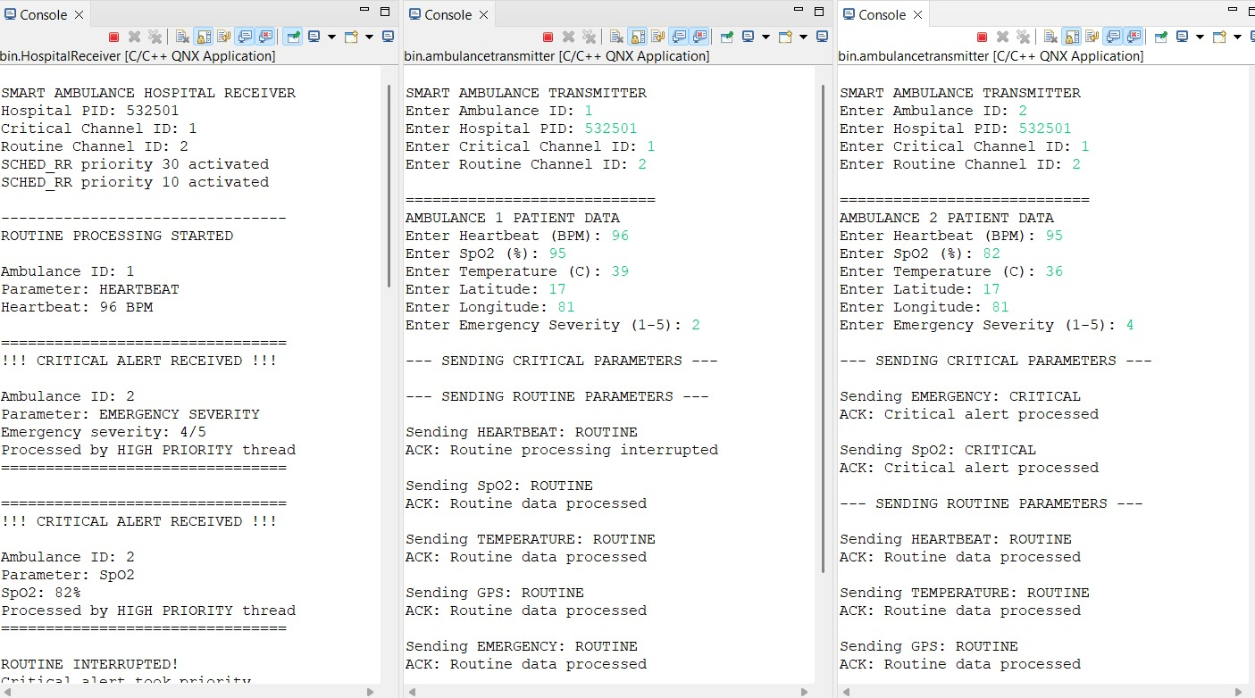
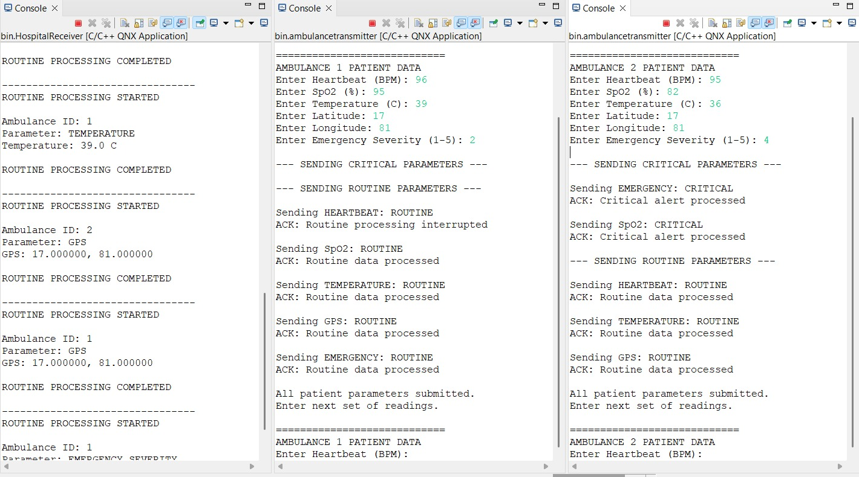
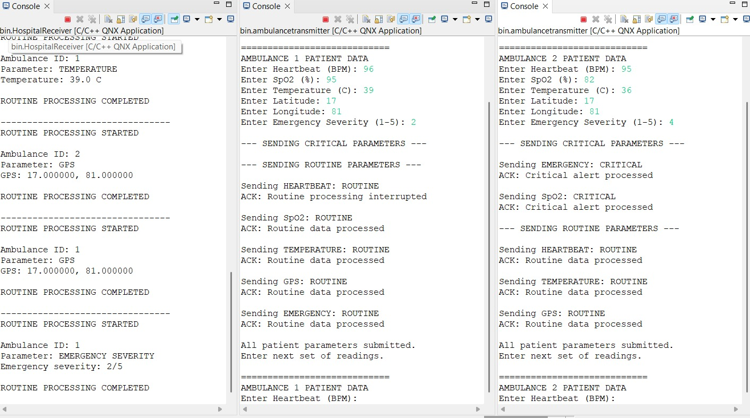
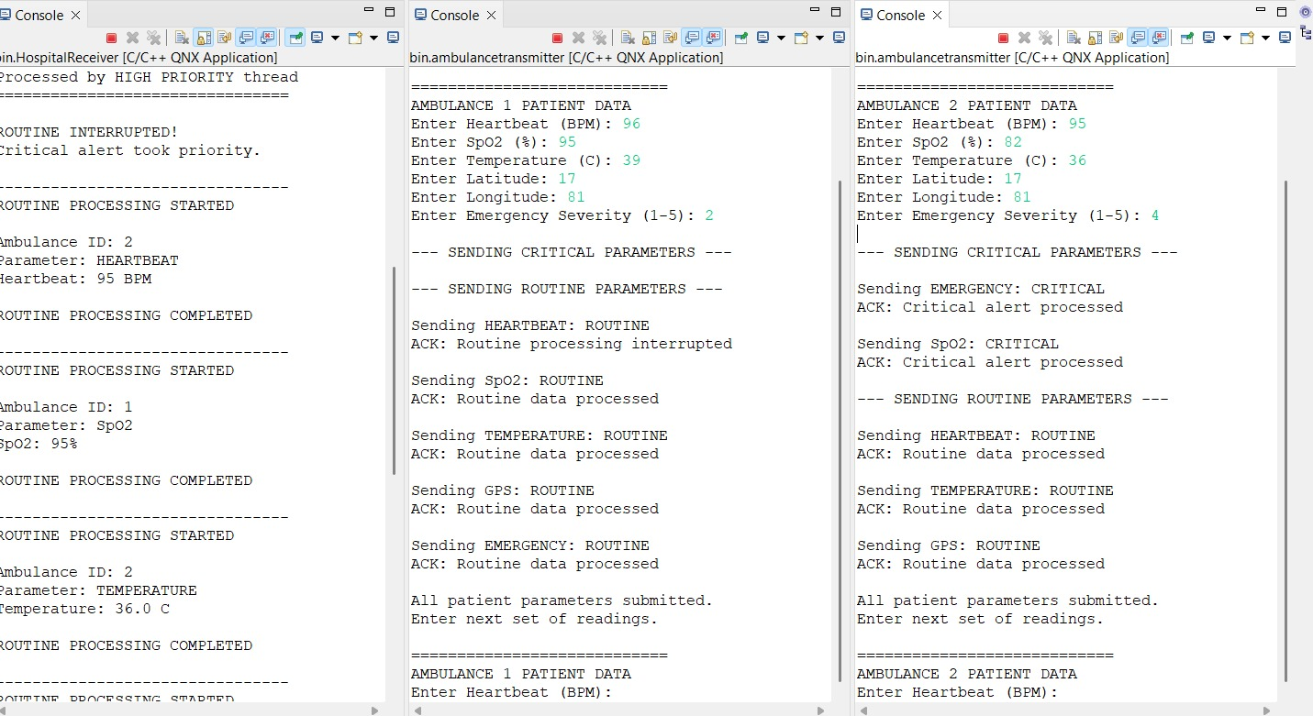
Performance Proof (The Profiler Slide)
Demonstration

Slide 7
Future Scalability & Conclusion
Demonstration
Innovation Arbitrage: scaling to industrial and automotive grade
Real sensors
Pulse-ox, temperature and GPS over UART or CAN replace console input.
Network scale
Same messages over QNX Qnet to a remote hospital node, many ambulances.
Event-driven
Replace 100 ms polling with an event or pulse for faster interruption.
Safety hardening
Priority-inheritance mutex, HAM auto-restart, CPU affinity, logging.
Learning Outcome:
A blocking MsgReceive server cannot be interrupted mid-job
Fix: priority-separated channels and threads
Mutex-protected counter polled every 100 ms
Every second counts: the right alert reaches the ER first, every time.

