Slide 1

HackNow 2026 | Accenture x ServiceNow | Problem HOT-04
Guest Complaint
Root-Cause Intelligence
One complaint. One root cause. Fixed once.
4-hour
3-tier
3
7
SLA timer
escalation
AI clusters
dashboard charts
Team TechNova: B. Pravallika (Lead), K. Meghana, K. Rahini, M. Samatha, G. Hemanjali Bhavani, S. Dhanush

Slide 2





THE PROBLEM
Four complaints, one hidden cause
AC not cooling
Wi-Fi dropping
No hot water
Too noisy
Every complaint is handled alone and closed. Look at Floor 5:
Room 501
Room 502
Room 503
Room 505
Today's reality
Four tickets, four small fixes
The same repair is paid for again and again
Managers see ticket counts, not the cause
AC not cooling
AC not cooling
AC not cooling
AC not cooling
ONE shared cooling system on Floor 5 is failing
Real-world parallel: a pothole reported by ten neighbours.
A good city repairs the road once. Our project gives a hotel the same ability.

Slide 3
APPROACH AND ARCHITECTURE
How it works: one complaint, step by step
Guest
Case
Routing
SLA timer
Escalation
>
>
>
>
form or chat
Customer Service Management
7 assignment rules
4 hours
3 flows: 75, 90, 100 percent
Recurrence
AI
Problem
Corrective task
Dashboard + survey
>
>
>
>
3 similar in 30 days
similarity and clustering
one root cause
permanent fix
7 charts, guest rating
Row 1: get the complaint to the right people on time. Row 2: find the real cause and fix it for good.
Built only with standard ServiceNow features. Real-world parallels: airport baggage desk (routing), hospital nurse to doctor to head (escalation), car recall (Problem and fix), flight board (dashboard)

Slide 4
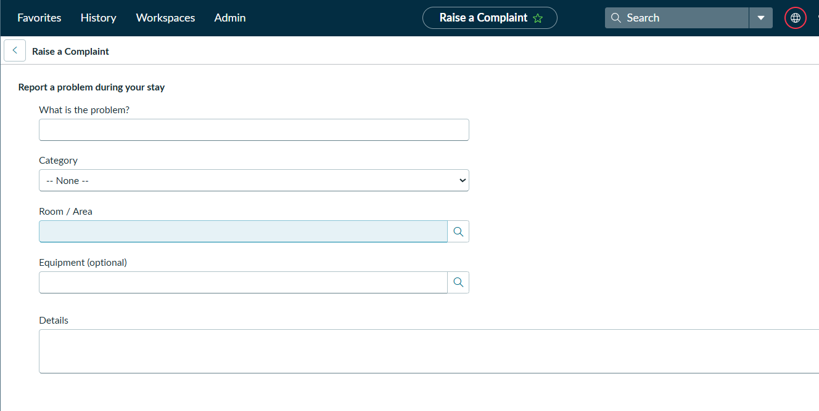
REAL RESULT 1
The guest form
The guest reports a problem
Types the problem
Picks a category, room or area and equipment
Adds details and presses Submit
Real hotel: a QR code in the room opens this form. A Virtual Agent chat does the same job.

Slide 5
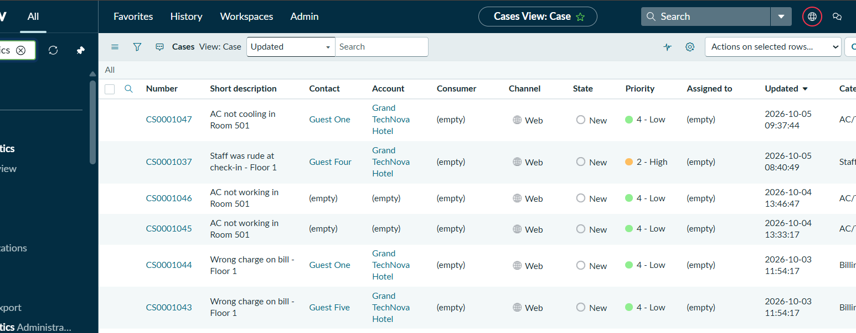
REAL RESULT 2
Every complaint becomes a case
Cases list
Each complaint is a case
Category, location and priority are filled in
Staff see everything in one place
Real hotel: the front desk sees every complaint on one screen instead of notes and calls.

Slide 6
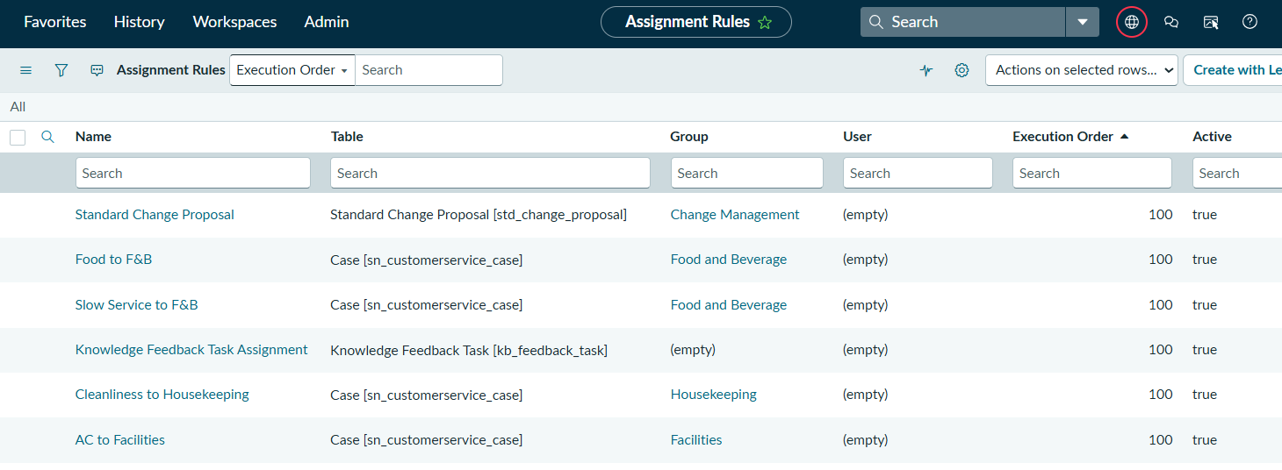
REAL RESULT 3
Smart routing and escalation
Assignment rules
AC problems go to Facilities, noise to Front Desk, cleanliness to Housekeeping
A 4-hour timer starts on each case
Escalation flows act at 75, 90 and 100 percent
Real world: an airport sends baggage problems to the baggage desk, not to ticketing.

Slide 7
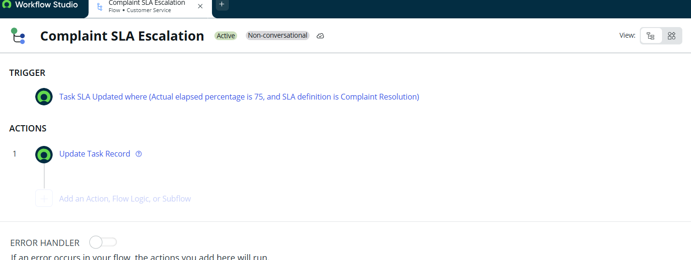
REAL RESULT 4
Automatic escalation
Escalation flow (Active)
Starts when 75 percent of the 4-hour timer is used
Raises the case priority
Two more flows act at 90 and 100 percent
Real world: a hospital moves a patient from nurse to doctor to department head.

Slide 8
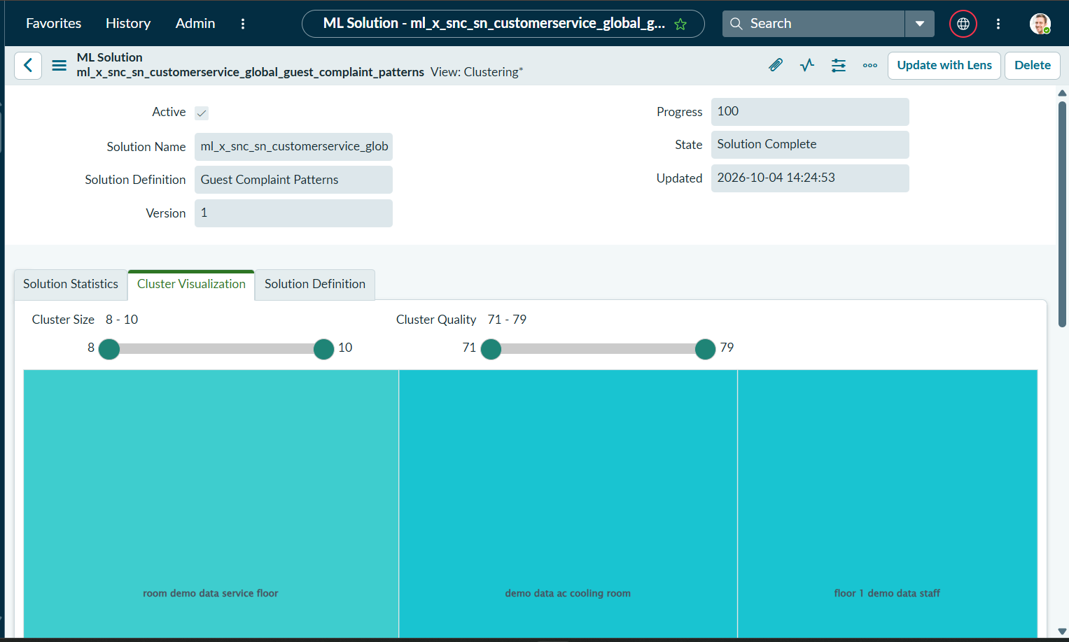
REAL RESULT 5
The AI groups similar complaints
Clustering
27 complaints grouped into 3 clusters
One cluster holds the cooling and AC complaints
Similarity also matches new complaints to old ones
Real world: a streaming service groups similar films. We group similar complaints.

Slide 9
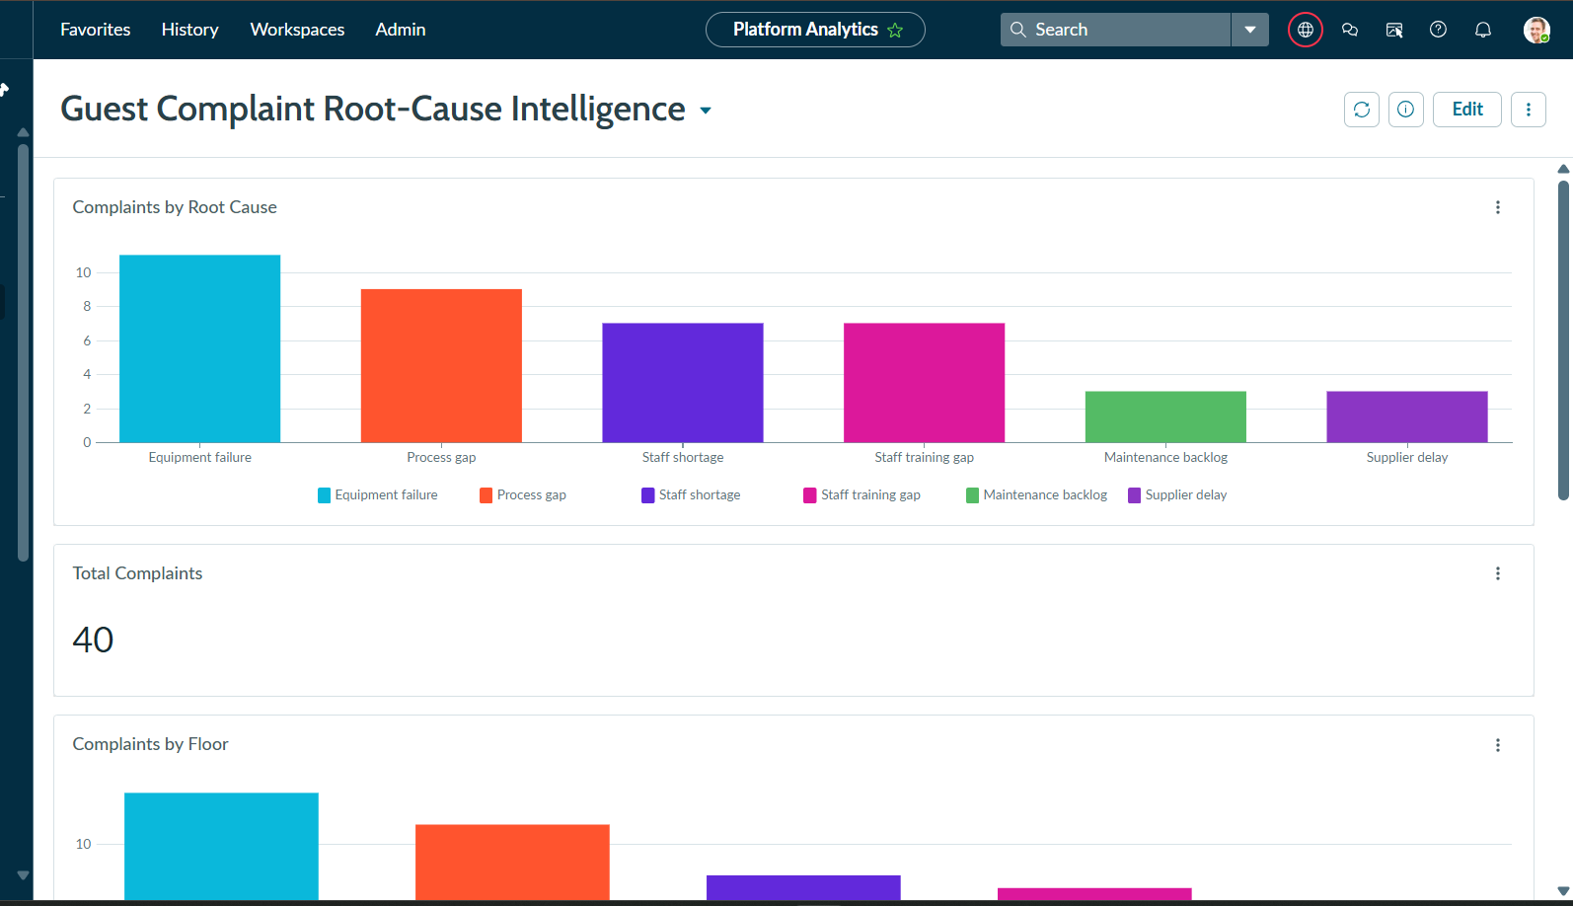
REAL RESULT 6
Management sees the root causes
Management dashboard
40 total complaints
Equipment failure is the tallest bar
AC units lead the equipment chart. 7 charts in total
Real world: a flight status board lets the manager see all delays at once.

Slide 10
IN OUR PROJECT
How the root cause is solved
1
Four AC complaints arrive
Rooms 501, 502, 503 and 505 each raise a case. All go to the cooling team.
2
Recurrence is flagged
3 or more complaints with the same category and location in 30 days raise the priority and add a note: Recurrence detected.
3
AI groups them
Similarity and clustering put the AC complaints together, even when guests used different words.
4
One Problem is created
The four cases are linked to a single Problem record. This record is the root cause, confirmed by the team.
5
A corrective task is created
A flow adds a task for Facilities: permanent fix for the root cause.
6
Management sees it
The dashboard shows equipment failure as the top cause and AC units leading the equipment chart. The guest survey shows if satisfaction improves.

Slide 11
SUMMARY
Before and after
Before
After
Complaints handled one by one
Late cases noticed by chance
Same fault returns again
Managers see ticket counts
Routed to the right team at once
Escalated automatically on a 4-hour timer
One Problem and one corrective task
Dashboard shows the top root cause

Slide 12
Thank you
One complaint. One root cause. Fixed once.
Thank you to Accenture and ServiceNow for HackNow 2026, to our mentors for their guidance, to the judges for their time, and to our families and friends for their support.
Team TechNova | HackNow 2026 | Problem HOT-04
B. Pravallika (Lead), K. Meghana, K. Rahini, M. Samatha, G. Hemanjali Bhavani, S. Dhanush

