Slide 1
Customer Churn Analysis
Team Members:
2010030168- Tahseen Begum
2010030046- E.Pravallika
2010030550- K.Kavya
2010030362- Rushitha

Slide 2

Table Of Contents
Introduction
Explanation
Literature Survey
Data Cleaning
Data Processing
Model Selection
Result
Charts / Graphs
Conclusion
Future Scope
References

Slide 3
Introduction
Customer churn analysis is the process of identifying customers who are likely to leave a business.
It involves analyzing customer behavior, demographics, and other data to understand why customers leave and what factors contribute to their decision.
The goal of churn analysis is to develop strategies to reduce customer churn and retain more customers.
Businesses can use churn analysis to improve customer satisfaction, increase revenue, and maintain a competitive edge in the market.
Advanced machine learning and artificial intelligence techniques are commonly used in customer churn analysis to predict and prevent churn.
Identify the factors contributing to customer churn and develop a predictive model that can forecast future churn events. Provide insights to help businesses take preventive measures and retain customers, ultimately leading to higher revenue and market share.

Slide 4
Explanation
Customer churn analysis is the process of identifying and understanding the reasons why customers stop using a company's products or services. It involves analyzing customer behavior and identifying patterns that can help predict which customers are at risk of churning.
The analysis typically involves collecting data on customer interactions, such as purchases, support requests, and website activity, and using this data to create predictive models. These models can then be used to identify customers who are likely to churn, allowing the company to take proactive measures to retain them.
There are several benefits to conducting customer churn analysis. It can help companies identify weaknesses in their products or services, allowing them to make improvements that can reduce churn. It can also help companies identify opportunities to upsell or cross-sell to customers who are at risk of churning. Additionally,

Slide 5
Literature Survey
Title | Author | About
A Survey On Data Mining Techniques In Customer Churn Analysis For Telecom Industry | Amal M. Almana, Date:6, May 2020 | This survey focuses on data mining techniques utilized for customer churn analysis in the telecom industry. The survey investigates the most commonly used data mining techniques for customer churn analysis, such as decision trees, logistic regression, and artificial neural networks. The survey also examines the effectiveness of these techniques in predicting customer churn and retaining customers. The study sheds light on the importance of customer churn analysis and the role of data mining in enabling telecom companies to understand their customers better and develop effective retention strategies. The survey concludes with recommendations for future research in this area.

Slide 6
Literature Survey
Title | Author | About
Mobile Phone Data: A Survey of Techniques, Features, and Applications | Mohammed Okmi, Lip Yee Por, Tan Fong Ang and Chin Soon Ku | The results also show that classification and clustering approaches have been widely used where algorithms such as SVM and k-means are used to classify or cluster human activities based on their calling or mobility features. The results show that the spatiotemporal calling feature has been widely used to depict human behaviors. This feature allows for the estimation of hourly dynamic population, the classification of land use, the estimation of ambient population, the investigation of the relationship between human dynamics and crime spatial–temporal patterns, defining the actual populations at risk, and others.

Slide 7
Literature Survey
Title | Author | About
Analysis of customer churn prediction in the telecom industry using decision trees and logistic regression | lonu܊ Brându܈oiu, Gavril Toderean, Horia | we describe the principal component analysis (PCA) technique that we apply to the dataset. In we present the architectures of the three machine learning algorithms used for classification, i.e. to predict the state of the Churn variable based on the independent variables. These algorithms are neural networks, support vector machines (SVM), and Bayesian networks (BN). the models have a very good performance of 99% to 100% in predicting churners in a mobile telecommunications company. Decision making employees can build different marketing approaches to retain churners based on the predictors that have higher importance in scoring the model performance.

Slide 8
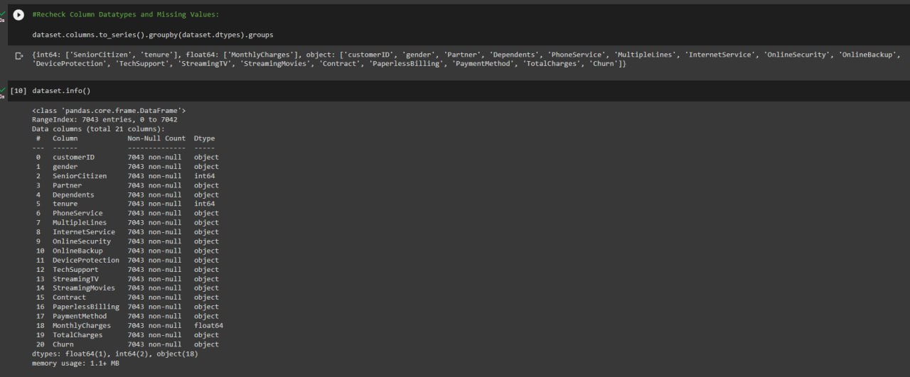
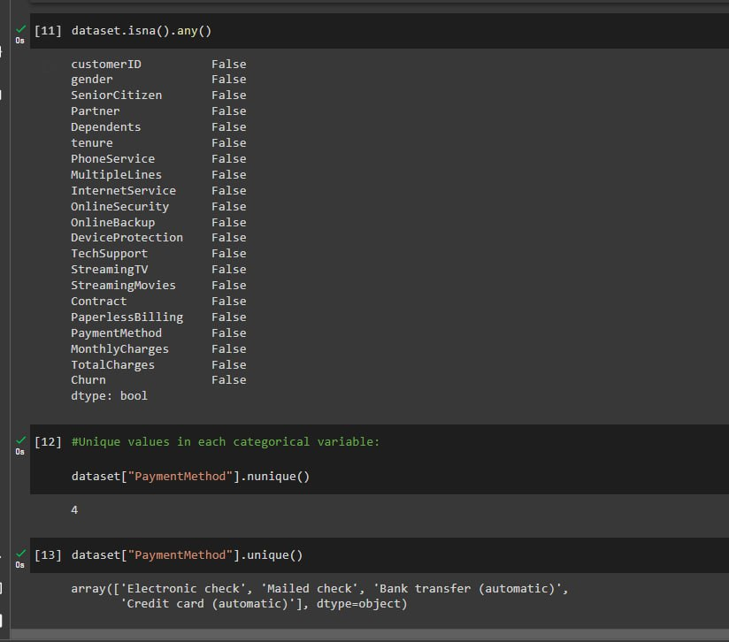
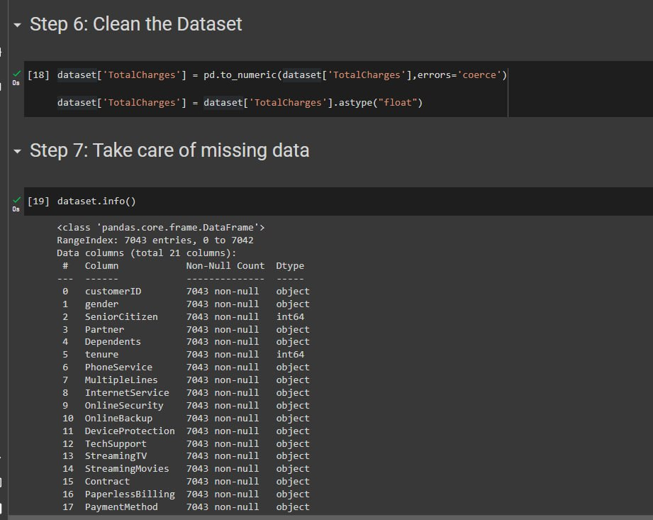
Data Cleaning

Slide 9
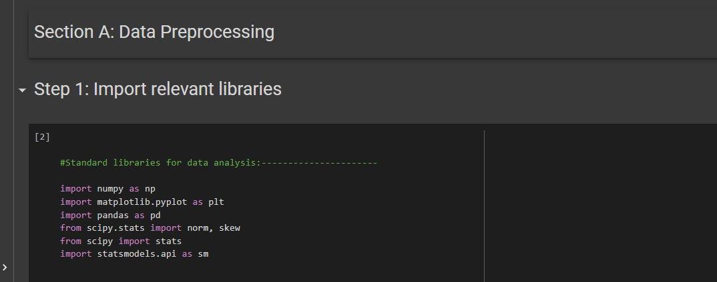
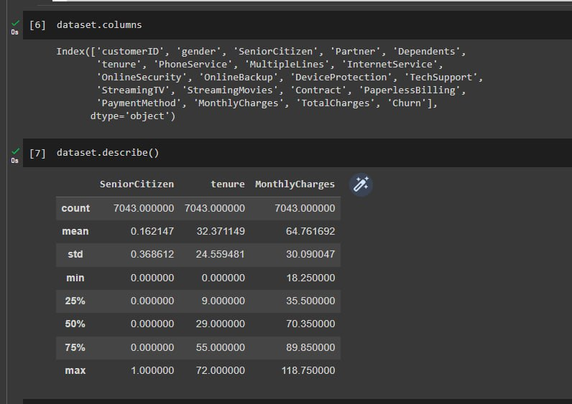
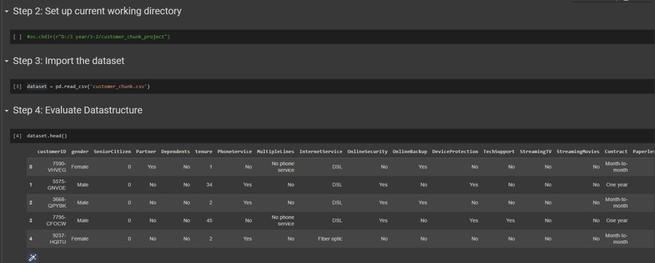
Data Processing

Slide 10
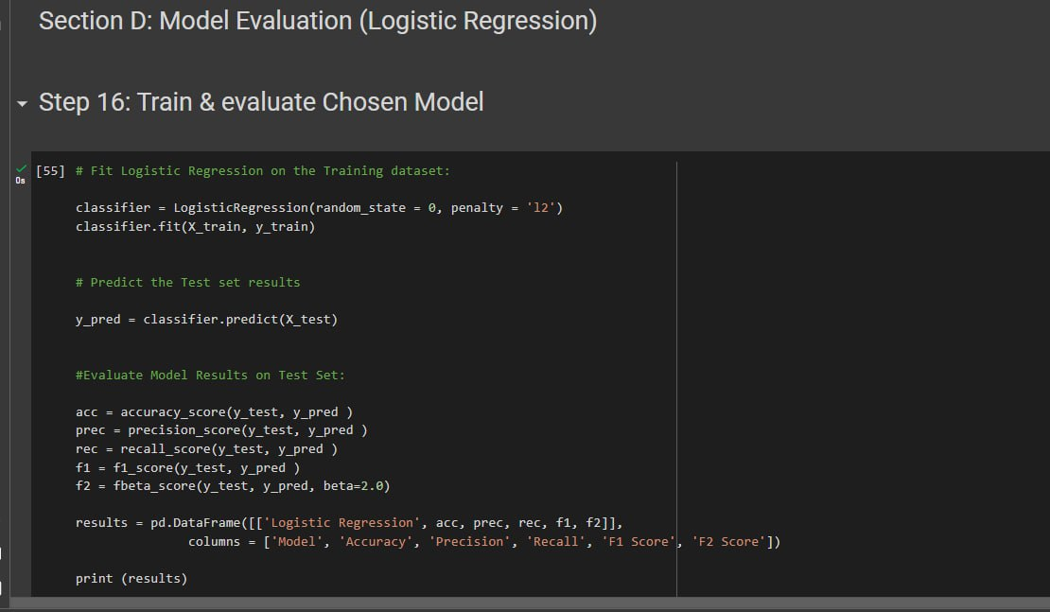
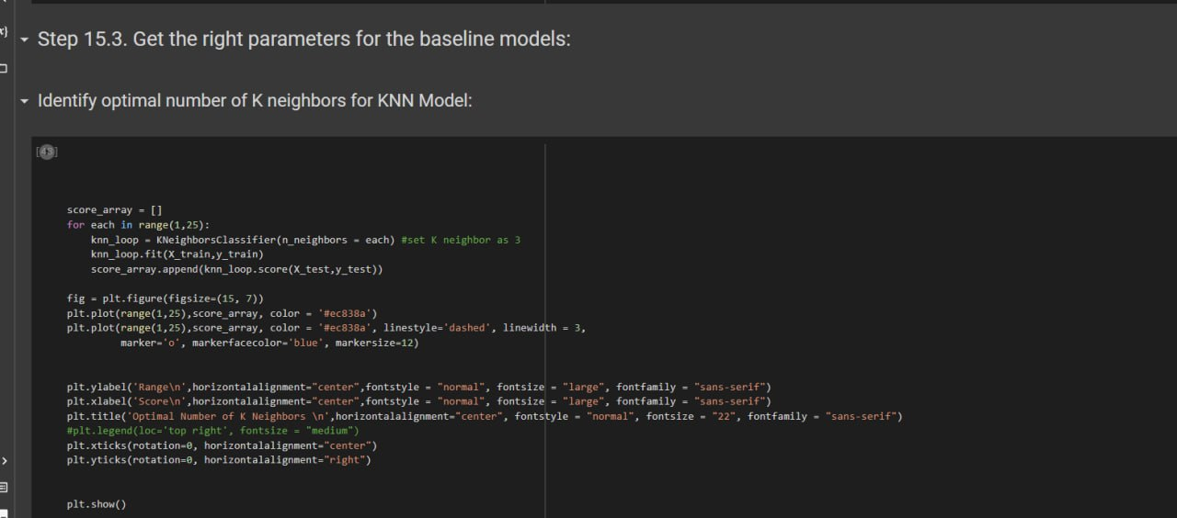
Model Selection

Slide 11
Result
Customer churn analysis is the process of identifying customers who are likely to discontinue their relationship with a business. This can be done by analyzing customer data such as purchase history, demographic information, and engagement metrics. The goal is to understand why customers are leaving and take proactive measures to prevent churn. This can include targeted marketing campaigns, improving customer service, or enhancing product features. By reducing customer churn, businesses can increase customer loyalty and revenue.

Slide 12
Charts / Graphs

Slide 13

Conclusion
Collect data from telecom to conduct customer churn analysis here we will use data analytics tools to extract insights from the data. Create visual representations of the data through graphs and charts. Develop strategies to address the underlying issues and reduce churn. Present the findings and recommendations through a website.

Slide 14

Future Scope
Collect data from telecom to conduct customer churn analysis here we will use data analytics tools to extract insights from the data. Create visual representations of the data through graphs and charts. Develop strategies to address the underlying issues and reduce churn. Present the findings and recommendations through a website.

Slide 15

Conclusion
Collect data from telecom to conduct customer churn analysis here we will use data analytics tools to extract insights from the data. Create visual representations of the data through graphs and charts. Develop strategies to address the underlying issues and reduce churn. Present the findings and recommendations through a website.

Slide 16

Reference
Collect data from telecom to conduct customer churn analysis here we will use data analytics tools to extract insights from the data. Create visual representations of the data through graphs and charts. Develop strategies to address the underlying issues and reduce churn. Present the findings and recommendations through a website.

Slide 17
Thank you

