Slide 1
Comment2Likes: Estimating Video Likes using Comment Data

Slide 2
TOPICS
1. Problem Statement
2. Tools Used
3. Approaches
4. EDA Insights

Slide 3
1.Problem Statement:
The objective of the "Comment2Likes: Estimating Video Likes using Comment Data" project is
to develop a predictive model that can estimate the number of likes a video will receive based
on the information extracted from its comments. By leveraging the valuable insights present in
user comments, this project aims to provide content creators, marketers, and platform
administrators with a tool to gauge the potential popularity of their videos and optimize their
content strategies accordingly.

Slide 4
2. Tools Used
Google Collab
Scikit learn
Pandas
Numpy
Nltk
Matplotlib
Seaborn

Slide 5
3. Approaches
Some common problems faced when dealing with text data(in this case Comments column)
Text Preprocessing
Remove Punctuation
Replacing short words
Making text lower case
Remove stopwords
Lemmatization
NLP(1 gram approach and TF-IDF)
ML Algorithms(Linear Regression and Decision Tree)

Slide 6
Remove Punctuation
In this step, all the punctuations from the text are removed.
some pre-defined list of punctuations such as
‘!”
#
$
%
&
‘
()*+,-./:;?@[\]^_`{|}~’

Slide 7
Replacing short words
In this step we are replacing all the words in text data whose length is less than 2 with an empty space.
In this step all words such as in,if,as,so,if,to,of etc will be deleted from this text data.

Slide 8
Making text lower case
In this step we are converting all the words in the sentence to the lowercase.
The meaning of “Happy” and “happy” are same but the model considers this two words as different meanings.
So to avoid this problem we are converting text into lowercase.
new_df['Comment_processed'] = [row.lower() for row in new_df['Comment_processed']]

Slide 9
Remove stopwords
Stopwords are the commonly used words and are removed from the text as they do not add any value to the analysis. These words carry less or no meaning.
NLTK library consists of a list of words that are considered stopwords for the English language. Some of them are : [i, me, my, myself, we, our, ours, ourselves, you, you’re, you’ve, you’ll, you’d, your, yours, yourself, yourselves, he, most, other, some, such, no, nor, not, only, own, same, so, then, too, very, s, t, can, will, just, don, don’t, should, should’ve, now, d, ll, m, o, re, ve, y, ain, aren’t, could, couldn’t, didn’t, didn’t]

Slide 10
Lemmatization
It stems the word but makes sure that it does not lose its meaning.
The difference between stemming and lemmatization is as follows:
Word stemming lemmatization
Caring Car Care
ML TECHNIQUES USED:
Linear Regression
DecisionTreeRegressor

Slide 11
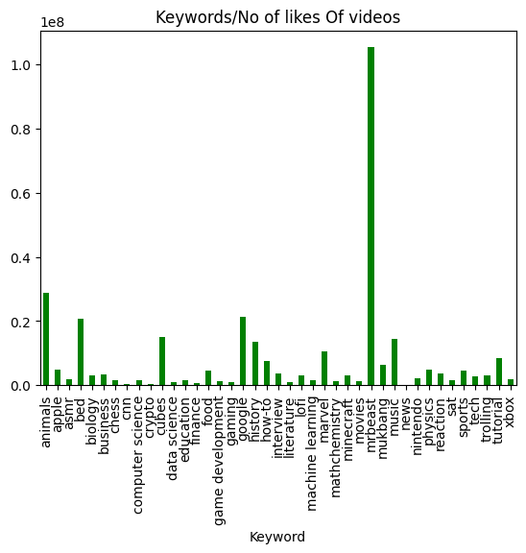
EDA

Slide 12
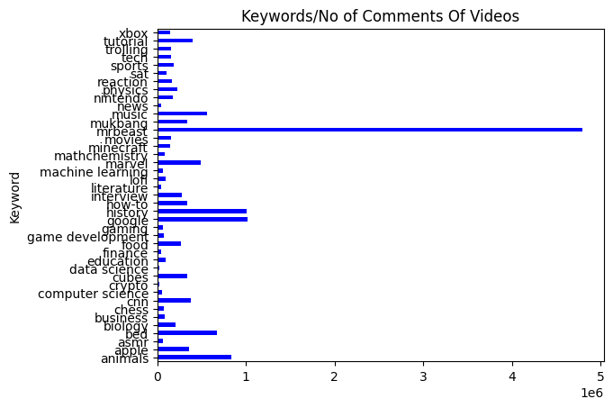

Slide 13
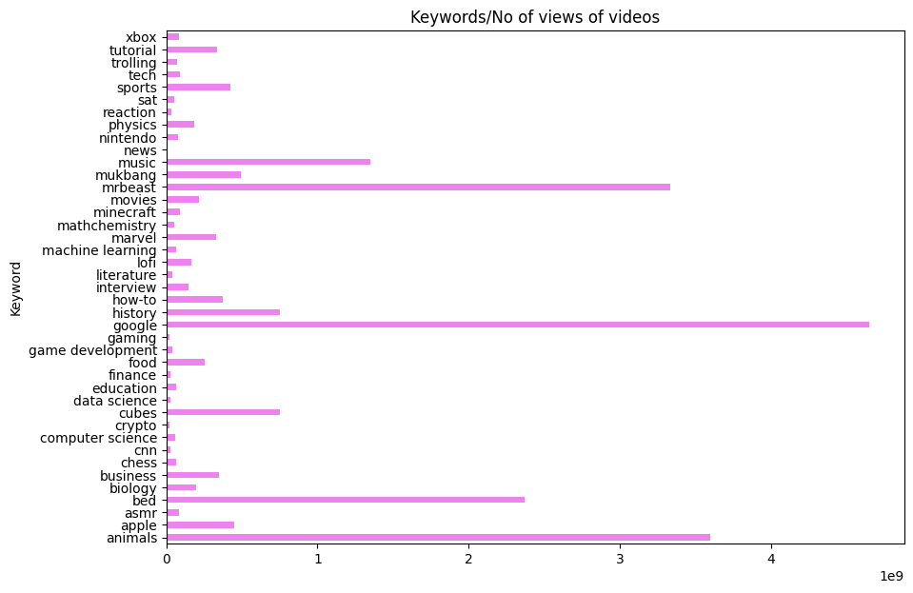

Slide 14
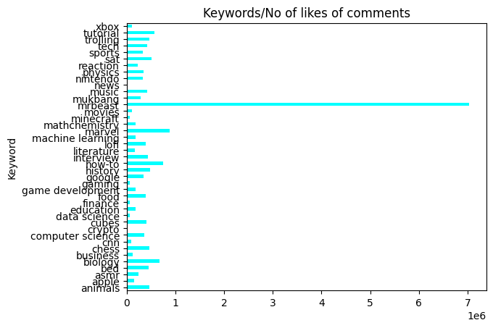

Slide 15
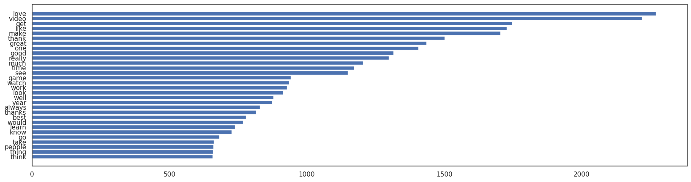

Slide 16
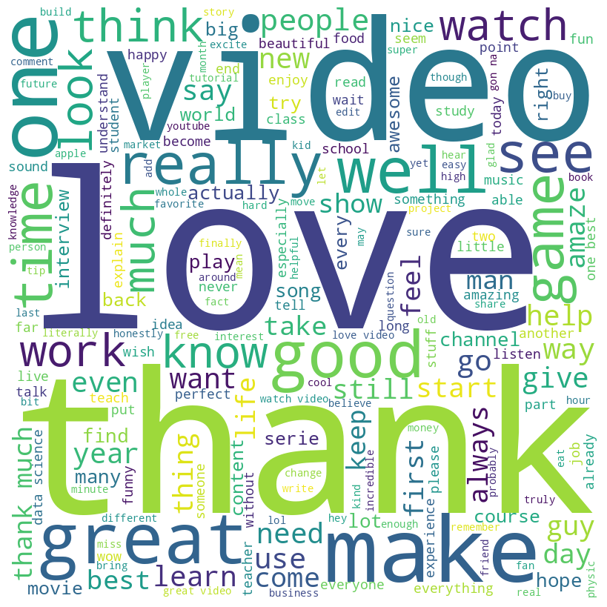

Slide 17
EDA INSIGHTS
1.Mr.Beast related videos has the highest number of likes of videos.
2. Mr.Beast related videos has the highest number of comments of videos.
3.Google related videos has the highest number of views for the video.
4.Mr.Beast has the highest number of likes of comments.
5.The love word is appeared more times in positive comments.

