Slide 1

Analyzing Swiggy
By: Pravar Ved
By: Siddharth Bedmutha

Slide 2
Introduction
The online food ordering market includes foods prepared by restaurants, prepared by independent people, and groceries being ordered online and then picked up or delivered. The first online food ordering service, World Wide Waiter (now known as Waiter.com), was founded in 1995. Online food ordering is the process of ordering food from a website or other application. The product can be either ready-to-eat food or food that has not been specially prepared for direction consumption.

Slide 3
Objective
Objective:
In the world of rising new technology and innovation, Food industry is advancing with the role of Data Science and Analytics. Data analysis can help them to understand their business in a quiet different manner and helps to improve the quality of the service by identifying the weak areas of the business.
Benefits:
Help out to make better business decisions.
Help analyze customer trends and satisfaction, which can lead to new and better products and
services.
Gives better insight of customers base.
Helps in easy flow for managing resources.

Slide 4

Problem Statement
Food industries are having important reflection of the economy from past few decades. Online food ordering is the process of ordering food from a website or other application. The product can be either ready-to-eat food or food that has not been specially prepared for direction consumption.
In this project, we are analyzing the various aspects with different use cases which covers
many aspects of Swiggy Food Delivery Service. It helps in not only understanding the
meaningful relationships between attributes, but it also allows us to do our own research and come-up with our findings.

Slide 5
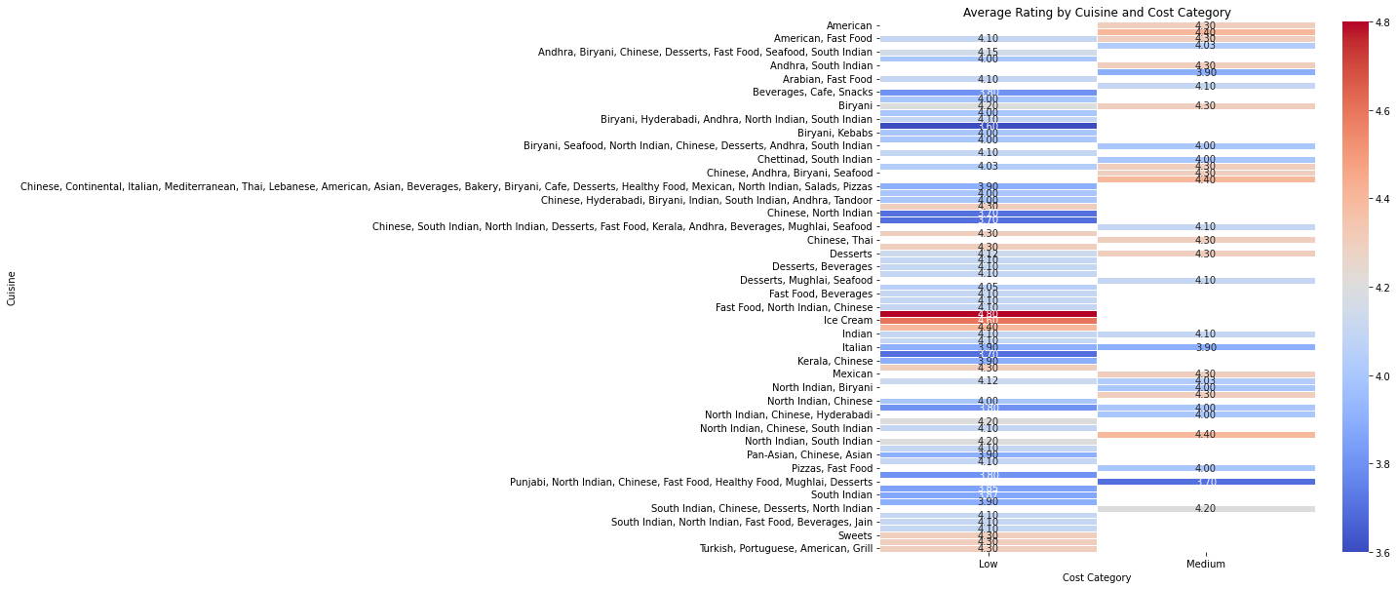
1.Average Rating by Cuisine And Cost Category :
Conclusion:
The heatmap displays the average cost and rating for each cuisine in Bangalore. This analysis helps to identify which cuisines have the highest average cost and rating. This information can help customers make informed choices when deciding on which cuisine to order.

Slide 6
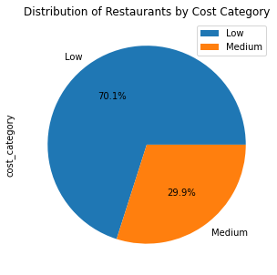
2. Pie chart of the distribution of restaurants by cost category:
Conclusion:
The pie chart displays the distribution of restaurants based on their cost category. The analysis helps to identify the percentage of restaurants that fall under each cost category. This information can help customers choose restaurants based on their budget.

Slide 7
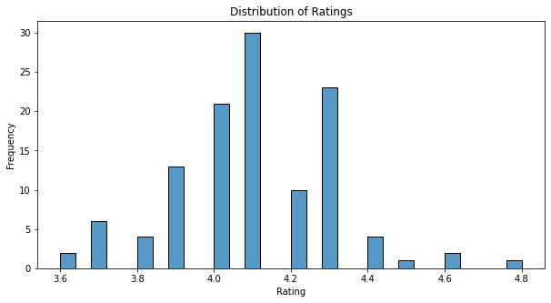
2. Histplot for distribution of ratings:
Conclusion:
The histogram displays the distribution of ratings for all the restaurants in Bangalore. The analysis helps to identify the distribution of ratings and the most common rating score given by customers.

Slide 8
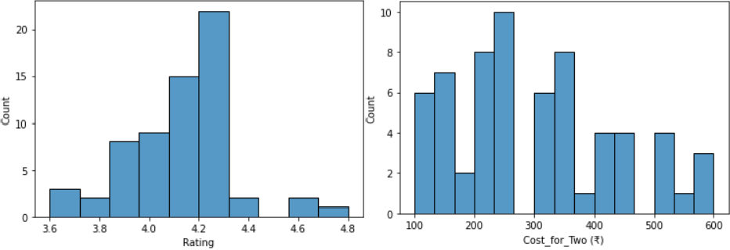
2. Area-wise Analysis on ‘Rating’ and ‘Cost_for_Two (₹)’ :
Koramangala Area:
Conclusion:
From this, you can produce Various Conclusions like –
Koramangala: Most has 4.0 to 4.3 Rating and Approx. Cost for Two People lies between 200 to 350. (Max. Cost goes upto 600)
With this we can conclude the Most Costly Area is HSR.

Slide 9
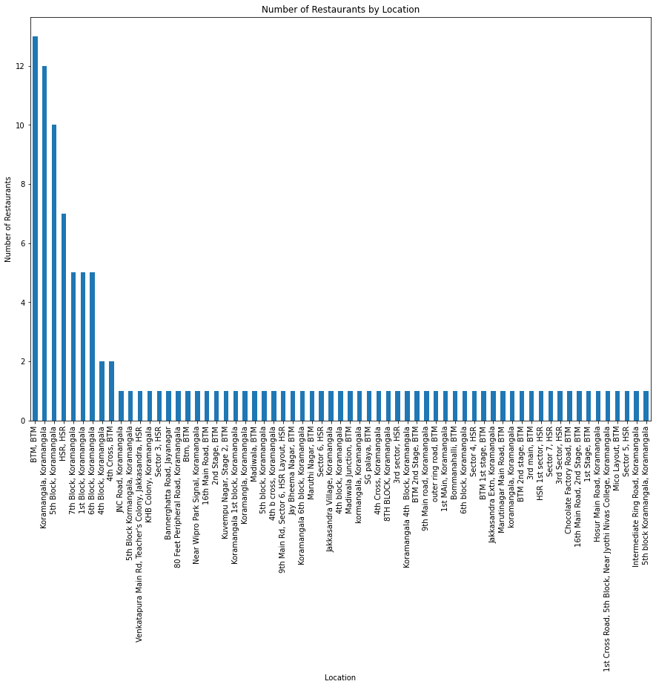
3. Number of restaurants by location:
Conclusion:
The analysis displays the number of restaurants by location. This information can help customers identify the areas with the highest number of restaurants and make informed choices when deciding on which area to order from.

Slide 10
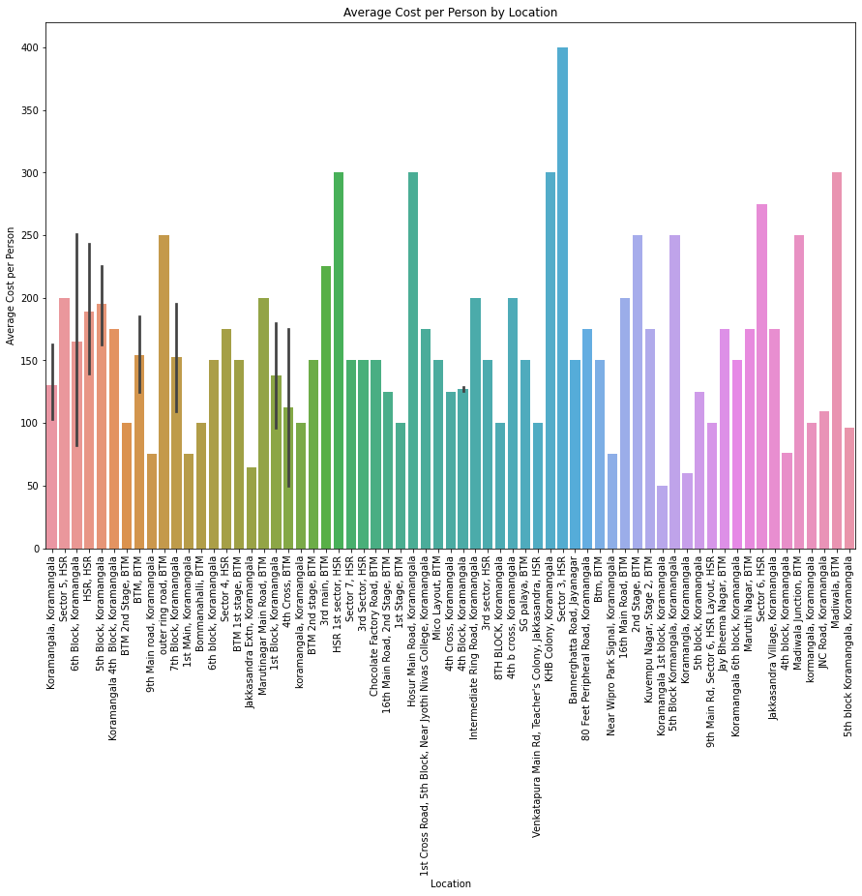
Barplot for Average cost per person by location:
Conclusion:
The barplot displays the average cost per person by location. This analysis helps to identify the areas with the highest and lowest average cost per person. This information can help customers choose restaurants based on their budget.

Slide 11
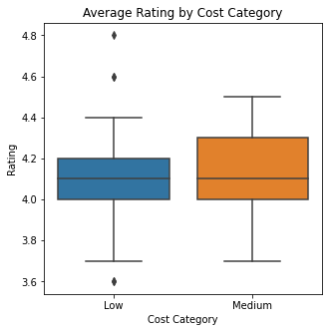
Box plot for Average Rating by Cost Category:
Conclusion:
The box plot displays the average rating by cost category. This analysis helps to identify which cost category has the highest average rating and which has the lowest. This information can help customers choose restaurants based on their budget and still enjoy good ratings.

Slide 12
Conclusion
Overall, the analysis performed in the project provides useful insights for customers in Bangalore who use Swiggy for food delivery services. The information can help customers make informed choices on which cuisine, restaurant, and location to order from based on their budget, preferred rating, and location.

Slide 13
Thank You

