Slide 1

User Authentication based on Keystroke Logging using Self-Organizing Maps
Group - 4
Pranit Chawla, Pravartya Dewangan, Subhadeep Paul,
Sumegh Roychowdhury and Vandit Sharma

Slide 2
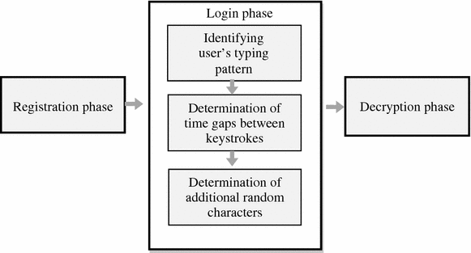
Problem Statement
To authenticate the user based on the keystroke logging features like hold time and latency time using self-organizing maps.

Slide 3
Introduction
The project aims to detect unauthorized people to prohibit access to the particular system and private data of users.
A “keystroke” is just any interaction you make with a button on your keyboard.
Keylogger features for a particular user are almost unique and hence it is used to uniquely identify the user.
Having these keylogging features along with the mouse dynamics can accurately authenticate the user but we are only using keylogging features in this project.

Slide 4
Self-Organizing Maps (SOM)
Self Organizing Maps are a kind of ANNs which learn neuron weights using competitive learning, which consists of three steps:
Competition: The neuron closest to the input vector (according to some distance measure) is selected as the “winner”.
Cooperation: A particular set of neurons close to the “winner” is selected using a neighborhood kernel function.
Adaptation: The weights of the selected neurons are updated according to a rule which depends on the difference of the current weight from the input vector.

Slide 5
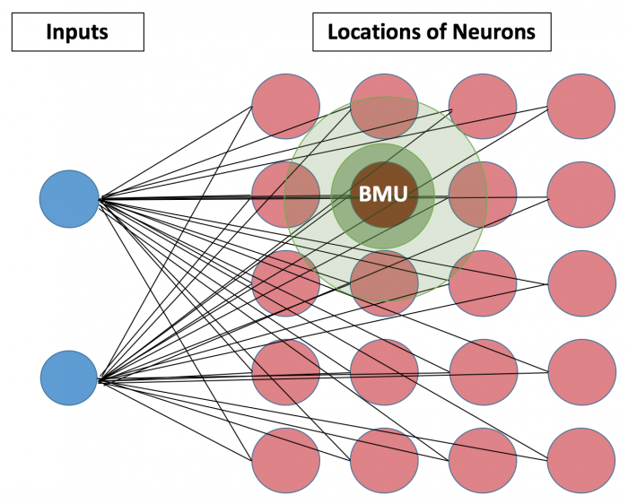
SOM - Architecture
Two layers: Input layer and output layer, also called feature vector. Each output neuron is of the same dimension as input.
Activation function is the identity function, that is, input values are directly propagated to the feature layer.

Slide 6
SOM - Differences from ANNs
Only two layers; typical deep ANNs can have many layers
Identity activation function is used in SOMs; ANNs often use sigmoid or ReLU activation functions
Backpropagation algorithm is not used to update the weights
All neuron weights do not get updated in each iteration. Neurons are selected based on a distance metric rather than probabilistically

Slide 7
SOM - Limitations
Does not handle categorical data well : The learning rule and calculation of the BMU cannot be easily generalized to categorical data.
Computationally expensive : Computation time can be reduced with initializations closer to the data points.
Potentially inconsistent solutions : As initial positions of neurons differ each time the SOM analysis is run, the eventual SOM map generated will also differ.

Slide 8
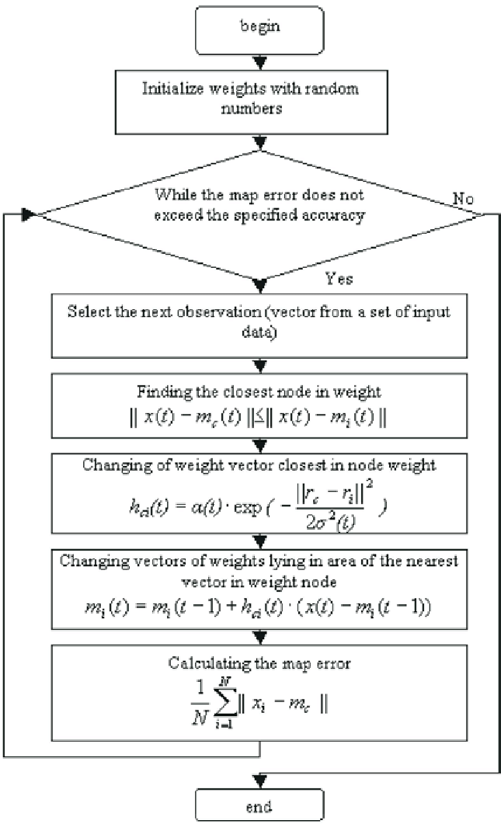
SOM - Algorithm

Slide 9
Data preprocessing
Since this is an unsupervised learning algorithm, it is sensitive to noise and outliers. Hence, we must weed out noisy data and also standardize the data so that learning can progress smoothly. A few ways by which data is preprocessed are:
Scaling: Data is scaled to have unit variance.
Data encoding: Since distance metrics are important in the SOM algorithm, it is important to encode the data if it is present in non-metric format.
Remove outliers: Presence of outliers can often increase the training time required to train the model.

Slide 10
Feature Extraction
We run the code provided to us for feature extraction, given the continuous data collected. The main features used here are:
Latency
Hold Time
AA | ………. | ……….. | ZZ
A | ………. | ……….. | Z
Flattenning
26*26 + 26
= 702 dimensional feature vector

Slide 11
Significance of extracted features
Hold time : Tells us the length of the keypress ( time difference between the press time and the release time) . Shows the impulsive nature of the user.
Latency : The time delay to switch from one key to the next. Shows the switching and typing speed of the user.
These features put surveillance on the user and decline the unauthorized user.

Slide 12
Dataset Statistics
After extracting the features for the various classes, we had 56 data points in total, which is quite less to obtain significant results.
Moreover, the data was quite imbalanced with an unequal amount of data points available for each class.
We first show results on this imbalanced class dataset and then we use techniques to solve this class imbalance problem by obtaining more data for the poorly represented classes.
We also generate some additional data points by taking the moving average of existing data points for the poorly represented classes.

Slide 13
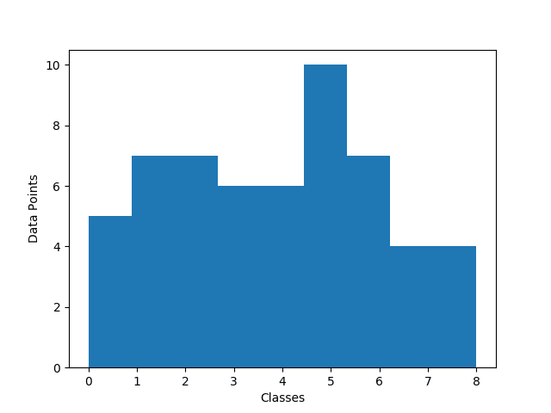
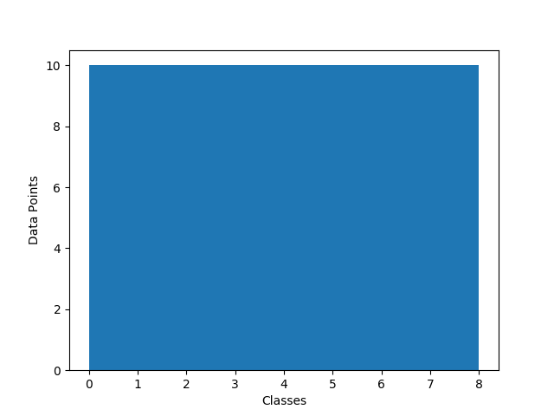
Dataset Statistics - Balanced & Imbalanced Data
Imbalanced Classes (lesser number for class 7-8)
After balancing classes

Slide 14
Hyper Parameter tuning on Imbalanced data
N_rows | N_cols | N_iter_super | N_iter_unsuper | K-Fold Accuracy | Random Baseline
50 | 50 | 1000 | 500 | 39.24 | 11.11
50 | 50 | 10000 | 5000 | 55 | 11.11
50 | 50 | 100 | 50 | 22.8 | 11.11
40 | 40 | 10000 | 5000 | 62.72 | 11.11
5 | 5 | 10000 | 5000 | 28.90 | 11.11
10 | 10 | 10000 | 5000 | 39.20 | 11.11
Varying Hyper-parameters on imbalanced dataset

Slide 15
Hyper Parameter tuning on Unbalanced data
N_rows | N_cols | N_iter_super | N_iter_unsuper | K-Fold Accuracy | At random
50 | 50 | 1000 | 500 | 60 | 11.11
50 | 50 | 10000 | 5000 | 83.33 | 11.11
50 | 50 | 100 | 50 | 42.22 | 11.11
40 | 40 | 10000 | 5000 | 81.01 | 11.11
5 | 5 | 10000 | 5000 | 47.77 | 11.11
10 | 10 | 10000 | 5000 | 77.77 | 11.11
Varying Hyper-parameters on balanced dataset

Slide 16
Final Results
Fold 1 | Fold 2 | Fold 3 | Fold 4 | Fold 5 | Average
50 | 81 | 63 | 55 | 63 | 62.72
Results for optimal parameter in unbalanced data
Fold 1 | Fold 2 | Fold 3 | Fold 4 | Fold 5 | Average
83 | 77 | 88 | 77 | 83 | 82
Results for optimal parameter in balanced data

Slide 17
Imposter Detection and User Authentication
Once we have trained this Self Organizing Map, it can be used to detect imposters and authenticate corresponding users
We took our group data as the user and the other group as the imposter, and tested our model on the unbalanced test set
We see that results on binary classification are much greater than multiclass.
Fold 1 | Fold 2 | Fold 3 | Fold 4 | Fold 5 | Average | Random baseline
83 | 91 | 82 | 1 | 63 | 84 | 50
Results on unbalanced data

Slide 18
Discussion
Accuracy on both balanced and imbalanced dataset significantly better than guess at random (63%, 83% vs 11.11%)
Unbalanced classes are a major source of poor performance of classification models and they can be solved using oversampling (the class with lesser number of points), undersampling(the class with more number of points)
Lack of training data affects the expressibility of the model. Model can be made much more expressive by larger amount of data.
The hold time and latencies of a user act as a signature and this 702 dimensional vector is able to uniquely identify the user with a decent accuracy.

Slide 19
Thank You!
Group - 4
Pranit Chawla (17EC35017)
Pravartya Dewangan (17EC35041)
Subhadeep Paul (17EC10064)
Sumegh Roychowdhury (17EC35033)
Vandit Sharma (17EC10060)

