Slide 1
Agriculture and Forest Land Emission Analysis
Biresh Kundu
Praveeja Sasidharan Suni
Ruma Talukder
Saranya Durairaju

Slide 2
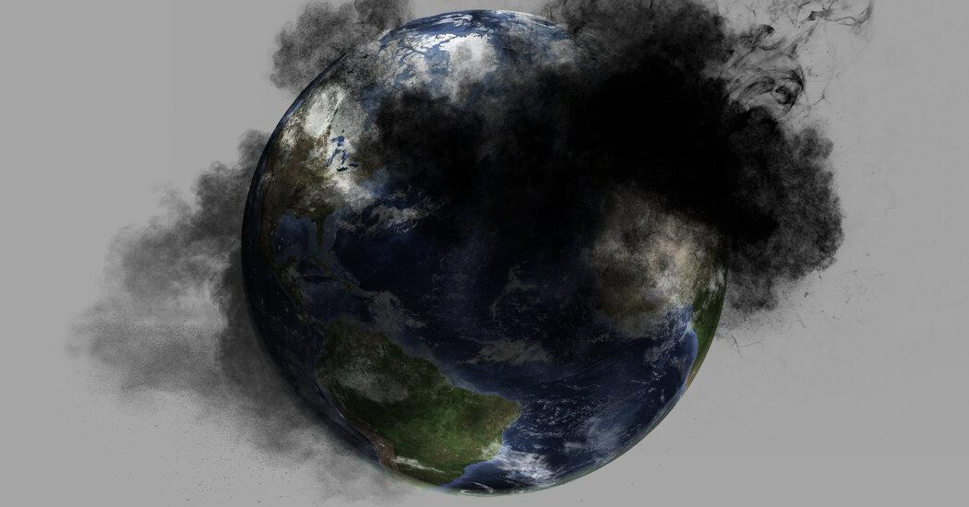

Slide 3
WHAT
Greenhouse gases such as
methane (CH4) and nitrous oxide (N2O) emissions from crop and livestock production, carbon dioxide (CO2) released from plants ,industries are trapped in the air and increase the temperature causing Global warming
WHY
All of us are aware of climate change and global warming. There are very large inequalities in per capita emissions across the world. We are concerned about greenhouse gas emission.
Though the amount is much less than CO2, N2O has warming potential almost three hundred times more than CO2.
About 33% of the N2O released in the atmosphere comes from human activity. Mostly due to the use of synthetic fertilizers in agriculture for more yield of crop.
Methane, the second-most emitted greenhouse gas on the planet, is 25 times more than CO2 to keep heat locked in the atmosphere.
Agriculture is one of the biggest contributors to CH4 emissions, largely because of livestock production and waste disposal.
Methane can come from pretty much anywhere food or plants decompose without oxygen, like marshes, landfills, and fossil fuels.
Deforestation and forest fires also contribute for CO2 release. Even agriculture and forest land emissions are the biggest contributors in greenhouse gas emission.
When we saw this information, started researching more and more and collected the data from FAO and UN. We will try to predict how it can harm more in near future through our analysis.

Slide 4
Flowchart

Slide 5
ETL

Slide 6
Database

Slide 7
Machine Learning

Slide 8
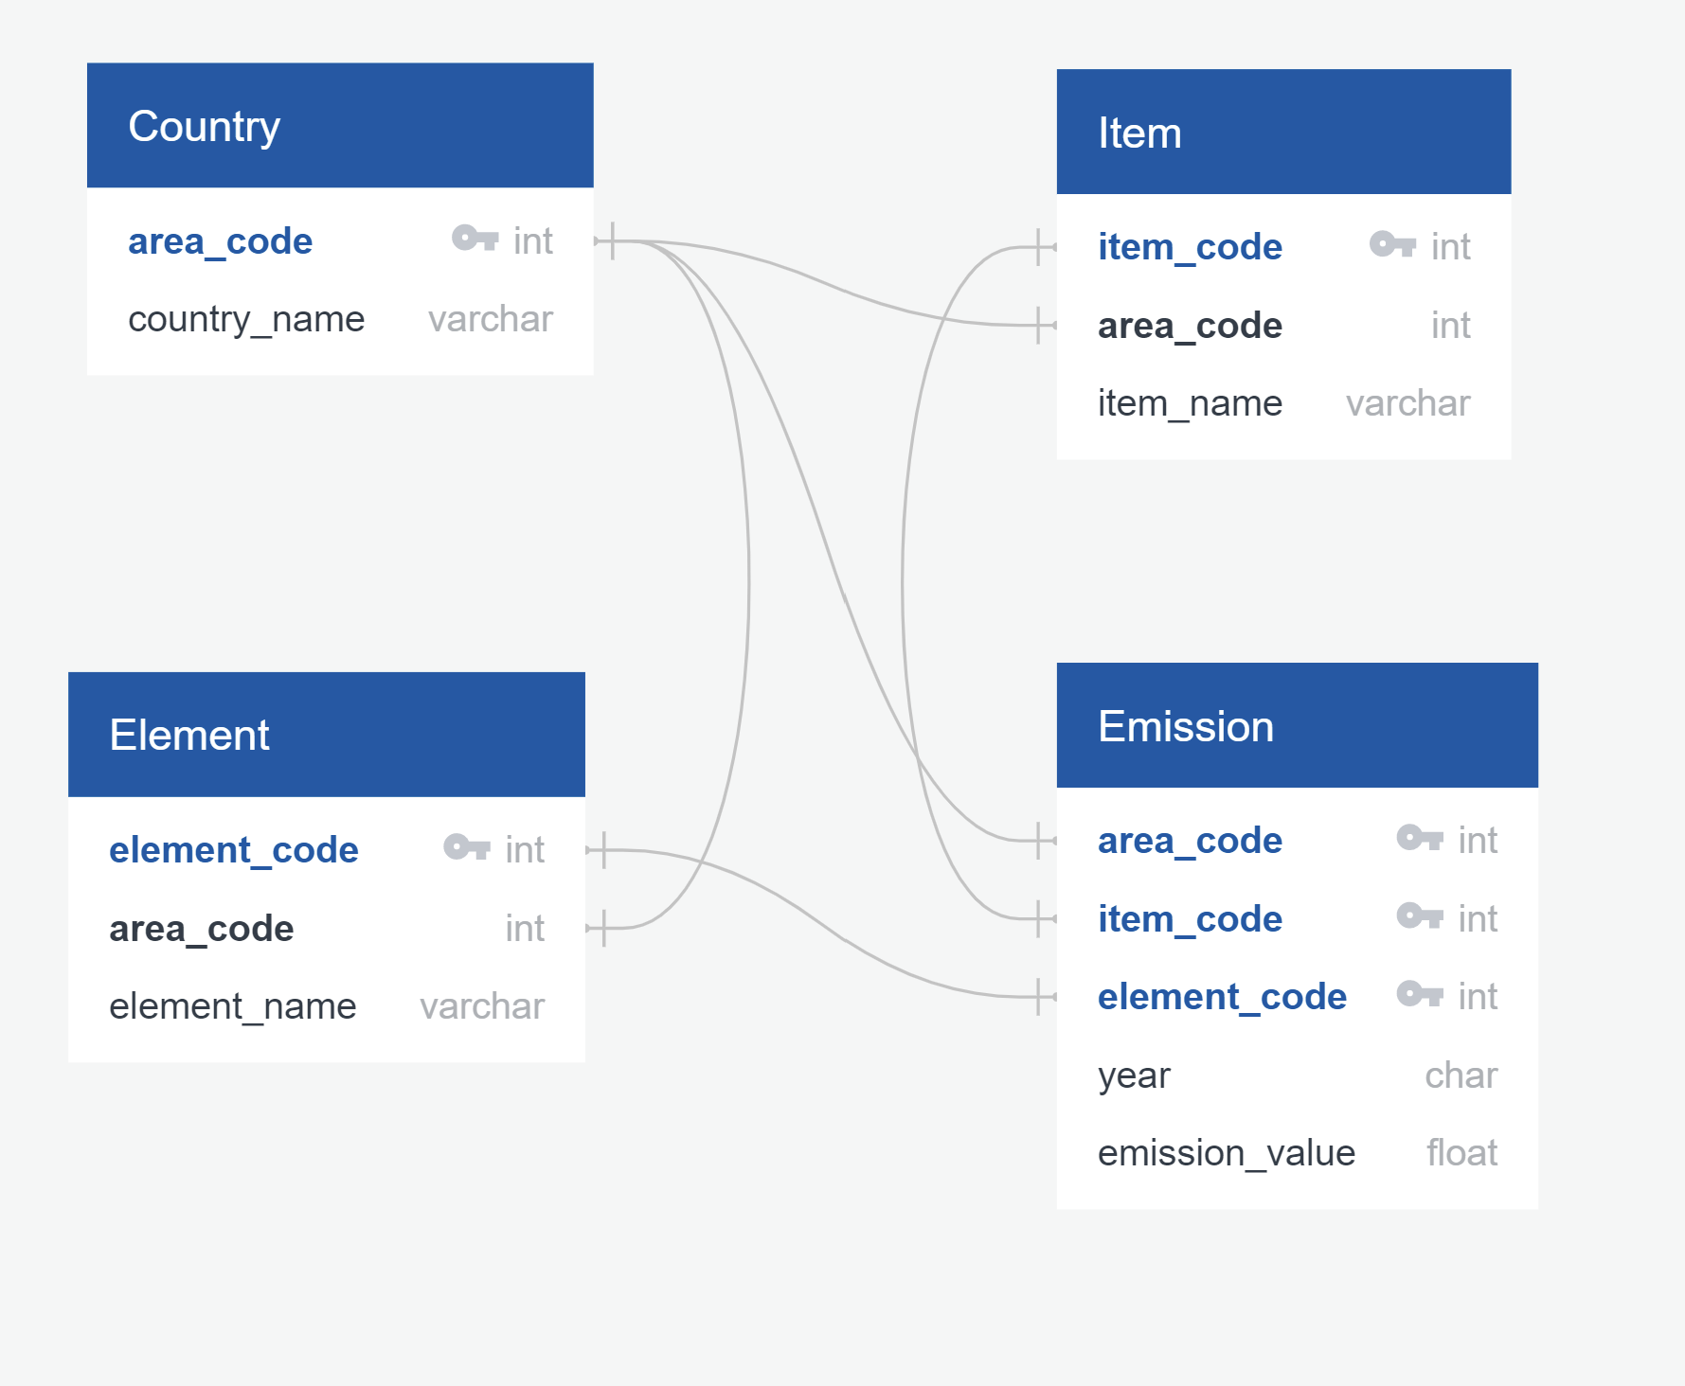
ERD

Slide 9
QUESTIONS
What are the countries with the most emissions?
What are the items and elements contributing to emissions?
How has emission value changed over two decades?
Is there any relationship between emission and population?
Is there any relationship between development and emission?
What are the special measures taken by the least contributing countries towards emissions?
How can we categorize the countries by the range of emissions into red, yellow, and green zones?
How has emission increased or decreased over past 20 years?
How can Machine learning algorithms be used to predict the emissions for the future?
Which Machine Learning Model should be selected for the data analysis? Why?

Slide 10
TOOLs & SOFTWARE
Python
Most popular programming Language
Code easy to write
Performs complex calculations quickly
Handles large Data Files
Help to access, process, and manipulate data
ETL
To get consistent Data
Reduce the time to do analysis with a robust data

Slide 11
AWS
Database deals with organized storage of data.
Easily accessible data for all team members with updated version.
The four basic functions of persistent data storage are Create, Read, Update, and Delete (CRUD)
Postgres
Import and export csv files, create tables with SQL

Slide 12
Source of Data:
We have used the data from data source of Food and Agriculture Organization of United Nation. This data is reliable and easily available.
https://www.fao.org/faostat/en/#data/GT
EIA - Greenhouse Gas Emissions - Nitrous Oxide Emissions

Slide 13
Data Exploration
United Nation’s Several websites specially Food and Agriculture Organization.
Different Government Websites
Research papers related to Emissions

Slide 14
Data Analysis
As lot of work is done on CO2 analysis,we chose to analyze more on N2O , CH4, and other emissions.
Country-wise,element-wise emissions are analyzed through bar, pie, line graph and charts.
Heat maps are created according to population and total emission.
Machine learning models are created to see the trends through linear regression model .
Exploring more options for the final project.

Slide 15
Interactive Dashboard
Will create interactive dashboard with country code,element code,item code using javascript.
Bar chart, bubble chart and gauge chart with N2O ,CH4, CO2 emission, will be created for better understanding of the project.

