Slide 1
Team-3 Capstone Project Presentation
Team Members
Praveen kumar
Suneel Padala
Priyanshu Garg
Nishant Kumar
Pujan Ghelani

Slide 2
Problem Statement
Validate transcript and certificates without any centralized authority.
There can be many different entities like Student, Colleges, Boards, Private organizations etc.
We want to provide a decentralized credential verification system with inherent trust powered by Blockchain and Smart contracts.

Slide 3
Why to choose Decentralized system
Transparency
Privacy
Efficiency
Security
No single point failure

Slide 4

Component Diagram
Issuer
Private Organization
Issue Claim
Present Claim
Regulated Entity
Private Entity
View Transcript
View Certificate
Issue Certificates/Transcript
Validate Claim
Public Ledger

Slide 5
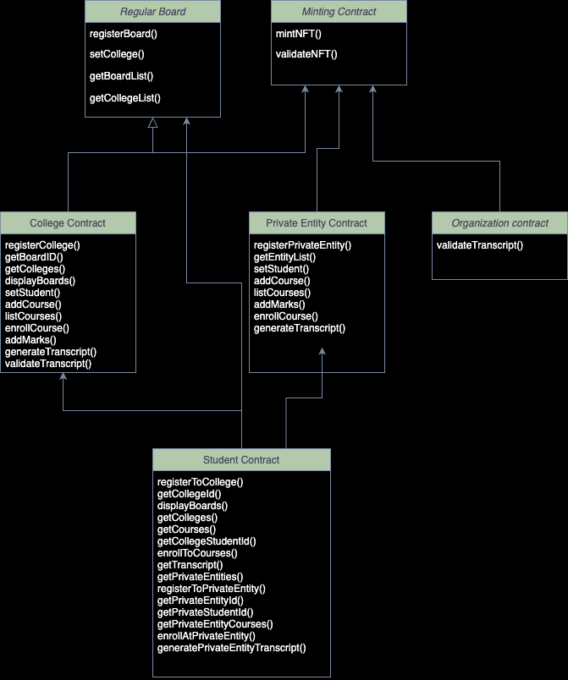
Class Diagram

Slide 6
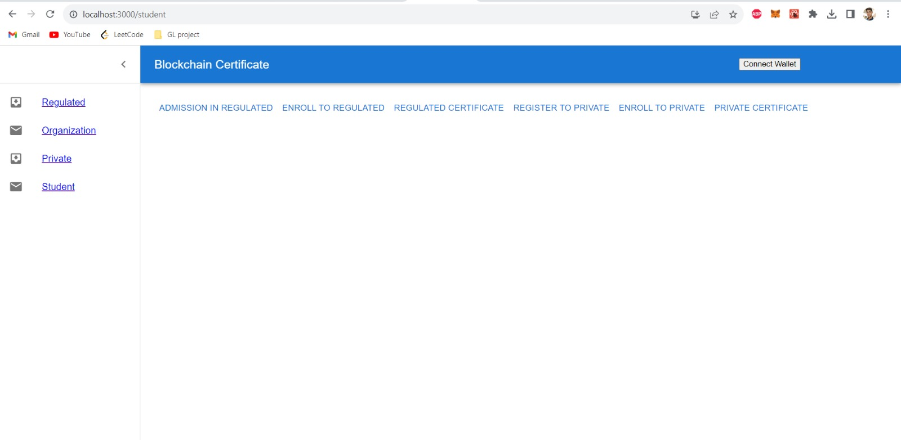

Regulated entity and Student Dashboard UI

Slide 7
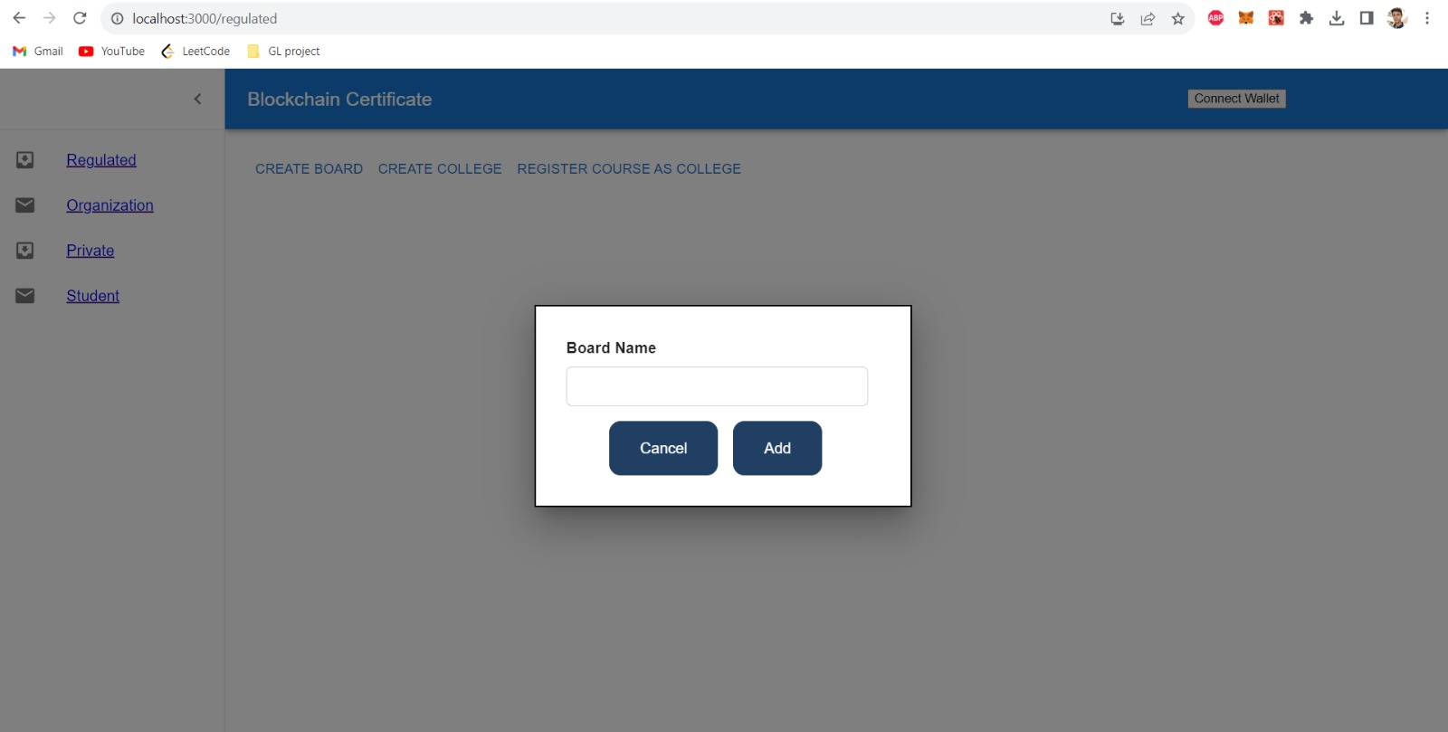
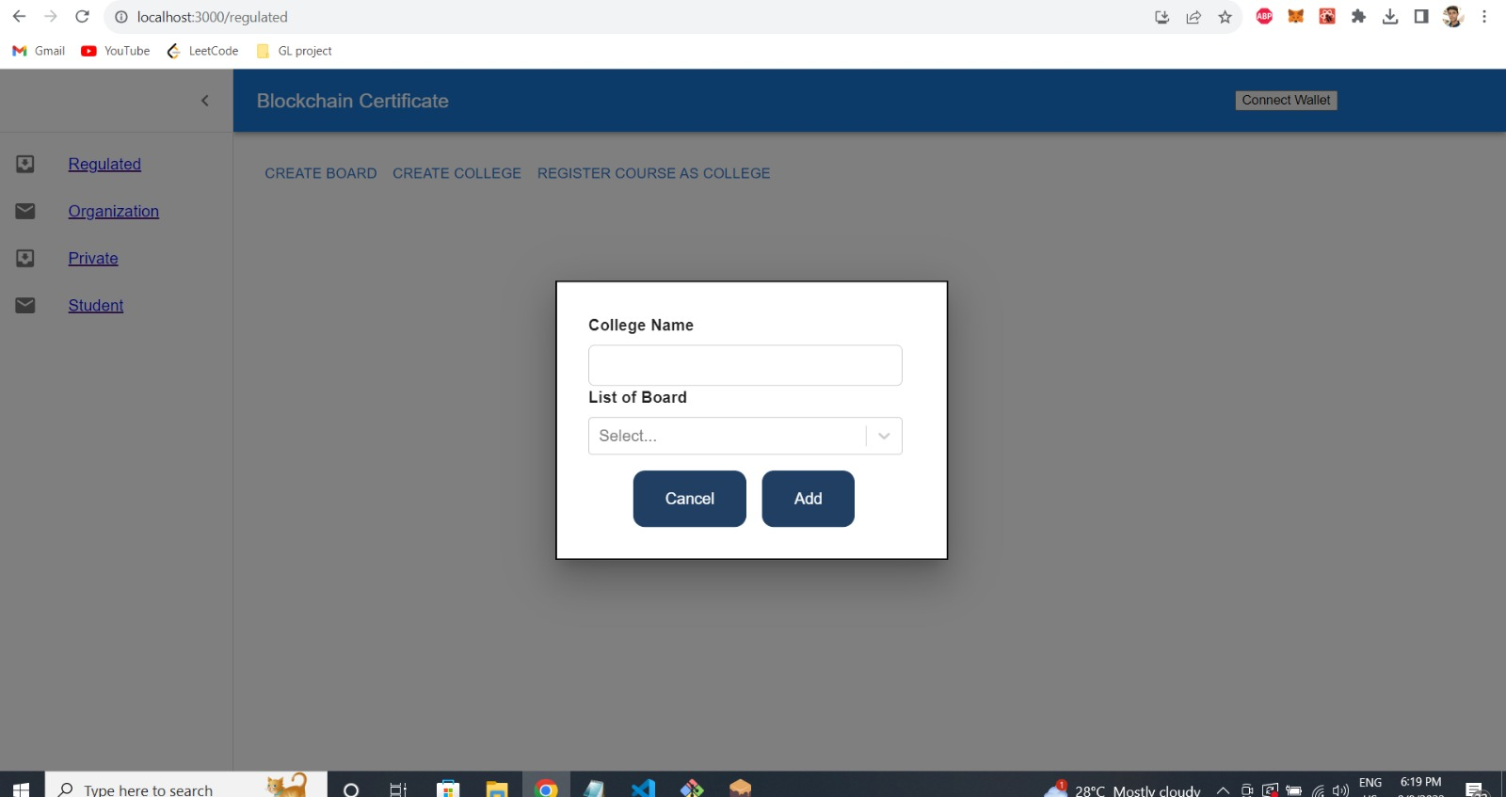
Register Board and Colleges

Slide 8
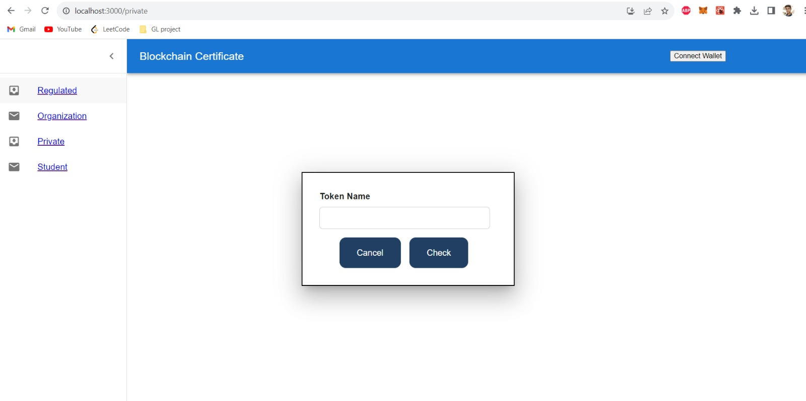
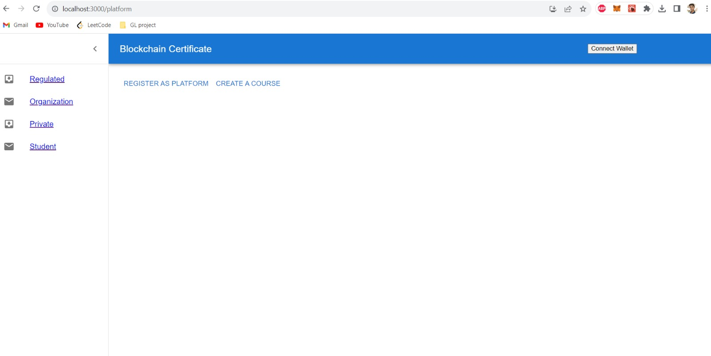
Organization and Private Entity Dashboard

Slide 9
GITHUB Repository Link
https://github.com/Praveen-1243/GL-Project

Slide 10


