Slide 1
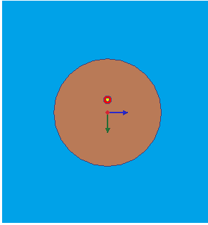
W
Circular patch
Coaxial feed point
L
r
Origin

Slide 2
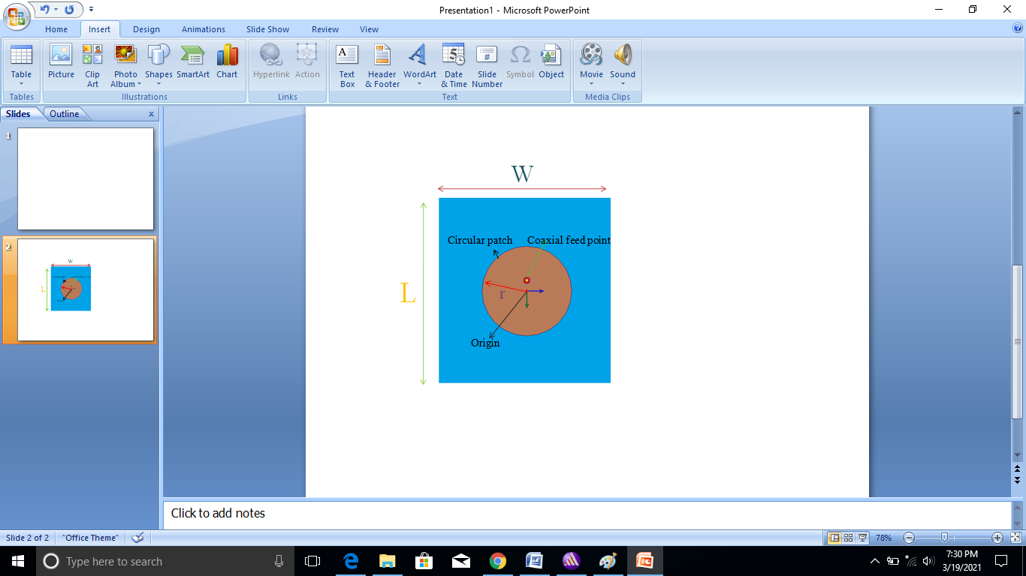
RT/Duroid 5880mm substrate material
Ground plane
z
y
x
(a)
(b)

Slide 3
RT duroid 5880mm substrate material
Ground plane
z
y
x
(a)
(b)

Slide 4
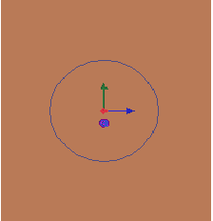

Slide 5
Ground plane
RT duroid 5880mm substrate material

Slide 6
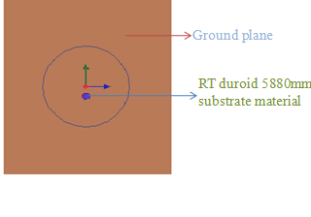
(b) Back view

Slide 7
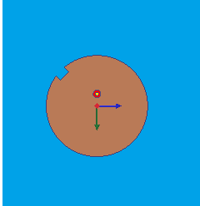

Slide 8
w
Slot creation
Coaxial feed point
L
r
Circular patch
origin
z
y
x

Slide 9
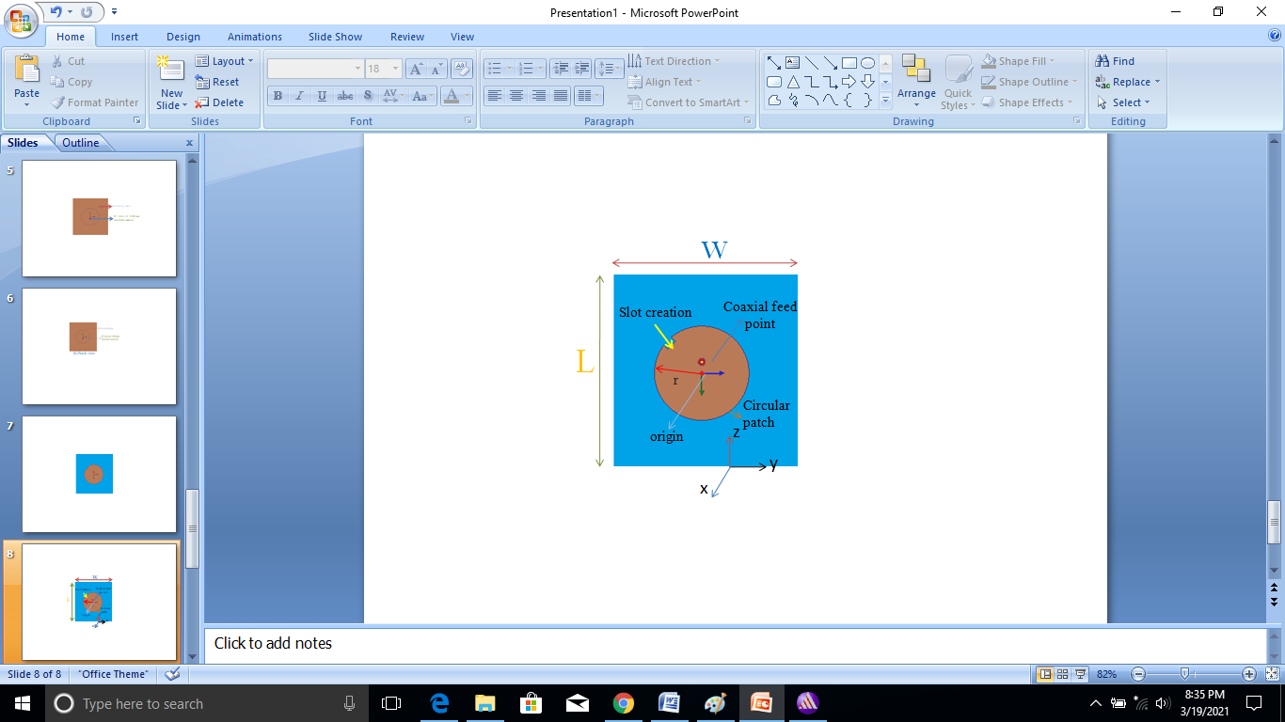
RT duroid 5880mm substrate material
Ground plane
(a)
(b)

Slide 10
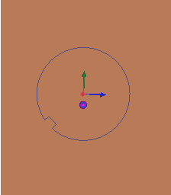

Slide 11
Ground plane
RT duroid 5880mm substrate material

Slide 12
This is with slot

Slide 13
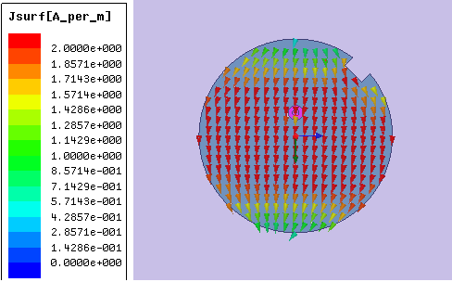
0 RHCP

Slide 14
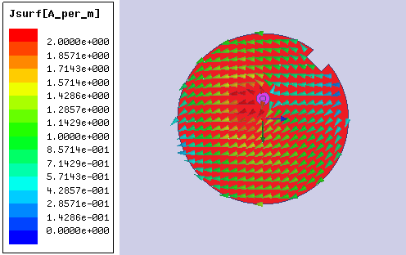
90

Slide 15
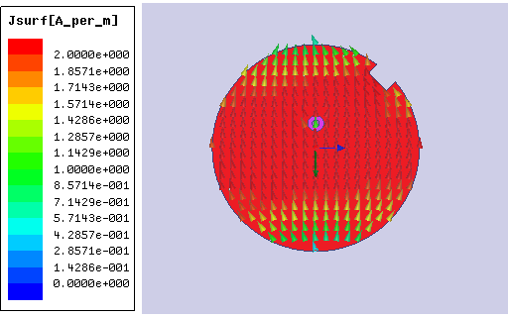
180

Slide 16
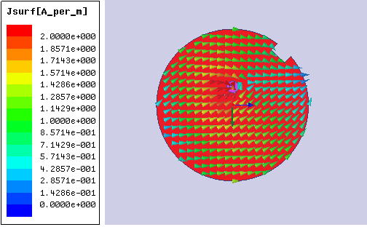
270

Slide 17
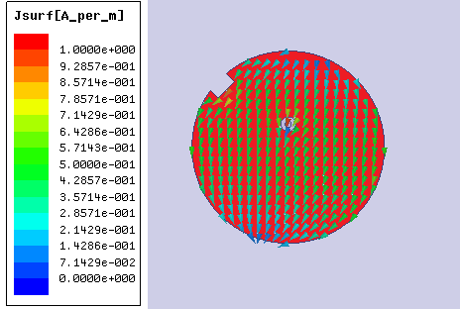
0 LHCP

Slide 18
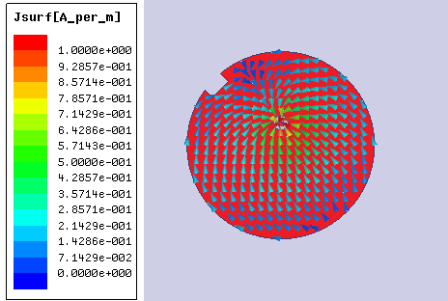
90

Slide 19
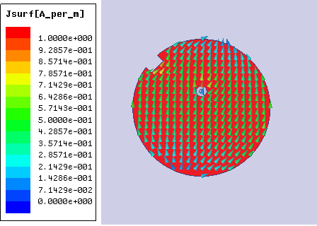
180

Slide 20
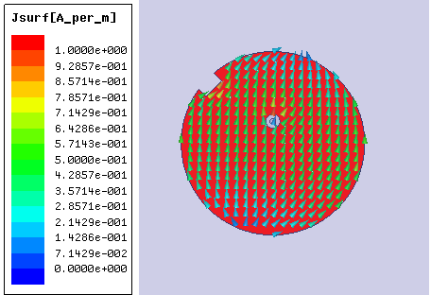
270

Slide 21
This is without slot

Slide 22
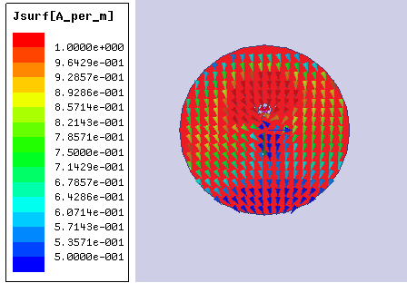
0 LHCP

Slide 23
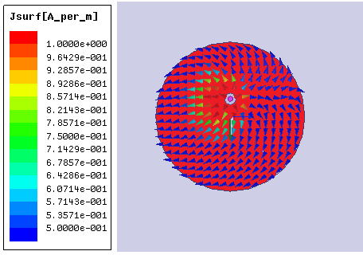
90

Slide 24
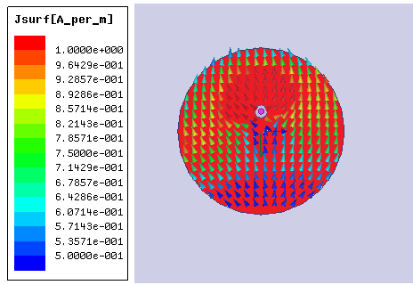
180

Slide 25
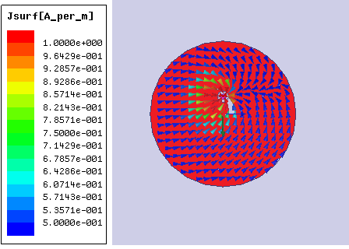
270

Slide 26

0 RHCP

Slide 27
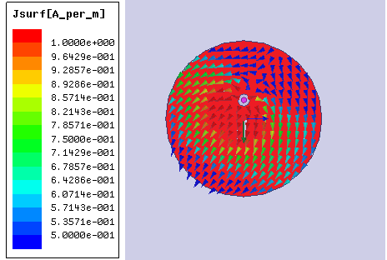
90

Slide 28

180

Slide 29
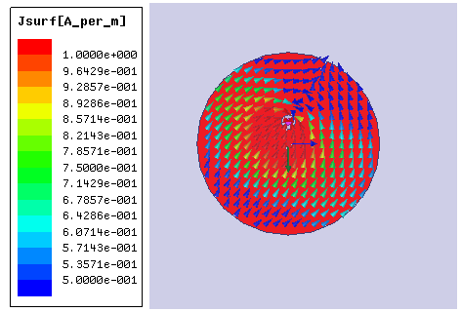
270

