Slide 1
STATISTICAL INFERENCE AND QUALITY CONTROL FOR MICROSURGERY STUDY
Swetcha Chowdary Karnati
Praveen Burra
Navya Doddapaneni

Slide 2
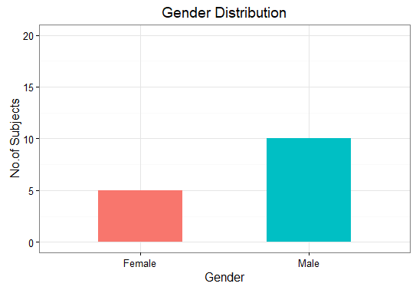
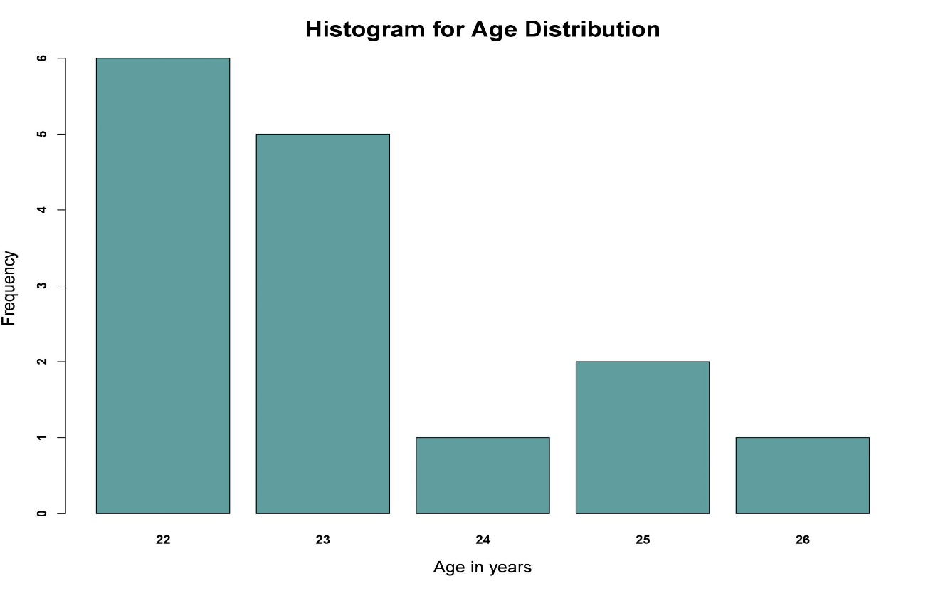
1. Biographic Data :
5 Female and 10 Male Subjects participated in the Microsurgery Study.
The subjects mainly belong to 22 years(6) and 23 years(5).
The average age of the Subjects is found out to be 23 years (approx).
The oldest person participated has 26 years.

Slide 3
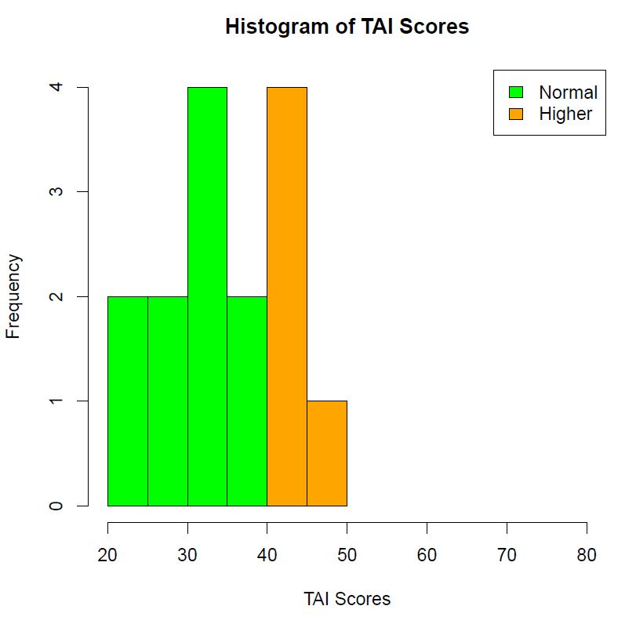
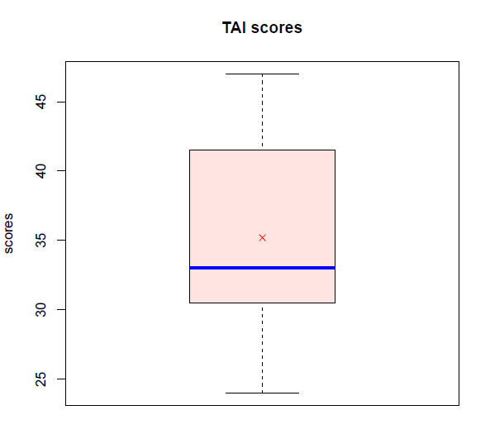
2. Trait Psychometric Data :
10 Subjects with TAI scores less than 40 and 5 with TAI scores in range of 40 and 50.
The mean of TAI scores is 35.2 and Standard Deviation is 7.0

Slide 4
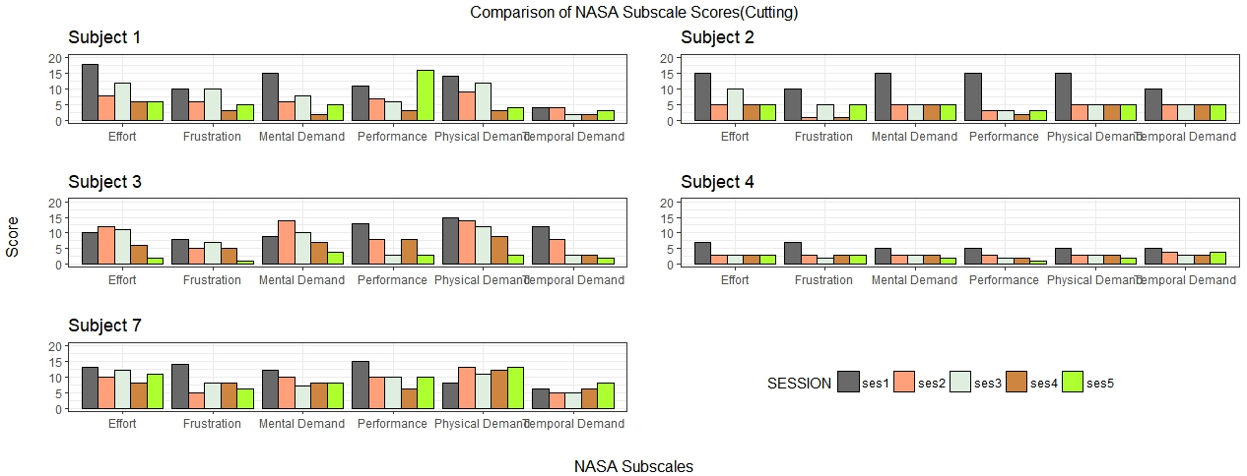
3. State Psychometric Data:

Slide 5
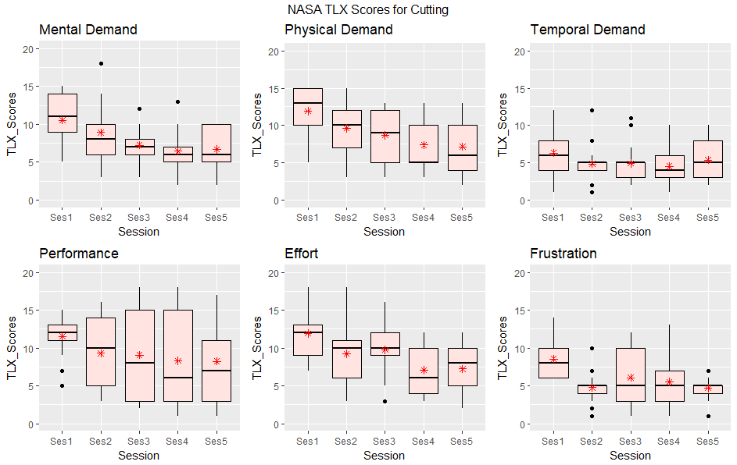
BOXPLOTS showing NASA TLX_Scores for different NASA Subscales over Sessions: Cutting

Slide 6
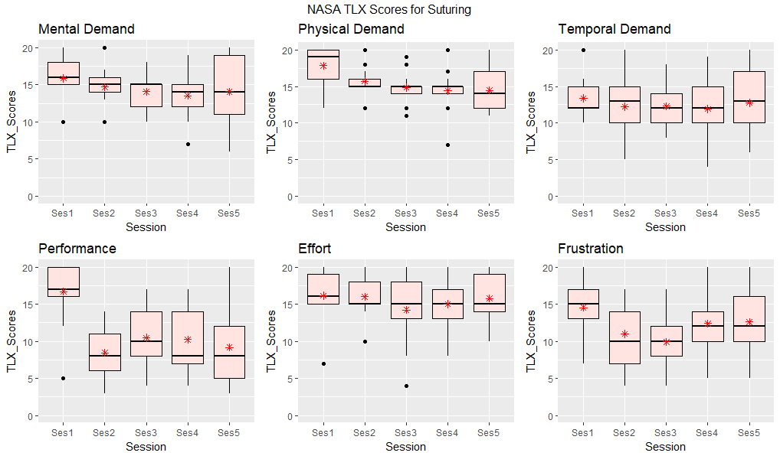
BOXPLOTS showing NASA TLX_Scores for different NASA Subscales over Sessions: Suturing

Slide 7
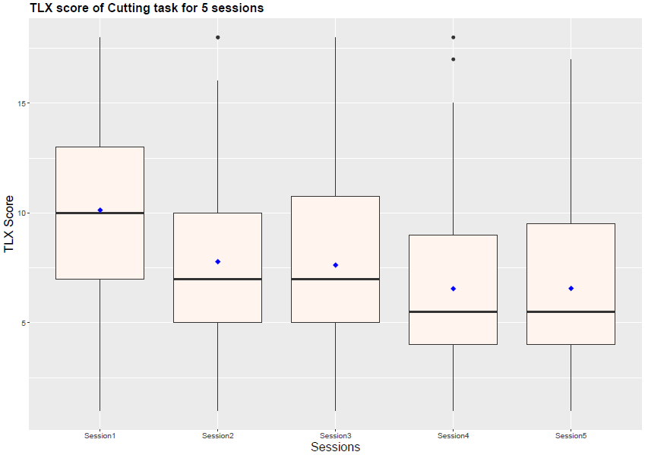
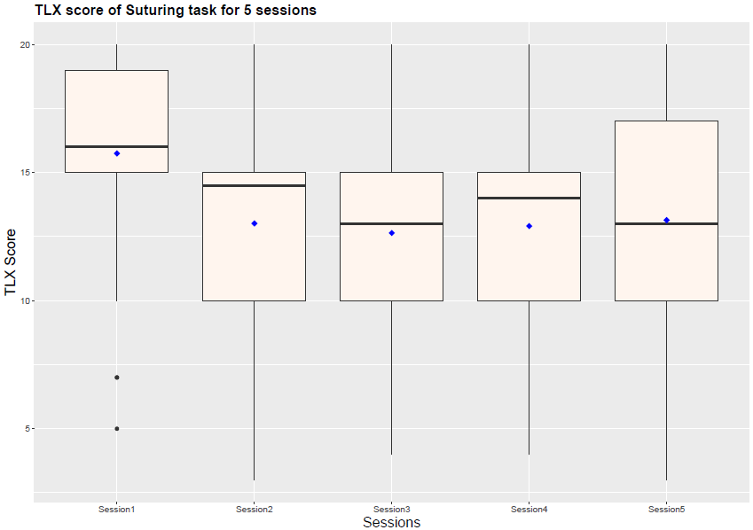
Boxplots for NASA_TLX Score over Sessions: Cutting & Suturing

Slide 8
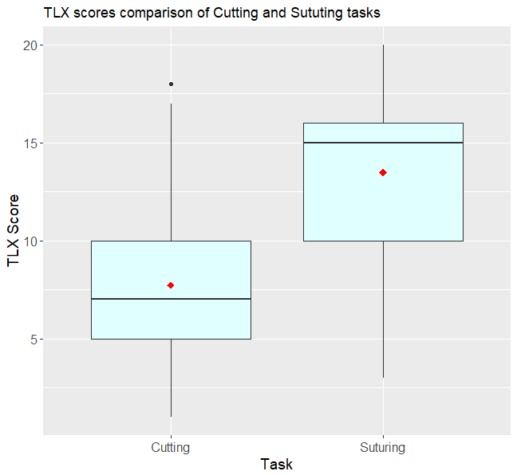
Boxplots for NASA_TLX Scores for Cutting and Suturing:

Slide 9
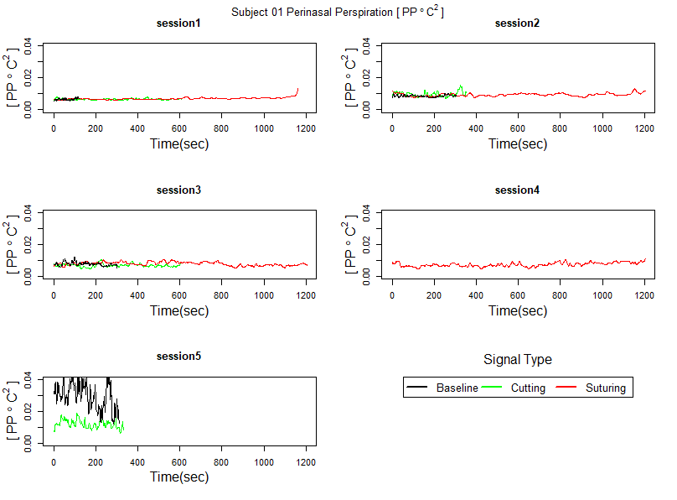
4. Perinasal Perspiration (Stress) Signal Data:

Slide 10
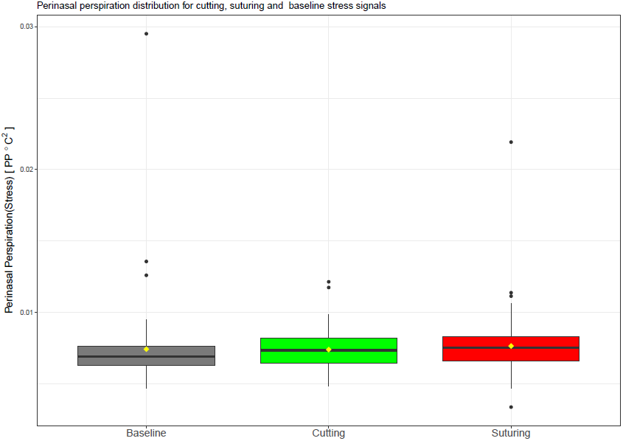
Boxplots showing distribution of different Stress Signals

Slide 11
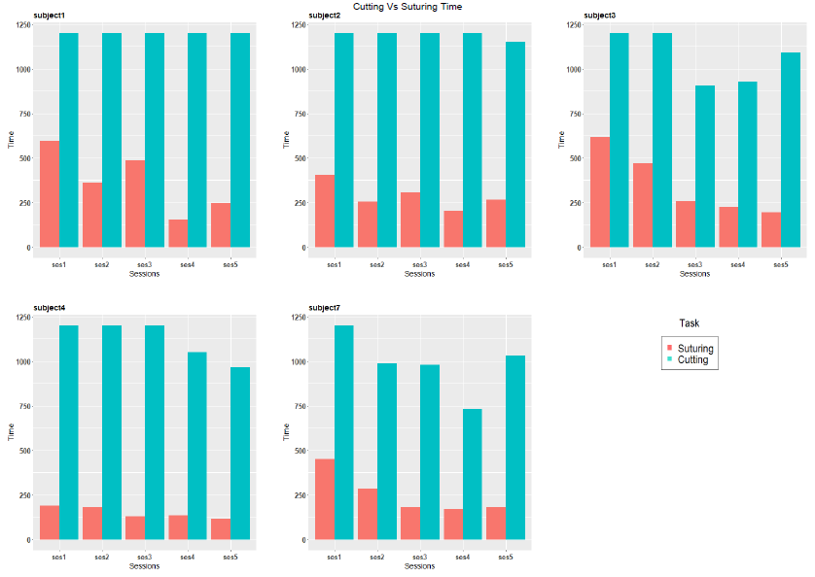
5. Performance Data:

Slide 12
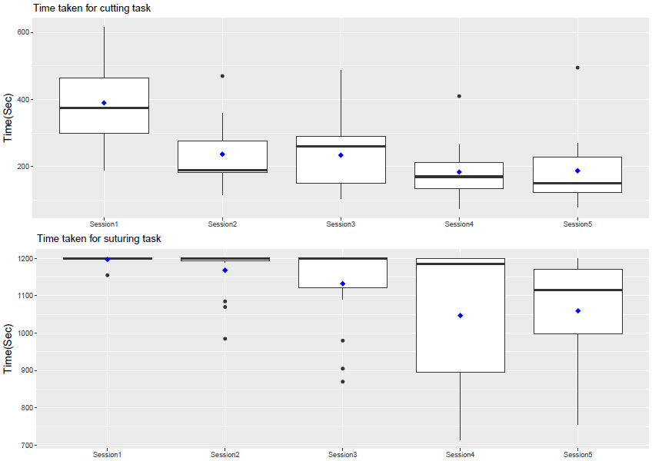
Boxplots showing Time taken for Cutting & Suturing over Different Sessions:

Slide 13
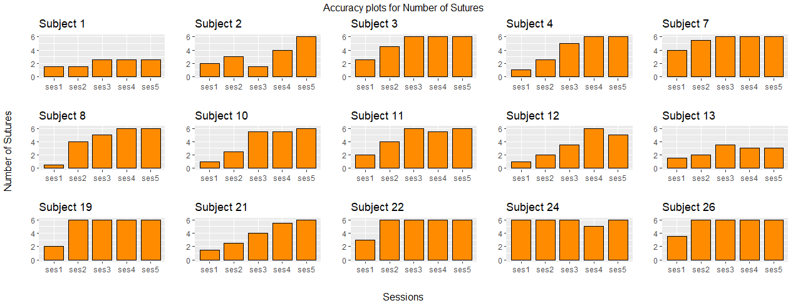
Accuracy plots for Number of Sutures:

Slide 14
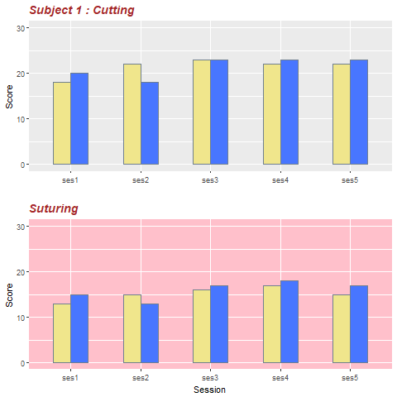
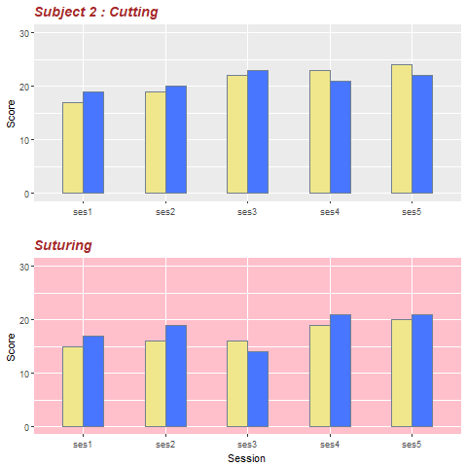
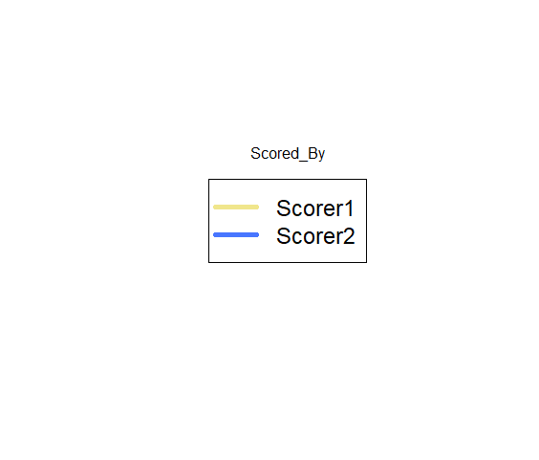
Accuracy plots for Scores over different Sessions: Cutting & Suturing

Slide 15
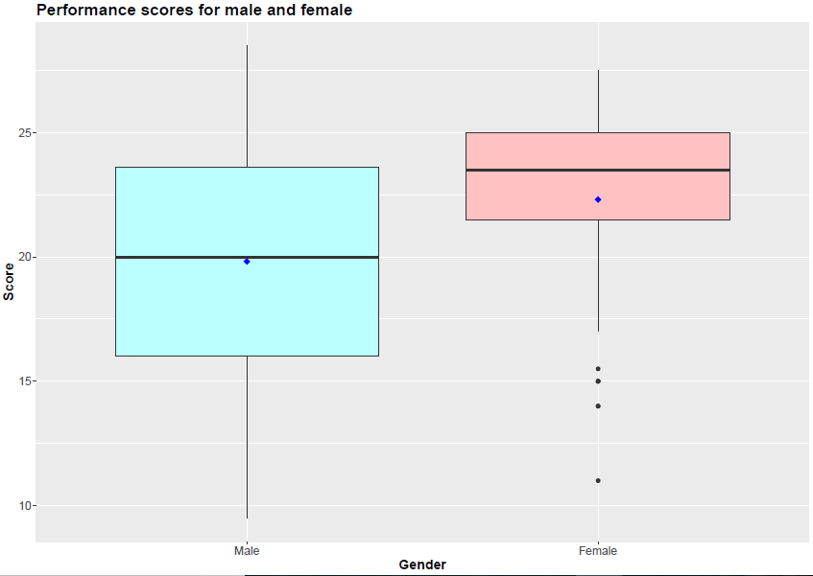
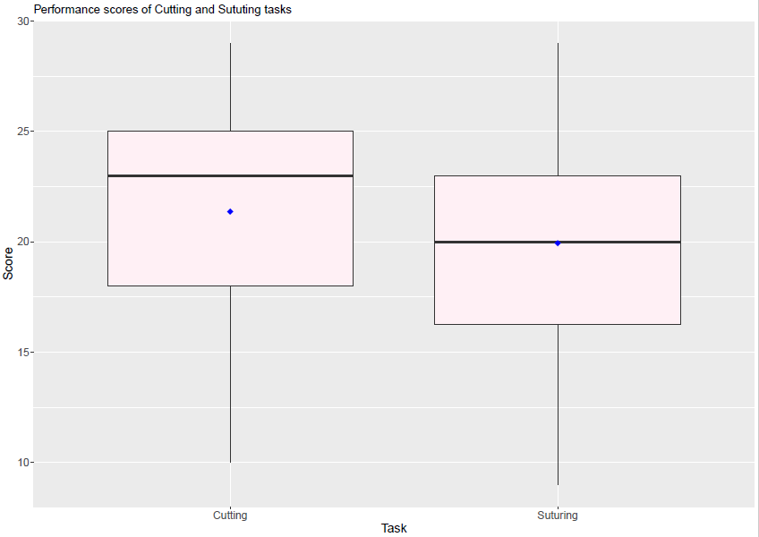
Boxplot showing Performance Scores Variation over Gender & Tasks:

Slide 16
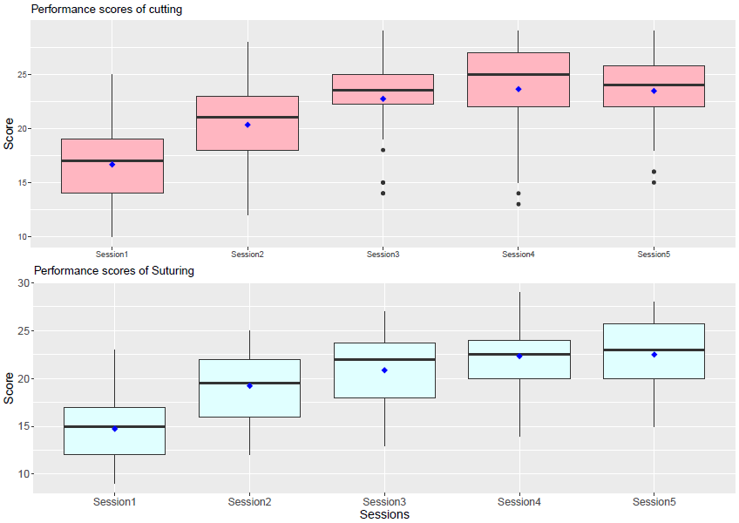
Boxplots for Performance Scores over different Sessions:

Slide 17
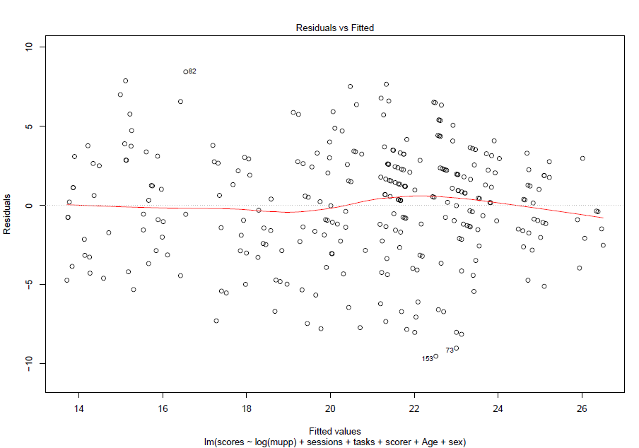
Residual plot of Linear Model:

