Slide 1


Department of Computer Science and Engineering
RAINFALL NOWCASTING AND PREDICTION USING MACHINE LEARNING
Mrs. M. Divya M.E
Asst.Professor,
Dept of CSE,
Rajalakshmi Engineering College
Praveen Kumar S (2116220701203)

Slide 2
Problem Statement and Motivation
Accurate rainfall prediction is complex due to the dynamic and non-linear nature of climatic variables. Traditional models often fail to capture localized, short-term precipitation patterns effectively. Rainfall prediction is vital for agriculture, urban planning, and disaster management. Inaccurate forecasts can result in crop failure, flooding, and water scarcity. This project leverages Random Forest regression for intelligent rainfall forecasting. Historical and real-time weather data are used for improved accuracy. The system aims to deliver timely, location-specific rainfall predictions. It supports informed decision-making and promotes climate resilience.

Slide 3
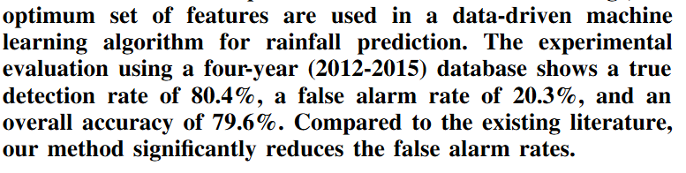
Existing System
Traditional rainfall prediction relies on statistical and numerical weather models.
These models often assume linear relationships among weather variables.
They lack adaptability to regional climate variations and short-term fluctuations.
Predictions are generally coarse, with limited spatial and temporal accuracy.
Dependence on complex simulations makes them computationally intensive.
As a result, timely and precise local rainfall forecasts remain a challenge. Accuracy of Existing System:

Slide 4
Objectives
To develop a machine learning model using Random Forest for accurate rainfall prediction.
To analyze and preprocess historical and real-time climatic data for training and testing.
To implement both single and batch prediction mechanisms for practical use cases.
To visualize forecast results for better interpretability and decision-making support.

Slide 5
Abstract
Rainfall prediction plays a critical role in agriculture, disaster management, and water resource planning. Traditional forecasting methods often lack accuracy and adaptability to local weather patterns. This project proposes a machine learning-based approach using Random Forest regression. Historical and real-time meteorological data are analyzed for training and evaluation. The system supports both single and batch prediction modes for practical deployment. Feature engineering and data preprocessing enhance model performance and reliability. Predicted results are visualized to aid interpretability and user decision-making. The aim is to deliver a robust, data-driven rainfall predictor that improves climate resilience.

Slide 6

Proposed System
The proposed system uses Random Forest regression to predict rainfall based on preprocessed historical and real-time weather data. Key atmospheric features are extracted and used to train the model for both single and batch predictions. The system includes visualizations to present accurate, localized forecasts that aid decision-making in agriculture and disaster management.
Accuracy of Existing System:

Slide 7
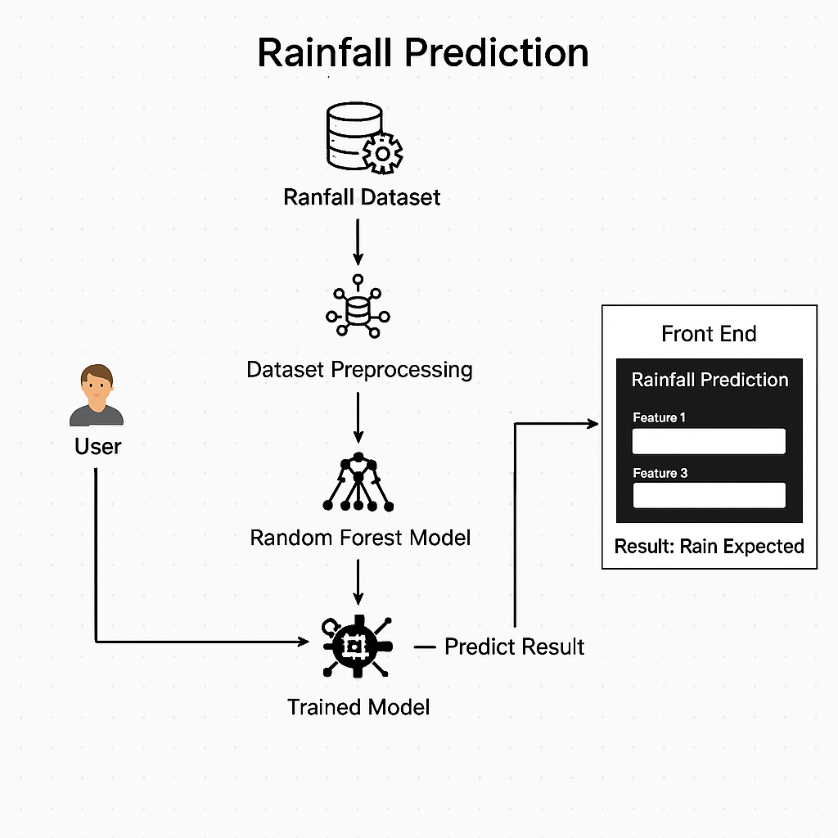
System Architecture

Slide 8
List of Modules
1) Data Collection & Preprocessing Module Gathers historical and real-time weather data, performs cleaning, normalization, and feature selection.
2) Model Training & Validation Module Implements Random Forest regression to train on processed data and evaluates model performance.
3) Prediction Module Enables single and batch rainfall predictions based on new input data.
4) Visualization & User Interface Module Displays prediction results graphically for easy interpretation and decision support.

Slide 9
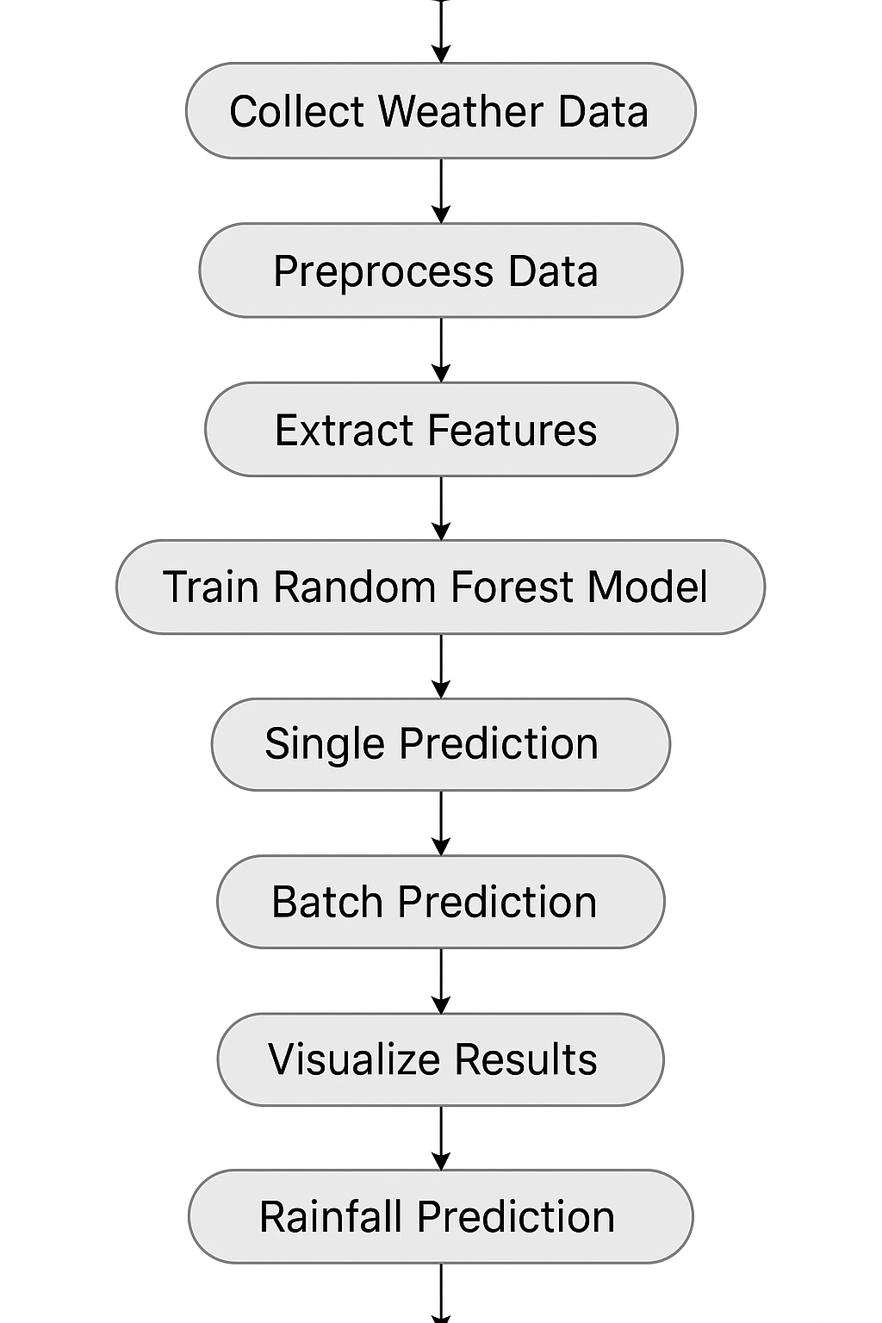
Functional Description for each modules with DFD and Activity Diagram

Slide 10
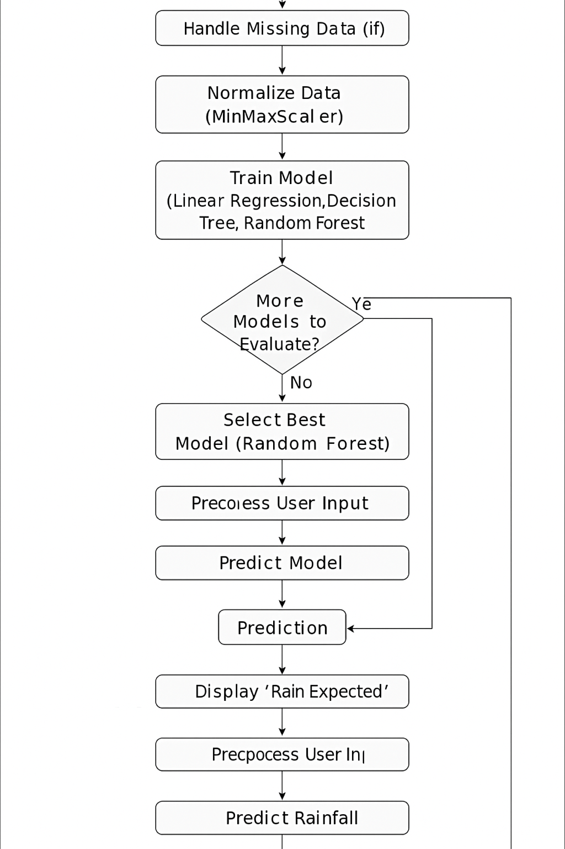
Functional Description for each modules with DFD and Activity Diagram

Slide 11
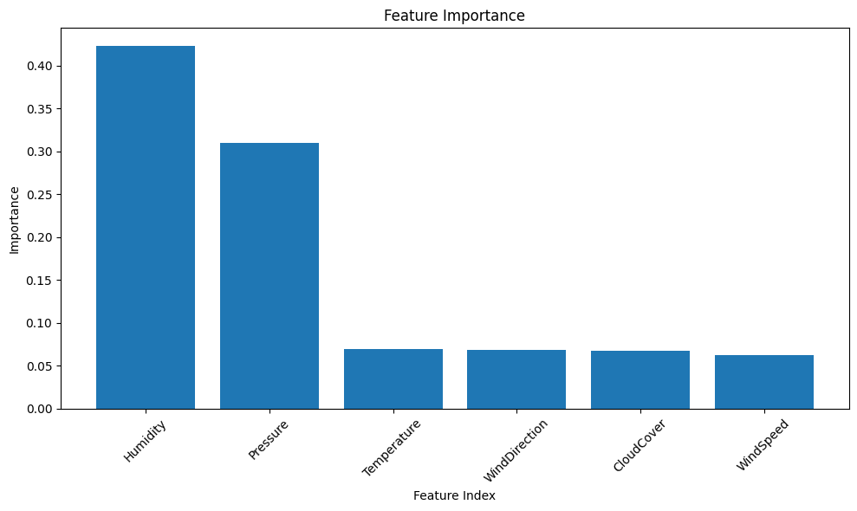
Implementation & Results of Module

Slide 12
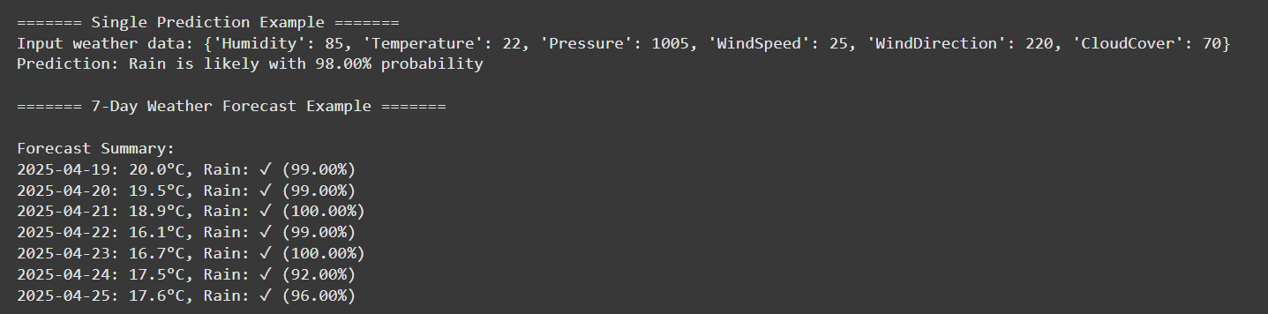
Implementation & Results of Module

Slide 13
Conclusion & Future Work
The proposed system successfully utilizes Random Forest regression for accurate rainfall prediction. It demonstrates strong performance using historical and real-time atmospheric data. The model aids decision-making in agriculture, urban planning, and disaster preparedness. Visualization of results enhances user interpretability and practical usability. In the future, the system can be extended using deep learning models like LSTM or CNN. Integration with IoT sensors can enable real-time data collection and alerts. A mobile or web-based interface can improve accessibility and user engagement. Cross-regional testing and model adaptation can further improve accuracy and reliability.

Slide 14
References
1)Archana Raut, Dr. Dipti Theng, Sarika Khandelwal (2023). Random Forest Regressor Model for Rainfall Prediction. ResearchGate.
2) I. Prathibha, D. Leela Rani (2025). Rainfall Forecasting in India Using Combined Machine Learning Approach and Soft Computing Techniques: A Hybrid Model. International Journal of Computational and Experimental Science and Engineering.
3) Anuradha R., S. R. Biradar, S. R. Biradar (2024). A Indian Rainfall Prediction Using Machine Learning Algorithms: A Comparative Study. ResearchGate.

Slide 15
Thank You

