Slide 1






Introduction to Robotic Process Automation
ORDER TRACKER BOT
220701203
Praveen Kumar S
Dr.N.Durai Murugan
Computer Science and Engineering

Slide 2
Abstract
The Order Tracker Bot is a virtual assistant designed to streamline order management and improve customer experience. It provides real-time updates on order statuses, including dispatch, transit, and delivery, accessible through email. Users can track shipping progress, receive estimated delivery times, and customize notifications for specific updates, such as delivery windows or location alerts. By automating order inquiries and reducing response times, the bot helps businesses enhance transparency and customer satisfaction. Additionally, it offers insights into potential delays and suggests solutions to optimize delivery processes. Suitable for e-commerce platforms and logistics providers, the Order Tracker Bot simplifies tracking and improves efficiency for both businesses and customers.
Department of Computer Science and Engineering
Rajalakshmi Engineering College
2

Slide 3
Need for the Proposed System
The Order Tracker System stands out from other tracking solutions by offering a more detailed and user-centric approach to delivery updates. Unlike traditional systems that provide limited information, this advanced tracker ensures users are informed at every possible stage of the delivery process. From order confirmation and packaging to dispatch, transit, and final delivery, the system offers timely notifications that keep users updated in real-time.
Its ability to provide granular updates, such as when an order is being processed, handed over to the courier, or delayed due to unforeseen circumstances, creates a level of transparency that fosters trust and confidence. Additionally, the system allows users to customize notifications, choosing to receive updates through their preferred channels, such as email,
Department of Computer Science and Engineering
Rajalakshmi Engineering College
3

Slide 4
Advantages of the Proposed System
Enhanced Transparency and Customer Experience: The system provides real-time updates at every stage of delivery, ensuring users are always informed, reducing uncertainties, and fostering trust.
Operational Efficiency and Business Advantage: Proactive notifications reduce customer support queries, streamline logistics, and give businesses a competitive edge by offering superior tracking capabilities.
Department of Computer Science and Engineering
Rajalakshmi Engineering College
4

Slide 5
Advantages of the Proposed System
3. Reduced Customer Support Load:
With proactive notifications, the system minimizes the need for customers to reach out to support teams for status updates, reducing the workload on help desks and improving overall efficiency.
4. Customizable Notifications:
Users can choose how and when they want to receive updates, tailoring the system to their preferences and making the experience more convenient and user-friendly.
Department of Computer Science and Engineering
Rajalakshmi Engineering College
5

Slide 6
Main Objective
Real-Time Order Updates.
Enhanced Customer Experience.
Proactive Notifications.
Multi-Channel Accessibility.
Reduced Customer Support Dependency.
Customization and Personalization.
Operational Efficiency.
Department of Computer Science and Engineering
Rajalakshmi Engineering College
6

Slide 7
Proposed solution
Order Tracker Bot:
The Order Tracker Bot will provide real-time updates on order status, from confirmation to delivery, through multiple channels like chat, email, and SMS. Key features include:
Real-Time Tracking: Instant updates at each stage of the delivery process.
Multi-Channel Communication: Accessible across different platforms for user convenience.
Customizable Alerts: Users can personalize notifications for delivery windows and updates.
Proactive Notifications: Automatic alerts for potential delays or order changes.
User-Friendly Interface: Easy to use for all customers, regardless of technical expertise.
Seamless Integration: Direct connection to backend systems for accurate, up-to-date information.
Department of Computer Science and Engineering
Rajalakshmi Engineering College
7

Slide 8
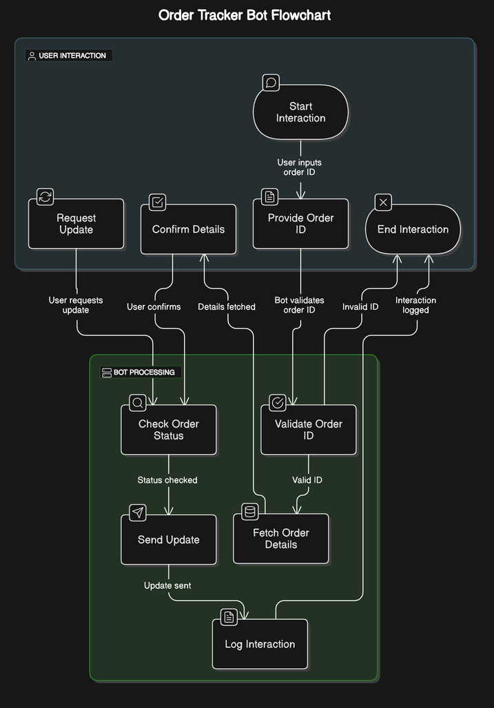
Flow diagram
Department of Computer Science and Engineering
Rajalakshmi Engineering College
8

Slide 9
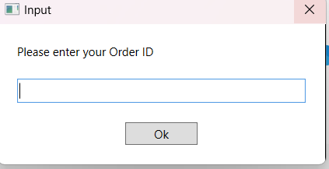
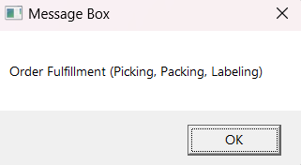
OUTPUT
Department of Computer Science and Engineering
Rajalakshmi Engineering College
9

Slide 10
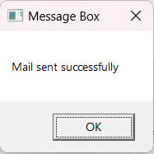
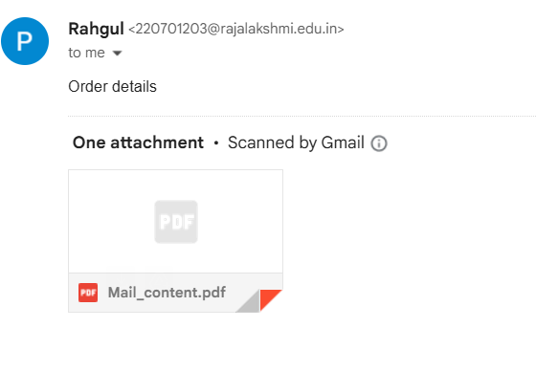

Slide 11
Conclusion
The Order Tracker Bot offers a comprehensive solution to enhance the order tracking experience for both businesses and customers. By providing real-time, transparent updates at every stage of the delivery process, it ensures customers are always informed, reducing uncertainty and improving satisfaction. With features like multi-channel communication, customizable notifications, and proactive alerts, the bot offers a personalized and convenient tracking experience. Its seamless integration with backend systems ensures accurate and timely updates, while its user-friendly interface makes it accessible to everyone.
Department of Computer Science and Engineering
Rajalakshmi Engineering College
10

Slide 12
Thank You

