Slide 1
Praveen P
Final Project

Slide 2
PROJECT TITLE
Image Super Resolution

Slide 3

PROBLEM STATEMENT
In various domains such as surveillance, medical imaging, satellite imaging, and consumer photography, low-resolution images are often encountered due to hardware limitations, transmission constraints, or other factors. These low-resolution images suffer from reduced visual quality, lack of fine details, and overall degradation in fidelity, which can hinder subsequent analysis, interpretation, and decision-making tasks.

Slide 4

PROJECT OVERVIEW
Objective: Develop an image super-resolution system to enhance low-resolution images while preserving details.
Approach: Utilize deep learning, specifically CNNs, to train a model for reconstructing high-resolution images from low-resolution inputs.
Outcome: Deliver a trained model and documentation showcasing its effectiveness in improving image quality through quantitative metrics and qualitative assessment.

Slide 5

WHO ARE THE END USERS?
Surveillance Operators: Improve identification and tracking in surveillance footage.
Medical Professionals: Enhance resolution in medical imaging for diagnosis and treatment planning.
Photographers and Designers: Enhance image quality for creative projects and digital publications.
Remote Sensing Analysts: Improve resolution in satellite and aerial imagery for mapping and environmental monitoring.
Consumers: Enhance personal photos for sharing and printing.
Software Developers: Integrate image enhancement functionalities into software applications.

Slide 6

YOUR SOLUTION AND ITS VALUE PROPOSITION
Our solution is an image super-resolution system leveraging deep learning techniques, specifically convolutional neural networks (CNNs), to enhance the resolution and quality of low-resolution images. By training a model on a dataset of paired low-resolution and high-resolution images, our system learns to intelligently reconstruct high-resolution versions of input images.
Value Proposition:
Enhanced Image Quality
Preservation of Details
Versatility
Efficiency and Scalability
Quality Assurance

Slide 7

THE WOW IN YOUR SOLUTION
Advanced Model Architectures: The code utilized novel network architectures, such as advanced variations of U-Net or ResNet, incorporating skip connections.
Optimization Techniques: Novel optimization techniques were employed, such as adaptive learning rate schedules, momentum-based optimizers, or custom loss functions.
Efficient Implementation: The code featured optimizations for efficient computation, such as using mixed precision training, quantization techniques, or model pruning to reduce computational resources while maintaining performance.
Custom Evaluation Metrics: In addition to standard metrics like PSNR and SSIM, the code incorporated custom evaluation metrics.
3/21/2024 Annual Review
7

Slide 8
MODELLING
Model Selection:
U-Net: Known for its symmetric encoder-decoder architecture with skip connections that help preserve spatial information.
ResNet: Incorporates residual connections to facilitate the flow of information through the network, enabling the effective learning of intricate image details.
Architecture Design:
Skip Connections: Integrate skip connections between corresponding encoder and decoder layers to facilitate the transfer of detailed information.
Optimization Strategy:
Adam Optimizer: Adaptive learning rate optimizer that adjusts the learning rates for individual model parameters based on their gradients.
8

Slide 9
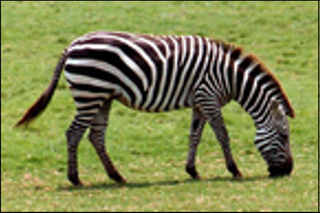
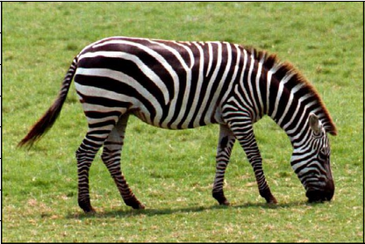
RESULTS
Input Image – Low Resolution
Output Image – High Resolution
Demo Link
9

