Slide 1

Zomato Restaurants Analysis
Data-Driven Restaurant Expansion Strategy
Praveen Raj S

Slide 2

行业PPT模板http://www.1ppt.com/hangye/
INTRODUCTION
The global restaurant industry is dynamic and competitive, with customer expectations constantly shifting.
As a key player, Zomato aims to use data insights to make informed decisions about market expansion and service improvements.
This project analyzes real-world restaurant data to uncover valuable trends and support strategic planning to open newer restaurants across the globe.

Slide 3

行业PPT模板http://www.1ppt.com/hangye/
OBJECTIVES
Identify countries and cities where there is less competition and a greater chance of new restaurant openings.
Analyze market trends like pricing, customer ratings, online delivery, and table booking preferences.
Examine the impact of price and cuisine varieties on customer ratings.
Deliver data based suggestion to open newer restaurants.

Slide 4

行业PPT模板http://www.1ppt.com/hangye/
Zomato Restaurants Data
Countries Covered: 15 countries across the globe
Cities Included: 141 cities spanning these countries
Total Number of Restaurants: 9,551 restaurants listed across 15 countries and 141 cities
Variety of Cuisines Offered: 1,826 different cuisines reflecting global food diversity
Opening Date: Shows when the restaurant started operations.
Online Delivery: Indicates whether online food delivery is available.
Table Booking: Shows if table reservations can be made.
Average Cost for Two: Approximate cost for two people dining together.
Customer Ratings: Reflects customer feedback on a scale(1-5)
Price Range: Categorizes restaurants into affordability levels.(1-4)

Slide 5
行业PPT模板http://www.1ppt.com/hangye/
Data Cleaning
Filled missing values in the Cuisines column (USA) with "American" based on frequency
Replaced zero values in Average_Cost_for_two with country-wise average
Corrected the currency for Philippines from "Botswana Pula (P)" to "Philippine Peso (₱)"
Converted ‘Datekey_opening’ to standard date format (DD-MM-YYYY)
Extracted Year from the converted date column
Created a new column: Average_Cost_for_two (INR)

Slide 6

行业PPT模板http://www.1ppt.com/hangye/
Methodology
Data Preparation: Cleaned the dataset by removing duplicates, fixing missing values, and standardizing inconsistent entries.
Data Enhancement: Applied VLOOKUP to map country names using country codes, and extracted new fields like the year of opening from date values.
Data Formatting: Reformatted the 'Date Key Opening' using TEXT and DATE functions; derived year using the YEAR function for yearly trend analysis.
Trend Analysis to study restaurant growth over time.
Descriptive Statistics for ratings, votes, and average costs
Correlation Analysis to evaluate the impact of price, rating, and delivery

Slide 7
行业PPT模板http://www.1ppt.com/hangye/
Methodology
Excel Tools & Functions Used:
Pivot Tables for summaries by country and city
Conditional Formatting to highlight high/low performers
String Functions for customizing price info (e.g., ₹500)
Logical Functions like IF, AND, OR to filter insights
Array Formulas for counting based on multiple conditions
Visualization : Created charts such as bar graphs, pie charts, scatter plots, and trend lines to clearly present insights and support recommendations.

Slide 8
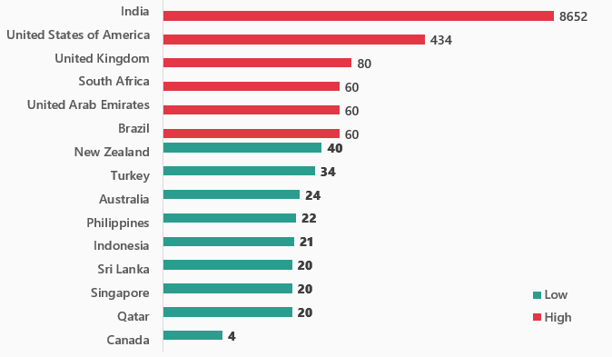
Identifying Potential Markets
Total Restaurants per Country
Red bars are highly competitive markets
Green bars are Low competitive markets
India & USA show high competition
Canada, Qatar, Singapore, Sri Lanka, Indonesia, Philippines, Australia, Turkey, and New Zealand have very low competition. So, they are the potential markets.
Low-competitive markets offer potential for:
The advantage of being the first.
Reduced expenses for marketing and entry.
Simpler acquisition of customers.
Growth and brand awareness can be accelerated by strategically concentrating on low competitive markets.

Slide 9
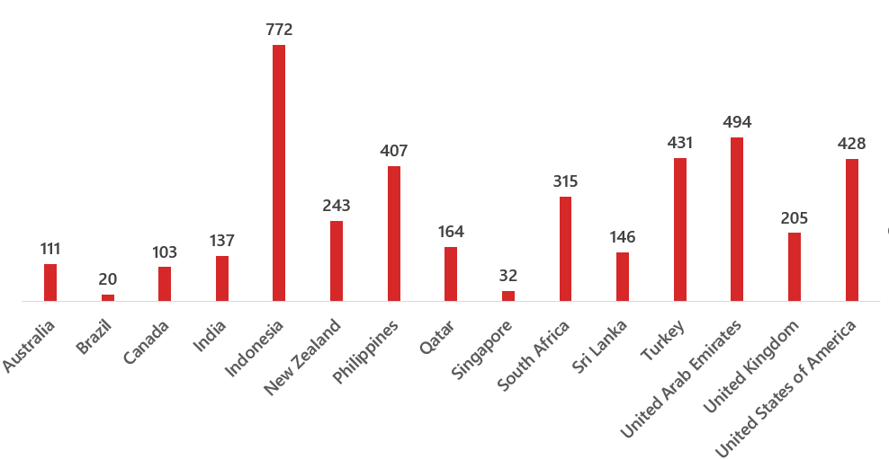
Customer Engagement by Country
Average Votes per Country
Indonesia leads significantly with 772 average votes, showing high customer activity and engagement.
UAE (494), Turkey (431), USA (428), and Philippines (407) also shows strong customer engagement.
Countries like Brazil (20) and Singapore (32) show low engagement, possibly indicating newer markets or less active user bases.
India has 137 average votes, suggesting a moderate engagement level despite having the most restaurants.
Indonesia, Turkey, and Philippines are the countries with high customer engagement and low competition. So, they shows the good potential to open new restaurants.

Slide 10
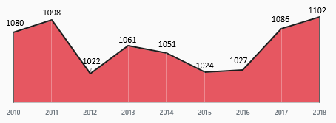
Trend of Restaurant Openings
Restaurant openings grew up steadily from 2010 to 2011 and peaked in 2018 (1102).
There was a dip in the trend in 2012 (1022), followed by ups and downs.
A strong and steady growth in the trend is seen after 2016, indicating renewed market interest.
So, this shows that this is the right time to open newer restaurants.
This growing trend shows a positive sign for us.

Slide 11
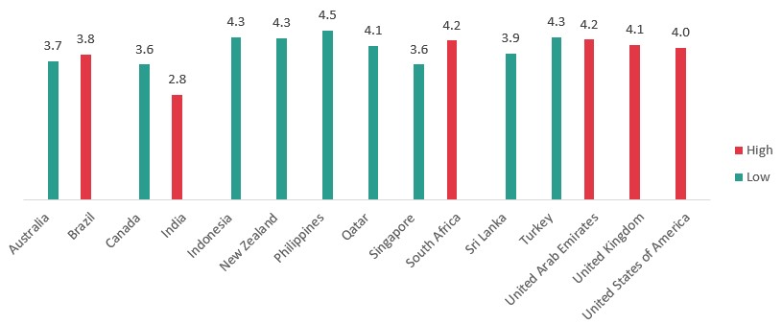
Customer Satisfaction by Country
Average Ratings per Country
Red bars are highly competitive markets
Green bars are Low competitive markets
Philippines (4.4) and Indonesia (4.3) has high average customer ratings, indicating high customer satisfaction and quality.
India (2.8), despite having the most restaurants, has a comparatively low rating, suggesting quality issues.
UK (4.0), USA (3.9), Turkey (4.1), and New Zealand (4.2) show consistently good ratings.
Brazil (2.1) and Qatar (2.4) have the lowest average ratings, indicating poor customer experience and lack of quality.
Countries with low ratings and low competition can be ideal for opening newer restaurants

Slide 12
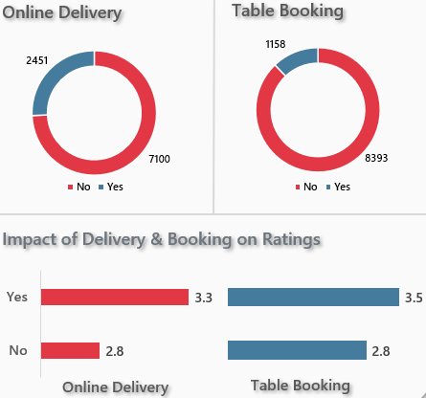
Impact of Delivery & Booking on Ratings
Average Ratings per Feature
Red bars indicate availability of the feature
Green bars indicate unavailability of the feature
Online Delivery availablity has average rating of 3.3 over 2451 restaurants and unavailability has average rating of 2.8 over 7100 restaurants.
Table Booking availablity has average rating of 3.5 over 1158 restaurants and unavailability has average rating of 2.8 over 8393 restaurants.
Providing both delivery and booking options is strongly impacts with higher ratings.

Slide 13
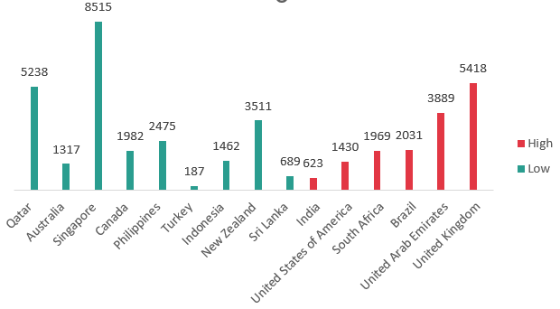
Food Expenditure by Country
Average Cost for Two (in INR)
Red bars are highly competitive markets
Green bars are Low competitive markets
Qatar, Singapore, and United Arab Emirates has the highest average food expenditure, insuitable for high end restaurants.
India and Brazil show lower average food costs, which shows budget conscious customer behavior.
Moderate pricing is seen in countries like USA, UK, Canada, and Australia, suggesting affordability
Countries with Food expenditure below the average and low competition can be ideal for opening newer restaurants
AVERAGE FOOD EXPENDITURE (INR) FOR TWO AMONG LOW COMPETITORS : ₹2,819

Slide 14
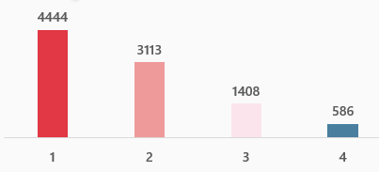
Restaurant Distribution by Price Range
Most restaurants fall under the price range 1 category - 4444 restaurants. Indicates a highly budget efficient restaurants across the globe.
Mid-range options (Price Range 2) are the second most common — 3113 restaurants.
High-end restaurants (Price Range 3 & 4) are much lesser 1408 and 586 respectively.
The majority of restaurants are clustered in affordable ranges, suggesting price is a major factor influencing the success.

Slide 15
Country and City Recommendations
COUNTRIES
CITIES
CUISINES
Australia
Canada
Indonesia
Turkey
Sri Lanka
Philippines
New Zealand
Qatar
Singapore
Montville(Australia)
Chatham-Kent(Canada)
Bogor(Indonesia)
Ankara(Turkey)
Istanbul(Turkey)
Colombo(Sri Lanka)
San Juan City(Philippines)
Auckland(New Zealand)
Wellington(New Zealand)
Doha (Qatar)
Singapore(Singapore)
Pizza, Bar Food (Australia)
Italian, Mediterranean, Pizza(Canada)
Sunda, Indonesian (Indonesia)
Bar Food(Turkey)
Sea Food(Sri Lanka)
European, Asian, Indian(Philippines)
Desserts (New Zealand)
Chinese (Qatar)
Italian (Singapore)
I suggest these countries and cities in the criteria of low competitors, high popularity, and low rating & cuisines based on popularity and high rating. This way, by opening high-quality restaurants in these cities, we can attract the existing customer base and stand out from poor-performing competitors.

Slide 16
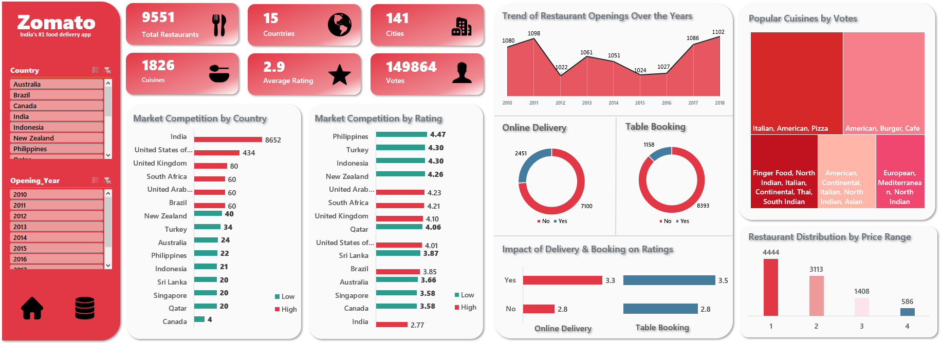
行业PPT模板http://www.1ppt.com/hangye/
DASHBOARD

Slide 17
行业PPT模板http://www.1ppt.com/hangye/
DASBOARD FEATURES AND INTERPRETABILITY
Features:
Filters for Country and Opening Year to explore specific markets and trends.
KPIs: Total Restaurants, Countries, Cities, Cuisines, Average Rating, and Votes.
Data visualizations: bar charts, trend lines, donut charts, and tree maps for deep insights.
Home Button: Navigates to Pivot Tables.
Data Button: Navigates to Raw Dataset.
Interpretability:
Market Competition chart uses color coding to show high (red) and low (green) competition.
Restaurant Opening Trend Charts help identify growth periods of restaurant.
Delivery & Table Booking impact charts highlight how features influence customer satisfaction.
Cuisine Popularity Map shows top food preferences by votes.
Restaurant Distribution by Price Range assists in identifying affordable vs. premium market focus.

Slide 18
行业PPT模板http://www.1ppt.com/hangye/
Conclusion
High competition in India and the USA, low competition in countries like Canada, Qatar, and Sri Lanka are ideal for new market entry.
Online delivery and table booking positively impact ratings, enhancing customer experience.
Majority of restaurants fall under affordable price ranges, highlighting large number of budget efficient restaurants.
Italian, American, and Pizza cuisines dominate in popularity by votes.
Steady growth in restaurant openings with a sharp rise after 2016, indicates a booming market in restaurant business.
This analysis supports data-driven choices for strategic positioning, service optimization, and market expansion in the international restaurant sector.

Slide 19
2025
Thank you
Praveen Raj S

