Slide 1

Group 9
QUANTITATIVE METHODS FOR DECISION MAKING
DHL SUPPLY CHAIN
GROUP | MEMBERS
Group 9 | 5 members (names redacted for public portfolio)

Slide 2
Scope & Problem Identification
Objective Function: Minimizing shipping cost and keeping it within the budget.
Our objective is to reduce the shipping cost and adhere to the budget of 3 Billion CNY, considering numerous numerical budget.
Total Constraints:
Demand
Budget
Production
Route
Weight
CO2 Emission
MINIMIZE
COST
Production Cost
Shipping Cost
CO2 EMISSIONS

Slide 3
Network Diagram
ODM 1
Air (1)
ODM 2
Express Air (2)
LCD 32” (A)
ODM 3
Road (3)
ODM 4
Road LTL (4)
LCD 42” (B)
ODM 5
Road Network (5)
ODM 6
Rail (6)
ODM 7
Water (7)

Slide 4
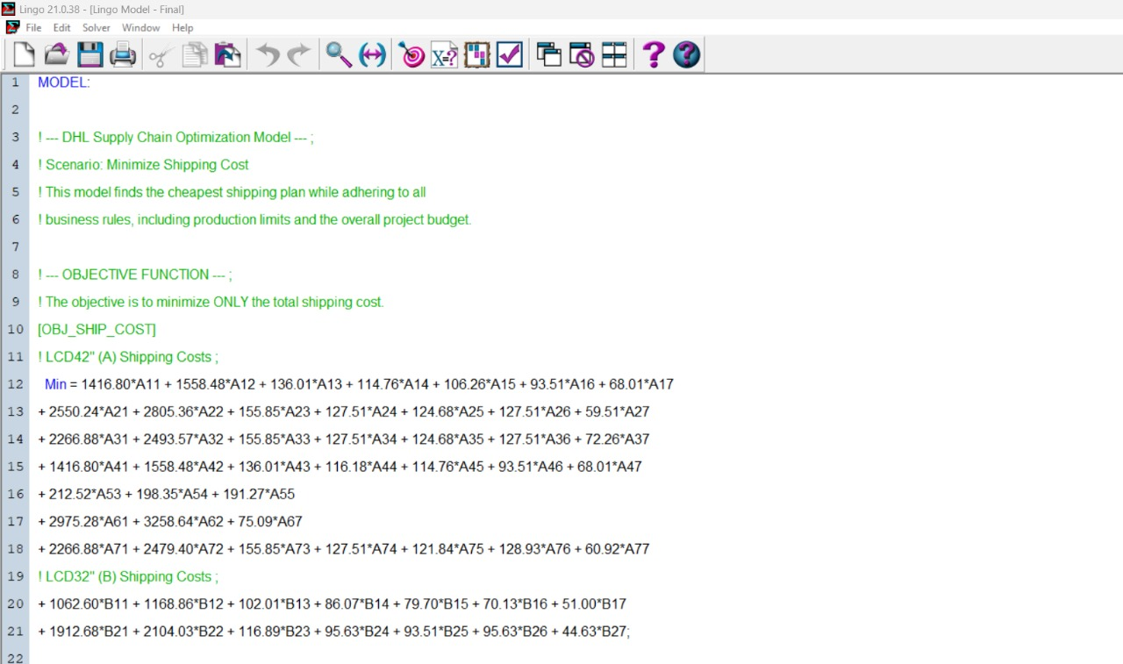
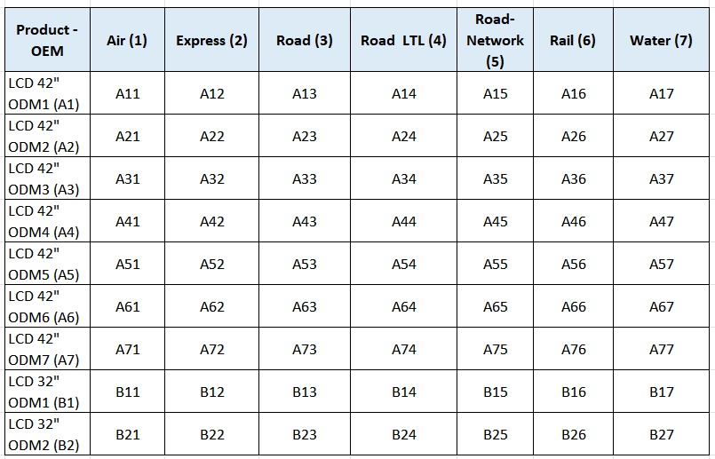
Mathematical Model & Lingo
Decision variables: 64 variables (A11…B27)
Objective function: Minimise shipping cost
Z = ∑ Shipping cost from A11 to B27

Slide 5
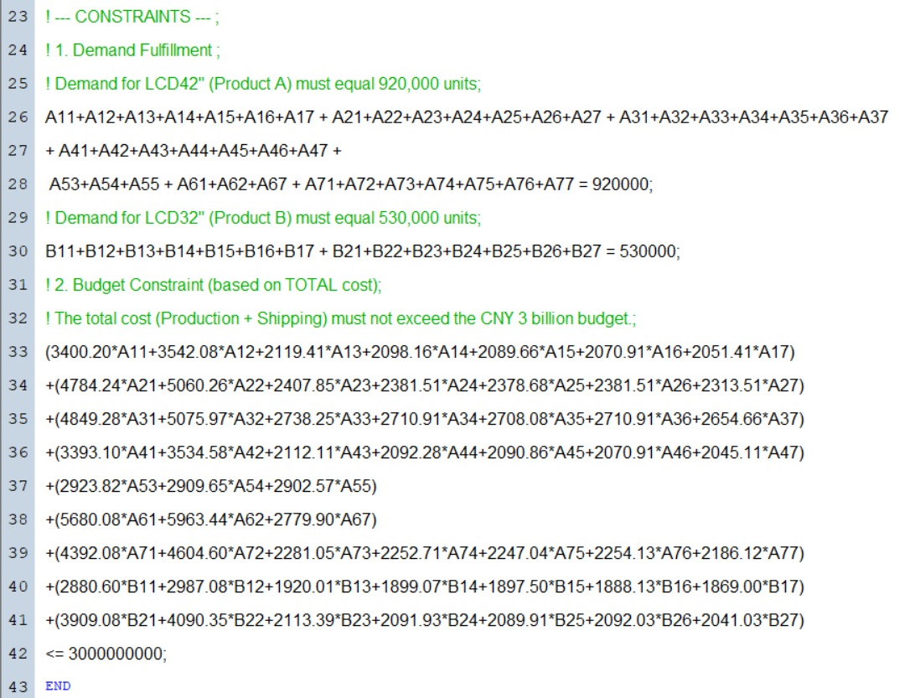
Constraints:
Demand Fulfillment: The model must ship the exact quantity of TVs required by the client, which is 920,000 units of 42" LCDs and 530,000 units of 32" LCDs.
Budget Constraint: The total cost of the operation, including both production and shipping, cannot exceed the allocated budget of CNY 3 billion.

Slide 6
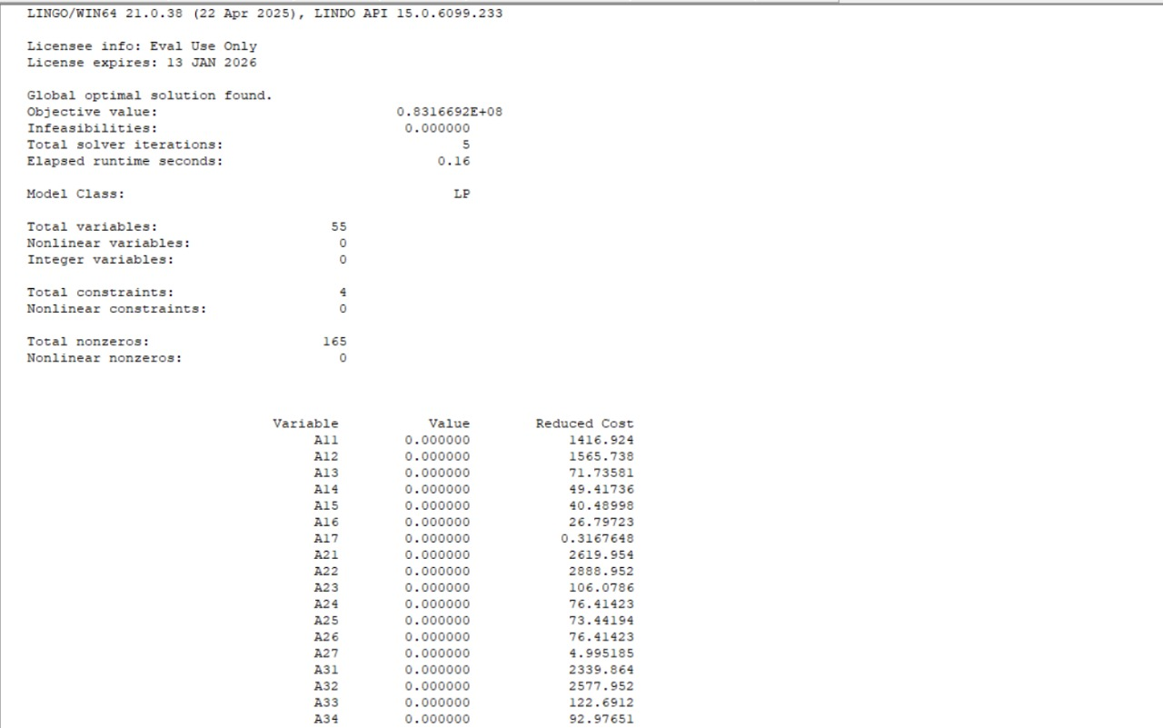
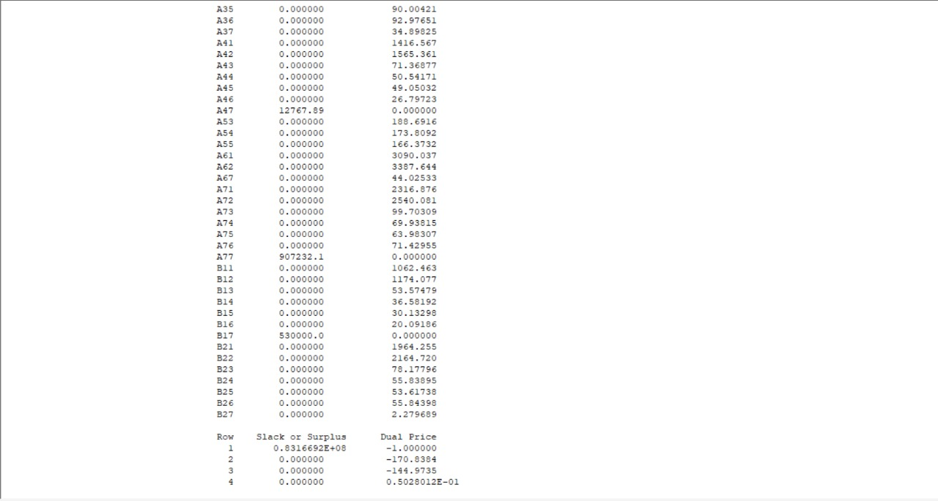
Output & Inference
Output from Lingo:

Slide 7
Results:
Minimum Shipping Cost: 83,166,920 CNY
Total Project Cost Utilized: ≤ 3,000,000,000 CNY
Feasibility: FEASIBLE - The solution meets demand and all other constraints within the specified budget.
Key Insights from the Optimal Solution:
The optimal plan for minimizing shipping cost provides a maximum logistics efficiency of 83,166,920 CNY. This is achieved by a specific allocation of orders. The chosen plan successfully meets the required demand for all 1,450,000 TVs.
Only A47, A77, and B17 have nonzero values.
A47 = LCD42" from ODM4 by water (12,767.89 units)
A77 = LCD42" from ODM7 by water (907,232.1 units)
B17 = LCD32" from ODM1 by water (530,000.0 units)
In our current solution, water is indeed the best transport mode according to your cost structure and constraints.
Inference

Slide 8
Thank You!

