Slide 1

Application of Statistical Methods in Decision Making within the Financial Services Sector
Group Project — 6 members | Course: Statistical Methods for Decision Making
Course: Statistical Methods for Decision Making

Slide 2
Introduction & Objective
Increasing data complexity in finance demands statistical tools. Our objective is to apply theoretical Statistical Methods for Decision Making (SMDM) tools to real-world stock data of Adani Ports & SEZ Ltd. We will use EDA, regression, forecasting, clustering, and hypothesis testing for functional decision-making.

Slide 3

Functional Area-Wise Use Cases
Marketing
Human Resources
Operations
Customer classification (clustering)
Attrition prediction (logistic regression)
Control charts for monitoring process stability
A/B testing, time series for trend prediction
Performance vs. training impact (correlation)
Forecasting workload, descriptive statistics

Slide 4
Descriptive Analysis – ADANI Ports Stock
₹344.11
₹325.75
2.95M
45%
Mean Close Price
Median Close Price
Avg. Daily Volume
Deliverable %
₹193
Standard Deviation
Indicates high volatility, suitable for high-risk investors and active traders.

Slide 5
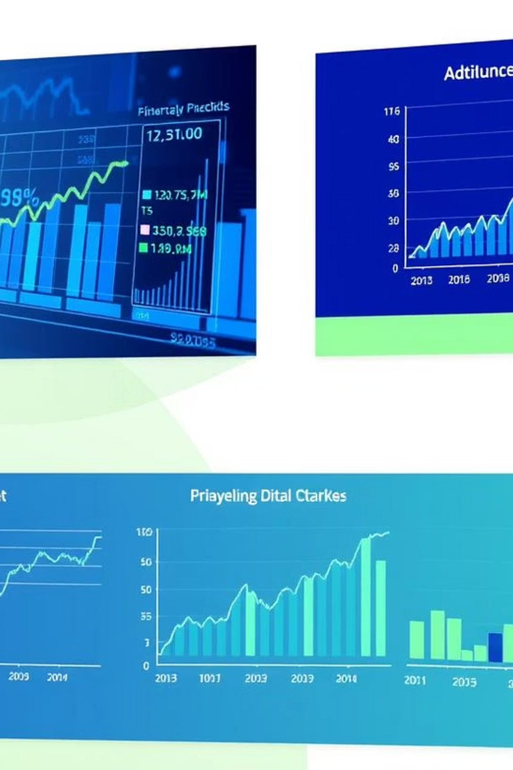
Inferential Analysis – ANOVA & T-Test
ANOVA Tests
T-Tests
Monthly/Quarterly/Yearly trends in returns
Pre/post 2008 crisis performance
Trend-based and volume-based segmentation of price behaviour
Volume comparison on high vs. low deliverable days
Weekend vs. weekday turnover
Day-of-week & event-based anomalies
Impact of corporate actions

Slide 6
Strategic Decision Mapping
Marketing
Clustering
Improved ROI, personalized targeting
HR
Logistic Regression
Retention improvement, fair policies
Operations
Control Charts, Forecasting
Efficiency, workload planning
Risk
Regression, VaR
Risk mitigation, exposure forecasting

Slide 7
Conclusion
ADANI Ports stock is volatile yet liquid, ideal for active traders.
Statistical tools revealed patterns and helped simulate real business decisions.
These insights can guide marketing segmentation, operational forecasting, and portfolio strategies.
Reinforces the strategic value of statistics in modern financial decision-making.

