Slide 1



Go-To-Market Strategy
for Samsung Ballie in India
AI-Powered Home Companion Robot
Marketing Management - 2 Project
Group Number: 01
Institute Name: Great Lakes Institute of Management
Team Members: M Praveen Kumar

Slide 2
TABLE OF CONTENTS
01. Executive Summary
09. Product Offering & Customer Value
02. Introduction to Samsung Ballie
10. Keys to Success & Critical Issues
03. Macro Environment Analysis (PESTLE)
11. Marketing & Financial Objectives
04. Market Needs & Trends
12. Target Market (STP)
05. Market Size & Growth
13. Marketing Tactics (4Ps)
06. SWOT Analysis
14. Marketing Frameworks (BCG & Ansoff)
07. Competitive Analysis
15. Conclusion & Recommendations
08. Perceptual Positioning Map
16. References

Slide 3







EXECUTIVE SUMMARY
The Product
The Opportunity
Samsung Ballie is a rolling AI home companion with a built-in projector, smart home integration (SmartThings via Tizen OS), and autonomous navigation. It bridges the gap between utility and companionship.
India's smart home market is projected to reach $14.28B by 2029 at a 30% CAGR. Rising nuclear families, premiumization, and high tech-adoption make India ripe for autonomous AI robotics.
Strategic Outcome
Target Audience
Achieve a 10% market share in the premium smart assistant segment within 2 years, driving an estimated $150M in hardware revenue and boosting SmartThings ecosystem lock-in.
Urban working professionals, nuclear families, and tech-enthusiasts (Gen Y & Z) seeking convenience, security, and elderly/pet monitoring solutions.

Slide 4

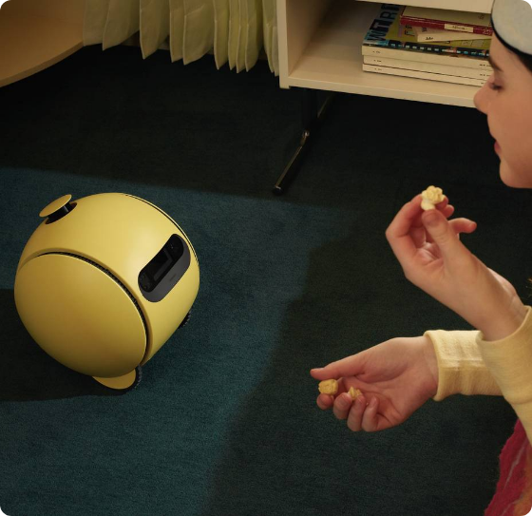
INTRODUCTION TO SAMSUNG BALLIE
What is Ballie?
An intelligent, autonomous rolling AI companion designed to manage smart homes, provide entertainment, and ensure home security.
Evolution: First debuted at CES 2020. The completely revamped version was unveiled at CES 2024 with a 1080p spatial projector and Tizen OS.
Built-in Projector: Detects posture/facial angle to project calls or workouts on walls/ceilings.
SmartThings Hub: Controls IoT devices (lights, ACs, dispensers).
Companion: Pet monitoring, elderly care, and routine automation.
Why Samsung? Unmatched R&D, existing vast SmartThings ecosystem, and strong brand trust in India.

Slide 5


MACRO ENVIRONMENT ANALYSIS (PESTLE) - INDIA
Political
Economic
Social
Government initiatives like "Smart Cities Mission" and "Digital India" strongly promote tech adoption and digital infrastructure.
Rising disposable incomes and expansion of the urban middle class. India's GDP growth supports premium appliance spending.
Increase in nuclear families, dual-income households, and a rising need for remote elderly and pet care solutions.
Technological
Legal
Environmental
Rapid 5G rollout (85% coverage) and high smartphone penetration enable seamless IoT and AI integrations.
Implementation of the DPDP (Digital Personal Data Protection) Act requires strict compliance for AI data processing.
Growing consumer focus on energy efficiency. Ballie can optimize home HVAC and lighting to reduce carbon footprints.

Slide 6












UNDERSTANDING MARKET NEEDS IN INDIA
Elderly & Child Care
Pet Companionship
Smart Home Automation
With dual-working parents, there is a massive need for autonomous monitoring devices that can detect falls, send video alerts, and facilitate emergency calls.
Pet ownership in India is booming. Owners need devices to monitor, entertain, and feed pets while at the office.
Consumers want centralized, seamless control over disparate devices (ACs, lights, security) without navigating multiple complex apps.
Working Professionals
Home Security
Energy Management
50% of smart home buyers in India are motivated by security. Mobile, autonomous patrolling offers superior peace of mind over fixed cameras.
Rising electricity costs push the need for AI systems that can proactively turn off appliances in empty rooms.
WFH and hybrid models demand productivity tools. Ballie's ability to project video calls and calendar updates solves friction points.

Slide 7
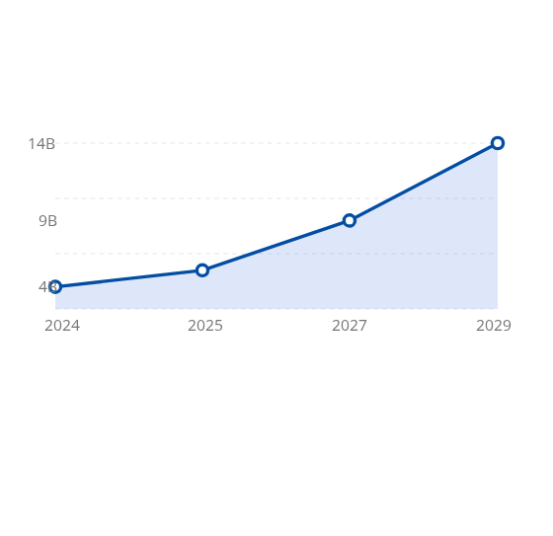
KEY MARKET TRENDS DRIVING ADOPTION
AI & Machine Learning: Shift from reactive voice assistants to proactive, context-aware AI that anticipates user needs.
India Smart Home Market Growth Forecast
Matter Standard Integration: Unified connectivity is reducing ecosystem fragmentation, allowing Samsung to orchestrate third-party devices easily.
Retrofit Smart Homes: Indian consumers prefer plug-and-play modular solutions over complete structural overhauls.
Domestic Robotics: Moving beyond simple robotic vacuums to multi-functional AI companions.

Slide 8

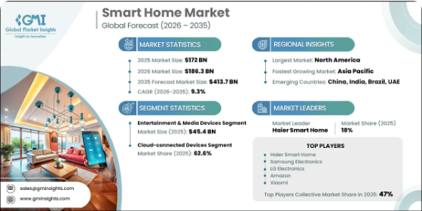
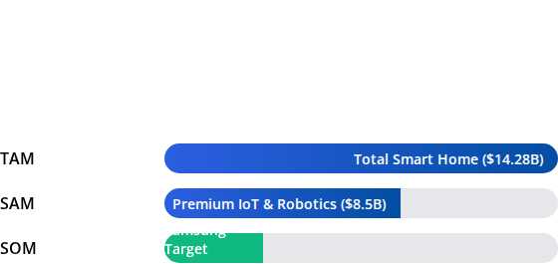
MARKET SIZE & GROWTH POTENTIAL
Addressable Market (India)
The Indian Smart Home Market is projected to grow from $4.0 Billion (2024) to $14.28 Billion (2029) at a staggering CAGR of 30%.

Slide 9




SWOT ANALYSIS: SAMSUNG BALLIE
Strengths
Weaknesses
Innovative built-in spatial projector.
Expected high premium pricing restricts mass-market adoption.
Seamless integration with Samsung SmartThings & Tizen OS.
Privacy concerns regarding a roaming camera in Indian households.
High brand equity & trust in the Indian appliance market.
Dependency on reliable, high-speed indoor Wi-Fi networks.
Advanced on-device AI and mobility (LiDAR/UWB).
Opportunities
Threats
Booming 30% CAGR in the Indian smart home sector.
Strong entrenchment of Amazon Alexa and Google Assistant ecosystems.
Rising demand for pet tech and elderly care solutions.
Invasion of cheaper, single-purpose smart home gadgets.
Partnerships with premium real estate developers (PropTech).
Rapid tech obsolescence requiring constant updates.

Slide 10
COMPETITIVE ANALYSIS
Competitor Profile | Product / Service | Strengths | Weaknesses
Direct: Amazon | Echo Show 10 / Astro (US) | Massive ecosystem, low price point, deep market penetration. | Stationary (Echo), limited physical utility, screen-dependent.
Direct: Google | Nest Hub Max | Superior voice AI, search integration, affordability. | Stationary, lacks physical roaming and projector capabilities.
Direct: Apple | HomePod Ecosystem | High privacy standards, premium build, walled garden lock-in. | Highly restrictive ecosystem, no visual UI/mobility.
Indirect: Xiaomi / IRobot | Robotic Vacuums / CCTVs | Highly functional chore completion, budget-friendly. | Single-purpose, lacks personality and AI companionship.

Slide 11







PERCEPTUAL POSITIONING MAP
High Human Interaction / Companionship
Stationary / Traditional
High Innovation / Mobility
Low Human Interaction (Utility)

Slide 12





PRODUCT OFFERING: THE THREE LEVELS
Core Product
Actual Product
Augmented Product
Peace of Mind & Convenience
Ballie Hardware & Tizen OS
Ecosystem & Support
The fundamental benefit. Users are buying seamless home management, security reassurance, and an enhanced lifestyle without manual effort.
The physical rolling robot, 1080p spatial projector, LiDAR/UWB sensors, cameras, microphones, and the Tizen-powered SmartThings UI.
Samsung Care+ warranty, continuous OTA AI firmware updates, integration with Galaxy wearables, and 24/7 customer support.

Slide 13
CUSTOMER VALUE HIERARCHY
Potential Product
Predictive Personal Response
DIFFERENTIATION & VALUE
Augmented Product
Spatial Projector, Pet Feeder Integration
Expected Product
App Control, Smart Home Hub, Alerts
Basic Product
Rolling Camera with Voice Control
Core Benefit
Digital Companionship & Unseen Automation
Moving up the hierarchy differentiates Ballie from a commodity to a premium lifestyle necessity.

Slide 14





KEYS TO SUCCESS
Ecosystem Synergy
Consumer Education
Leveraging the existing base of Samsung Galaxy, TV, and appliance users in India to create a seamless, locked-in smart home environment.
Transitioning consumer perception from viewing Ballie as a "toy" to recognizing it as an indispensable home management utility.
Experiential Retail
Data Privacy Assurance
Deploying interactive demo zones in premium locations (e.g., Samsung Opera House, Bengaluru) so users can experience the projector and AI in a simulated home.
Establishing absolute trust via Samsung Knox security, ensuring Indian consumers that roaming camera data is processed on-device and highly secure.

Slide 15
CRITICAL ISSUES & MITIGATION
Critical Issue | Impact Level | Mitigation Strategy
High Pricing Barrier Expected premium price alienates middle-class. | High | Target NCCS A segment initially. Offer EMI schemes, and bundle with premium Galaxy Z-series or Neo QLED TVs.
Data Privacy Concerns Fear of constant surveillance/hacking. | High | Highlight Knox Matrix security. Include physical privacy shutters/modes. Transparent local processing policies.
Low Tech Awareness Confusion regarding utility vs existing smart speakers. | Medium | Aggressive PR & Influencer campaigns demonstrating specific use-cases (e.g., fitness projection, pet monitoring).
Infrastructure Dependencies Power cuts, poor Wi-Fi, cluttered Indian homes. | Medium | Emphasize battery backup, robust LiDAR pathfinding capabilities, and offline basic automation features.

Slide 16

MARKETING OBJECTIVES (SMART)
Brand Awareness: Achieve 60% aided brand awareness among Tier-1 SEC A households within the first 6 months of launch via digital campaigns.
Market Penetration: Capture a 10% share of the premium smart home hub market in India by the end of Year 1.
Ecosystem Expansion: Ensure 40% of Ballie purchasers link at least 3 other Samsung smart appliances within 30 days of activation.
Customer Engagement: Generate 100,000+ interactive demos across Samsung Experience Stores nationwide in Q1.

Slide 17
FINANCIAL OBJECTIVES
Metric | Year 1 Target | Year 2 Target | Strategic Rationale
Unit Sales | 15,000 Units | 35,000 Units | Targeting early adopters & premium real estate developers.
Revenue Target | ₹112 Crores (~$13.5M) | ₹260 Crores (~$31M) | Assumes an ASP of ~₹75,000. Revenue scales as production costs drop.
Market Penetration | 10% (Premium Segment) | 18% (Premium Segment) | Capitalizing on the 30% overall smart home market CAGR.
Ecosystem ROI | +15% Appliance Sales | +25% Appliance Sales | Ballie acts as a loss-leader/catalyst for broader SmartThings hardware sales.

Slide 18


TARGET MARKET (STP STRATEGY)
1. Segmentation
2. Targeting
3. Positioning
Demographic: 25-45 years, SEC A+, dual-income.
Primary: DINKs (Double Income, No Kids) and nuclear families with pets or elderly parents requiring remote monitoring.
Positioned not just as a smart speaker, but as an "Intelligent, autonomous family member."
Geographic: Tier 1 & Metro cities (Mumbai, Bengaluru, Delhi NCR).
Secondary: Prop-Tech developers and luxury real estate builders looking to pre-install smart home infrastructure.
Premium, highly secure, and visually interactive (projector) compared to stationary, voice-only alternatives.
Psychographic: Tech-savvy, status-conscious, values convenience and security.
Behavioral: Early adopters, heavily invested in existing smart ecosystems.

Slide 19




POSITIONING & VALUE PROPOSITION
"For tech-forward Indian households seeking seamless convenience and peace of mind, Samsung Ballie is the ultimate AI robotic companion that proactively manages your home, protects your loved ones, and elevates your lifestyle through intuitive mobility and visual interaction."
Brand Promise
Customer Pain Reliever
Gain Creator
Intelligent care and effortless control, always by your side.
Eliminates the anxiety of unmonitored homes and pets.
Projects content dynamically, turning any wall into a screen.

Slide 20
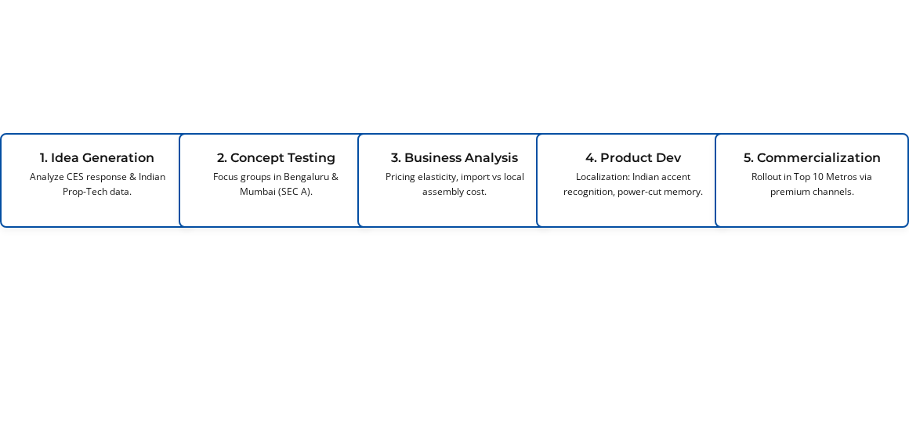
PRODUCT STRATEGY & NPD PROCESS
Product Type: Specialty/Shopping Product. Impact: Disruptive innovation creating a new sub-category of mobile smart hubs.
New Product Development (Localization for India) Flowchart

Slide 21


BRAND ATTRIBUTES (IDENTITY PRISM)
Physique
Personality
Iconic spherical design, bowling-ball size, sleek yellow/white casing, high-tech spatial projector lens, and rolling mobility.
Helpful, intuitive, slightly playful, highly intelligent, loyal, and unobtrusive (like an ideal digital butler or smart pet).
Relationship
Customer Reflection
A companion rather than a tool. Fosters trust, safety, and a personalized bond through AI learning of user habits.
The user sees themselves as a modern, successful, tech-forward individual who values premium lifestyle and efficiency.

Slide 22
PRICING STRATEGY
Primary Objective: Market Skimming (Maximize revenue from early tech-adopters, establish premium brand equity).
Element | Strategy / Tactic | Rationale
Pricing Policy | Premium Skimming Pricing (~₹70,000 - ₹85,000) | Covers high R&D/import costs. Positions Ballie above stationary smart speakers as a luxury robotic asset.
Competitor Reaction | Aggressive discounts on Echo/Nest. | Competitors will defend their low-end dominance. Ballie must justify premium via the projector & mobility.
Customer Incentives | Pre-order bundled with Galaxy Buds / SmartTags. No-cost EMI. | Lowers the psychological barrier to entry. Drives ecosystem lock-in.
Collaborator Incentives | High margins for premium integrators & Prop-Tech builders. | Encourages B2B push where Ballie is sold as part of a ₹5L smart home package.

Slide 23








COMMUNICATION STRATEGY (IMC)
#MeetBallie Teasers
To Samsung Members
Tech & Pet Bloggers
Targeted YouTube/Meta
Live Demos in Malls
Tech Publications

Slide 24
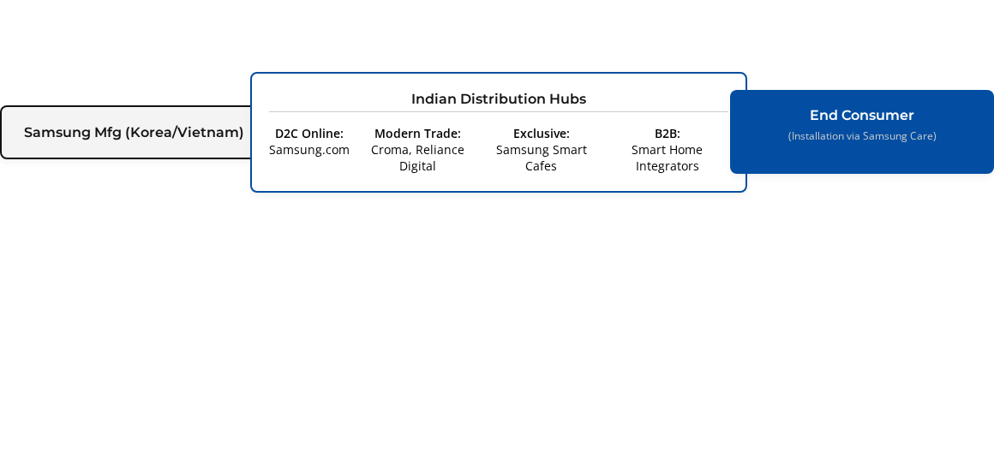
DISTRIBUTION STRATEGY
Omnichannel approach with a focus on High-Touch Premium Retail and B2B Integrators.
*Critical: In-home installation and ecosystem setup by Samsung technicians is mandatory to ensure a flawless initial user experience.

Slide 25




GROWTH STRATEGY: ANSOFF MATRIX
Market Penetration
Product Development
Existing Products / Existing Markets
New Products / Existing Markets
Selling more Galaxy phones or standard Smart TVs in India through aggressive promos.
*Primary Ballie Strategy*
Introducing a completely new, innovative product (Ballie) to Samsung's existing loyal customer base in India.
Market Development
Diversification
Existing Products / New Markets
New Products / New Markets
Expanding current appliance sales into deeper Tier-3/Tier-4 rural Indian markets.
Samsung creating enterprise-level industrial robotics for new B2B manufacturing clients.

Slide 26




PRODUCT PORTFOLIO ANALYSIS: BCG MATRIX
Evaluating Ballie within Samsung's Indian Smart Home Portfolio:
Relative Market Share →
Stars
Question Marks
(High Growth, High Share)
(High Growth, Low Share)
Samsung Smart TVs, Premium Neo QLEDs, and Smart Refrigerators.
Samsung Ballie. Operates in a booming 30% CAGR market, but holds 0% share at launch. Requires heavy investment to become a Star.
Cash Cows
Dogs
(Low Growth, High Share)
(Low Growth, Low Share)
Standard Microwave Ovens, Traditional AC units, Mid-range smartphones.
Outdated point-and-shoot cameras, obsolete feature phones.

Slide 27
Conclusion & Strategic Recommendations
Samsung Ballie is positioned to redefine the Indian Smart Home landscape, moving beyond reactive voice control to proactive, visual, and mobile companionship.
Focus on Experiential Marketing: Demos are critical; consumers must see the projector and tracking in action.
Leverage the Galaxy Ecosystem: Bundle with existing premium products to lower the initial price barrier.
Prioritize B2B PropTech: Partner with luxury builders to integrate Ballie as a standard home feature.
Emphasize Security & Care: Win the trust of working parents and pet owners.

Slide 28
REFERENCES
Gulf News. (2024, January). CES 2024: Meet Samsung's Ballie, a rolling AI robot that helps control your home, entertain pets. Retrieved from https://gulfnews.com
IMARC Group. (2025). Smart Home Devices Market in India - Size & Forecast 2034. Retrieved from https://www.imarcgroup.com/india-smart-home-devices-market
Next Move Strategy Consulting. (2024). Samsung Unveils Ballie AI Home Companion at CES 2024. Retrieved from https://www.nextmsc.com
Research and Markets. (2024). India Smart Home - Market Share Analysis, Industry Trends & Statistics, Growth Forecasts (2024 - 2029).
Samsung Newsroom. (2024, January 8). A Day in the Life With Ballie: An AI Companion Robot for the Home. Retrieved from https://news.samsung.com/us
Tom's Guide. (2024, January 8). The Samsung Ballie robot invades CES 2024 — here's everything it can do. Retrieved from https://www.tomsguide.com

Slide 29


IMAGE SOURCES
https://static0.anpoimages.com/wordpress/wp-content/uploads/2025/04/samsung-digital-appliances-ballie-partmership-with-google-cloud_gemini-to-ballie_dl1.jpg?w=1600&h=900&fit=crop
Source: www.androidpolice.com
https://cdn.gminsights.com/cdn-cgi/image/fit=scale-down,format=webp,quality=60,width=1200/image/rd/consumer-goods-and-services/smart-home-market-research-report.webp?t=1779706736799
Source: www.gminsights.com

