Slide 1




Trade Document Automation
Agent for Compliance and Efficiency
Group 2
GROUP MEMBERS
Group Project — 5 members
Group Project — 5 members
Group Project — 5 members
Group Project — 5 members
M PRAVEEN
KUMAR

Slide 2










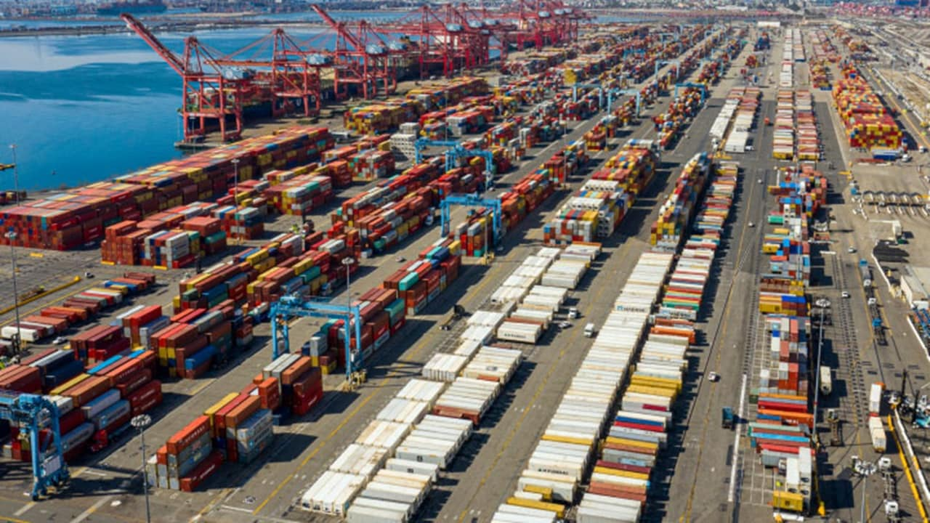

Supply Chain Context & Problem Understanding
Key Issues
Supply Chain Context
International trade moves goods globally through exporters, importers, customs, and logistics providers—handling millions of shipments daily.
Manual Errors
Compliance Risks
Missing fields, incorrect data, typographical mistakes
Non-adherence to regulations, wrong classifications
Commercial Invoices
Bills of Lading
Operational Delays
Lack of Automation
Packing Lists
Customs Declarations
Time-consuming verification, clearance delays
No real-time validation, manual dependency
PROBLEM STATEMENT
Trade documentation in supply chains is prone to manual errors and compliance issues, leading to delays, increased costs, and inefficiencies. There is a need for an intelligent system that can automatically validate documents and ensure accuracy and compliance.
Global Trade & Logistics Operations

Slide 3















Agent / Method
Implementation
Hybrid AI Agent
How It Solves the Problem
Rule-Based + Mistral LLM
Automates document validation process
Identifies data errors and logical mismatches
Structured data → strict rule validation
Reduces rework cycles and processing time
Unstructured context → AI reasoning
Improves compliance and accuracy
JUSTIFICATION
Outcome
Accurate field validation
Context-aware compliance checking
Transforms a manual system into an intelligent AI agent for efficient trade document processing
Reduces manual effort, errors, and delays
AGENT ARCHITECTURE
PDF/CSV/Excel
Extraction
Validation
KEY BENEFITS
LLM detects contextual inconsistencies
Extract → Validate → Detect Errors → Send Alerts
Faster
Accurate
Compliant

Slide 4
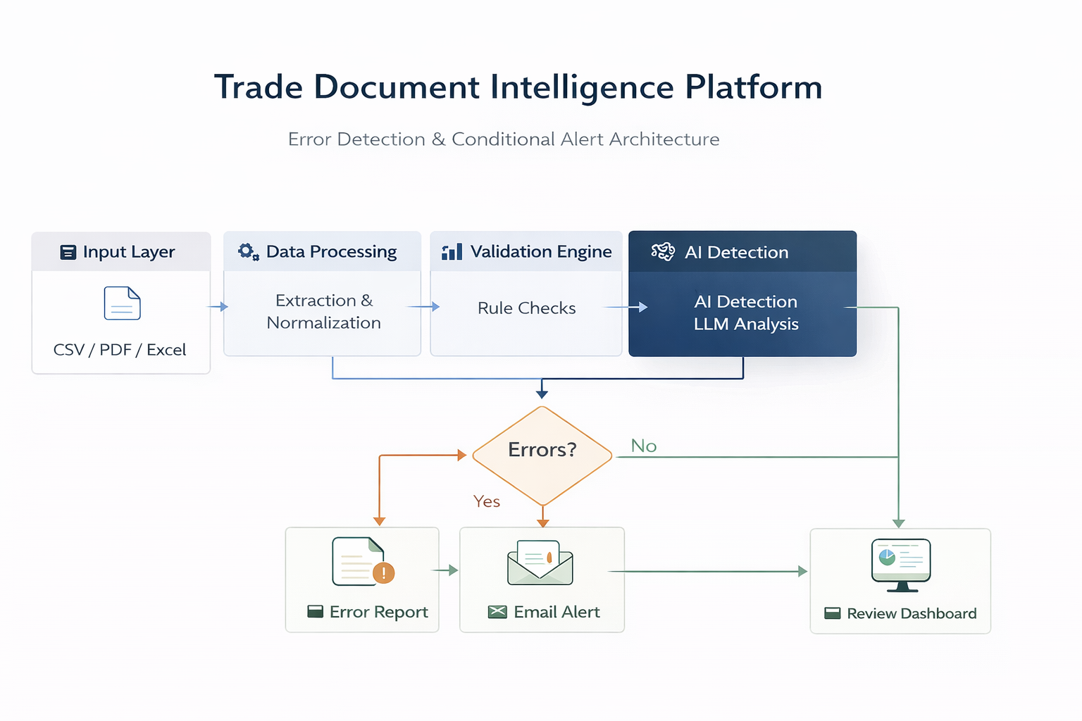

Slide 5















Insights for AI-Driven
Trade Documentation
Strategic Insights
Actionable Recommendations
Data Consistency Critical
Cross-Document Validation
Dynamic Compliance Engine
Errors arise across multiple documents (Invoice vs Bill of Lading)
Compare invoice, packing list, BOL fields
Update rules by country regulations
Compliance is Dynamic
Trade regulations vary by country and change frequently
Source-Level Validation
Critical Field Monitoring
Upstream Quality Matters
Validate at entry point (exporter)
Stricter validation on high-impact fields
Poor input data leads to compounded downstream errors
High-Risk Field Impact
System Integration Checks
HS Code, Country, Incoterms cause major failures
Ensure consistency across ERP, logistics, and customs systems
Error Propagation
Incorrect data flows into ERP/logistics systems
Business Impact
Reduced Discrepancies
Better Compliance
Fewer cross-document errors
Global adaptability to regulations
Faster Flow
Lower Costs
Accelerated end-to-end supply chain
Fewer downstream errors

