Slide 1

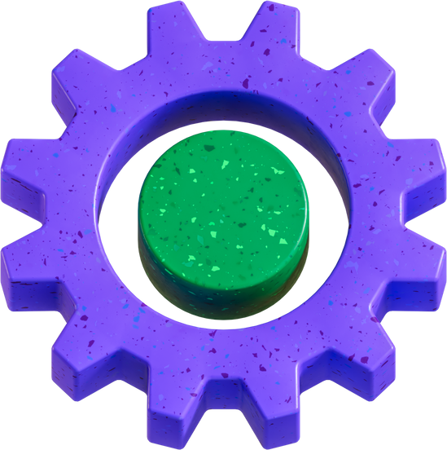

How can junior employees effectively champion career development and foster innovation while upholding existing corporate frameworks and respecting supervisory authority?
Problem Statement
  Ineffective Organizational Communication Channels
Grace's decision to bypass her manager and directly contact the divisional VP highlights a lack of structured feedback mechanisms for employees to propose innovative solutions.
Risks
  Supervisory control over opportunities
Landon's repeated dismissal of Grace’s requests leads her to believe he is deliberately stalling her growth, contributing to a breakdown in trust and communication.
  Divergence between individual aspiration and corporate culture
Grace's proactive approach clashes with 8SK Consulting’s hierarchical structure, where junior employees are expected to follow established pathways rather than drive innovation.
  Risk of Overstepping Boundaries when engaging with leadership.
While Grace exhibits significant initiative, her unconventional approach for change—through peer influence and direct executive engagement—creates tension and potential reputational Vulnerabilities.
  Lack of career roadmap clarity
The firm lacks transparent process mechanisms for junior employees to advocate for career advancement, leading Grace to seek alternative routes such as direct executive engagement.

Slide 2



Ai Recommendations: Grace -> 8SK Consulting
Recommendation: Strategic Alignment of Individual Initiative
  Statement: Implement a structured framework for junior employee innovation, channelling proactive ideas through established, yet adaptable, internal processes.
Works if:
  Grace adopts a collaborative, influence-based approach, framing proposals with clear organizational benefits.
  8SK Consulting provides clear guidelines for proposal submission and review, with designated channels for innovative ideas.
Fails if:
  Grace perceives this as stifling and reverts to aggressive, informal tactics.
  8SK Consulting's framework remains rigid, bureaucratic, or lacks genuine receptiveness to new ideas.
  Landon feels threatened or lacks the authority/support to act on recommendations.
Recommendation: Enhance Organizational Receptivity to Bottom-Up Innovation
  Statement: 8SK Consulting should proactively develop mechanisms (e.g., innovation hubs, cross-functional project teams, formal mentorship programs) to solicit and integrate junior-level insights.
Works if:
  Leadership actively promotes a culture of psychological safety and values diverse perspectives.
  Clear feedback loops and recognition systems are established for innovative contributions.
Fails if:
  Initiatives are merely performative without genuine commitment or resource allocation.
  Management perceives bottom-up innovation as a threat to control or existing power structures.
  Lack of follow-through on promising ideas leads to employee disillusionment.

Slide 3
Construct proposals to articulate clear benefits for the organization, underscoring their strategic contribution.
Engage with mentors to understand optimal approaches for driving change within the corporate structure.
Possible Solutions
Approach interactions with Landon by affirming his role and aligning with his objectives.
  If upward mobility seems unattainable, explore external opportunities that value initiative and leadership potential.
Strategic Communication and Influence Without Bypassing Hierarchy
Move from directly pushing concepts to strategically building consensus and buy-in through cooperative efforts.
OPTIONS THAT GRACE CAN CHOOSE
Understanding the Workplace Hierarchy and Managerial Concerns
Evaluating Next Steps Based on Organizational Fit
  Make career decisions based on long-term alignment with personal growth objectives rather than frustration with immediate setbacks
Gaining Visibility and Career Advancement Through Credible Actions
Investigate the formal and informal decision-making channels at 8SK Consulting to determine if Grace's methods are congruent with company expectations.
  Strengthen professional network within the organization to gain allies in decision-making roles.
  Request involvement in projects that align with company priorities while respecting managerial approval processes.
  Leverage small wins to demonstrate leadership capability before aiming for larger initiatives.

Slide 4
Relatable Career Challenges:
A Collective View
  Praveen:
  Problem Statement: Initially, my aspiration to transition from an IT Administrator Support role to a BI Developer position was met with organizational constraints due to my critical involvement in ongoing IT projects.
  Solution & Outcome:
  To overcome this, I proposed and successfully implemented a parallel work model. This allowed me to continue supporting my existing IT responsibilities while simultaneously taking on new BI development tasks. This proactive approach not only facilitated my career transition but also provided invaluable exposure to multiple project methodologies and fostered direct collaboration with senior management, significantly broadening my professional network and strategic understanding.
  ________:
  Problem Statement:
  Solution & Outcome:
  _____________
  Problem Statement:
  Solution & Outcome:
  ___________:
  Problem Statement:
  Solution & Outcome:

