Slide 1
Strategic Challenges & Prospects of Warner Bros. Discovery
An MBA-Level Analysis using the CTS 7-Step Decision-Making Framework
Confidential Strategic Deck | June 2026

Slide 2
Agenda: Strategic Roadmap
Part 1: The Context
Part 2: The Decision Logic
•
Company Overview & Legacy
•
Financial Analysis & Stress Testing
•
Industry Disruption Analysis
•
Criteria & Strategic Weighting
•
CTS Framework: Problem Definition
•
Alternative Strategic Paths
•
Key Challenges Analysis
•
Decision Matrix & Recommendation
This presentation utilizes the CTS model to navigate the complex merger and restructuring landscape currently impacting Warner Bros. Discovery.

Slide 3

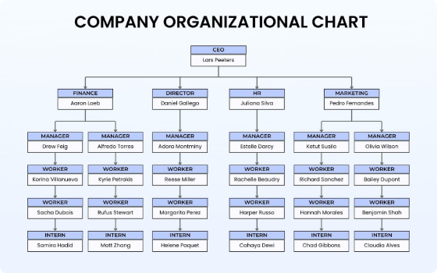
Company Overview: Legacy & Transformation
Merger Context
Formed through the 2022 merger of WarnerMedia and Discovery, the entity brought together iconic brands like HBO, CNN, and the Discovery suite, creating a content powerhouse with a high-leverage balance sheet.
Portfolio Depth
WBD holds a massive IP library including DC Comics, Game of Thrones, and live news/sports infrastructure, making it a critical player in both linear and digital ecosystems.

Slide 4
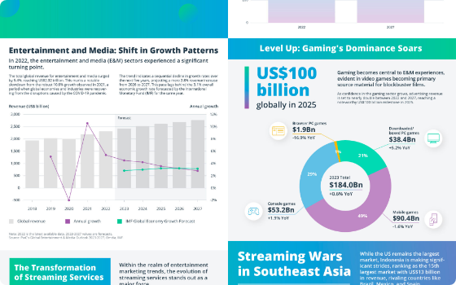
Industry Overview: The Streaming Disruption
Cord-Cutting Accelerators
Linear cable revenue is eroding faster than anticipated, forcing all major media players to transition rapidly into Direct-to-Consumer (DTC) models while maintaining profitability.
Market Saturation
The streaming industry is currently defined by intense rivalry, where high churn rates and rising production costs have squeezed margins, shifting the goalpost from subscriber growth to ARPU (Average Revenue Per User) and profitability.

Slide 5
CTS Step 1: Defining the Core Problem
Structural Financial Fragility
The primary problem is an unsustainable capital structure characterized by high debt levels ($43B+), which limits operational flexibility and restricts the ability to compete in high-stakes content bidding wars against deep-pocketed tech rivals.
Strategic Misalignment
The company faces a crisis of identity between legacy linear assets that generate cash and streaming assets that require aggressive investment, leading to investor disillusionment and stock devaluation.
Evidence: Q1 2026 earnings showed significant misses, reflecting that current deleveraging efforts are not outpacing the erosion of the legacy linear business.

Slide 6
Key Strategic Challenges
Financial Burden
Market/Competitive
The crushing debt load requires constant cash diversion, stifling R&D and digital product innovation, and resulting in controversial cost-cutting measures.
Netflix and Big Tech players are changing consumer behavior, making it nearly impossible for WBD to compete on pure volume alone without superior technological infrastructure.

Slide 7
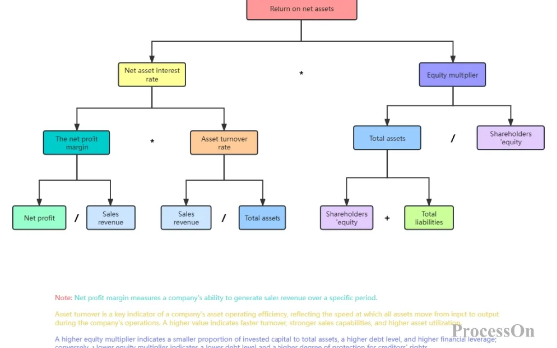
Financial Analysis: Leverage & Cash Flow
Debt and De-leveraging
The high debt-to-EBITDA ratio acts as a strategic anchor. Market devaluation by over 60% in 2025 forced board-level discussions on corporate separation and potential asset sales to preserve value.
Operating Margins
Cost-cutting strategies (tax write-offs, removal of content) have provided short-term liquidity but risk damaging the long-term equity of core brands like HBO.

Slide 8
CTS Step 2: Defining Decision Criteria
Financial Sustainability (40%)
Any solution must provide an immediate path to de-leveraging the balance sheet and ensuring liquidity without jeopardizing core operations.
Market Innovation (25%)
The ability to adapt to new technology/platforms (AI integration, gaming, interactive content) is non-negotiable for future competitive survival.
Brand Integrity (20%)
Preservation of premium tier value (HBO/DC) during the restructuring process is essential to maintain long-term asset valuations.
Leadership/Culture (15%)
The solution must address organizational stability and employee retention amidst the ongoing mergers and reorganizations.

Slide 9
CTS Step 3: Strategic Weighting
The weighting reflects the executive imperative for survival. In 2026, financial survival is paramount over all other considerations.
Criterion | Weight | Strategic Rationale
Financial Stability | 40% | Debt servicing is a prerequisite for operational independence.
Innovation Capacity | 25% | Without tech-edge, WBD cannot compete with streamers.
Brand Equity | 20% | Long-term survival relies on IP valuation.
Operational Agility | 15% | Post-merger integration requires streamlined execution.

Slide 10
CTS Step 4: Streaming-First Strategy
Strategy Overview
Doubling down on Max by aggressively shifting all linear budgets to DTC expansion, cutting physical production, and prioritizing digital engagement.
Pros & Cons
Benefit: Maximizes engagement metrics. Risk: Extremely capital intensive with delayed ROI, further stressing the cash position during a critical deleveraging phase.
Outcomes
Potential for high subscriber growth but carries extreme short-term liquidity risk.

Slide 11
CTS Step 4: Financial Restructuring
Strategy Overview
Focusing on massive asset divestiture, aggressive debt refinancing, and spinning off non-core linear networks to pure-play investors.
Pros & Cons
Benefit: Rapid improvement in balance sheet health. Risk: Loss of operational scale and market power, potentially making the remaining entity an acquisition target.
Outcomes
Stabilization at the expense of market relevance and future scaling capabilities.

Slide 12
CTS Step 4: Strategic Partnerships/Mergers
Strategy Overview
Seeking synergy with a larger technology conglomerate (e.g., the Paramount Skydance acquisition path) to trade independent survival for balance sheet stability.
Pros & Cons
Benefit: Immediate access to capital and operational synergies. Risk: Loss of strategic independence and potential for regulatory pushback during antitrust review.

Slide 13
Strategic Assessment: SWOT Analysis
Strengths & Weaknesses
Opportunities & Threats
Strengths: Peerless IP portfolio, global production footprint, established HBO brand.
Opportunities: Global distribution expansion, live sports integration, AI-driven content efficiency.
Weaknesses: Excessive leverage, declining linear networks, fragmented streaming user base.
Threats: Regulatory interference, technological obsolescence of legacy distribution, hyper-competitive pricing.

Slide 14
Environmental Context: PESTLE Analysis
Political: Heightened scrutiny from antitrust regulators regarding media consolidation.
Economic: High-interest rate environment increases the cost of refinancing debt.
Social: Fragmented consumer loyalty across competing streaming platforms.
Technological: Rapid shift towards AI-generated content production and delivery.

Slide 15
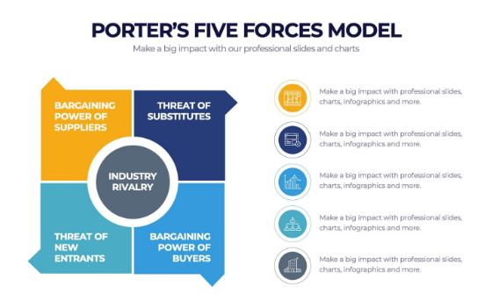
Industry Landscape: Porter's Five Forces
Competitive Rivalry (High)
Streaming dominance requires massive capital. Rivalry is driven by subscription wars.
Buyer Power (High)
Low switching costs for consumers make churn management difficult.

Slide 16
CTS Step 5: Decision Matrix Evaluation
Criterion | Weight | Streaming First | Restructuring | Partnership/Merger
Fin. Sustainability | 40% | 2 | 4 | 5
Innovation | 25% | 4 | 2 | 4
Brand Equity | 20% | 5 | 3 | 4
Leadership | 15% | 2 | 3 | 4
Total Score | - | 3.35 | 3.3 | 4.45
The "Partnership/Merger" path emerges as the clear winner due to its ability to resolve the debt crisis while maintaining operational scale.

Slide 17
CTS Step 6: Recommended Strategy
The Hybrid Strategy
Execution of a structured merger/acquisition path coupled with immediate operational restructuring is the optimal route to maximize long-term shareholder value.
Strategic Rationale
By leveraging an external partner's balance sheet, WBD can stabilize its debt while retaining the creative autonomy of the Warner Bros. studios, effectively trading equity for structural solvency.

Slide 18
CTS Step 7: Implementation Roadmap
Short-Term (0-12 months): Regulatory Clearance & Deleveraging
Finalizing the merger agreement, securing bridge financing, and executing the tax-free spin-off of non-core entities.
Medium-Term (1-3 years): Integration & Synergy
Merging tech stacks, unifying content licensing, and achieving the target cost synergies to drive margin expansion.
Long-Term (3-5 years): Value Creation
Reinvesting realized cash flows into premium IP development and global expansion to cement market leadership.

Slide 19
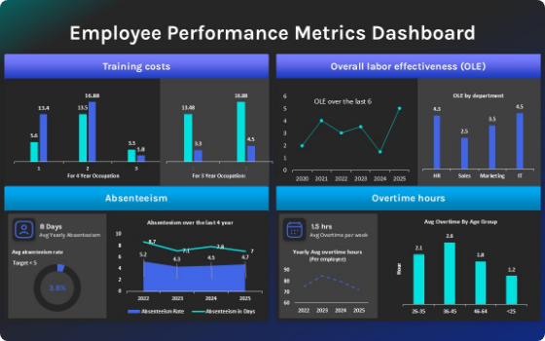
KPI Dashboard: Success Metrics
•
Debt-to-EBITDA: Targeted reduction to < 3.0x
•
DTC Profitability: Quarterly EBITDA break-even by year 2
•
Content ROI: 15% increase in efficiency via AI-optimized production

Slide 20
Conclusion: Future Outlook
Summary
Warner Bros. Discovery stands at an inflection point. The merger path, while difficult, represents the most pragmatic solution to years of systemic under-capitalization.
Executive Takeaway
Managerial priority must shift from "subscriber growth at any cost" to "value creation through structural discipline." The future lies in the integration of studio excellence with tech-driven distribution platforms.

Slide 21
References
1. WBD Annual Report (2025). Investor Relations Disclosures.
2. Wikipedia (2026). Proposed acquisition of Warner Bros. Discovery by Paramount Skydance.
3. Enders Analysis (2023). Warner Bros. Discovery: A Tricky Path.
4. Symonds Research (2026). 7 Steps of the Decision-Making Process.
9. Lucidchart Blog (2026). Rational Decision-Making Models.
10. Industry Analyst Consortium (2025). Streaming Market Trends and Competitive Rivalry.

Slide 22






Image Sources
https://template.canva.com/EAGtVkfnY24/1/0/1600w-lUxcY6NKz0c.jpg
Source: www.canva.com
https://d3twecw9qvot3u.cloudfront.net/wp-content/uploads/2023/12/infographic-14-scaled.jpg
Source: intellias.com
https://cdn.processon.io/admin/knowledge/article_content_img/69e9c497bda86a2515e5df5e.png
Source: www.processon.io
http://static1.squarespace.com/static/6348398d9d21fd6277c64f96/t/661e6a9cb3bcc6550de3334d/1713269404793/swot+analysis+matrix+diagram+templates.png?format=1500w
Source: www.bitesizelearning.co.uk
https://stg-uploads.slidenest.com/template_1398/templateColor_1417/previewImages/porters-five-forces-diagram-powerpoint-google-slides-keynote-presentation-template-3.jpeg
Source: slidenest.com
https://slidebazaar.com/wp-content/uploads/2025/06/employee-performance-metrics-dashboard-dark-template-powerpoint-google-slides.jpg
Source: slidebazaar.com

