Slide 1
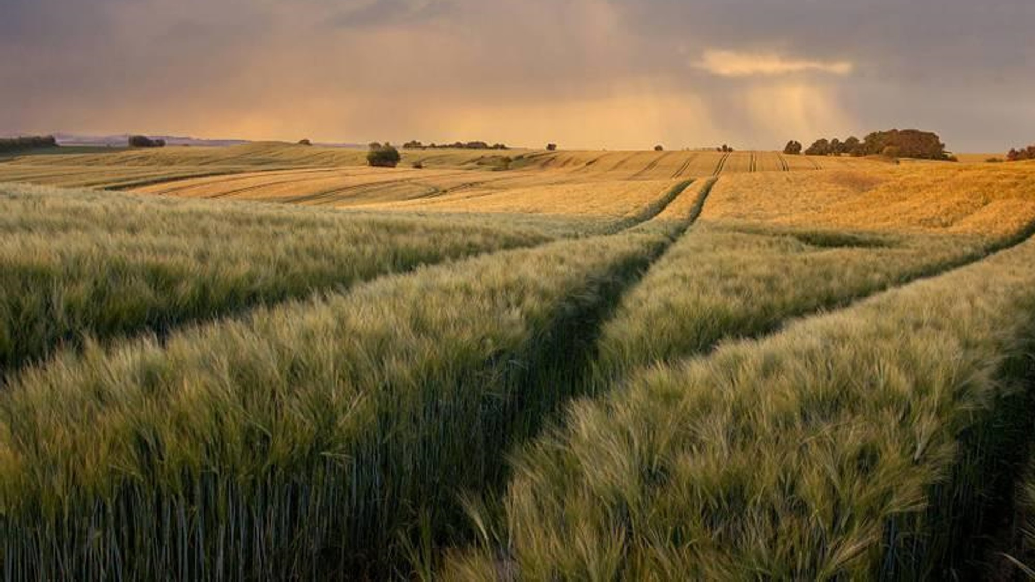
crop disease detection presented by, name:a.praveen kumar reg no:613521104027 dept:cse 3rd year government college of engineering,dharmapuri

Slide 2

AGENDA
*Problem Statement
*Proposed System/Solution
*System Development
*Algorithm$Deployment
*Result
*Conclusion
*References

Slide 3
problem statement
Agriculture serves as the backbone of many economies worldwide, providing sustenance and livelihoods for billions of people. However, crop diseases pose a significant threat to agricultural productivity, leading to substantial yield losses and economic damages. Early detection and timely intervention are crucial for effective disease management and ensuring food security.

Slide 4
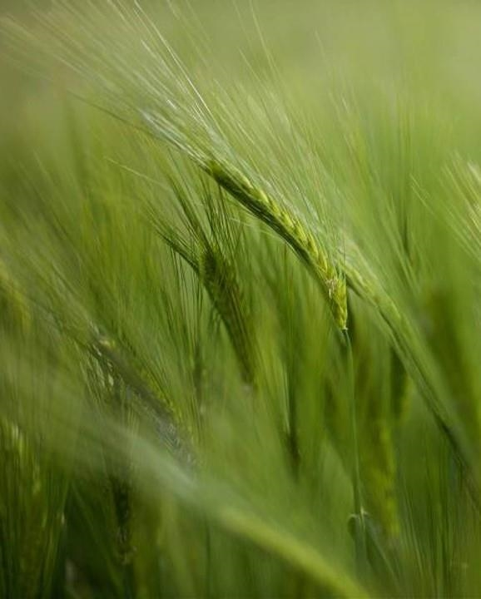
proposed system/solution
The proposed system aims to revolutionize crop disease detection by integrating machine learning techniques with remote sensing technology. It will provide farmers with a user-friendly and efficient tool for early identification and management of crop diseases, thereby enhancing agricultural productivity and sustainability.
*data collection and preprocessing
*model development
*field testing and validation

Slide 5
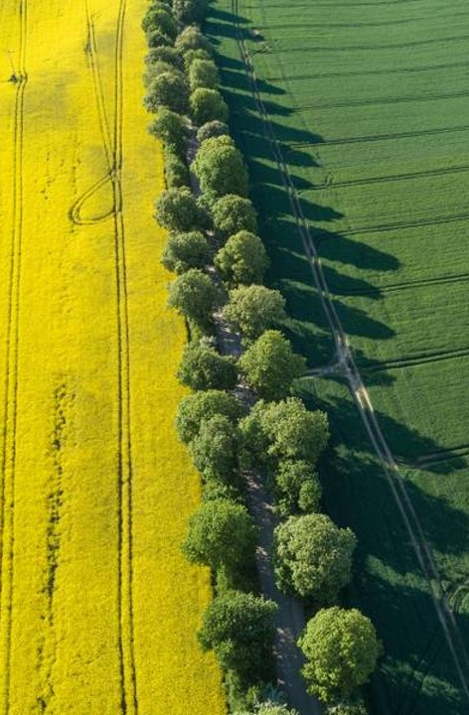
system development approach
It includes,
1.Requirement analysis
2.Data collection and annotation
3.Preprocessing and feature extraction
4.Model selection and training
5.Integration of remote sensing data
6.System implementation
7.Testing and evaluation
8.Deployemnt and Monitoring

Slide 6
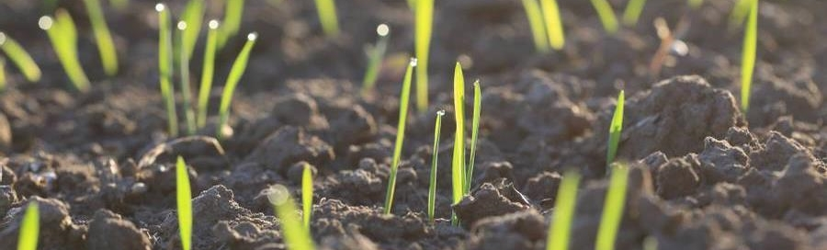
algorithm& deployment
Here,Convolutional Neural Network algorithm (CNN) is implemented.It is used for data collection and preprocessing,model architecture design,training and for evaluation.
The deployment predicts model export,user interface development,integration with deployment platform,deployment testing and monitoring and maintenance.

Slide 7
Result
The detection and classification of crop diseases is an essential use of DL, ML, and computer vision techniques in agriculture industries [1]. The aim is to develop algorithms and techniques based on images of leaves or other plant features that can automatically detect and classify agricultural plant diseases.

Slide 8
References
[https://drive.google.com/file/d/1i466c4XOs048Q54EPCqgzoG8zWcARnrj/view?usp=sharing](https://drive.google.com/file/d/1rKh-IElSdHTqax7XdfSdZTn-r8T_qWPf/view?usp=drive_link)https://drive.google.com/file/d/1rKh-IElSdHTqax7XdfSdZTn-r8T_qWPf/view?usp=drive_link

Slide 9
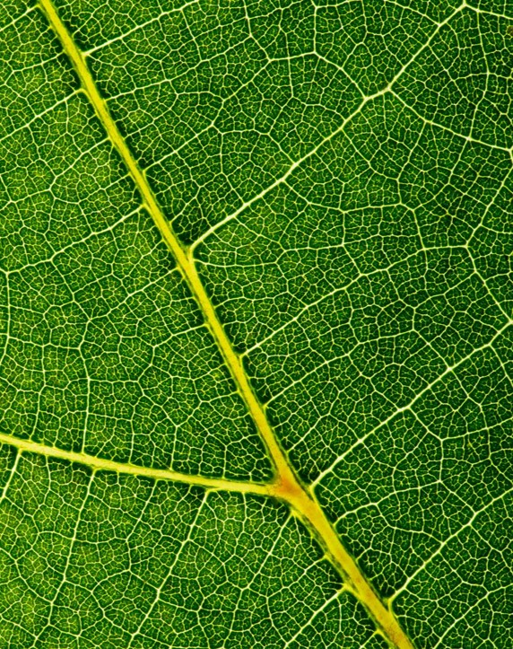
Thank you

