Slide 1
BLUEWAY – Bluetooth Based
Indoor Navigation System
Phase-2 Review -2
Tag-8 Cooperative Cyber-Physical Social Systems
Guide: Dr. Vijaya Kumar Sundar
SL NO. | Roll No | Name
1 | CB.EN.U4CSE20421 | Guru Prasad K S
2 | CB.EN.U4CSE20435 | Logeswaran S R
3 | CB.EN.U4CSE20437 | Manish S
4 | CB.EN.U4CSE20449 | Praveen Kumar M

Slide 2
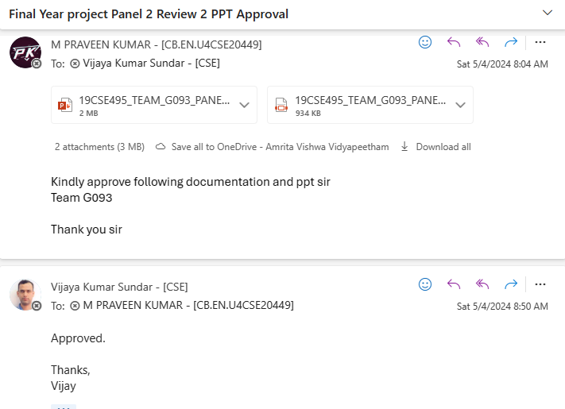

Slide 3
Objective
To develop an indoor navigation app designed to enhance the user experience by assisting clients with seamless navigation inside a building.

Slide 4
Issue Mentioned
What happens when the user stands in a dead zone in between two bluetooth beacons?
When standing in a dead zone between two Bluetooth beacons, the user's location can't be accurately determined, so it's typically inferred from the last known beacon signal. This means the location will remain fixed to the previous beacon until the user moves within range of another beacon or a different location tracking method is used.

Slide 5
Problem Statement
1. To create an innovative indoor navigation system that reduces the time spent in searching location in building.
2. To design and implement indoor navigation app to assist the clients in finding location efficiently.

Slide 6
Motivation
Customer Convenience
Reduce the manpower
Efficiency
Data analytics
Social distance

Slide 7
Research gap
1.Comprehensive Integration of Technologies: Existing studies often focus on individual technologies in isolation. Our project bridges the gap by integrating Android apps, ESP32 Bluetooth beacons, cloud processing, gyroscope, and RSSI-based positioning into a cohesive system, providing a comprehensive solution for supermarket navigation. 2. User-Centric Approach: Many navigation systems lack a user-centric perspective, leading to suboptimal user experiences. Our solution prioritizes user needs by introducing a streamlined app interface, real-time directional guidance, and personalized route optimization, addressing the research gap in user-centric design for supermarket navigation.

Slide 8
Research gap
3. Cloud-Based Processing for Efficiency: Traditional Bluetooth navigation systems may face limitations in real-time processing and adaptability. Our project introduces cloud-based processing, allowing offloading of complex computations, dynamic adjustments, and scalability, addressing the research gap in efficient and adaptable navigation systems.
4. Hybrid Localization Methods: Many Bluetooth-based localization systems rely solely on RSSI, which can be affected by environmental challenges. Our project addresses this gap by proposing a hybrid localization approach that combines RSSI-based positioning with gyroscope data and step counting, offering a more robust and reliable solution.

Slide 9
Novelty of the solution
Shortest path algorithm for route optimization
Cloud processing for scalability and adaptability
Combined approach for improved location tracking
Step counting for additional confirmation
Compass values for directional approach
Fault detection

Slide 10
Proposed methodology
Route optimization using shortest path algorithms
2. Use of ESP32 for Bluetooth module
Use of accelerometer and gyroscope for position accuracy
Fault detection

Slide 11

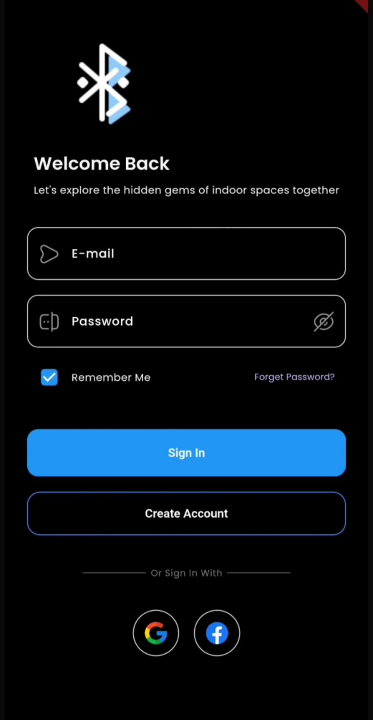
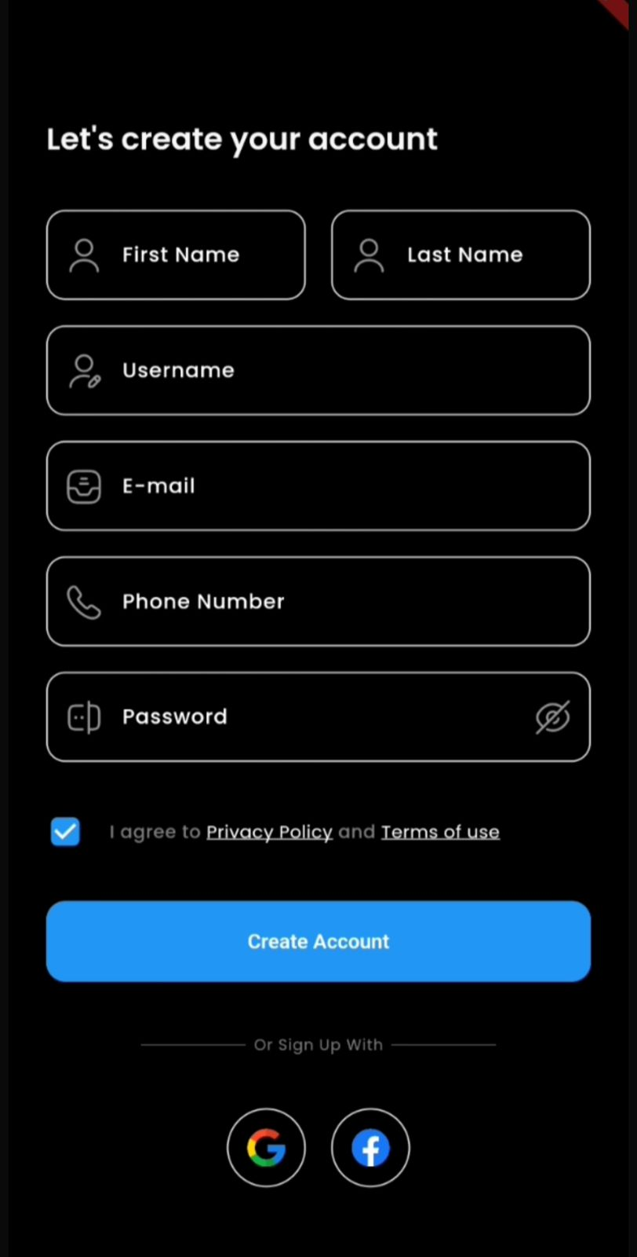
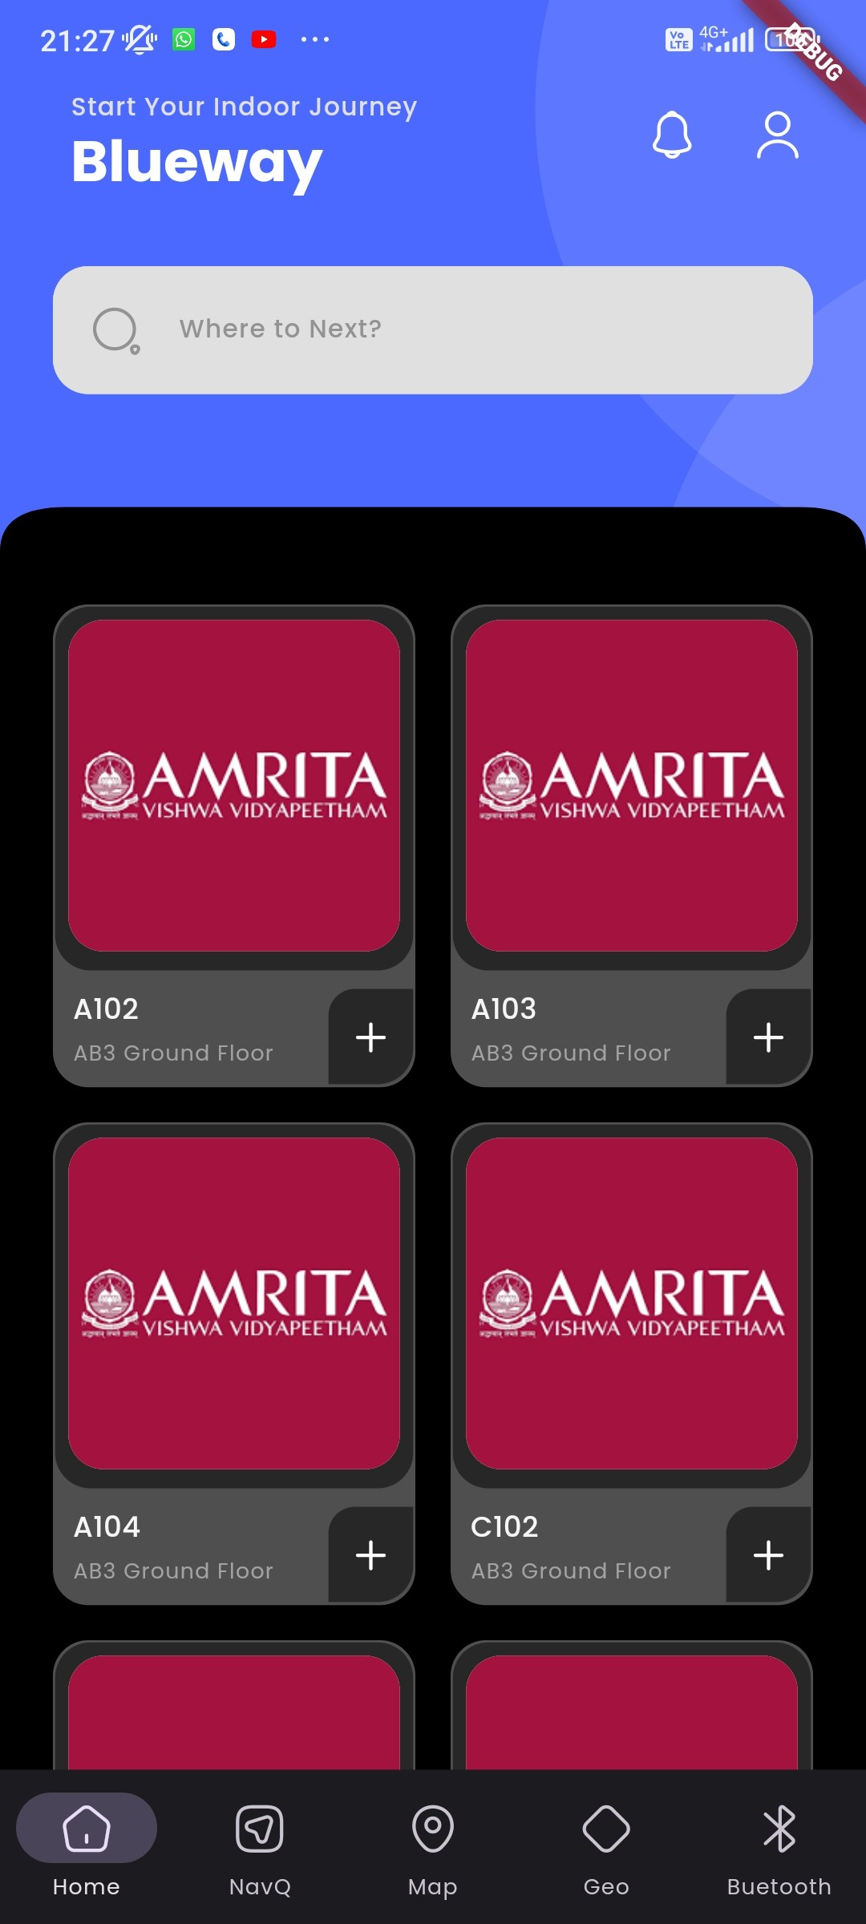
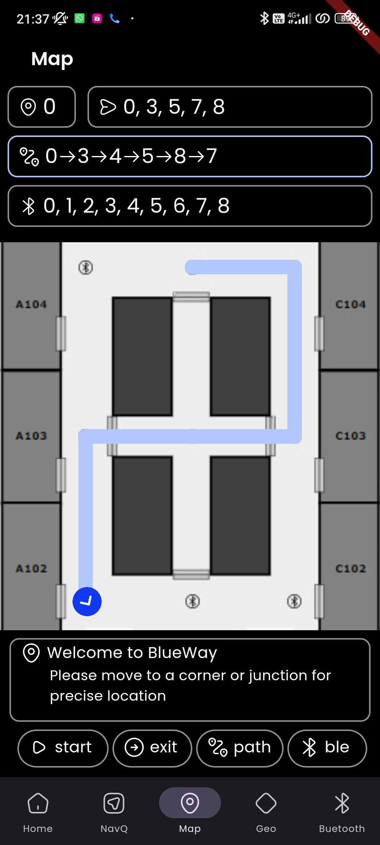
User Experience

Slide 12
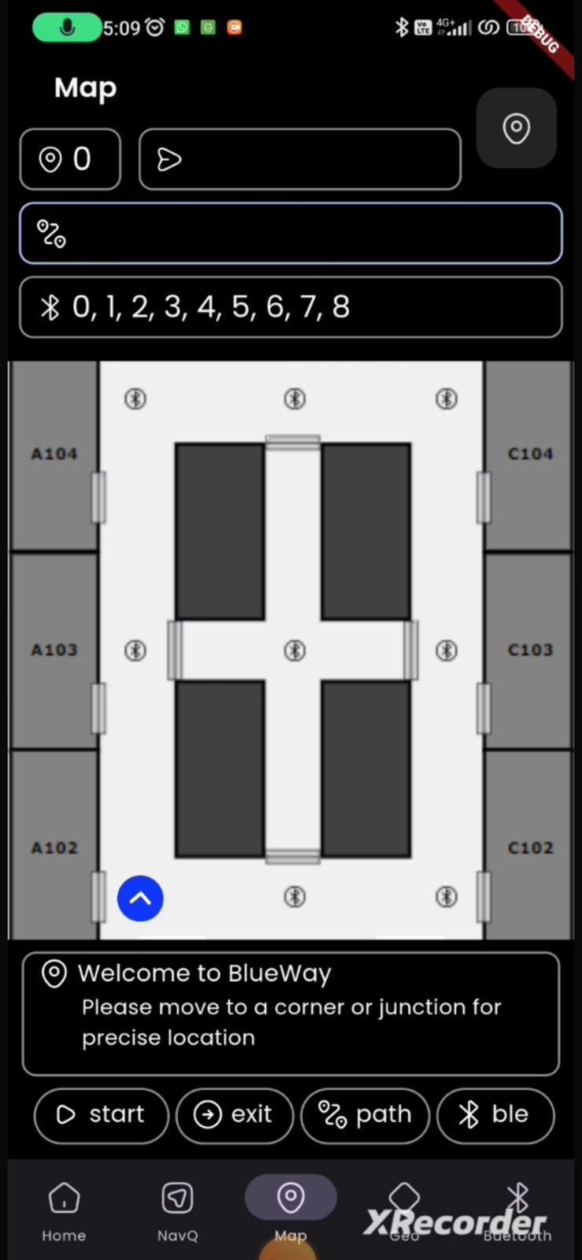
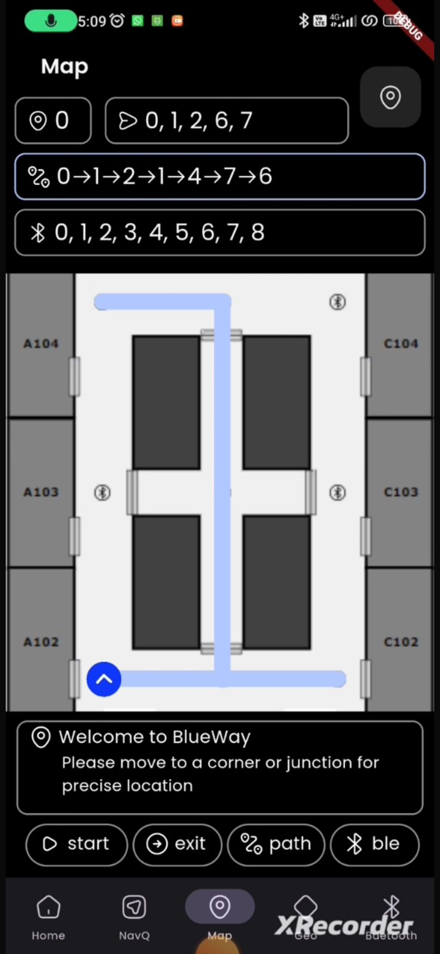
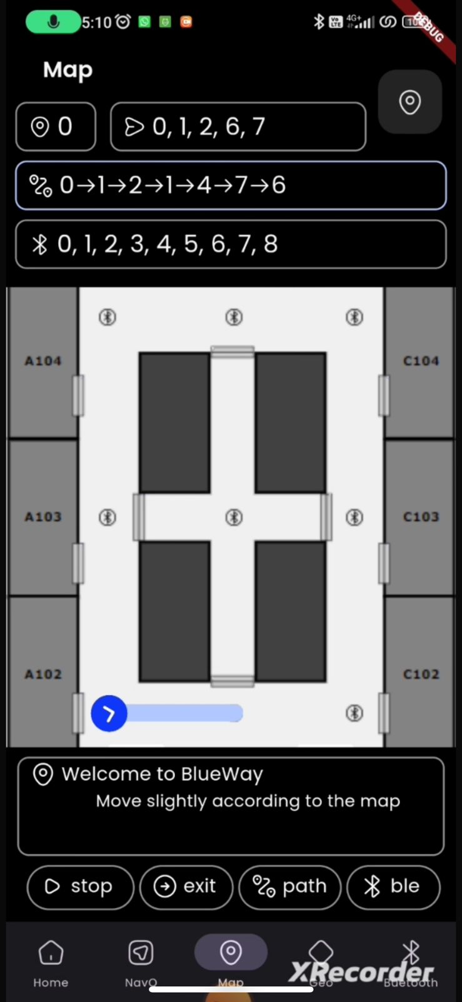
Map
Path Finding
Navigation

Slide 13
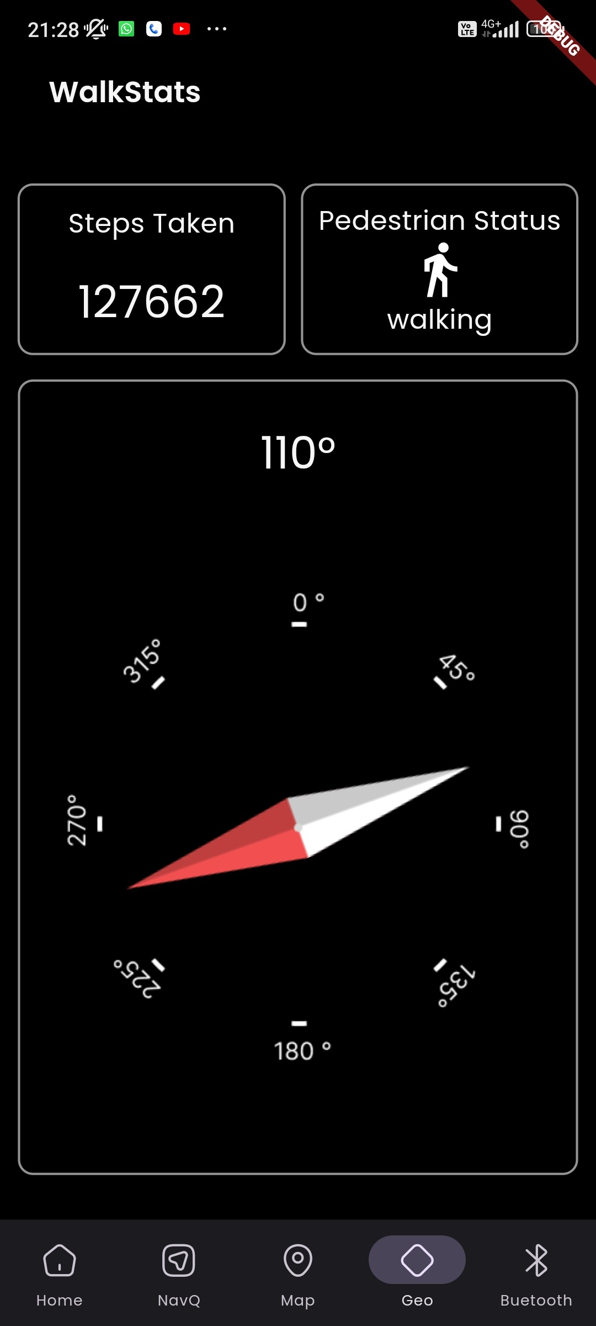
Compass and step counting
The compass features, in the navigation system are designed to help users find their way as they move around indoors. Using compass data, the system can update the
relationship with each point-to-point direction to ensure the user is on track.

Slide 14
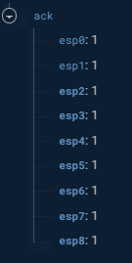
Fault Detection
The indoor navigation system now includes a fault detection feature that utilizes the Firebase real time database. This function is intended to maintain the dependability and consistency of the system by keeping an eye on the condition of ESP32 devices located across the surroundings.

Slide 15
Challenges
Battery Consumption : Many indoor navigation solutions rely on mobile devices, which can drain battery life quickly, especially when using energy-intensive positioning techniques like GPS or Wi-Fi scanning.
2. Infrastructure Requirements : Effective indoor navigation typically requires the installation, maintenance of infrastructure such as beacons, sensors, or Wi-Fi networks. This can be costly an time-consuming, especially in large or complex indoor environments.
3. Accuracy : Indoor navigation systems often struggle to achieve the same level of accuracy as GPS-based outdoor navigation. Factors such as signal interference, multi-path propagation, and obstacles like walls and furniture can degrade the accuracy of indoor positioning technologies.

Slide 16
Literature Survey
Ref # &Year | Title | Problem Statement | Methodology | Outcome
2023 | Precision Localization: An Experimental Study on BLE Fingerprinting and Trilateration with ESP32 | To addresses the problem of indoor localization using Bluetooth Low Energy (BLE) technology and a network of wireless anchors. | The research paper employed two techniques for indoor localization: Fingerprinting (FP) and Trilateration. Both techniques were tested in various environments and layouts to evaluate their accuracy for indoor localization. The aim was to investigate the accuracy of each technique, and each technique was tested multiple times on different conditions | Fingerprinting achieved an accuracy of 79.31% without positions on the other side of a separating concrete wall and 71.88% including those positions. Trilateration, on the other hand, achieved an accuracy of 44.44%. The results indicate that FP is more suitable for indoor localization, particularly in large buildings with many rooms.
2022 | Fine Time Measurement for the Internet of Things: A Practical Approach Using ESP32 | The paper addresses the limitations of the current ESP32-S2 estimation algorithm for distance measurement using Wi-Fi FTM technology, specifically in indoor environments where distance estimates may have errors of tens of meters. The goal is to improve the accuracy of distance estimates and analyze the suitability of the ESP32-S2 for IoT environments. | This paper applies machine learning techniques, including artificial neural networks (ANN) and Gaussian probability distribution, to estimate distances using Wi-Fi FTM technology indoors, achieving sub-4-meter error for 90% of samples. It utilizes Gaussian probability for function behavior modelling, employing an exponential kernel for accurate regression and classification models | This paper enhances indoor distance estimation with Wi-Fi FTM and the ESP32-S2 SOC, using ANN and Gaussian probability. The ANN achieves sub-4-meter error for 90% of samples, and Gaussian probability aids function behaviour modelling with an exponential kernel. It also explores the ESP32-S2 SOC's IoT potential due to its affordability and advanced wireless features.

Slide 17
Ref # &Year | Title | Problem Statement | Methodology | Outcome
2019 | An Indoor Positioning Service for Bluetooth Ad Hoc Networks | To Develop a low-cost and accurate indoor positioning system using Bluetooth technology. | Use Bluetooth signal strength measurements to triangulate the position of a mobile device from known positions of reference tags and Investigate the relationship between Bluetooth signal strength and distance in different indoor environments. | A low-cost and accurate indoor positioning system using Bluetooth technology. This system can be used to track the location of people or objects indoors with high accuracy.
2023 | Fault Detection in Overhead Transmission Lines and Automation using Cloud Base System | The problem addressed in the paper is the increased risk of faults in extended power transmission lines, necessitating the development of a quick and efficient fault detection system to minimize damage and downtime. | The methodology involves real-time monitoring of transmission line parameters using ESP32, data transmission to the Blynk application, implementation of a fault detection algorithm (potentially wavelet transform or artificial neural networks), and triggering relay modules for automatic isolation of faulty sections. | The paper's results demonstrate a successful implementation where the Arduino-based system detects and locates faults in the transmission line using Ohm's Law, displays the fault information on an LCD, and triggers relay modules to disconnect the corresponding load, effectively restoring normal operation after the fault is cleared.

Slide 18
Ref # &Year | Title | Problem Statement | Methodology | Outcome
2023 | Radio map generation approaches for an RSSI-based indoor positioning System. | Efficient generation of RSSI radio maps for indoor positioning systems is hindered by the time-intensive process; this paper seeks to address this challenge through innovative methods for faster map creation without compromising accuracy. | •Fingerprinting Localization Method •Biharmonic Spline Interpolation Method •Location Estimation Process | The paper's outcome demonstrates the effectiveness of the Biharmonic Spline Interpolation (BSI) method, improving indoor positioning system efficiency with an average accuracy of approximately 0.45 meters. This suggests the potential applicability of the proposed methodologies in diverse location-based scenarios, including critical situations like emergency evacuations.
2023 | Enhancement of an RSSI‑Based Min–Max Localization Method with Forbidden Zone Consideration for Indoor Corridor Environments | To addresses the challenges of inaccuracies in Received Signal Strength Indicator (RSSI)-based indoor corridor localization, emphasizing signal fluctuations, RSSI-to-distance conversion issues, and limitations of the traditional min–max method. | Min–Max Method with Forbidden Zone Consideration Experimental Evaluation Localization Accuracy Analysis Computational Cost Analysis Consideration of RSSI Variation Integration of Forbidden Zone Handling Zone Selection Technique Comparison with Traditional Min–Max Method Extension of Min–Max Method Future Work Considerations | The proposed RSSI-based localization system, integrating the Min–Max method with forbidden zone consideration, demonstrated superior accuracy (52.189% improvement) in indoor corridor environments, ensuring all estimated locations were within the corridor area.

Slide 19
Ref # &Year | Title | Problem Statement | Methodology | Outcome
2023 | Efficient Localization Method Based on RSSI for AP Clusters | To address the susceptibility of RSSI-based wireless localization methods to signal strength fluctuations and the computational complexity associated with nonconvex maximum likelihood estimation (MLE) for target tracking. | RSSI-Based Access Point Cluster Localization (APCL) Method, Eigenvalue Transformation Localization (ETL) Algorithm, Radio Distance Weighting (RDW) Algorithm, Simulation and Experimental Evaluation, Localization Experiments Based on Public Datasets, RMSE (Root Mean Square Error) Calculation , Computational Cost Analysis, Comparison with Classical Localization Algorithms. | The APCL method, integrating RDW and ETL algorithms, achieves superior positioning accuracy, low computational complexity, and efficient real-time tracking for indoor mobile targets, outperforming classical localization algorithms.

Slide 20
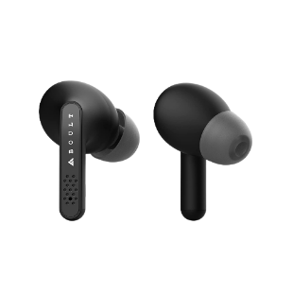
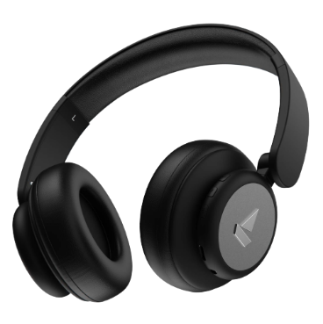
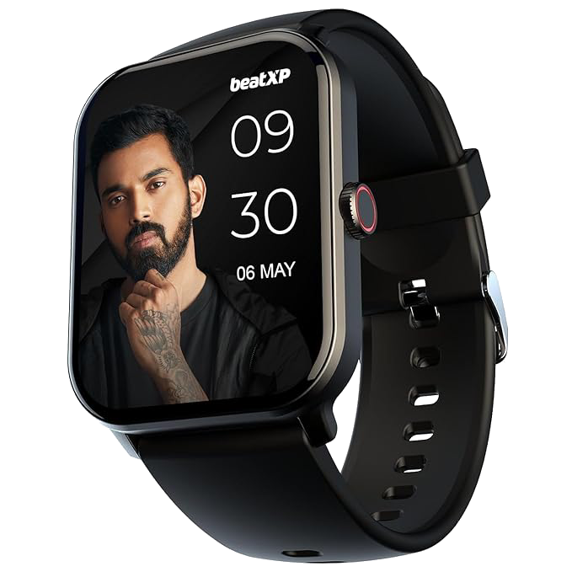
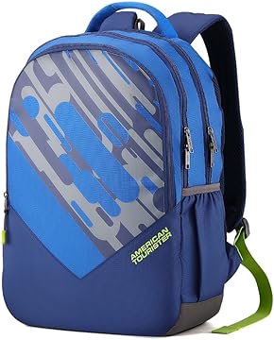
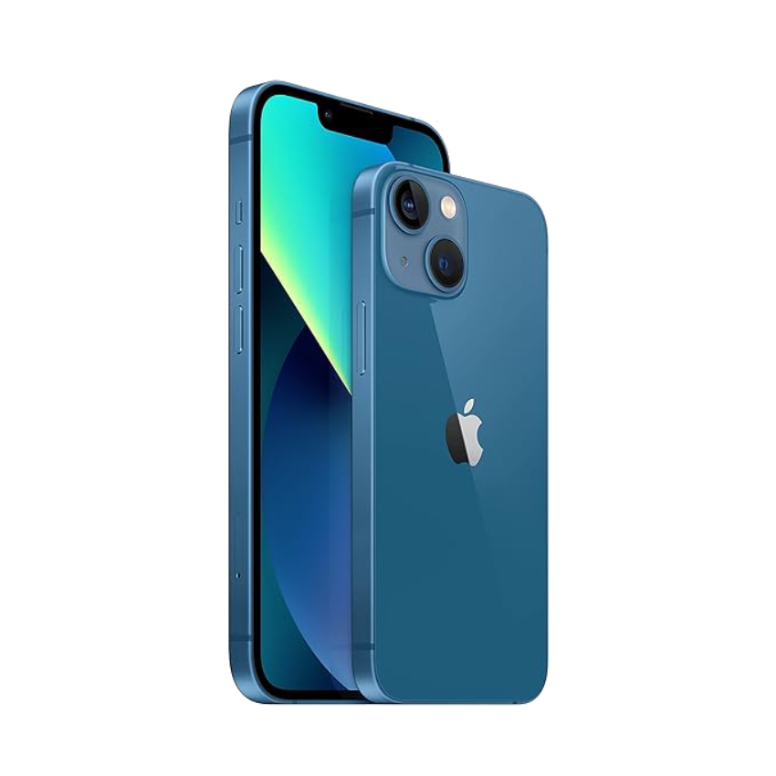


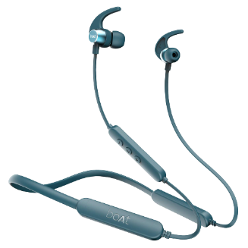
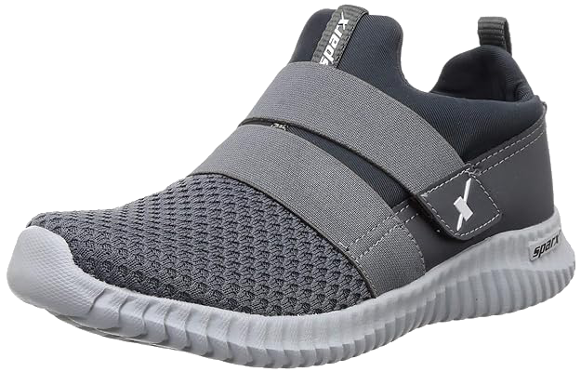
Algorithm
2
1
finding the shortest possible path between all nodes in a weighted graph
finding all shortest path between the targeted nodes
finding the shortest path from the above paths
adding the intermediate nodes in the shortest path
[ 8 ]
[ 2 ]
[ 3 ]
3
1
3
[ 3, 7, 6 ]
[ 1 ]
2
4
[ 4 ]
2
1
4
[ 7 ]
[ 0 ]
[ 5 ]
[ 6 ]

Slide 21
References
droid application based monitoring and controlling of movement of a remotely con- trolled robotic car mounted with various sensors via bluetooth.” 2016 International Conference on Advances in Electrical, Electronic and Systems Engineering (ICAEES), IEEE. 170–175.
Faragher, R. and Harle, R. (2014). “An analysis of the accuracy of bluetooth low energy for indoor positioning applications.” Proceedings of the 27th International Technical Meeting of The Satellite Division of the Institute of Navigation (ION GNSS+ 2014). 201–210.
La Delfa, G. C., Catania, V., Monteleone, S., De Paz, J. F., and Bajo, J. (2015). “Computer vision based indoor navigation: a visual markers evaluation.” Ambient Intelligence-Software and Applications: 6th International Symposium on Ambient In- telligence (ISAmI 2015), Springer. 165–173.
Padiya, S. D. and Gulhane, V. S. (2020). “Iot and ble beacons: Demand, challenges, re- quirements, and research opportunities-planning-strategy.” 2020 IEEE 9th International Conference on Communication Systems and Network Technologies (CSNT), IEEE. 125–129.

Slide 22
References
Song, W., Lee, H., Lee, S.-H., Choi, M.-H., and Hong, M. (2018). “Implementation of android application for indoor positioning system with estimote ble beacons.” Journal of Internet Technology, 19(3), 871–878.
Sun, M., Kamoto, K. M., Liu, Q., Liu, X., and Qi, L. (2020). “Application of blue- tooth low energy beacons and fog computing for smarter environments in emerging economies.” Cloud Computing, Smart Grid and Innovative Frontiers in Telecommuni- cations: 9th EAI International Conference, CloudComp 2019, and 4th EAI Interna- tional Conference, SmartGIFT 2019, Beijing, China, December 4-5, 2019, and Decem- ber 21-22, 2019 9, Springer. 101–110.
Swathi, B., Kamsali, S., Gayathri, K., and Lakshmi, M. D. (2023). “Design and imple- mentation of an iot-enabled bluetooth robot car with obstacle avoidance.” International Journal of Intelligent Systems and Applications in Engineering, 11(6s), 13–22.
Thapa, K. and Case, S. (2003). “An indoor positioning service for bluetooth ad hoc networks.” Midwest Instruction and Computing Symposium, MICS

