Slide 1
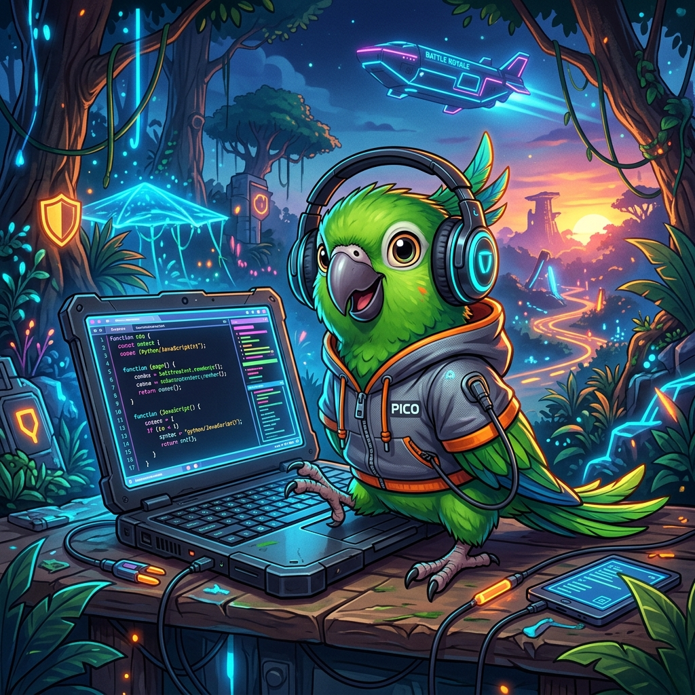
Pico: Mastering DSA Through Gamification
Empowering the next generation of Zoho Elite developers.

Slide 2
The Vision
Making DSA learning an adventure, not a chore.
• Goal: Build a student-centric platform for interview preparation.
• Focus: Zoho Elite curriculum and real-world coding success.
• Methodology: High-energy gamification to boost retention.

Slide 3
The Challenge
• Traditional platforms are dry and uninspiring.
• Students lose motivation within the first few weeks.
• High dropout rates in standard DSA courses.
• Lack of real-time feedback and engaging competition.

Slide 4
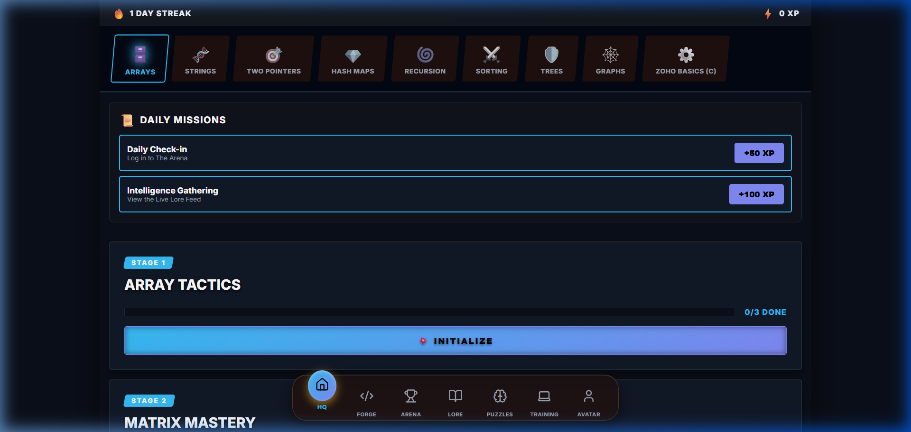
The Pico Solution
Combining Interview Prep with 'Battle Royale' Dynamics

Slide 5
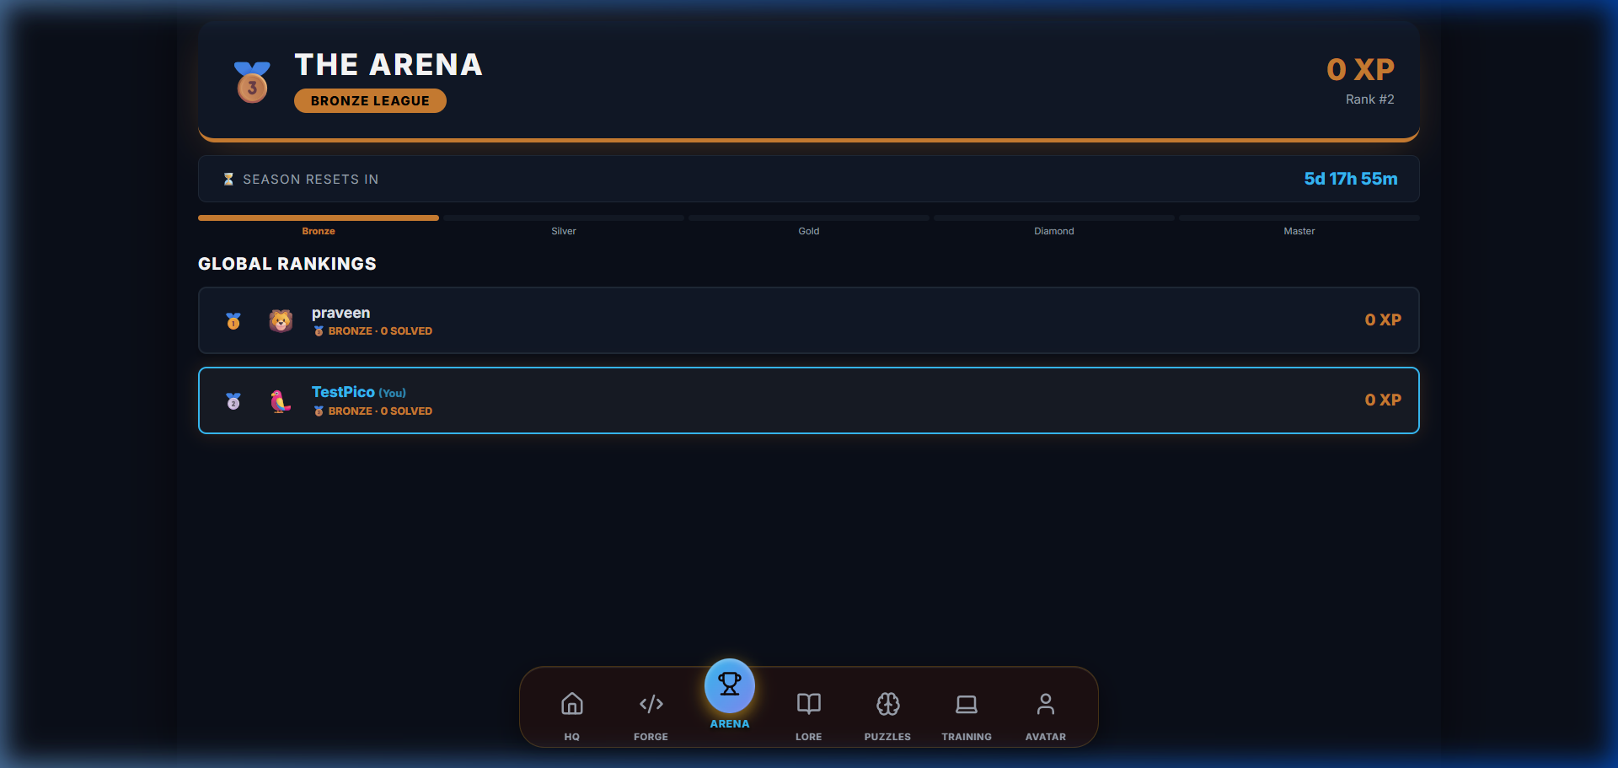
Engage, Compete, Level Up
• Animated wildlife themes (Parrot vs Goat)
• Daily quests and high-reward missions
• Progressive unlocks and RPG-style leveling

Slide 6
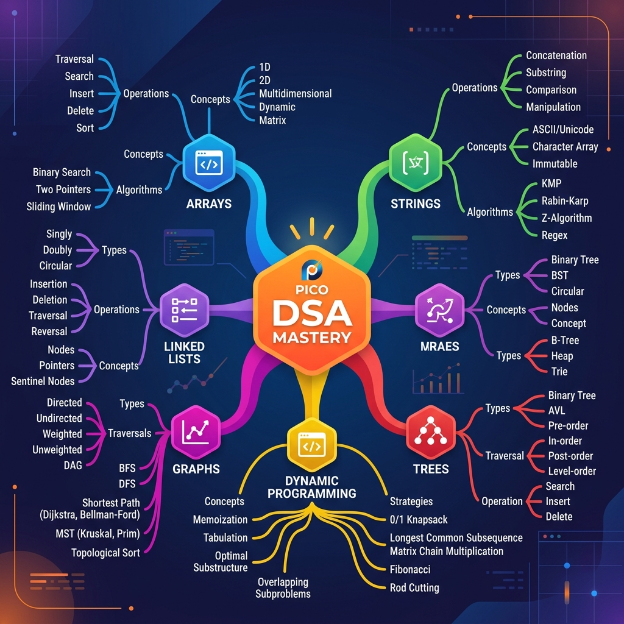
Zoho Elite Curriculum

Slide 7
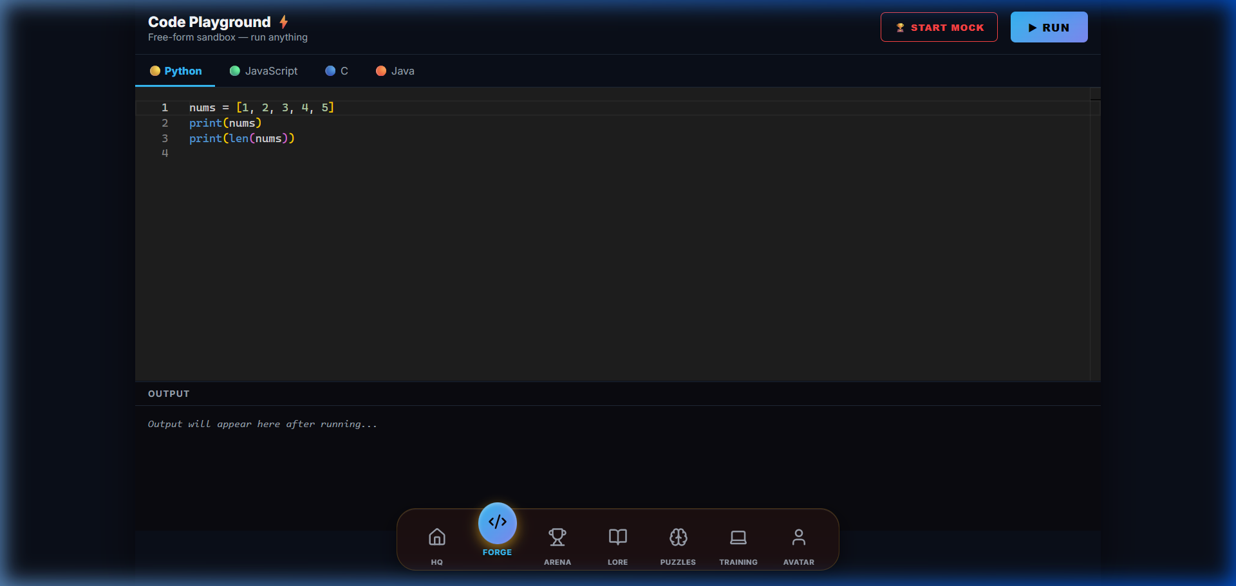
Interactive Code Engine
Real-time results with support for C, Java, Python, and more.

Slide 8
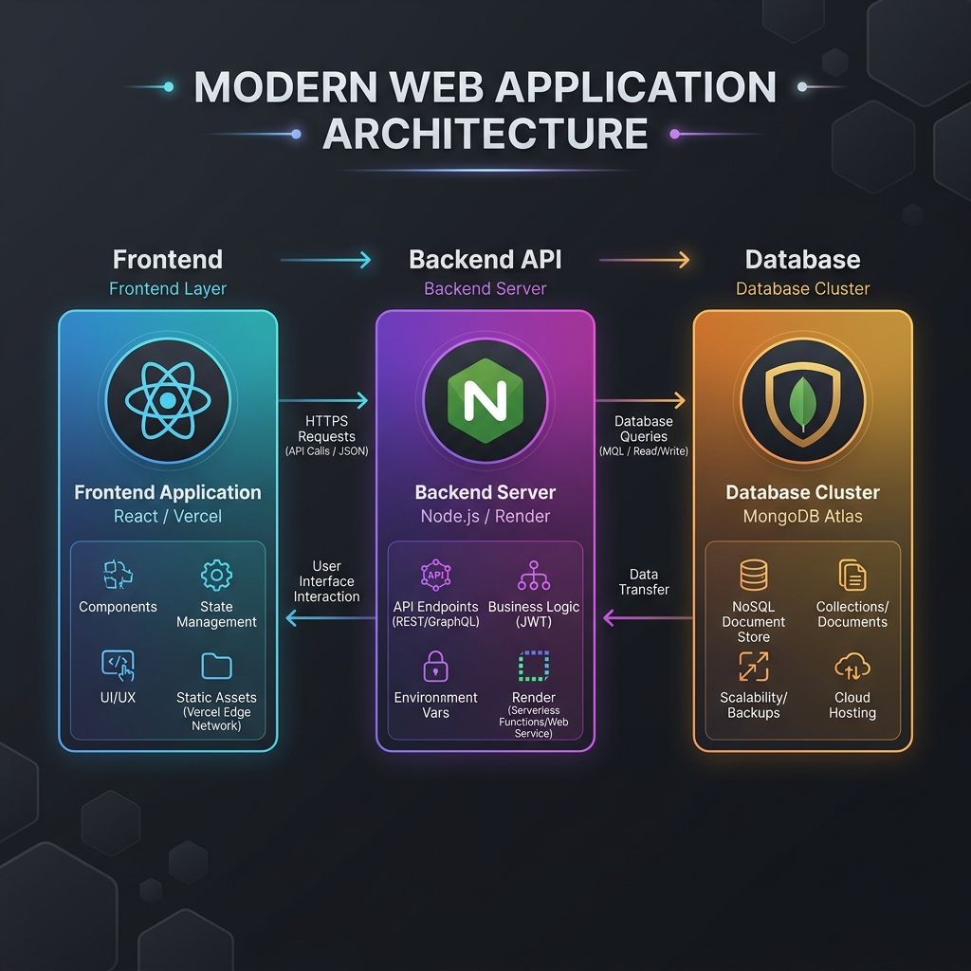
Technical Architecture

Slide 9
Scalable Cloud Infrastructure
• Frontend: React hosted on Vercel.
• Backend: Node.js/Express hosted on Render.
• Database: MongoDB Atlas (Cloud-native).
• Code Runner: Piston API Integration.
• Real-time: Socket.io for live updates.

Slide 10
The Future of DSA learning starts here
Join the Pico quest to master algorithms and land your dream job.

