Slide 1
Prediction

Slide 2
Team Members

Slide 3
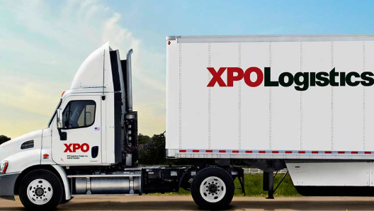
Problem Statement
2015
2016
2017
Products
PREDICT

Slide 4
What Can we do
Time Series Models
Classification Models
Forecasting
2018
Products

Slide 5

What we have done ?
Probability of the number of products per zip code.
By taking the probability of products acc to zip code ,we have taken the account of Zip code dependency.
Probability of number of products per month.
By taking the probability of products w.r.t month we have taken the account of seasonality of the products.
We have taken the total probabilities so that effect of seasonality and effect of zip code is taken into account.

Slide 6
Opportunities

