Slide 1


GridSense AI
AI-Powered Smart Grid, Energy Demand & Anomaly Intelligence Platform
Real-Time Energy Consumption, Solar Generation & Grid Risk Intelligence — Built on Power BI
PRESENTED BY
PRAVEEN M
Smarter Grids, Greener Tomorrow
ANUDIP FOUNDATION • BATCH - AI&ML
Power BI Project Review • Energy Analytics & Visualization
ID.no – AF05305017
Notes:
Welcome the panel and introduce GridSense AI: a Power BI-based analytics platform built on a cleaned smart-grid dataset (~20,000 readings) covering consumption, solar generation, weather and anomaly/risk signals. State the project is a data analytics and visualization project (not a deployed ML system) suitable for academic review.

Slide 2
GridSense AI
INTRODUCTION
Smart Grid & Energy Analytics
Why data-driven visibility matters for modern power networks
A smart grid layers digital sensors, smart meters and two-way communication onto traditional electricity infrastructure.
Every meter continuously reports consumption, solar generation, and environmental conditions — generating large volumes of time-series data.
Business Intelligence tools like Power BI turn this raw data into interactive dashboards for monitoring, comparison and planning.
GridSense AI applies this approach to a cleaned smart-grid dataset, organizing consumption, solar, weather, forecasting and anomaly signals into one analytical model.
PROJECT SCOPE SNAPSHOT
~20,000
SMART METER READINGS
20+
ANALYTICAL DATA FIELDS
4
POWER BI DASHBOARD PAGES
5
REGIONS & BUILDING TYPES TRACKED
GridSense AI | Academic Project Review
2
Notes:
Explain that smart grids depend on continuous data from meters and sensors. Frame Power BI as the tool that converts this stream into something people can act on. The scope panel on the right previews the scale of the dataset used in this project.

Slide 3




GridSense AI
PROBLEM STATEMENT
Problem Statement
Key challenges in monitoring and safeguarding a modern energy grid
Limited Visibility
Manual Anomaly Detection
Consumption, solar output and grid health are scattered across systems, with no consolidated real-time view by region or building type.
Spotting unusual consumption spikes or faulty readings by manual review is slow, inconsistent and easy to miss.
Reactive Maintenance
Fragmented Weather Insight
Without a structured risk score, sensor faults and outage risks are typically addressed only after failures occur.
Temperature, wind and humidity are rarely analyzed alongside demand, hiding how weather drives consumption.
GridSense AI | Academic Project Review
3
Notes:
Walk through each of the four challenges. Emphasize that these are the practical, everyday pain points that motivated GridSense AI — not hypothetical issues. Keep this factual and grounded in operations, since no ML claims are being made yet.

Slide 4





GridSense AI
OBJECTIVES
Project Objectives
What GridSense AI sets out to achieve
1. Consolidate multi-source data
Bring smart meter, solar generation and weather data into a single analytical model.
2. Enable real-time visibility
Surface consumption trends across regions, building types and individual meters.
3. Surface anomalies & risk early
Highlight anomaly flags, high-usage events, sensor health and outage risk in one view.
4. Support demand planning
Track forecast error and demand patterns to inform operational and capacity decisions.
5. Correlate weather & consumption
Connect temperature, wind and humidity with energy demand and solar output.
GridSense AI | Academic Project Review
4
Notes:
These five objectives map directly to the four dashboard pages shown later. Objective 1 underpins the data model; objectives 2–5 map to Energy Overview, Anomaly Intelligence, Forecasting and Weather Intelligence respectively.

Slide 5




GridSense AI
PROPOSED SYSTEM
Proposed System — GridSense AI
A unified Power BI analytics layer over smart-grid data
Unified Data Model
Interactive Filtering
Anomaly & Risk Monitoring
Meter, solar, weather and risk fields combined into one Power BI data model.
Slice every page by date range, region, building type and meter ID.
Anomaly flags, risk categories and outage risk scoring surfaced visually.
Forecast Insight
Weather Correlation
DAX-Driven KPIs
Actual vs. predicted consumption and forecast error tracked over time.
Temperature, wind and humidity analyzed against demand and solar output.
Custom DAX measures power every KPI card across the four dashboard pages.
GridSense AI | Academic Project Review
5
Notes:
GridSense AI's six pillars are all implemented as Power BI report features: data model, filters/slicers, conditional visuals for anomalies, forecast-vs-actual visuals, weather scatter/bar visuals, and DAX measures behind every KPI card.

Slide 6
GridSense AI
DATASET & TECH
Dataset & Technologies Used
~20,000-row cleaned smart-grid dataset, modeled and visualized in Power BI
DATASET FIELD GROUPS
TECHNOLOGY STACK
Time & Identifiers
Power BI Desktop
timestamp, date, month, day_name, meter_id, region, building_type
Report authoring & interactive dashboards
Consumption & Forecasting
Power Query
consumption_kwh, next_hour_consumption_kwh, lag1_kwh, lag24_kwh, roll24_std_kwh, Forecast Error, Forecast Error Band
Data cleaning, transformation & shaping
Solar & Weather
Data Modeling
solar_generation_kwh, solar_kw_installed, temp_c, wind_ms, humidity_pct, Temperature Range
Relationships across meters, time & weather
Anomaly & Risk
DAX
anomaly_flag, high_usage_flag, sensor_health, outage_risk_score, risk_category, peak_period
Custom measures behind every KPI & visual
GridSense AI | Academic Project Review
6
Notes:
The dataset groups roughly into four families of fields: identifiers/time, consumption & forecasting, solar & weather, and anomaly & risk. All cleaning and shaping was done in Power Query before modeling; DAX measures then drive every KPI and chart in Power BI.

Slide 7

GridSense AI
ARCHITECTURE
System Architecture & Workflow
From raw smart-grid data to decision-ready dashboards
1
2
3
4
5
Dataset
Data Cleaning
Data Modeling & DAX
Power BI Dashboard
Insights
~20,000 rows of
smart-grid records
Power Query:
formatting & shaping
Relationships +
custom measures
4 interactive
report pages
Monitoring, anomaly
& risk decisions
Existing (Implemented in Power BI): All five stages above are built and functioning in the current report. Proposed (Future Scope):
Automated alerting and predictive ML models layered on top of this workflow (see Slide 12).
GridSense AI | Academic Project Review
7
Notes:
Walk left to right through the pipeline: raw dataset, Power Query cleaning, data modeling with DAX measures, the Power BI dashboard itself, and finally the insights it enables. The callout box clarifies that this full pipeline already exists — nothing here is simulated.

Slide 8
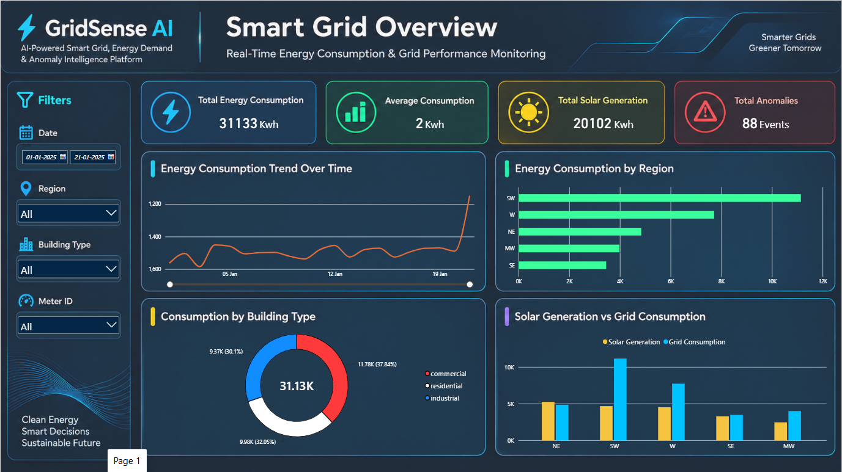
GridSense AI
DASHBOARD · PAGE 1
Page 1 — Energy Overview
Baseline consumption, generation and anomaly snapshot
KPI CARDS
Total Energy Consumption
Average Consumption
Total Solar Generation
Total Anomalies
KEY VISUALS
Energy Consumption Trend Over Time
Consumption by Region
Consumption by Building Type
Solar Generation vs Grid Consumption
DAX FOCUS
Total Consumption =
SUM(consumption_kwh)
Avg Consumption =
AVERAGE(consumption_kwh)
Live Power BI dashboard screenshot — existing implementation
GridSense AI | Academic Project Review
8
Notes:
This is the landing page of the report. KPI cards summarize total and average consumption, total solar generation and anomaly count. The trend line shows consumption over the selected date range, while the region, building-type and solar-vs-grid visuals let reviewers compare where energy is used and how much is offset by solar.

Slide 9
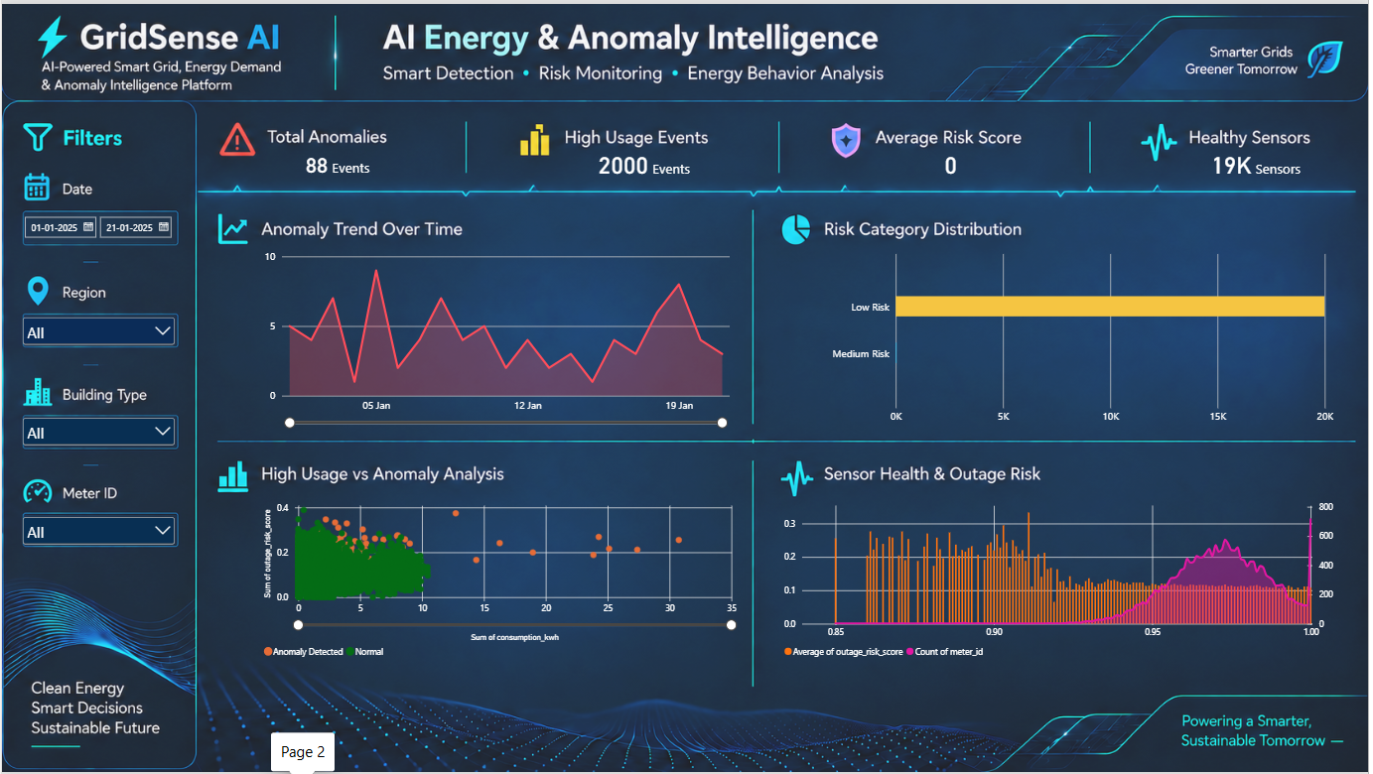
GridSense AI
DASHBOARD · PAGE 2
Page 2 — AI Energy & Anomaly Intelligence
Anomaly detection, sensor health and outage risk monitoring
KPI CARDS
Total Anomalies
High Usage Events
Average Risk Score
Healthy Sensors
KEY VISUALS
Anomaly Trend Over Time
Risk Category Distribution
High Usage vs Anomaly Analysis
Sensor Health & Outage Risk
DAX FOCUS
Total Anomalies =
SUM(anomaly_flag)
Avg Risk Score =
AVERAGE(outage_risk_score)
Live Power BI dashboard screenshot — existing implementation
GridSense AI | Academic Project Review
9
Notes:
This page focuses on anomaly and risk signals already present in the cleaned dataset — anomaly_flag, high_usage_flag, sensor_health, outage_risk_score and risk_category. It is descriptive analytics: the flags and scores are read from the data, not produced by a trained model. The scatter and distribution visuals help spot where anomalies cluster.

Slide 10
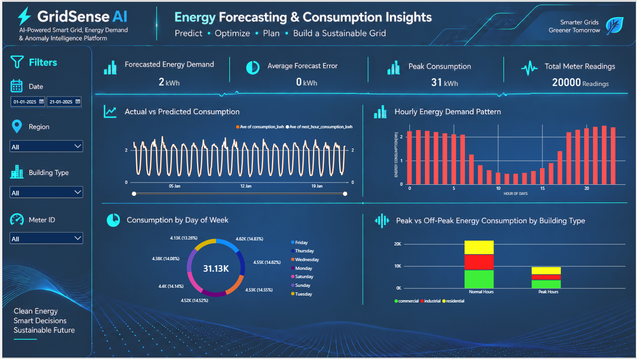
GridSense AI
DASHBOARD · PAGE 3
Page 3 — Forecasting & Consumption Insights
Actual vs. predicted demand and consumption patterns
KPI CARDS
Forecasted Energy Demand
Average Forecast Error
Peak Consumption
Total Meter Readings
KEY VISUALS
Actual vs Predicted Consumption
Hourly Energy Demand Pattern
Consumption by Day of Week
Peak vs Off-Peak Consumption by Building Type
DAX FOCUS
Forecast Demand =
SUM(next_hour_consumption_kwh)
Avg Forecast Error =
AVERAGE([Forecast Error])
Live Power BI dashboard screenshot — existing implementation
GridSense AI | Academic Project Review
10
Notes:
The forecasting page compares consumption against the pre-computed next_hour_consumption_kwh and Forecast Error fields already in the dataset — this is visualization of existing forecast-related columns, not a model trained within this project. Hourly and day-of-week visuals reveal demand rhythm; the peak-vs-off-peak chart breaks this down by building type.

Slide 11
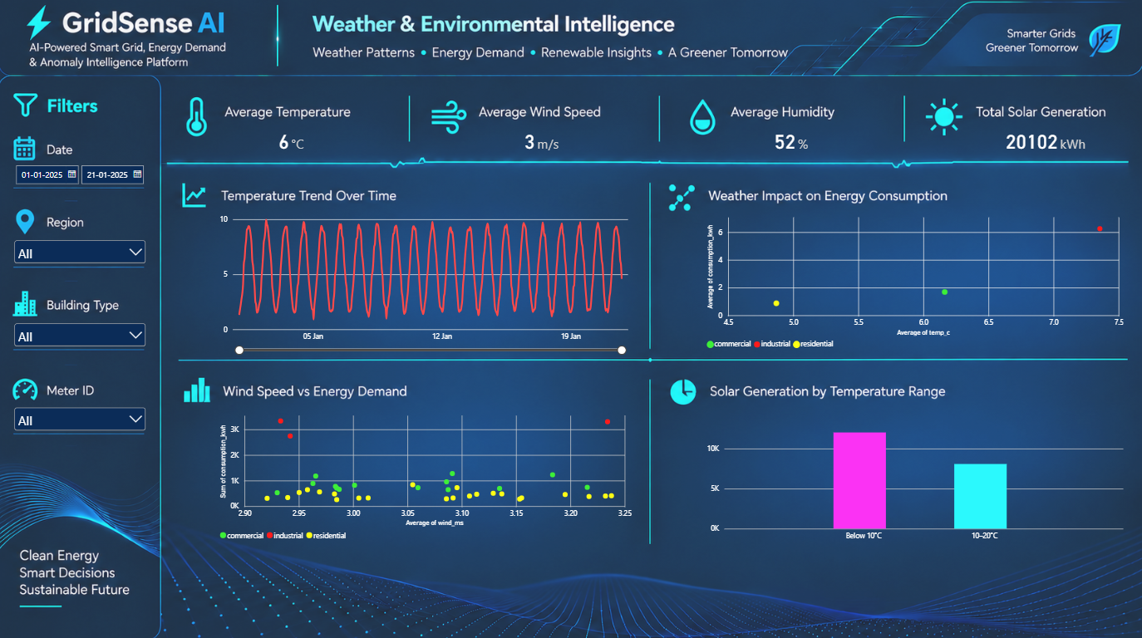
GridSense AI
DASHBOARD · PAGE 4
Page 4 — Weather & Environmental Intelligence
Correlating temperature, wind and humidity with energy demand
KPI CARDS
Average Temperature
Average Wind Speed
Average Humidity
Total Solar Generation
KEY VISUALS
Temperature Trend Over Time
Weather Impact on Energy Consumption
Wind Speed vs Energy Demand
Solar Generation by Temperature Range
DAX FOCUS
Avg Temperature =
AVERAGE(temp_c)
Solar by Temp Band =
SUM(solar_generation_kwh)
by [Temperature Range]
Live Power BI dashboard screenshot — existing implementation
GridSense AI | Academic Project Review
11
Notes:
This page overlays environmental fields — temp_c, wind_ms, humidity_pct — with consumption and solar generation. The scatter visuals let a reviewer see whether demand or solar output shifts with weather conditions, using the Temperature Range field to bucket results.

Slide 12


GridSense AI
CONCLUSION
Conclusion & Future Scope
What GridSense AI delivers today, and where it can go next
Current Implementation (Power BI)
Future Enhancements (Proposed)
Cleaned ~20,000-row smart-grid dataset modeled in Power BI
4 interactive dashboard pages covering overview, anomaly/risk, forecasting and weather
DAX measures driving every KPI card and chart
Filters for date, region, building type and meter ID across all pages
Descriptive anomaly, risk and forecast-error visuals based on existing dataset fields
Machine-learning based anomaly detection and demand forecasting model (not yet trained or deployed)
Automated alerts and notifications for high-risk anomalies and sensor faults
Live streaming integration with real smart-meter feeds, beyond static historical data
Mobile-optimized dashboard views for field engineers
Expanded scope to include cost/billing and carbon-impact analytics
GridSense AI | Academic Project Review
12
Notes:
Close by clearly separating what exists today from what is proposed. Everything on the left is implemented and demonstrable in the current Power BI report. Everything on the right — especially any machine-learning model — is future scope only, not claimed as built or evaluated in this project. Thank the panel and invite questions.

