Slide 1





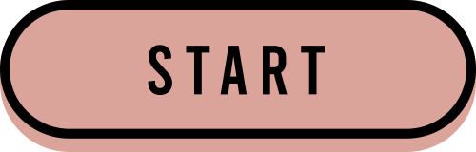

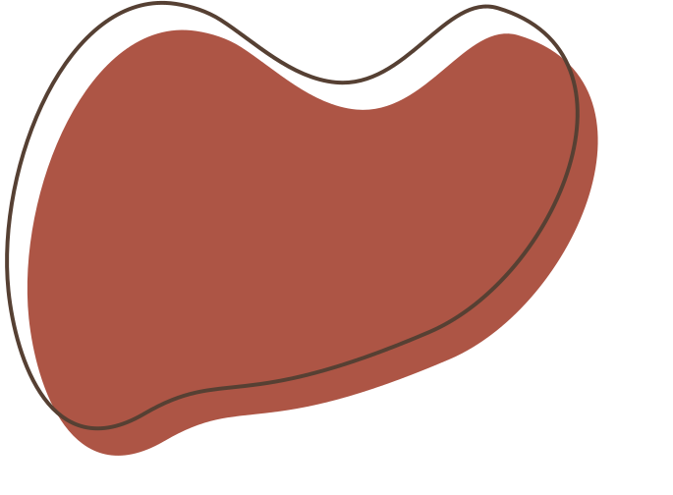
SMART PARKING
Presented by PRAVEEN S

Slide 2
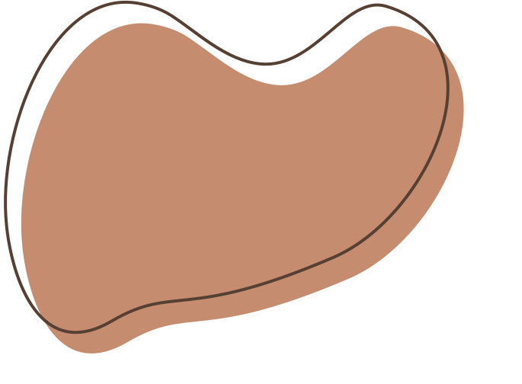







Project Planning
Start by defining clear objectives and goals for the project. What are you aiming to achieve by integrating IoT sensors into public transportation vehicles?

Slide 3
Research and Requirements Gathering:
Research existing IoT sensor technologies suitable for public transportation.
Gather requirements from stakeholders, including transit agencies, commuters, and the public, to understand their needs and expectations.

Slide 4
IoT Sensor System Design
Design the IoT sensor system, including the type of sensors to be used, their placement within vehicles, and data communication protocols.
Ensure data security and privacy considerations are incorporated into the design.

Slide 5
Hardware Implementation
Procure the necessary IoT sensors and hardware components.
Install and configure the sensors on public transportation vehicles

Slide 6
Software Development
Develop the real-time transit information platform using Python or other suitable technologies.
Create a user-friendly interface for commuters to access real-time transit data.

Slide 7
Data Collection and Analysis:
Collect data from the IoT sensors, such as ridership counts and vehicle locations.
Implement predictive algorithms to estimate arrival times based on collected data.

Slide 8
Integration
Integrate the IoT sensor system with the real-time transit information platform.
Ensure seamless data flow between sensors and the platform

Slide 9
Testing and Quality Assurance
Conduct thorough testing to ensure the system functions correctly and provides accurate information.
Address any bugs or issues that arise during testing.

Slide 10
Deployment
Deploy the integrated system on public transportation vehicles.
Make the real-time transit information platform accessible to the public through a user-friendly interface.

Slide 11
Monitoring and Maintenance
Implement a system for monitoring the performance of sensors and the platform.
Set up regular maintenance schedules to ensure the system remains operational

Slide 12
Documentation and Training:
Document the entire project, including system architecture, hardware configurations, and software code.
Provide training to relevant personnel on how to operate and maintain the system

Slide 13
Public Outreach::
Promote the availability of real-time transit information to the public through various channels.
Gather feedback from users to continually improve the system.

Slide 14
Evaluation:
Assess the project's success by measuring key performance indicators, such as improved transit efficiency and user satisfaction.

Slide 15
Iterate and Improve:
Document the entire project, including system architecture, hardware configurations, and software code.
Provide training to relevant personnel on how to operate and maintain the system

Slide 16
Phase 1:
Project Definition and Design Thinking:

Slide 17
1.Project objectives:
Define specific objectives, such as real-time parking space monitoring, mobile app integration, and efficient parking guidance.

Slide 18
2.Iot senor designs:
Plan the design and deployment of IoT sensors in parking spaces to detect occupancy and availability. Decide on the type of sensors and their placement.

Slide 19
3.Real-Time Transit
Information Platform::
Design a mobile app interface that displays real-time parking availability to users. Consider user-friendly features like real-time maps and notifications

Slide 20
4.Integration Approach
Determine how Raspberry Pi will collect data from sensors and update the mobile app. Define data communication protocols and data flow.

Slide 21
Phase 2: Innovation
Consider integrating camera-based solutions for image processing to detect parking space availability. Explore technologies like computer vision for more accurate data.

Slide 22
Phase 3: Development Part 1n
Start building the IoT sensor system by procuring the necessary hardware components and installing sensors in parking spaces.
Begin Raspberry Pi integration to collect data from sensors. Develop the necessary software to transmit data.

Slide 23
Phase 4: Development Part 2
Develop the mobile app using Python or a suitable technology. Ensure it can receive real-time parking availability data from the IoT sensors and display it to users..

Slide 24
Phase 5: Project Documentation
& Submission
Document the Smart Parking project comprehensively. Your documentation should include:

Slide 25




Project objectives: Describe the specific objectives and goals.
IoT sensor setup: Explain the hardware and sensor types used, their placement, and how they work.
Mobile app development: Provide details on the app's functionality, design, and how it connects to the IoT sensor system.

Slide 26
Raspberry Pi integration: Describe how Raspberry Pi collects and processes data from sensors.
Code implementation: Share the source code for the IoT sensors, Raspberry Pi, and the mobile app.
Include diagrams, schematics, and screenshots to illustrate your setup and the mobile app interface.
Explain how the real-time parking availability system benefits drivers, reduces parking issues, and enhances the overall parking experience.

Slide 27

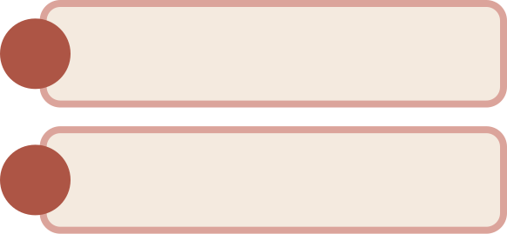
Project Goals
1.
Real-Time Parking Space Monitoring:
2.
Mobile App Integration
3.
Efficient Parking Guidance
4.
Enhancing Public Transportation Services

Slide 28
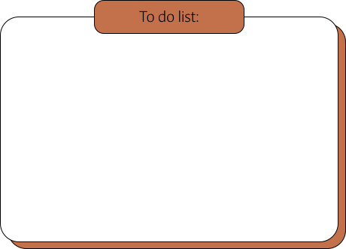
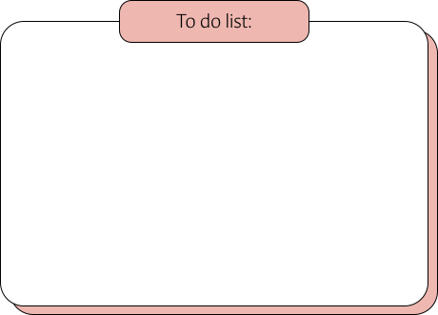
Result
Result 1
Result 2
User-Friendly Mobile App: The developed mobile app will offer a user-friendly interface, making it easy for drivers to access real-time parking information, receive guidance to available spaces, and streamline their parking experience.
Real-Time Parking Availability Data: The project will provide real-time data on parking space availability, allowing drivers to access up-to-the-minute information on parking availability in a given area.

Slide 29


Conclusion
Ensure your documentation is clear and well-organized, making it easy for your course instructors and peers to understand your project's concept and implementation. Finally, prepare your project for submission following any specific submission guidelines provided by your course.

Slide 30






