Slide 1
Side-Channel and Fault Attack Lab

Slide 2
Lab Session
Outline:
Timing attack: Password Checker
SPA: RSA Square & Multiply
Fault Attack: RSA Bellcore Attack
Fault Attack: Password Checker Emulator

Slide 3
Lab Session
Outline:
Timing attack: Password Checker
SPA: RSA Square & Multiply
Fault Attack: RSA Bellcore Attack
Fault Attack: Password Checker Emulator

Slide 4
Timing Attack
In naïve scenario, the comparison is done one at a time resulting in timing leakage
✓
✓
✕
✓
✕
✓
✓
✕
✓
✓
✓
✓
✓
✕
✓
✓
✓
✓
✕
✕
With Timing Oracle
Constant Time Oracle

Slide 5
Lab Session
Outline:
Timing attack: Password Checker
SPA: RSA Square & Multiply
Fault Attack: RSA Bellcore Attack
Fault Attack: Password Checker Emulator

Slide 6
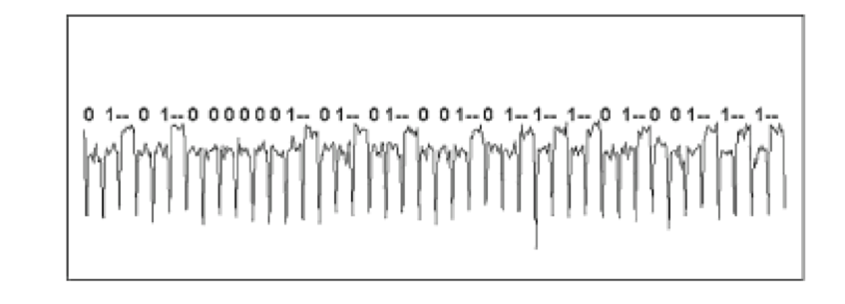
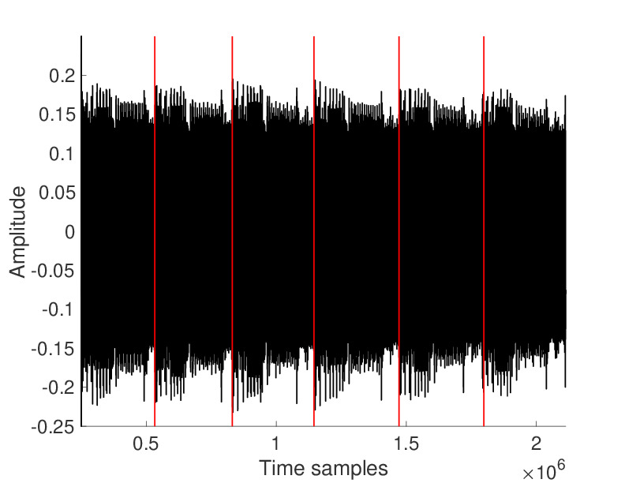
Simple Power/EM Analysis (SPA/SEMA)
Adversary learns secret information by visual inspection of (usually single) power/EM measurement
Ex: observe square & multiply in exponentiation etc.
Common Targets:
Key dependent operations, number of rounds/operations, memory access pattern, etc
1
2
3
4
5
6
Key Recovery from RSA Exponentiation
No. of Function Calls
Source: https://anysilicon.com/side-channel-attacks-differential-power-analysis-dpa-simple-power-analysis-spa-works/

Slide 7
Square & Multiply
An efficient way of computing C^{d} mod n is using an algorithm called square-and-multiply
Let's compute 117^65 mod 133
Convert 65 to binary ➔ 0b1000001
We started with C=117
Bit 0=1: 117
Bit 1=0: 117^2 mod 133 =123 ➔ S
Bit 2= 0: 123^2 mod 133 = 100 ➔ S
Bit 3= 0: 100^2 mod 133 = 25 ➔ S
Bit 4= 0: 25^2 mod 133 = 93 ➔ S
Bit 5= 0: 93^2 mod 133 = 4 ➔ S
Bit 6= 1: (4^2 * 117) mod 133 = 10 ➔ SM

Slide 8
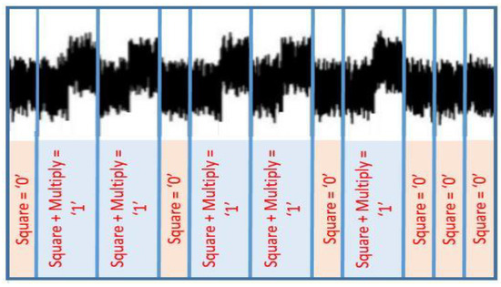
SPA on RSA: Square & Multiply
Ciphertext C, Modulus n, R=1
for i from k-1 to 0 do
R= R^2 mod n
if i=1 then
R= R*C mod n
Return R
Ciphertext C, Modulus n, R=1
for i from k-1 to 0 do
R₀= R^2 mod n
R₁= R*C mod n
R= R_{i}
Return R
Protection
SPA Leakage
0b011011010000

Slide 9
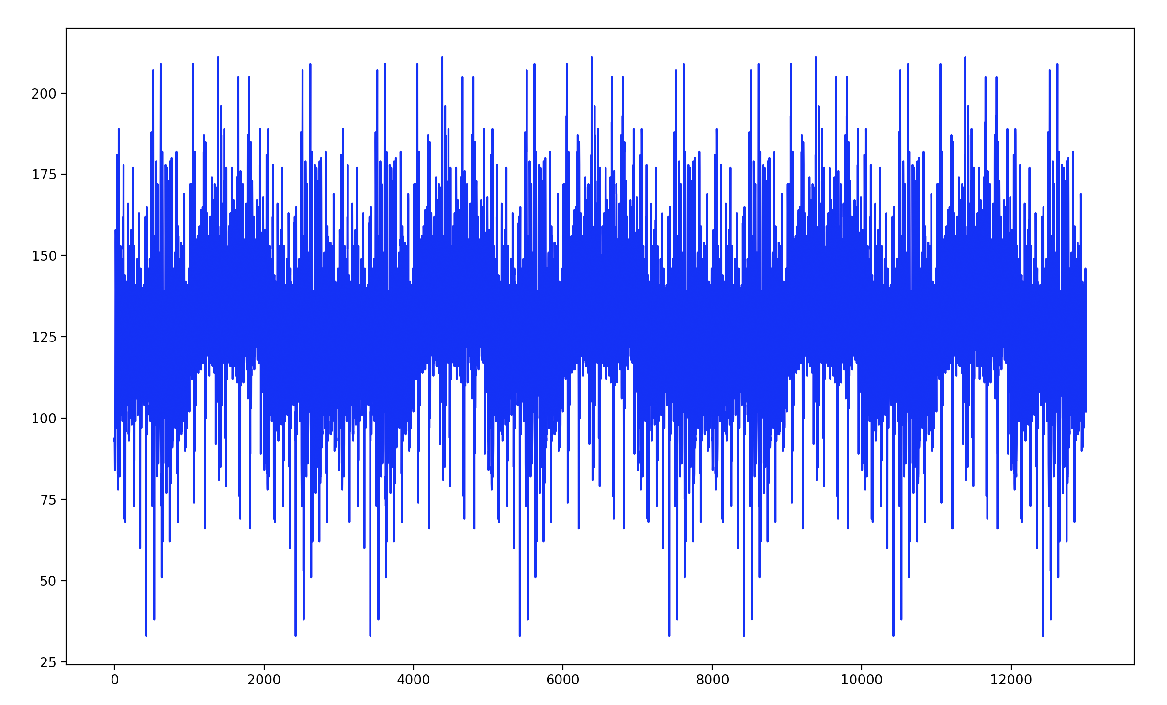
Find the Key
1 0 1 1 0 1 1 0 = 0xB6

Slide 10
Lab Session
Outline:
Timing attack: Password Checker
SPA: RSA Square & Multiply
Fault Attack: RSA Bellcore Attack
Fault Attack: Password Checker Emulator

Slide 11
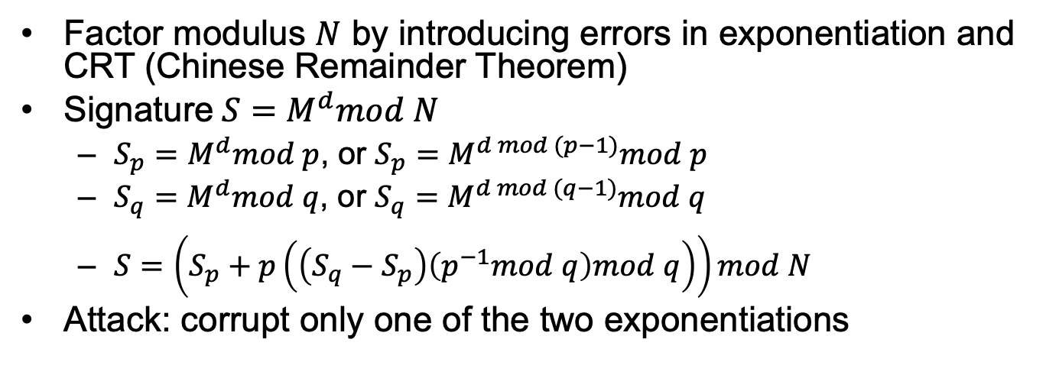
RSA Fault Attack: Bellcore
Factor modulus $N$ by introducing errors in exponentiation and CRT (Chinese Remainder Theorem)
Signature$S=M^{d}mod N$
$S_{p}=M^{d}mod p$, or $S_{p}=M^{d mod (p−1)}mod p$
$S_{q}=M^{d}mod q$, or $S_{q}=M^{d mod (q−1)}mod q$
$S=\left(S_{p}+p\left(\left(S_{q}−S_{p}\right)\left(p^{−1}mod q\right)mod q\right)\right)mod N$
Attack: corrupt only one of the two exponentiations

Slide 12
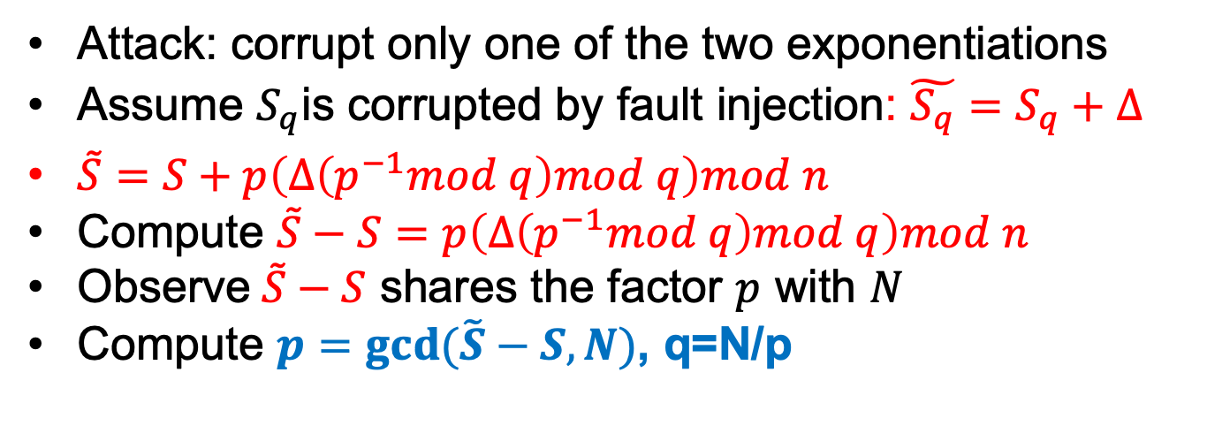
RSA Attack: Bellcore
Attack: corrupt only one of the two exponentiations
Assume $S_{q}$is corrupted by fault injection: $\tilde{S_{q}}=S_{q}+Δ$
$\tilde{S}=S+p\left(Δ\left(p^{−1}mod q\right)mod q\right)mod n$
Compute $\tilde{S}−S=p\left(Δ\left(p^{−1}mod q\right)mod q\right)mod n$
Observe$\tilde{S}−S$ shares the factor $p$ with $N$
Compute $p=gcd⁡(\tilde{S}−S,N)$, q=N/p
Notes:
\cite{http://euler.ecs.umass.edu/research/bbkn-IEEEP-2012.pdf}

Slide 13
Lab Session
Outline:
Timing attack: Password Checker
SPA: RSA Square & Multiply
Fault Attack: RSA Bellcore Attack
Fault Attack: Password Checker Emulator

Slide 14
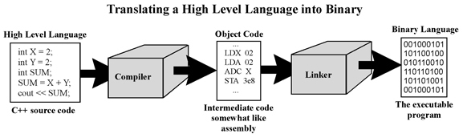
How Compiler Works
Basic illustration on how computer processes high level programming language

Slide 15
Bypass Password Check (Fault)
Task:
Given the binary for a basic password check. Gain a successful password check by skipping a specific instruction
Task:
Given the binary for a basic password check. Gain a successful password by introducing a “Delayed” Fault

