Slide 1
Waste Collection Data of India And Tamil Nadu
In
2023
NAME: Praveen Kumar N
ROLE: Data Science Trainee

Slide 2
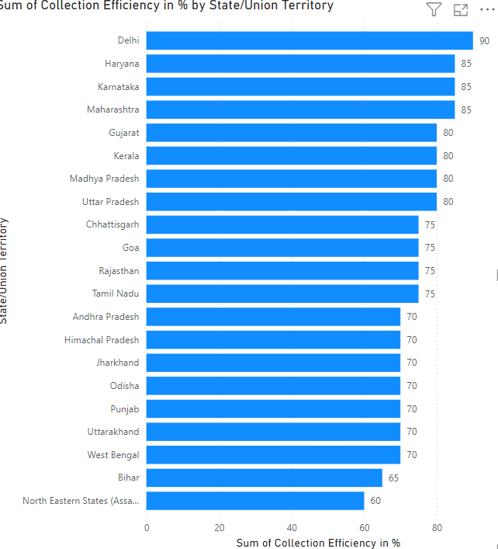
Visualization Of Indian State
1) Efficiency of Collection of Waste
In India, the efficiency of waste collection varies significantly across states, with Delhi leading in high efficiency and North Eastern states showing comparatively lower performance.
Delhi's efficient waste management practices likely result from robust infrastructure, organized systems, and strict regulatory enforcement.
Metropolitan cities generally have better waste collection and disposal due to larger budgets, higher population density, and more advanced waste management programs.
Conversely, the North Eastern states, often with challenging geography, lower population density, and limited access to resources, face difficulties in maintaining consistent waste collection services.

Slide 3
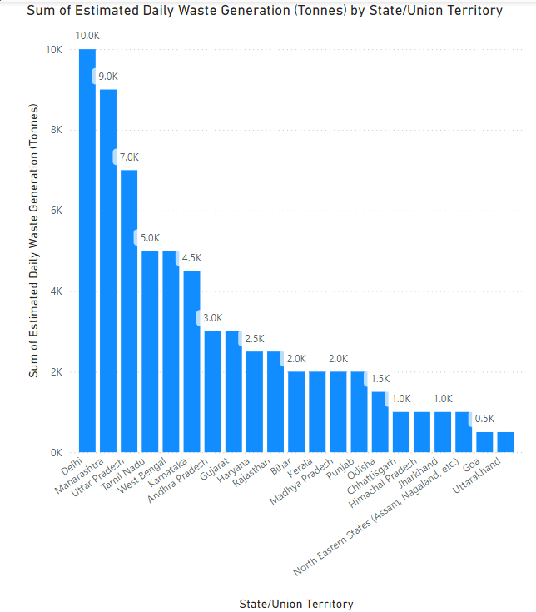
2) Estimation of daily waste in Each State
In India, Delhi leads with the highest daily waste collection, attributed to its large urban population, well-established waste management systems, and efficient collection processes.
The city's organized infrastructure and high waste generation due to dense population drive significant daily collection volumes. In contrast, Uttarakhand records the lowest daily waste collection.
This is likely due to its smaller population, widespread rural areas, and challenging terrain, which limit the ease and frequency of collection. Additionally, Uttarakhand's relatively lower waste generation per capita reduces the overall collection volume.
The contrast between Delhi and Uttarakhand emphasizes how urban density, infrastructure, and geographic factors influence waste collection efficiency and highlights the need for adaptable approaches to waste management across diverse regions in India.

Slide 4
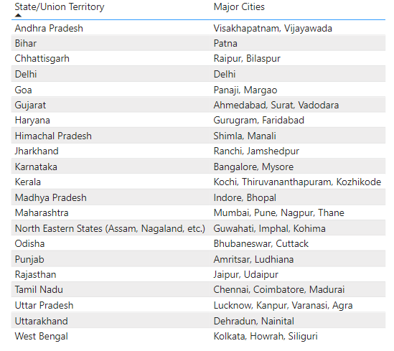
3) Major Cities That Contributes Waste
The table highlights the contribution of specific districts across various Indian states to overall waste collection volumes.
It shows that certain districts, often urban or densely populated, significantly contribute to their state’s waste generation.
These high-waste districts usually have larger populations and more commercial activity, leading to greater waste output.
The data underscores the importance of targeting waste management efforts in these districts to optimize collection and disposal efficiency.

Slide 5
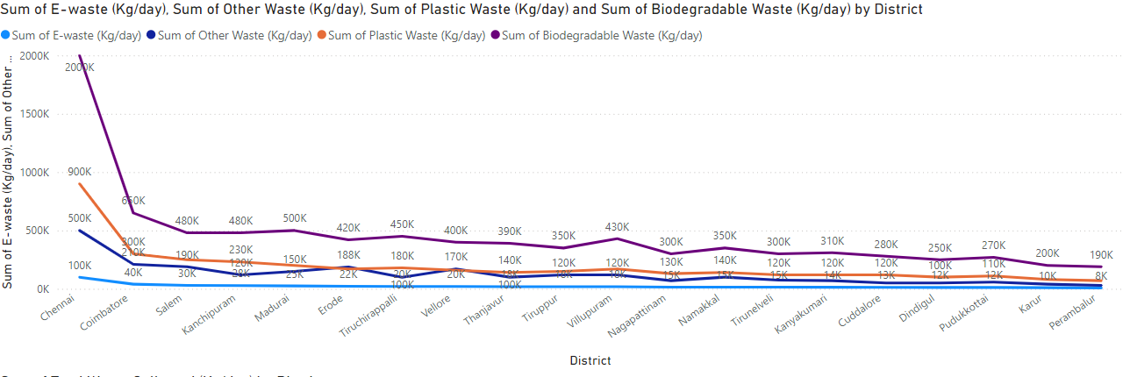
Visualization Of Waste Collection Tamil Nadu in District Wise
1)Sum of Different Types of Waste collected in a District

Slide 6
The visualization illustrates daily waste collection data across various districts in Tamil Nadu, categorizing it into types: Biodegradable Waste, Plastic Waste, E-waste, and Other Waste. It reveals that biodegradable waste typically forms the largest portion, reflecting widespread organic waste generation from households and food-related industries.
Plastic waste is also prevalent, especially in urban areas, due to high consumption of single-use plastics and packaging. E-waste, although less in volume, indicates growing electronic consumption and disposal trends, particularly in developed districts. "Other Waste" includes a mix of non-organic, construction, and industrial waste types, showing variation depending on district-specific activities.
This breakdown highlights the need for specialized waste management strategies for each type to enhance recycling, disposal efficiency, and environmental impact mitigation. Addressing waste categories at the district level can lead to more tailored and effective waste management solutions.

Slide 7
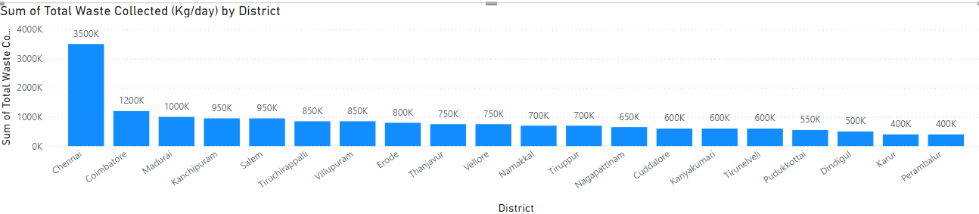
2) Sum of Waste Collected in Each District of Tamil Nadu
In Tamil Nadu, Chennai ranks highest in daily waste collection due to its large population, urban density, and commercial activity, resulting in significant waste generation. As the state's capital, Chennai has well-developed waste management systems, with extensive collection networks handling various waste types, from household to industrial.
In contrast, Perambur records the lowest waste collection in Tamil Nadu, likely due to its smaller population and lower waste output. The disparity between Chennai and Perambur showcases how population size, urbanization, and economic activities influence waste volumes across districts.
Chennai’s high waste output underscores the need for efficient processing and disposal systems, while Perambur’s lower waste generation highlights the different challenges and needs within Tamil Nadu's waste management framework. Tailored strategies for each area would enhance efficiency and sustainability in waste collection and processing.

Slide 8
Explanation of Waste Types:
Biodegradable Waste: Includes organic waste like food scraps, garden waste, etc.
Plastic Waste: Includes all forms of plastic like bags, bottles, wrappers, etc.
E-waste: Includes discarded electronics like old phones, laptops, batteries, etc.
Other Waste: Includes other waste categories like construction debris, hazardous waste, textiles, etc.
The waste produced in India has significant implications not only for the country itself but also for the world. India's rapid urbanization, population growth, and industrialization have led to a rise in waste generation. This waste impacts the global environment, public health, and economies in several ways. Below, I'll explain how the waste produced in India affects the world in various forms:

Slide 9
Conclusion
The waste management data for India in 2023 reveals significant variation in waste generation and collection efficiency across states, with urban centers such as Delhi, Maharashtra, and Tamil Nadu producing substantial waste volumes due to high population density and industrial activities.
Collection efficiency ranges from high in cities like Delhi, with robust infrastructure and organized systems, to lower rates in states with challenging terrains like the North Eastern states, underscoring the need for region-specific strategies.
Tamil Nadu's data shows Chennai as the highest contributor to daily waste, especially in biodegradable and plastic categories, reflecting the impact of urbanization and consumer habits. High levels of e-waste indicate rising electronic consumption. Poor waste management has serious global environmental and health impacts, including plastic pollution, greenhouse gas emissions, and economic losses.
Addressing waste issues with targeted strategies—enhancing recycling, reducing plastic use, and developing efficient collection systems—will be essential for mitigating both national and international consequences of waste mismanagement.

