Slide 1
Hackathon Project
GROUP- 3 (CSDQEA24QE002) gen-c training

Slide 2
Team Members
Maha Vishnu A - 2318459
Baradwaj E - 2318452
Kumaran Selvaraj - 2318586
Praveen A - 2318578
Mukilan R - 2318461

Slide 3
Project Title : Display Bookshelves
Display the name, price of 1. Bookshelves below Rs. 15000 2. Including out of stock 3. Storage type should be open. 3. Take first 3 study chair details with highest recommendation If more than one item with same price displayed, include that details as well.

Slide 4
Detailed Description
1. Search for "Bookshelves" with price below Rs. 15000, Category anyone (like Wall Shelves / Kid Bookshelves / Study Tables, etc ) & exclude out of stock. Sort by price "High to Low", fetch the top 3 items & print all details in console output. 2. From Living, retrieve all items under any one of sub-menu items like "Seating & Chairs" or "Living Storage". Also print the same in console output. 3. Under "Gift cards", choose "Birthday/Anniversary"; Fill "Customize your gift card" with valid price & date and click "Next" button; Fill "To" & "From" details under "who is this lucky person" with any one email id invalid (example: without @ symbol) and click "Submit"; Capture & display the error message in console output. Then give valid email id & validate all the given details in the "Confirm Details" section

Slide 5
Website used:
https://www.urbanladder.com/
Tools/Software's Used:
Selenium – Portable Framework for testing Web Applications and automating the process.
Java – High level Programming Language.
Eclipse – Integrated Development Environment for various ‘Languages’.
Cucumber – Opensource testing framework.
Maven – Software and project Management Tool.
POM – Object repository design pattern.
Jenkins – An opensource automation server for continuous integration.
Selenium Grid – Tool use to distribute test to run test in parallel on multiple machine or browser.
GIT – A distributed version-control system for tracking changes in any set of files for better co-ordination.

Slide 6
Work Done
The code is written in JAVA language and then is further automated using Selenium.
Page Object Model(POM) is used to reduce the code duplication for various instances.
Data input is taken from a file with variables written in it.
Jenkins, Grid and GIT repositories are also used, to make it easy to make changes to various versions of code and to modularise it; also, to help with continuous integration.

Slide 7
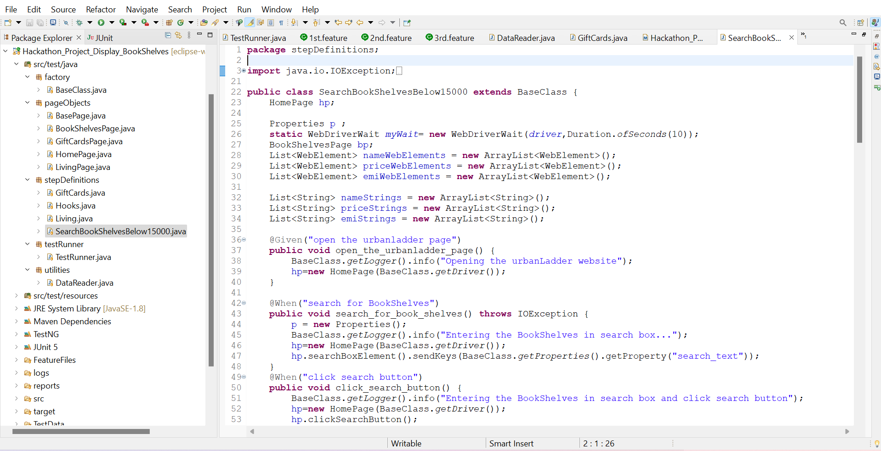
Project Structure

Slide 8
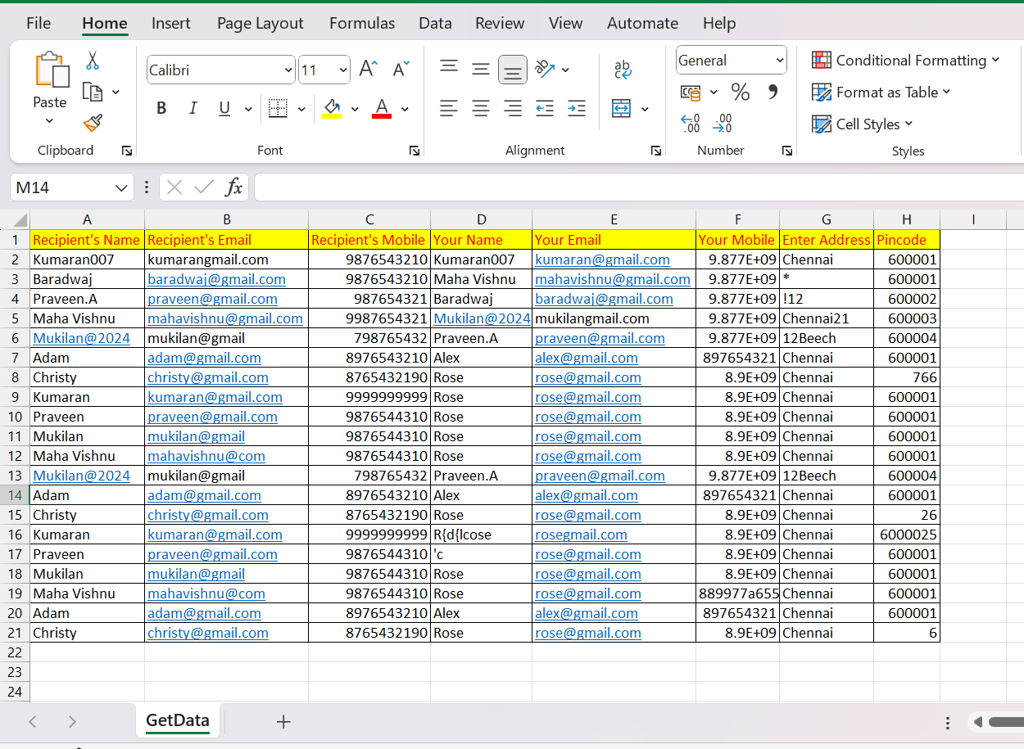
Input Excel File

Slide 9
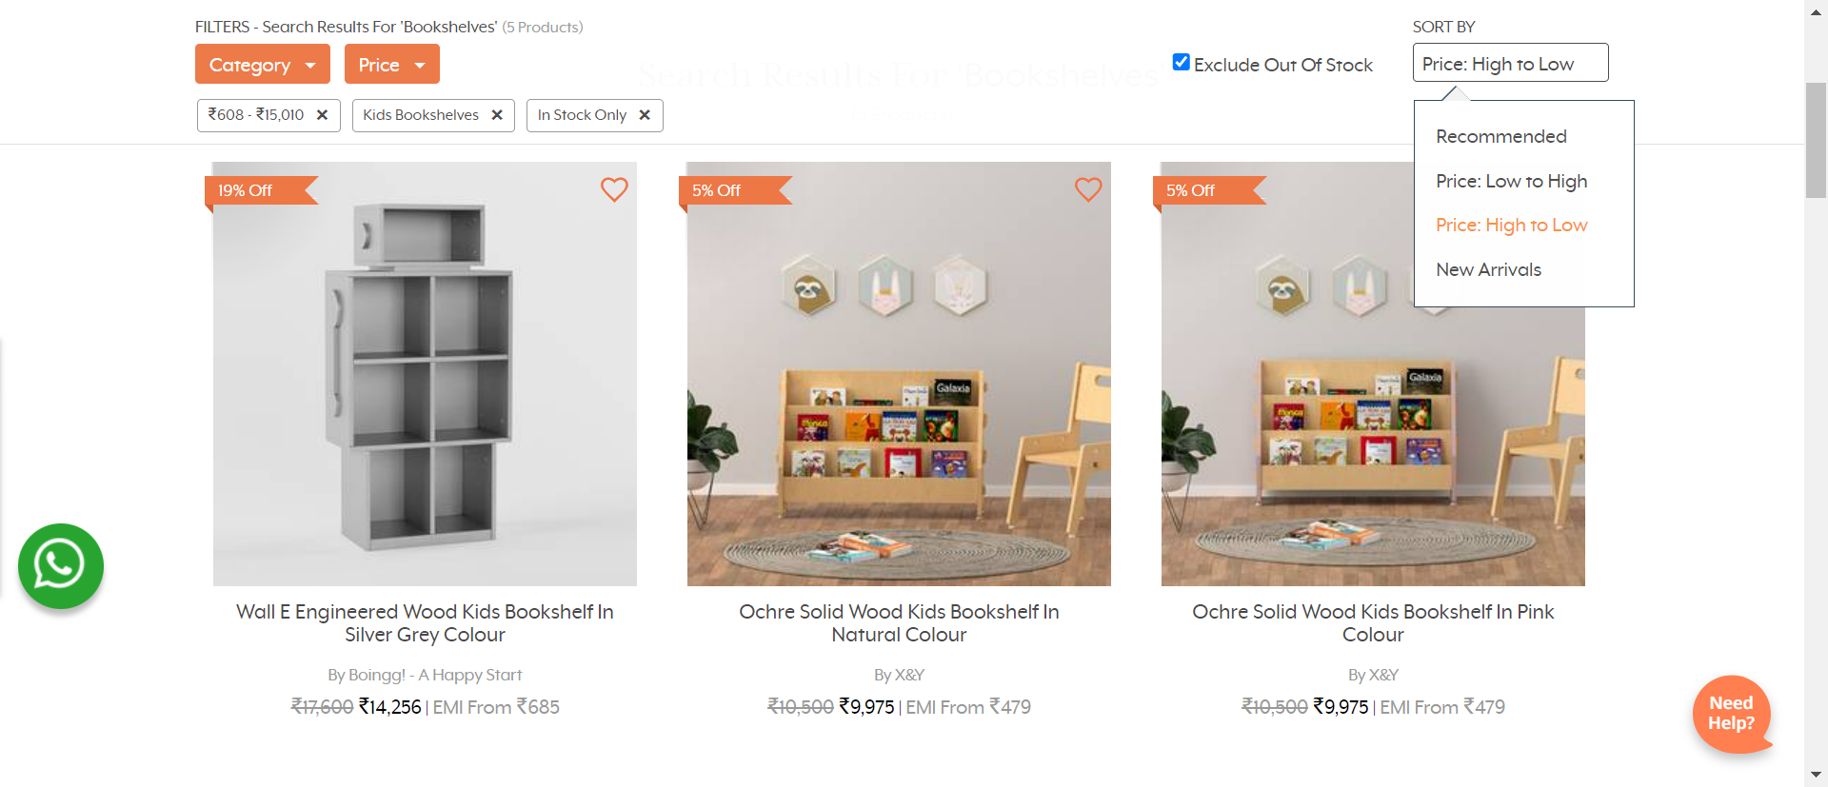
BookShelves Screenshot

Slide 10
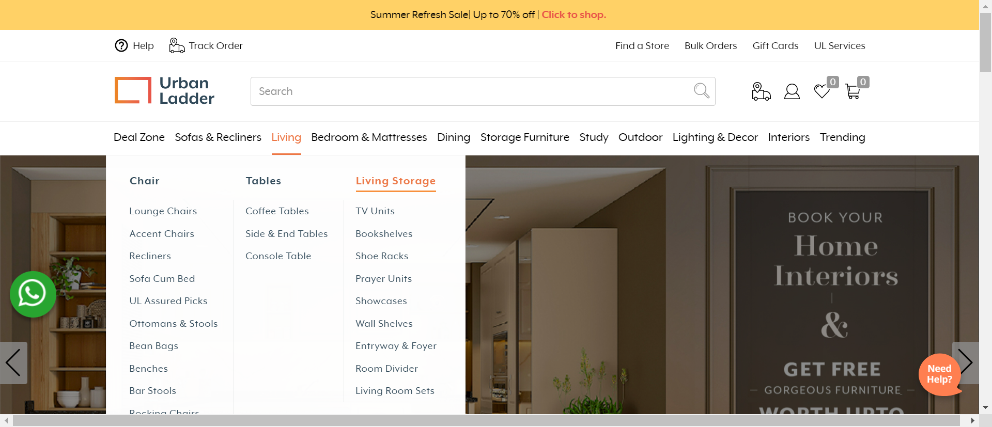
Living Page Screenshot

Slide 11
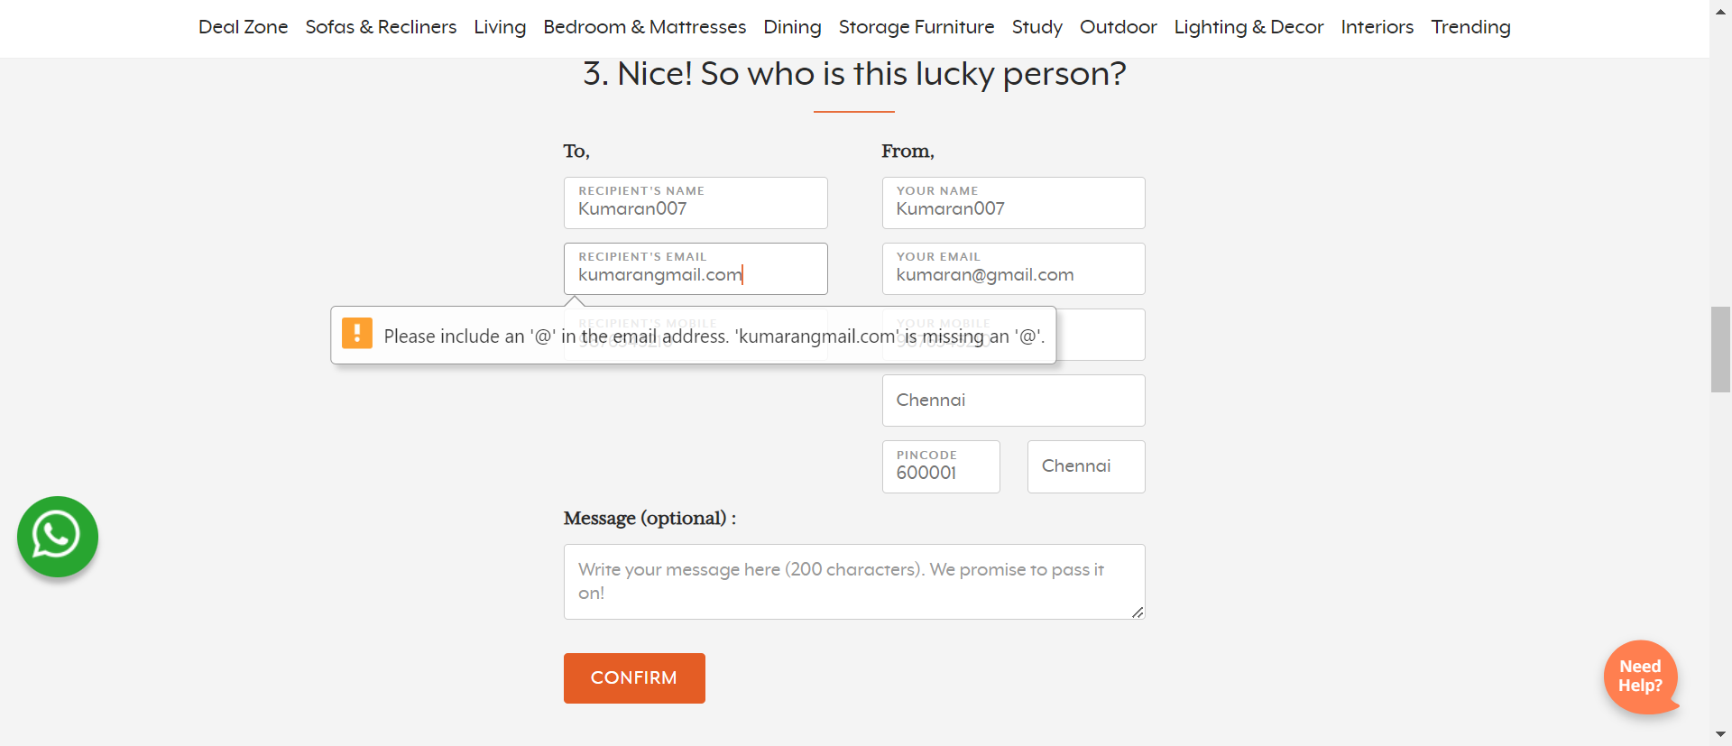
Gift Cards Screenshot – Wrong input

Slide 12
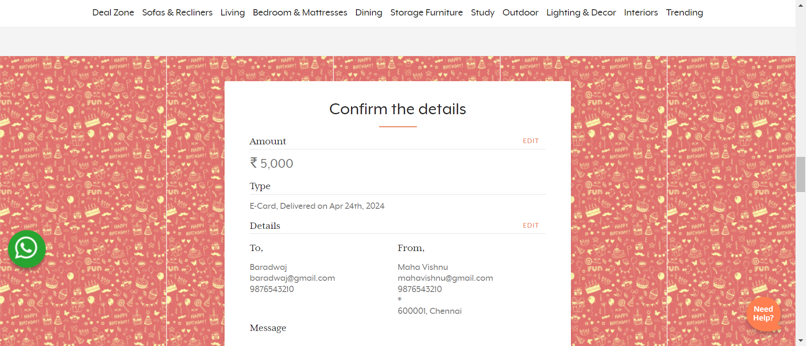
Gift Cards Screenshot – Valid Email

Slide 13
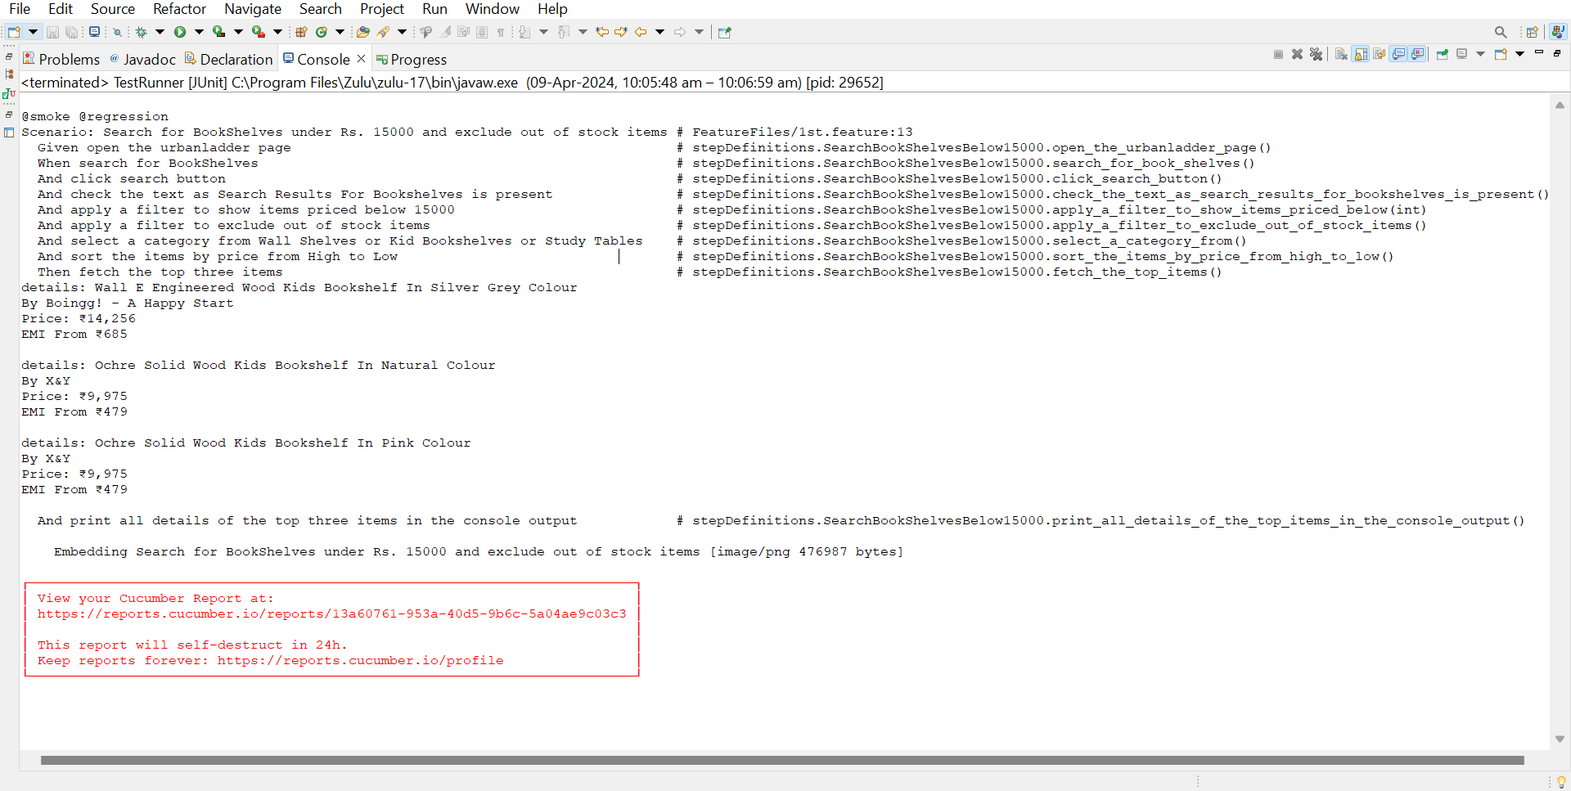
Saved Output Screenshot – 1st Scenario
TESTNG

Slide 14
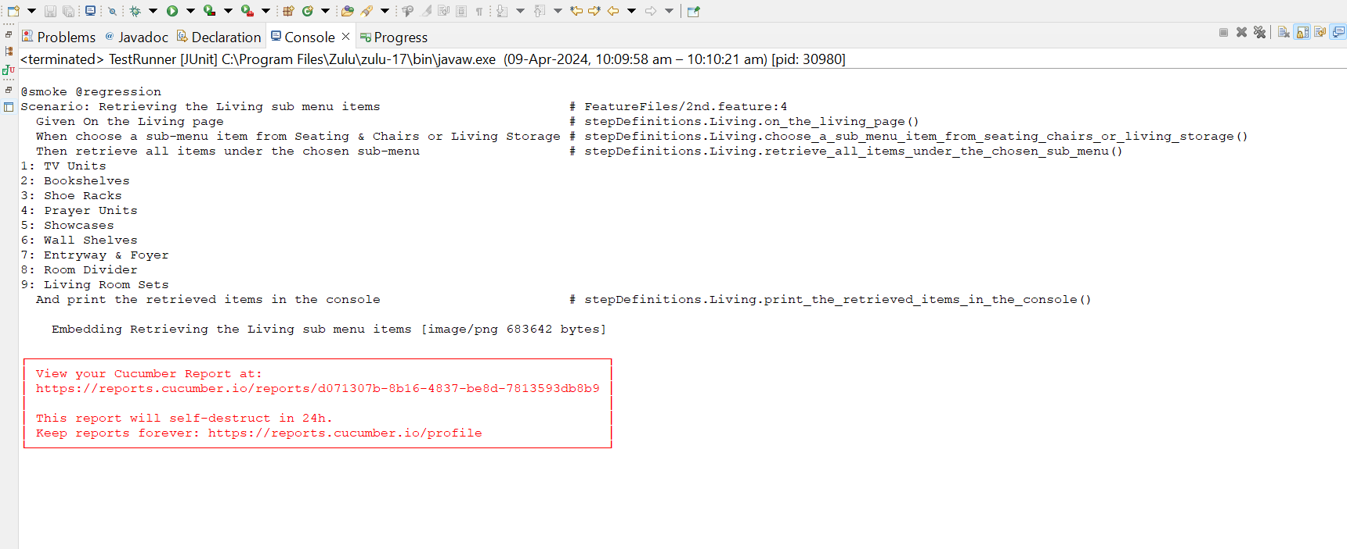
Saved Output Screenshot – 2nd Scenario

Slide 15
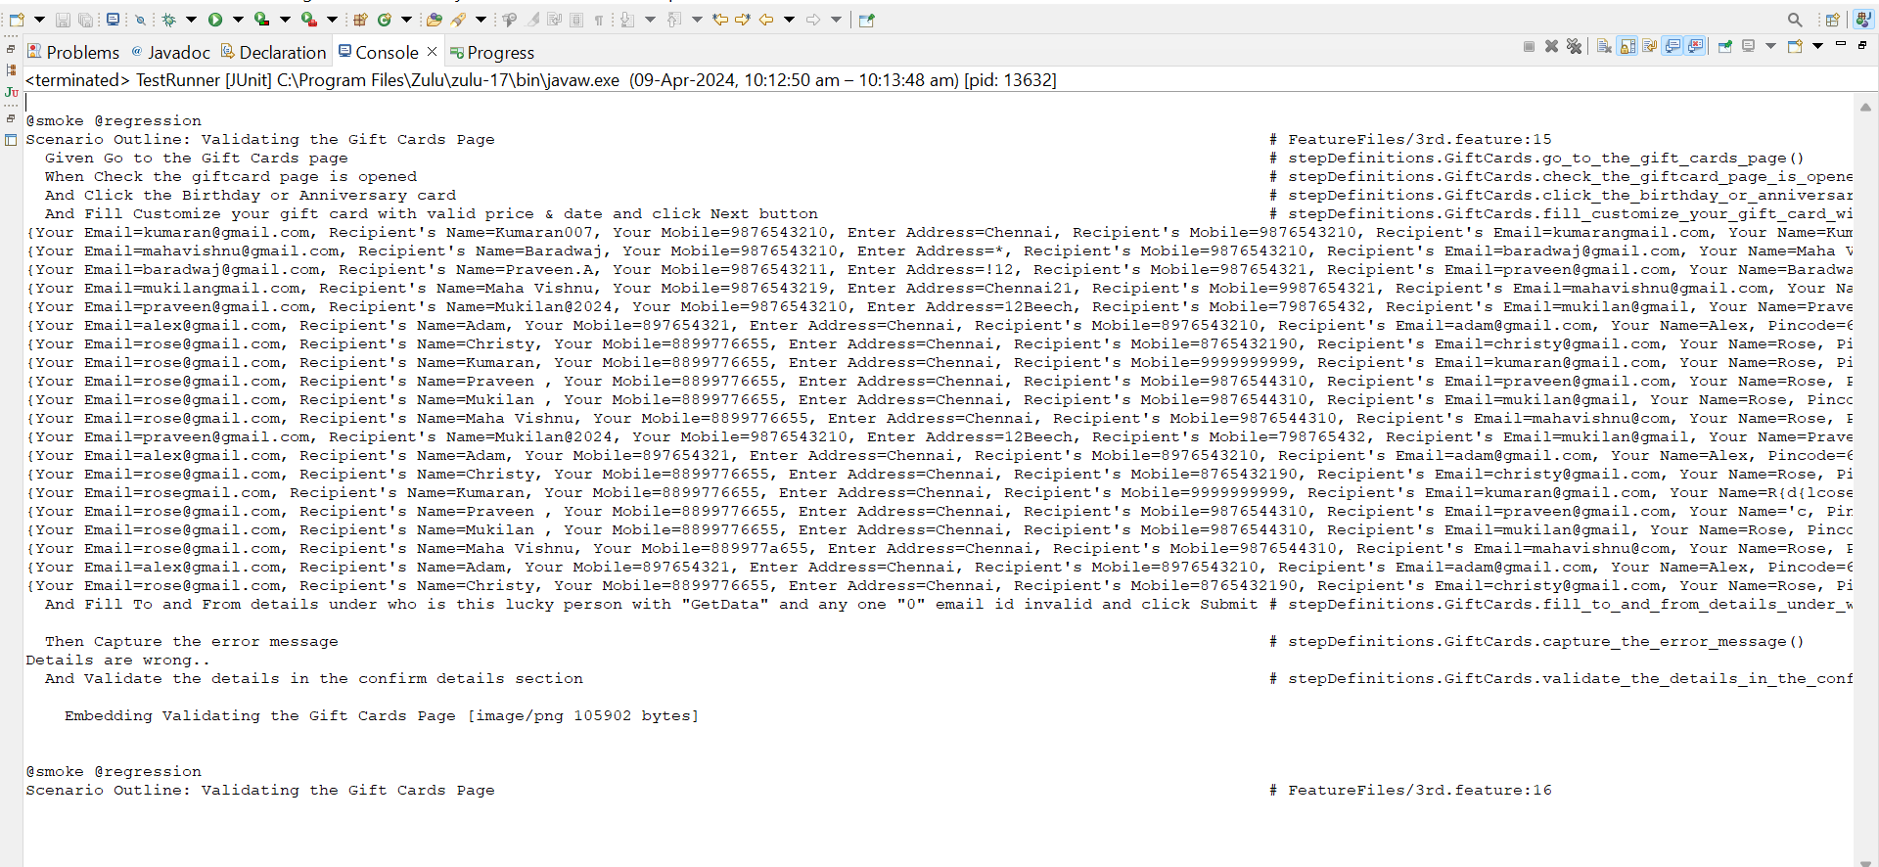
Saved Output Screenshot – 3rd Scenario

Slide 16
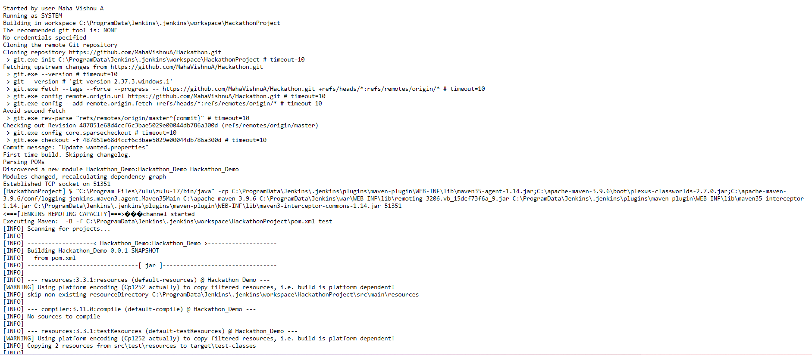
Saved Output Screenshot
JENKINS

Slide 17
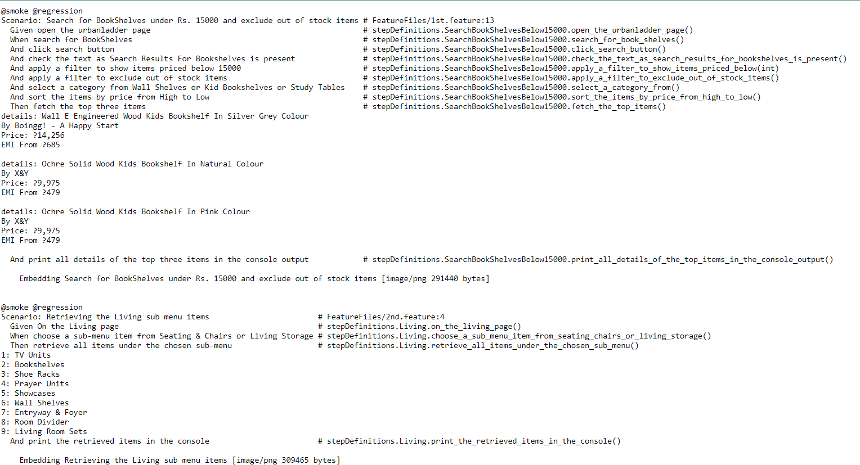
Saved Output Screenshot

Slide 18
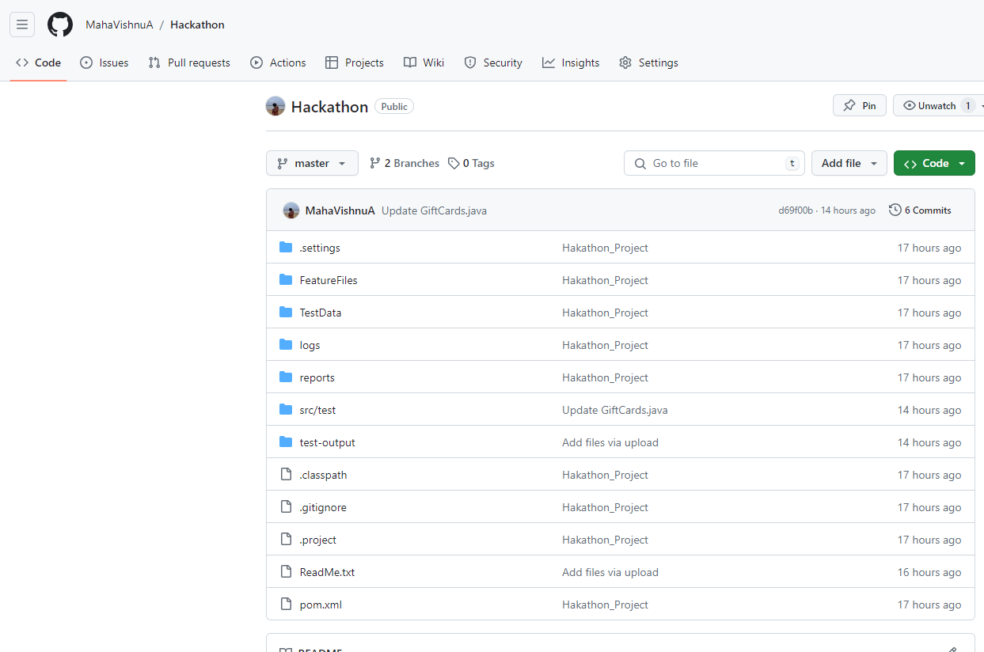
Github Screenshot
https://github.com/MahaVishnuA/Hackathon.git

Slide 19
THANK YOU

