Slide 1


MINI PROJECT - II
PROJECT TITLE: GRAPHIC DESIGN PORTFOLIO
NAME:PRAVEEN N
ROLL NO:727621MCA061
GUIDE NAME:MRS.G.DEEPA M.E.,

Slide 2
ABSTRACT
This project based on web page is a sort of "Graphic Design Portfolio". A graphic design portfolio is a well curated presentation of work to the world. This web page contains some common features that can be found in some popular portfolio sites , which are the show my works, freelance work, course, live events, Tracking Results, etc. User can buy my products and sale , and learning graphic design courses. Admin can post their works in that page, sale of our products and manage activity.

Slide 3

User Interface Design
HOME PAGE

Slide 4

ABOUT

Slide 5
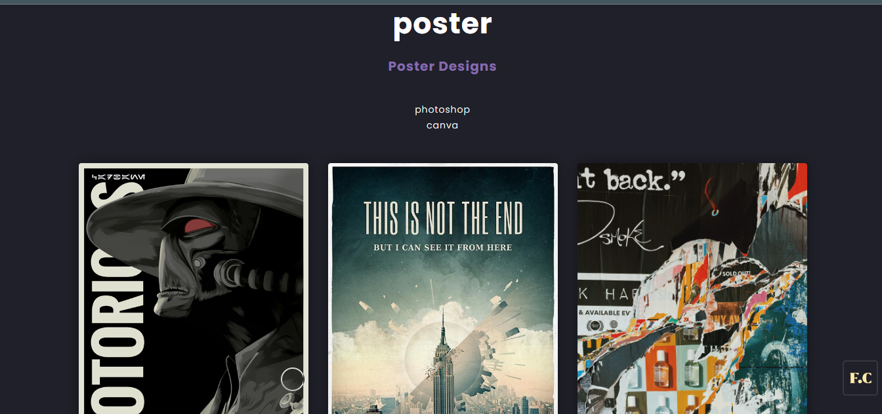
SERVICES
POSTER DESIGN

Slide 6
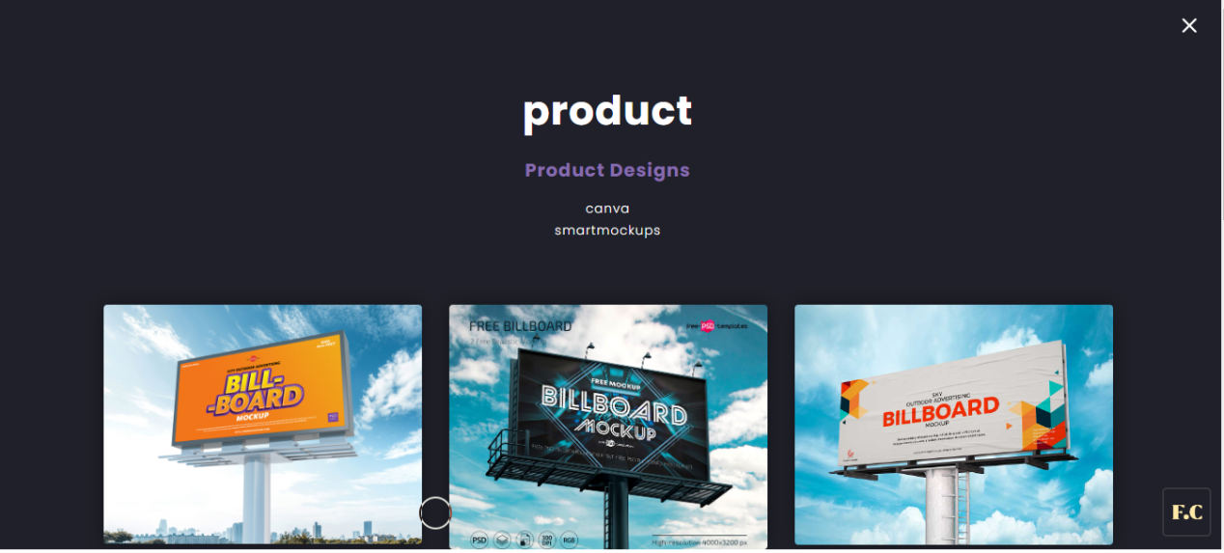
PRODUCT DESIGN

Slide 7
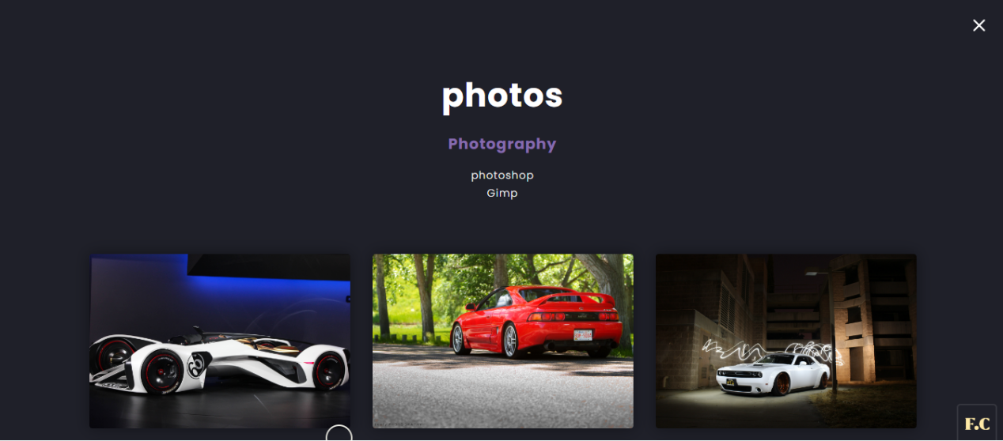
PHOTOGRAPHY

Slide 8
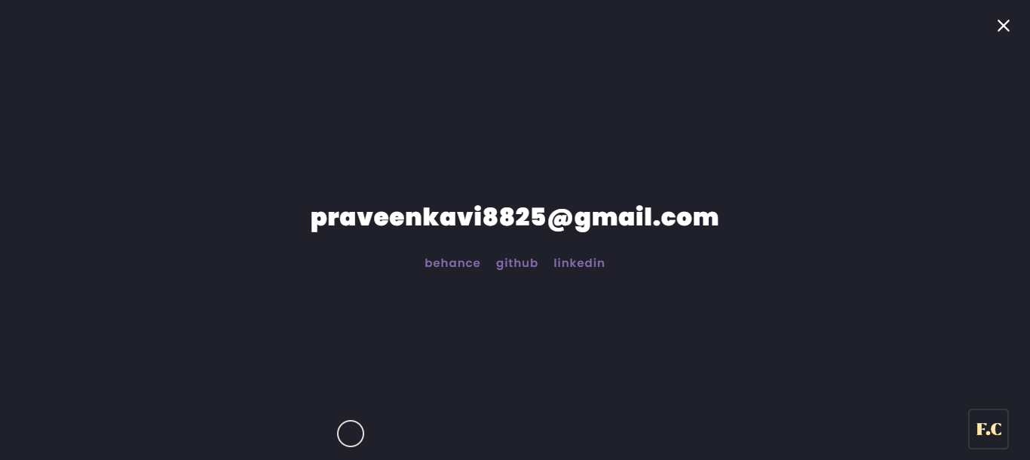
CONTACT PAGE

Slide 9
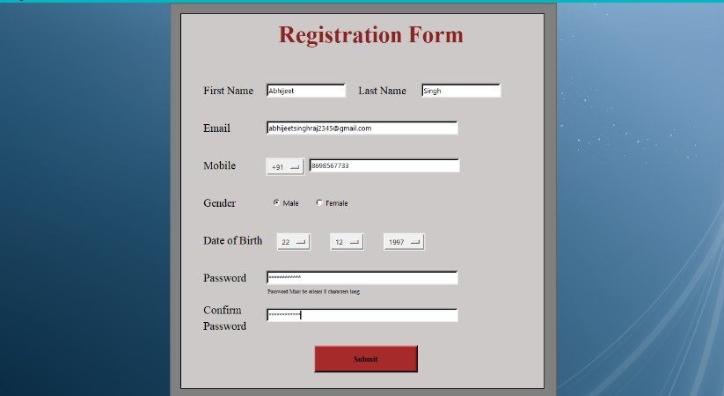
REGISTRATION

Slide 10
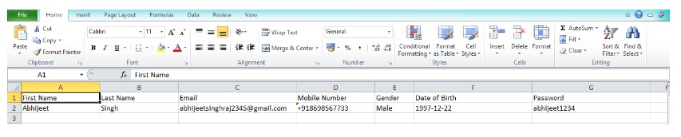
DATABASE

Slide 11
TEST CASE
TESTCASE ID | TEST CASENAME | TEST CASEDESC | TEST PRIORITY |  | RESULT
 |  |  | STEP | RESULT
1 | Username | To verify theuser name if it is unique | Nothing enters and focus on next control | An error message shows username is required | Pass
2 | Password | To verify thepassword if it is unique | Nothing enters and focus on next control | Accepted | Pass
3 | Valid Contact & email | for adding valid contact & email | valid mobile number and email | add contact & email | Pass

Slide 12
TESTING STRATEGIES
Functional Testing:
This feature is tested by providing a valid and invalid mobile number and also by providing a valid and invalid combination of country code with the mobile number. For instance, an invalid country code with a valid mobile number or vise Versa. We ensure that correct error messages are provided in all the negative scenarios of the registration feature. Some other negative scenario is to verify the correct error message is displayed when the user enters less than or more than the required digits in the mobile number field.

Slide 13
Usability Testing:
We test if the registration flow is easy for the users to follow
We test if the text font and colors are correctly matched to avoid any difficulties while reading the options
We test if the registration screen follows common colors.

Slide 14
Unit Testing
In Unit testing, test each module individually and integrate the overall system. Unit testing focuses verification effort even in the smallest unit of software development in each module. This is also known as module testing. The modules of the system is tested separately. Testing includes the process of checking Email Id and password, validating that the associate can move to respective module” sub modules. And also checking that this system is adaptable for all browsers. The modules events, coaches, rules and regulation Details, in forms and tested individually.

Slide 15
Validation Testing
Validation testing refers to a different set of activities that ensure that the system that has been traceable to customer requirements. Data entered by the user should be validated properly and finally moved to the server. Validation testing has been applied from the login page. Phone number can be validated.
•The username and Password is wrong the system should alert to the user that
“Enter the Valid Credentials”. Passwords are also validated.
• Based on the category the sub category should be loaded.

Slide 16
THANK YOU!

