Slide 1
Optimizing Playing XI Selection Using Reinforcement Learning
Team Members: Mounish – CS22B2029
Praveen - CS22B2033
Course: Reinforcement Learning

Slide 2
Problem Statement
To Use Reinforcement Learning (RL) that can optimize the Playing XI selection for a cricket match based on historical data, venue-specific performance, and match conditions.
Challenges:
Player performance varies across different venues.
Balancing the team composition between anchors, power hitters, all-rounders, and bowlers.
Training an RL model that can generalize well to different match conditions and teams

Slide 3
Motivation and Objectives
Motivation
Cricket team selection is traditionally manual and based on experience and intuition, leading to subjective decisions.
Performance varies based on venue conditions, opposition, and player form, making selection complex.
Reinforcement Learning (RL) can help optimize selection by analyzing historical data and adapting to different conditions.
Objectives
Develop an RL-based model to optimize Playing XI selection for a cricket match.
Implement batsman selection first, considering batting average, strike rate, venue-specific stats, and form.
Extend the model to select bowlers and all-rounders for a balanced Playing XI.

Slide 4
System Architecture
Data Layer:
CSV inputs (Batting Avg, Strike Rate, Matches Played, Historical Data).
Preprocessing:
Standard Scaling, Role Classification (Batsman/Bowler/WK/AllRounder).
RL Agent Core:
DQN Model: 64-neuron hidden layers, MSE loss, Adam optimizer.
Memory Replay: Batch training with epsilon-greedy exploration.
Output: Optimized playing XI based on venue-specific performance.
Flow:
Data → Preprocess → State Representation → DQN Action Selection → Reward Calculation → Team Optimization

Slide 5
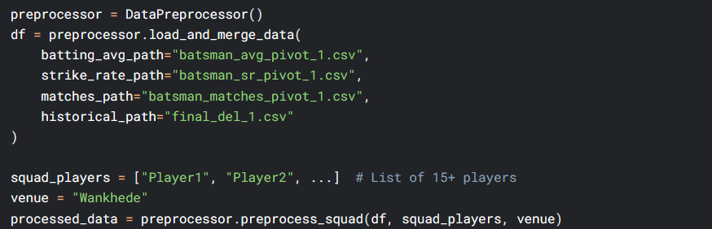
Dataset & Preprocessing
Datasets Used:
batsman_avg_pivot_1.csv → Batting averages
batsman_matches_pivot_1.csv → Matches played
batsman_sr_pivot_1.csv → Strike rates
final_del_1.csv → Runs scored at particular venue
Preprocessing :
.

Slide 6
RL Framework
Environment
Players squad (user input), Match venue (e.g., Chennai)
Goal: Select best Playing XI with role + performance balance
State
4 role counts: [Batsman, Bowler, AllRounder, WK]
5 player stats: [Avg, SR, Matches, Wickets, Economy]
Action
Pick one player (not yet selected) and Action space = all unselected players
Reward Function
reward = (Batting Strength + Bowling Strength) - Role Penalty
Terminal Reward: +100 for valid XI, -10 for invalid.
Agent (DQN)
Policy: ε-Greedy exploration (ε=1.0 → 0.01).
Training: Memory replay + Q-learning.

Slide 7
DQN Algorithm
Parameters:
γ (discount) = 0.95
ε (exploration) decays from 1.0 → 0.01
Replay batch size = 32
Optimizer = Adam
Q-Network
Input: 9-D state vector
Output: Q-values for each possible action (player)
Architecture: Dense(64) → Dropout → Dense(64) → Output(Q-values)
Training Loop
Initialize replay memory and Q-network
For each episode:
Build team by picking players using ε-greedy strategy
Store experiences: (state, action, reward, next_state, done)
After episode, sample a minibatch from memory
Update Q-network using Bellman equation:
target = reward + γ * max(Q(next_state))

Slide 8
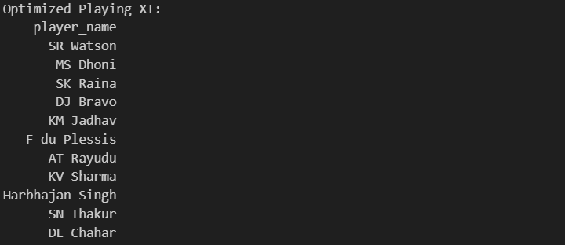
Results:

Slide 9
Challenges & Solutions
1. High-Dimensional Player Stats
Challenge: Hard to capture performance across different venues and roles.
Solution: Used feature scaling + role classification + venue-based filtering.
2. Team Balance Constraints
Challenge: Ensuring required roles (e.g., 4 Batsmen, 3 Bowlers, etc.) are fulfilled.
Solution: Role-aware reward function penalizes unbalanced teams.
3. Exploration vs Exploitation
Challenge: Need to explore enough player combos before settling on optimal.
Solution: Used ε-greedy strategy with decay to balance both phases.
4. Limited Training Samples

Slide 10
Contributions
CS22B2029(Mounish):
Data Preprocessing & Cleaning
Feature Selection
Dataset Merging
RL Algorithm Implementation
CS22B2033(Praveen):
RL Algorithm Implementation
Model Training
Result Analysis & Optimization

Slide 11
Conclusion & Future Scope
Conclusion
Implemented a Deep Q-Network to optimize IPL Playing XI selection.
Successfully learned to pick balanced teams based on player stats, roles, and venue performance.
Reinforcement learning approach proved effective for dynamic, data-driven team selection
Future Scope
Include Bowling Stats: Add real-world bowling data (wickets, economy, overs).
Opponent-Based Selection: Factor in opposition team and head-to-head data.
Live Updates: Integrate real-time stats and injury reports.
Multicriteria Optimization: Incorporate cost, team chemistry, and match conditions.
Transfer Learning: Use past seasons to fine-tune agent faster for future matches.

Slide 12
Thank You

