Slide 1
Banking Acquisition Analytics SUBMISSION
Submitted by : Praveen Nair

Slide 2
Problem Statement
The purpose of Classification is to predict whether the client will subscribe a term deposit or not.
Identify relevant predictor variables for a response using EDA.
Build predictive models and choose the best one.
Sort the prospects in order of decreasing probability of response (predicted by the best model) and target the top X% (or top Y deciles), where X would be determined by your business objective (e.g., maximising the overall response rate/number of responders at a fixed marketing cost).

Slide 3
Objective
The main task is build LR model without including the variable ‘duration’. This will help you understand the relationship of the other variables with the response.
Give the insights and calculate the X in the top X%, i.e., how many prospects should be called to meet the business objective where business objective is to achieving 80% of total responders at the minimum possible cost. The total number of responders is the total number of prospects who responded, from the available data of about 45,000 prospects.

Slide 4
Data Cleaning and Preparation
Data Understanding
Data Cleaning
Data Preparation
Data Modelling (LR)
Model Evaluation

Slide 5
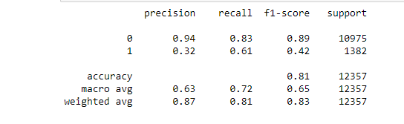
Linear Regression Model Report

Slide 6
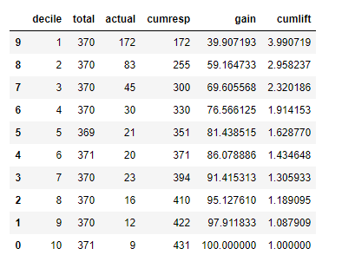
Gain
Note that you can attain 81% of total conversions by targeting only 50% of the total client base

Slide 7
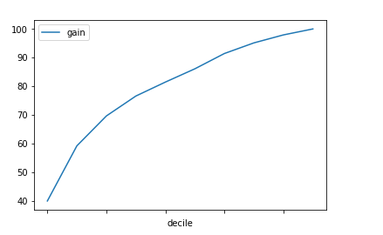
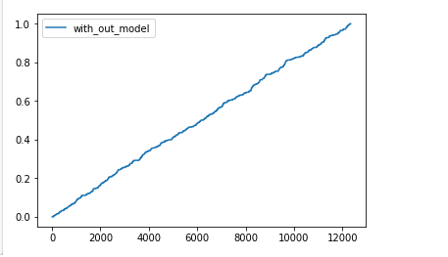
Lift Chart

Slide 8
Contd.
5069 is the cost of Acquistion with a mean duration of 248 seconds.

