Slide 1


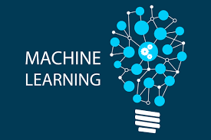
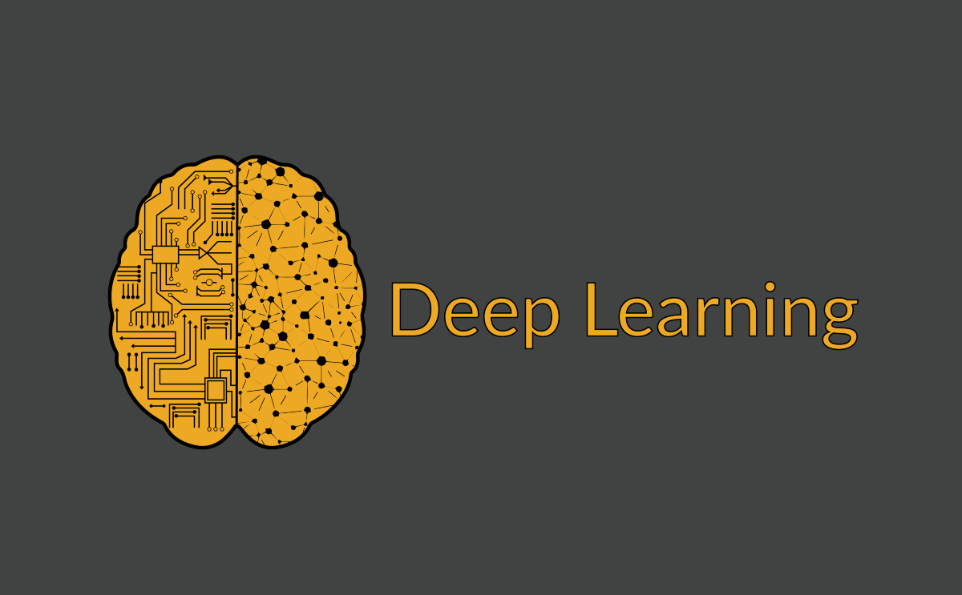
MACHINE LEARNING

Slide 2
What is an artificial intelligence?

Slide 3
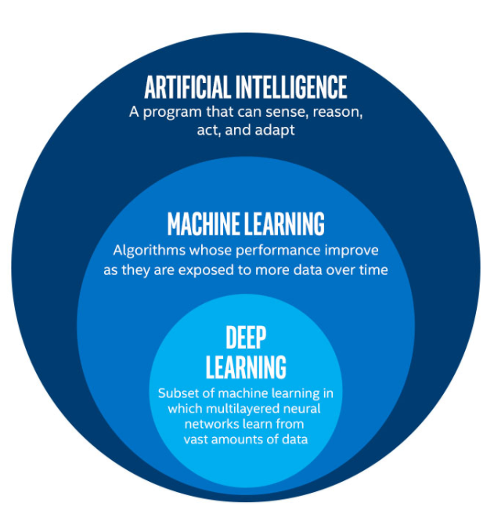
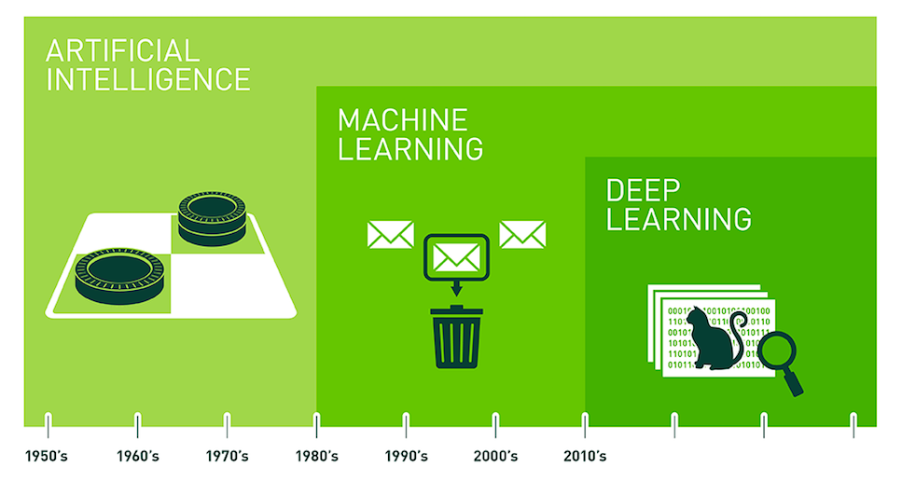
What is an artificial intelligence?

Slide 4
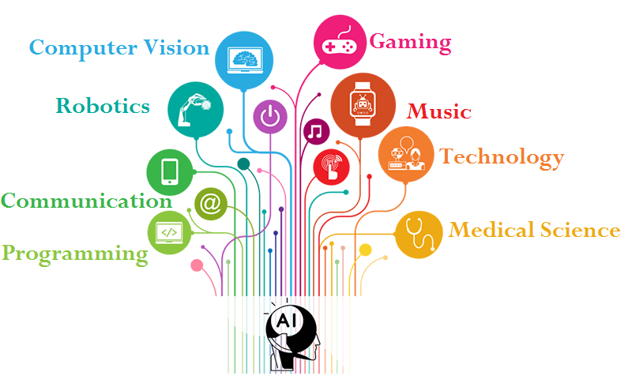
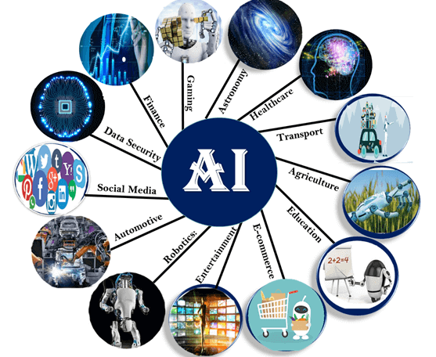
AI Applications

Slide 5
History of AI

Slide 6
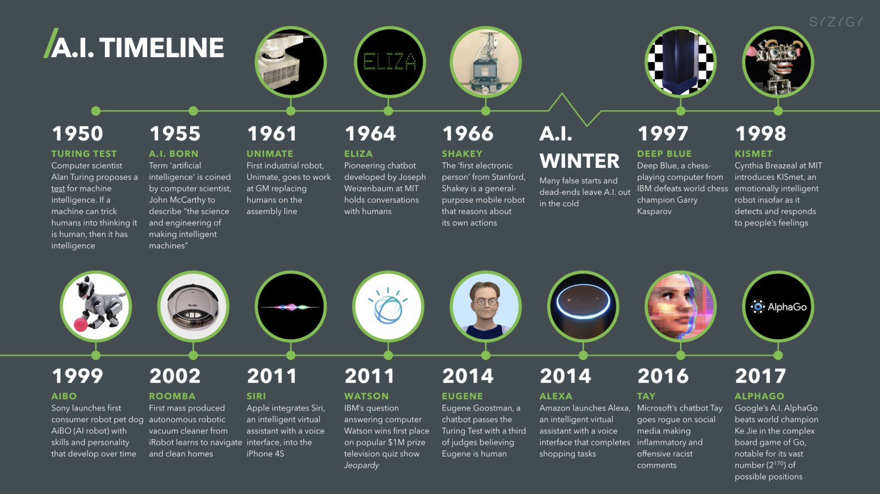
HISTORY OF AI

Slide 7
What is Machine Learning?

Slide 8
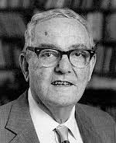

INTRODUCTION
Herbert Alexander Simon:
“Learning is any process by which a system improves performance from experience.”
•“Machine Learning is concerned with computer programs that automatically improve their performance through experience.
Definition by Tom Mitchell (1998): Machine Learning is the study of algorithms that • improve their performance P • at some task T • with experience E. A well-defined learning task is given by P+T+E.

Slide 9
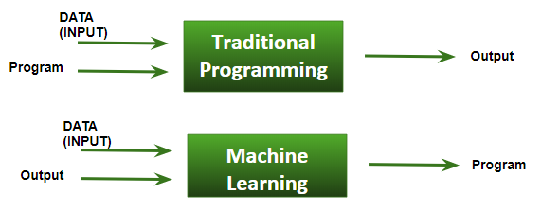
TRADITIONAL PROGRAM VS MACHINE LEARNING

Slide 10
What is Machine Learning?
Machine learning is an artificial intelligence section that enables computer systems to learn from examples, information, and experience directly.
Machine learning systems can conduct complicated procedures by learning from data rather than following pre-programmed guidelines by allowing computers to perform particular duties intelligently.
Machine learning helps to improve the accuracy and ability to complete the task by figuring out by itself.

Slide 11
When Do We Use Machine Learning?

Slide 12
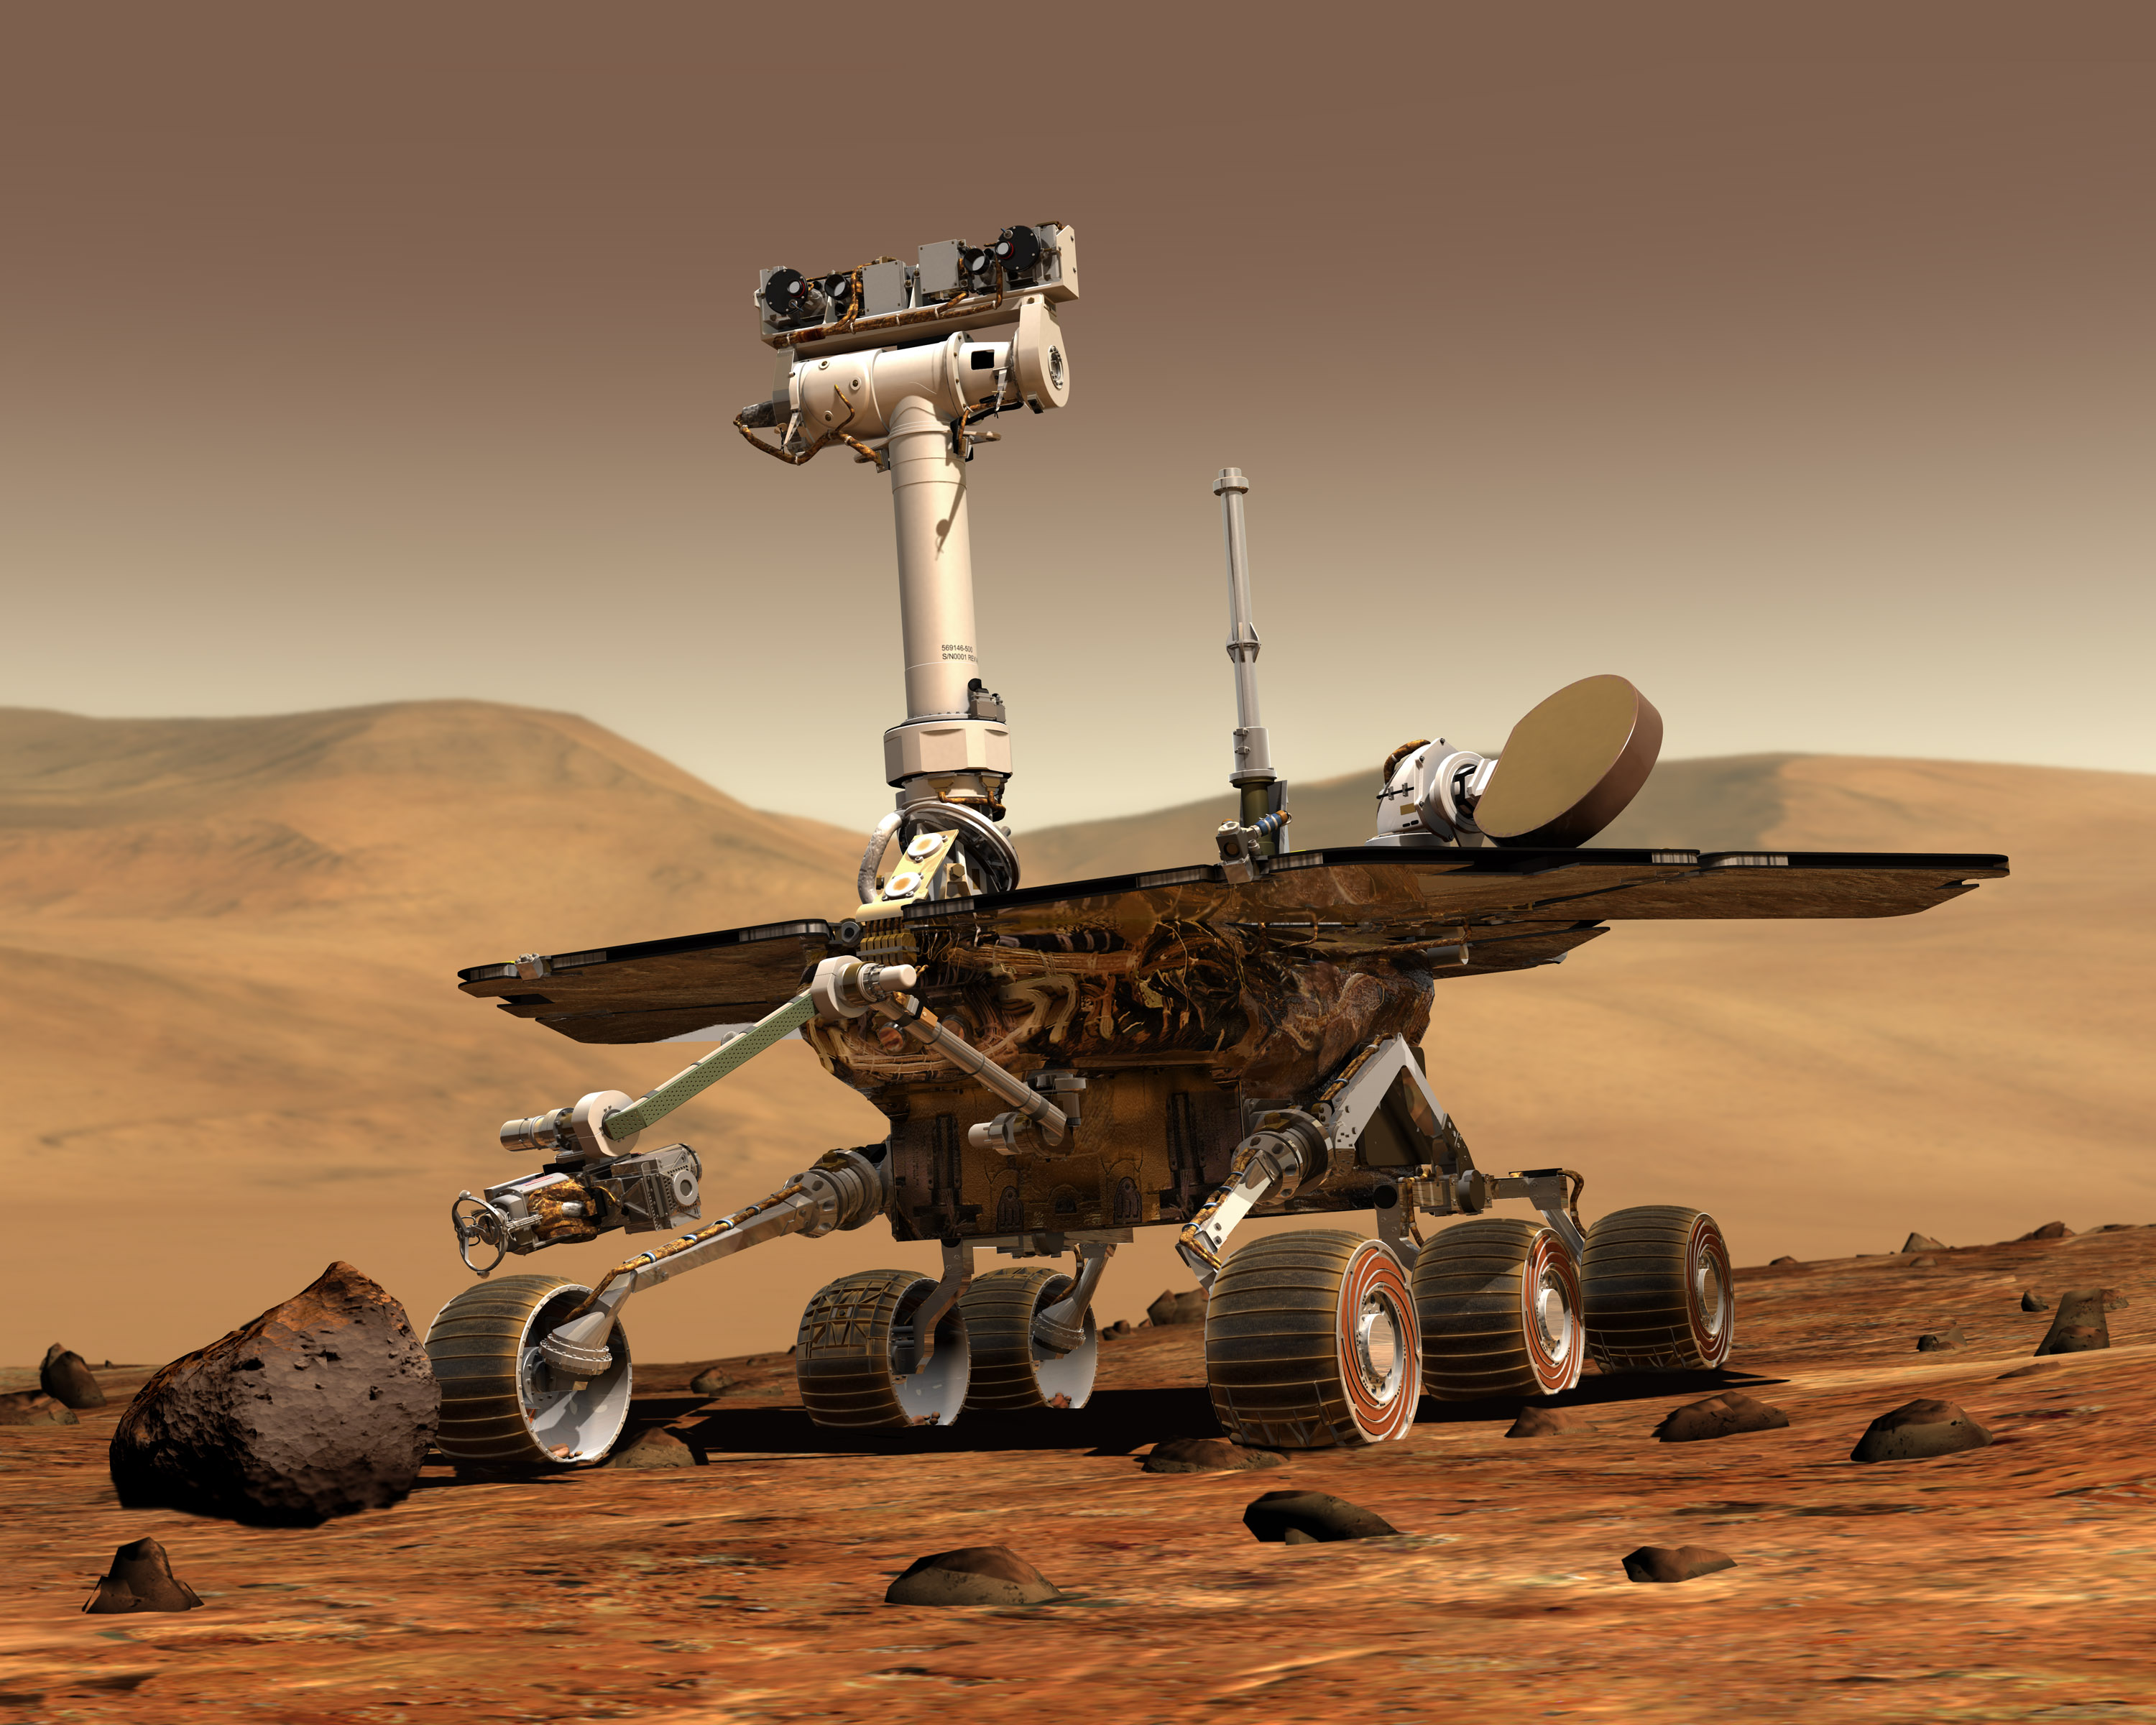

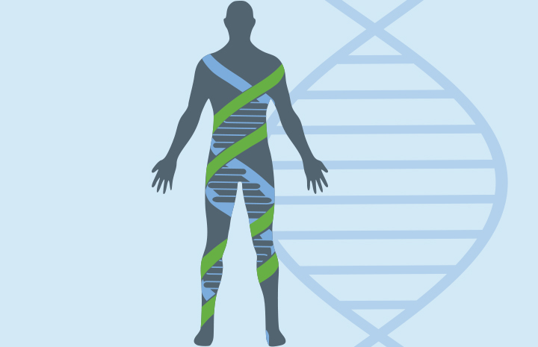
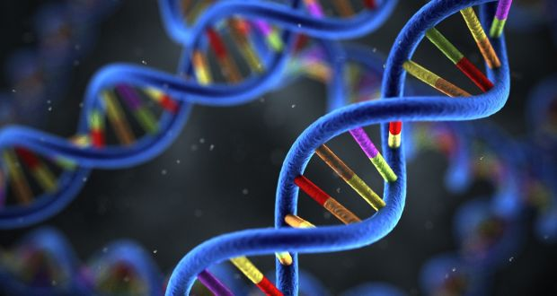
When Do We Use Machine Learning?
ML is used when:
• Human expertise does not exist (navigating on Mars)
• Humans can’t explain their expertise (speech recognition)
• Models must be customized (personalized medicine)
• Models are based on huge amounts of data (genomics)

Slide 13
When Do We Use Machine Learning?
• Recognizing patterns: – Facial identities or facial expressions – Handwritten or spoken words – Medical images
• Generating patterns: – Generating images or motion sequences
• Recognizing anomalies: – Unusual credit card transactions – Unusual patterns of sensor readings in a nuclear power plant
• Prediction: – Future stock prices or currency exchange rates

Slide 14
Types of ML

Slide 15
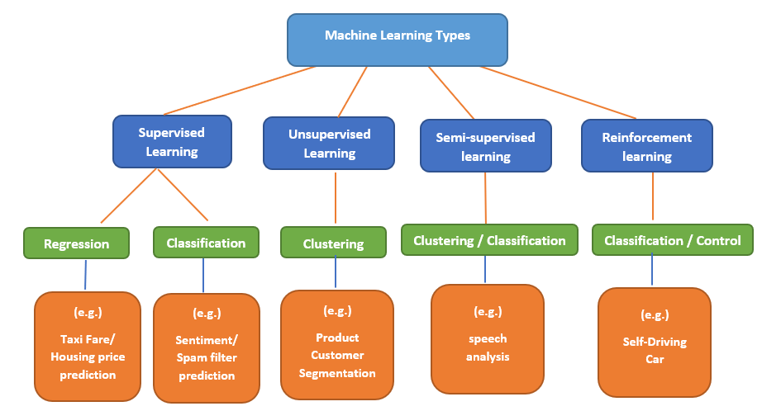
Types of ML

Slide 16
DEEP LEARNING

Slide 17
Introduction

Slide 18
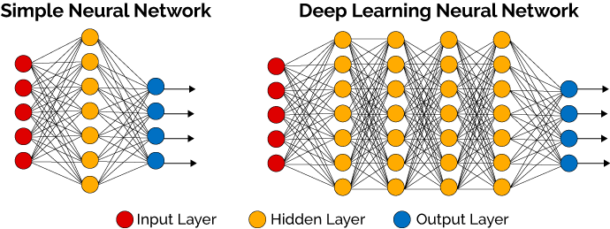
What is Deep learning?
Deep learning is an artificial intelligence function that imitates the workings of the human brain in processing data and creating patterns for use in decision making.
Deep learning is a subset of machine learning in artificial intelligence (AI) that has networks capable of learning unsupervised from data that is unstructured or unlabeled. Also known as deep neural learning or deep neural network.

Slide 19
Application of DL

Slide 20
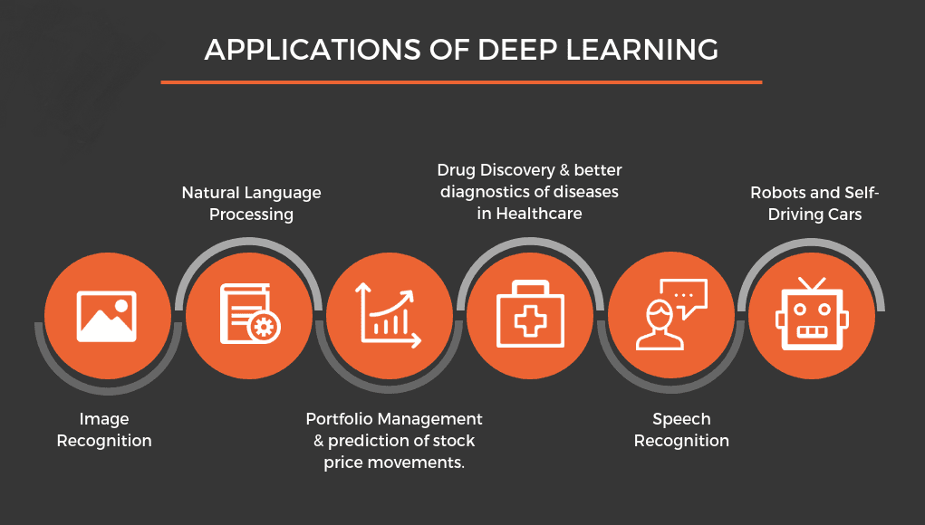
Application of DL

Slide 21
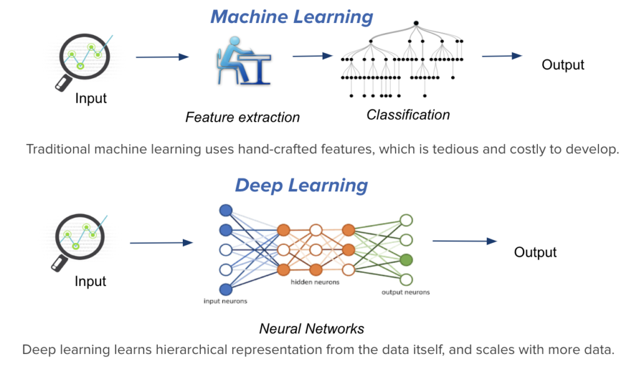

Slide 22
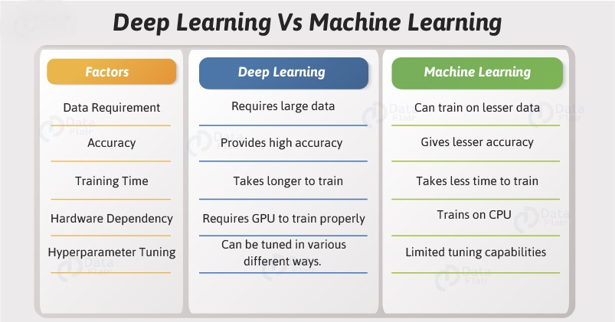

Slide 23
Supervised Learning

Slide 24

Supervised Learning
Supervised Learning is an area of machine learning where we work on predicting the values using labeled data sets.
The labeled input datasets are called the independent variable while the predicted results are called the dependent variable because they depend on the independent variable for their results.

Slide 25
Supervised Learning
Regression
Classification
Linear regression
Yh
Ik7i
Uj6ui
utiu56

Slide 26
Simple Linear Regression
REGRESSION

Slide 27
Simple Linear Regression
Linear regression models are used to show or predict the relationship between two variables or factors.
The factor that is being predicted (the factor that the equation solves for) is called the dependent variable.
The factors that are used to predict the value of the dependent variable are called the independent variables.

Slide 28
Where is used SLR?
Evaluating trends and sales estimates.
Analyzing the impact of price changes.
Assessment of risk in financial services and insurance domain.

Slide 29
Understanding LR Algorithm?
Reg line
Y = MX + C
Estimate value
X -> predictor (present in data)
M -> co-efficient (estimated by regression)
C -> intercept (estimated by regression)
Y -> predicted value (calculated from C,M,X)
error
Dependent variable (y)
Actual value
Independent variable (x)

Slide 30
Understanding LR Algorithm?
Dependent variable
x | y
1 | 3
2 | 4
3 | 2
4 | 4
5 | 5
3 | 3.6
x-x` | y-y` | (x-x)^2 | (x-x`)(y-y`)
-2 | -0.6 | 4 | 1.2
-1 | 0.4 | 1 | -0.4
0 | -1.6 | 0 | 0
1 | 0.4 | 1 | 0.4
2 | 1.4 | 4 | 2.8
 |  | 10 | 4
Distance (y)
1 2 3 4 5
(3,3.6)
Mean of
Sum of
M = sum of ( (x-x`) (y-y`) / (x-x`)^2 )
M = 4 / 10 = 0.4
Y = MX + C => y=3.6, M=0.4, x=3 => C=2.4
Y= 0.4X + 2.4
0 1 2 3 4 5
Speed (x)
Independent variable

Slide 31
Mean square Error
Dependent variable
M=0.4 , C=2.4,
Y= 0.4X + 2.4
predict values of y for x= {1,2,3,4,5}
Y = 0.4 * 1 + 2.4 = 2.8
Y = 0.4 * 2 + 2.4 = 3.2
Y = 0.4 * 3 + 2.4 = 3.6
Y = 0.4 * 4 + 2.4 = 4.0
Y = 0.4 * 5 + 2.4 = 4.4
Distance (y)
1 2 3 4 5
(3,3.6)
0 1 2 3 4 5
Distance between actual and predict value
less means best fit
Speed (x)
Independent variable

Slide 32
What is R-square?
R-squared value is a statistical measure of how close the data are to the fitted regression line.
It is also known as coefficient of determination, or the coefficient of multiple determination.

Slide 33
Calculation of R-square
Dependent variable
Distance actual – mean VS distance predict – mean
This is nothing but
R^2 = sum of (Yp – y`)^2 / sum of (y-y`)^2
Distance (y)
1 2 3 4 5
(3,3.6)
0 1 2 3 4 5
Speed (x)
Independent variable

Slide 34
Calculation of R-square
Dependent variable
x | y
1 | 3
2 | 4
3 | 2
4 | 4
5 | 5
 | 3.6
y-y` | (y-y`)^2 | Yp | (Yp-y) | (Yp-y)^2
-0.6 | 0.36 | 2.8 | -0.8 | 0.64
0.4 | 0.16 | 3.2 | -0.4 | 0.16
-1.6 | 2.56 | 3.6 | 0 | 0
0.4 | 0.16 | 4.0 | 0.4 | 0.16
1.4 | 1.96 | 4.4 | 0.8 | 0.64
 | 5.2 |  |  | 1.6
Distance (y)
1 2 3 4 5
(3,3.6)
Mean of
Sum of
Sum of
R^2 = sum of (Yp – y`)^2 / sum of (y-y`)^2
= 1.6 / 5.2
~ = 0.3
0 1 2 3 4 5
Speed (x)
Independent variable

Slide 35
OPENCV Features

