Slide 1


CPAG – Energy Cluster
Rajasthan RE Projects
Monthly Report for Aug-26

Slide 2
Agenda
Executive Summary
Project Wise Update (Bandha-II 500 MW, Baiya 600 MW)
            Project Information & Salient Features
            Project Plot Plant
            Overall S Curve
            Engineering Progress
            Three Month Rolling Plan for Material Supply
            Detailed Progress Update (Activity Wise)
            Major Milestone- Next 3 Months
            Manpower Deployment Plan vs Actual
2

Slide 3
Rajasthan Projects Executive Summary
SN | Location | Project Name | Project Capacity (MW) | FY 27 Initial Plan (MW) | FY 27 Current Forecast (MW) | COD |  | Overall Progress % |  | Remarks
 |  |  |  |  |  | Baseline Plan | Achieved/ Expected | Plan | Actual
1 | RJ | MLP T1 TN – 500 MW Bandha II | 500 | 362.5 | 362.5 | 31-Jan-27 | 22-May-27 | 82 | 76 | 137.5 MW – Commissioned in Mar’26 Commissioning of balance 362.5 MW by May-27 based on LTA elements readiness.
2 | RJ | NHPC BOO 600 MW, Baiya | 600 | 349 | 349 | 31-Jan-27 | 23-Mar-27 | 83 | 79 | 251 MW – Commissioned in Mar’26 Commissioning of balance 349 MW is planned by Mar-27 considering court ruling in favour of AGEL by 17-Sep-26 and Piling work start by 4th week of Sep-26.
Total |  |  | 1,100 | 711.5 | 711.5

Slide 4
MLP T1 TN 500 MW Bandha Solar Project
4

Slide 5
500 MW Bandha: Salient Project Features
Project | 500 MW Bandha
Project Scope/ Capacity | 500 MW (695 MWdc)
Owner/ Developer | Adani Green Energy Twenty-Five B Limited
Location | Village – Bandha, Tehsil – Jaisalmer, Dist. Jaisalmer, Rajasthan
Concessionaire, If applicable | -
EPC, If applicable | NA
Land Area | 1853.25 Acre
Approved Budget (INR Cr.) (date: 01-Apr-25) | INR 2019.3 Cr
Revised Budget (INR Cr.) | NA
Project Start Date | Aug-24
Schedule COD | LTA operationalization + 60 days (Forecast LTA operationalization – Dec’26)
Revised COD, if any | -
Expected COD | 19-Feb-27 (137.5 MW Commissioned in Mar’26, 212.5 MW by Jan’27, 150 MW by Feb’27)
Other Comments
5

Slide 6
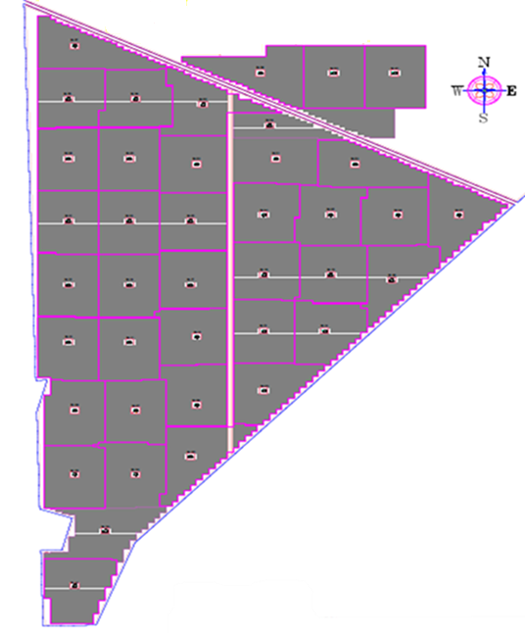
500 MW Bandha: Project Plot Plan
Description | Bandha II
Type of MMS | No. of Blocks | MW
Fixed Tilt | 40 | 500
Total | 40 | 500
Type of Land | Acres
Govt. | 1853.25
Pvt. | -
Total | 1853.25
6

Slide 7
500 MW Bandha: Overall S Curve
Gap Analysis
Progress Parameter | Weightage | Cumm. Plan | Cumm. Actual | Variance | Remarks for Variance
Land & Statutory | 7% | 98% | 63% | 35% | Land Sub Lease Pending
Engineering+ System Study | 13% | 100% | 100% | 0%
Procurement | 30% | 89% | 83% | 6%
Construction | 50% | 71% | 68% | 4%
Overall | 100% | 82% | 76% | 6%
7

Slide 8
500 MW Bandha: Engineering Progress
Sr. No | Description | No. of Drawings | %
A (B+C) | Total | 272 | 100%
B (RFC+b1+b2+b3) | Approved | 272 | 100%
RFC | RFC | 241
b1 | A1-Category | 23
b2 | A2-Category | 0
b3 | I-Category | 8
C | Pending | 0
A1-Category: Approved
A2-Category: Approved with Comments
I-Category: Information
8

Slide 9
500 MW Bandha: Procurement & 3 month rolling plan for Supply Status
S.No. | Packages | UOM | Scope | Ordering Completed | Balance Ordering | Delivered at Site up to Aug’26 | Forecast delivery schedule
 |  |  |  |  |  |  | Sep-26 | Oct-26 | Nov-26
1 | Module | MWp | 695 | 198 | 497 | 198 | - | - | -
2 | MMS - FT | MW | 500 | 500 | - | 500 | - | - | -
3 | IDT | Nos. | 41 | 41 | - | 41 | - | - | -
4 | Inverter | Nos. | 1937 | 1937 | - | 1937 | - | - | -
5 | HT Panel | Nos. | 40 | 40 | - | 40 | - | - | -
6 | LT Panel | Nos. | 654 | 654 | - | 654 | - | - | -
7 | HT Cable | km | 298 | 298 | - | 298 | - | - | -
8 | LT Cable | km | 457 | 457 | - | 457 | - | - | -
9 | Control Cable | km | 29 | 29 | - | 29 | - | - | -
10 | DC Cable | km | 3742 | 3742 | - | 3742 | - | - | -
11 | Robotic Module Cleaning System | Nos. | 1034 | 1034 | - | 1034 | - | - | -
9

Slide 10
500 MW Bandha: Construction Progress Update
Description | UOM | Scope | Completed upto Aug’26 | Balance as on Aug’26 | For the Month Aug'26 |  | Next 3 Month Rolling Plan |  |  | Completion Target
 |  |  |  |  | Plan | Actual | Sep-26 | Oct-26 | Nov-26
Piling | Nos | 2,47,030 | 2,47,030 | - | - | - | - | - | - | 29-Dec-25
MMS - FT | Tables | 20,180 | 18,678 | 1,502 | - | - | 587 | 915 | - | 27-Oct-26
IDT Foundation | Blocks | 40 | 40 | - | - | - | - | - | - | 02-Oct-25
HT & LT Slab | Blocks | 40 | 40 | - | - | - | - | - | - | 13-Oct-25
HT & LT Canopy | Blocks | 40 | 40 | - | - | - | - | - | - | 12-Feb-26
IDT Erection | Blocks | 40 | 40 | - | - | - | - | - | - | 31-Jan-26
HT Panel Erection | Blocks | 40 | 40 | - | - | - | - | - | - | 25-Dec-25
LT Panel Erection | Nos. | 640 | 640 | - | 24 | 24 | - | - | - | 31-Aug-26
Inverter Erection | Nos. | 1,918 | 1,918 | - | - | - | - | - | - | 25-Jul-26
LT Cabling Works | Kms | 430 | 430 | - | - | - | - | - | - | 30-Jul-26
HT Cabling Works | Kms | 298 | 298 | - | - | - | - | - | - | 22-Jun-26
Module [Erection] | MWdc | 695 | 191 | 504 | - | - | - | - | - | 03-May-27
MC4 & VOC | MWdc | 695 | 191 | 504 | - | - | - | - | - | 08-May-27
CEA Inspection & Approval | MW | 500 | 137.5 | 363 | - | - | - | - | - | 10-May-27
Commissioning & Trial Run | MW | 500 | 137.5 | 363 | - | - | - | - | - | 22-May-27
10

Slide 11
500 MW Bandha: Major Milestone – Next 3 months
Oct’26
Milestone: 100% MMS Erection to be done. Status: ~93% MMS Erection already completed, balance is in progress.
11

Slide 12
500 MW Bandha: Manpower Deployment Plan vs Actual
12

Slide 13
NHPC BOO 600 MW Baiya Solar Project
13

Slide 14
600 MW Baiya: Salient Project Features
Project | NHPC BOO – Baiya
Project Scope/ Capacity | 600 MW (816 MWdc)
Owner/ Developer | Adani Solar Energy Barmer One Private Limited
Location | Village – Baiya, Tehsil – Fatehgarh, Dist. Jaisalmer, Rajasthan
Concessionaire, If applicable | -
EPC, If applicable | NA
Land Area | 2290 Acre
Approved Budget (INR Cr.) (date: 23-Jul-24) | INR 2773 Cr
Revised Budget (INR Cr.) | NA
Project Start Date | 11-Aug-23
Schedule COD | 09-Mar-22. Extension received up to 31-Mar-26 for 320 MW (MP) & 30-Jun-26 for 280 MW (J&K)
Revised COD, if any | 320 MW PPA (M&P): 31-Mar-26 (LD as per PPA shall be apply to any capacity commissioned between 31-Mar-26 to 30-Sep-26) 280 MW PPA (J&K): SCD 30-Jun-26.
Expected COD | 16-Mar-27 (251 MW Commissioned in Mar’26, 139 MW by Dec’26, 90 MW by Jan’27 & 120 MW by Mar’27)
Other Comments
14

Slide 15
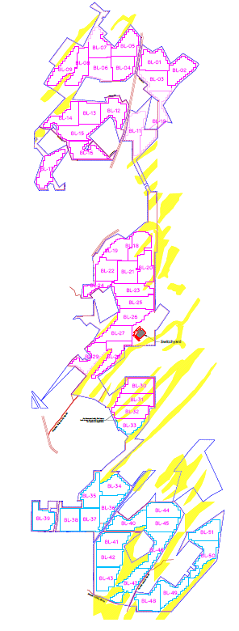
600 MW Baiya: Project Plot Plan
Description | Baiya
Type of MMS | No. of Blocks | MW
Fixed Tilt | 51 | 600
Total | 51 | 600
Type of Land | Acres
Govt. | 2133.43
Pvt. | 156.9
Total | 2290.33
15

Slide 16
600 MW Baiya: Overall S Curve
Gap Analysis
Progress Parameter | Weightage | Cumm. Plan | Cumm. Actual | Variance | Remarks for Variance
Land & Statutory | 7% | 100% | 99% | 1%
Engineering+ System Study | 13% | 100% | 100% | 0%
Procurement | 30% | 100% | 100% | 0%
Construction | 50% | 65% | 59% | 2% | Delayed on account of unavailability of bush cutting permission
Overall | 100% | 83% | 79% | 2%
16

Slide 17
600 MW Baiya: Engineering Progress
Sr. No | Description | No. of Drawings | %
A (B+C) | Total | 468
B (RFC+b1+b2+b3) | Approved | 468 | 100%
RFC | RFC | 329
b1 | A1-Category | 115
b2 | A2-Category | 3
b3 | I-Category | 21
C | Pending | 0
A1-Category: Approved
A2-Category: Approved with Comments
I-Category: Information
17

Slide 18
600 MW Baiya: Procurement & 3 month rolling plan for Supply Status
S.No. | Packages | UOM | Scope | Ordering Completed | Balance Ordering | Delivered at Site up to Aug’26 | Forecast delivery schedule
 |  |  |  |  |  |  | Sep-26 | Oct-26 | Nov-26
1 | Module | MWp | 816 | 816 | - | 816 | - | - | -
2 | MMS - FT | MW | 600 | 600 | - | 600 | - | - | -
3 | IDT | Nos. | 52 | 52 | - | 52 | - | - | -
4 | Inverter | Nos. | 2142 | 2142 | - | 2142 | - | - | -
5 | HT Panel | Nos. | 51 | 51 | - | 51 | - | - | -
6 | LT Panel | Nos. | 816 | 816 | - | 816 | - | - | -
7 | HT Cable | km | 255 | 255 | - | 255 | - | - | -
8 | LT Cable | km | 729 | 729 | - | 729 | - | - | -
9 | Control Cable | km | 25 | 25 | - | 25 | - | - | -
10 | DC Cable | km | 4808 | 4808 | - | 4808 | - | - | -
11 | Robotic Module Cleaning System | Nos. | 2268 | 2268 | - | 2268 | - | - | -
18

Slide 19
600 MW Baiya: Construction Progress Update
Description | UOM | Scope | Completed upto Aug’26 | Balance as on Aug’26 | For the Month Aug'26 |  | Next 3 Month Rolling Plan |  |  | Completion Target
 |  |  |  |  | Plan | Actual | Sep-26 | Oct-26 | Nov-26
Piling | Nos | 3,01,798 | 1,79,613 | 1,22,185 | - | - | 5,507 | 38,564 | 27,545 | 10-Feb-27
MMS - FT | Tables | 24,582 | 13,232 | 11,350 | - | - | 170 | 2,485 | 2,174 | 20-Feb-27
IDT Foundation | Blocks | 52 | 45 | 7 | - | - | 2 | 4 |  | 24-Oct-26
HT & LT Slab | Blocks | 52 | 44 | 8 | - | - | 2 | 5 |  | 24-Oct-26
HT & LT Canopy | Blocks | 52 | 38 | 14 | - | - | 7 | 6 | 1 | 24-Nov-26
IDT Erection | Blocks | 52 | 37 | 15 | - | - | 7 | 5 | 2 | 18-Nov-26
HT Panel Erection | Blocks | 52 | 33 | 19 | - | - | 10 | 1 | 7 | 25-Nov-26
LT Panel Erection | Nos. | 832 | 500 | 332 | 148 | - | 188 | 8 | 120 | 30-Nov-26
Inverter Erection | Nos. | 2,130 | 1,262 | 868 | - | - | 3 | 220 | 100 | 28-Jan-27
LT Cabling Works | Kms | 521 | 303 | 218 | - | - |  | 80 | 36 | 28-Jan-27
HT Cabling Works | Kms | 231 | 207 | 24 | - | - | 5 | 7 |  | 26-Oct-26
Module [Erection] | MWdc | 834 | 409 | 425 | - | - | 1 | 66 | 76 | 03-Mar-27
MC4 & VOC | MWdc | 834 | 372 | 462 | - | - | - | - |  | 04-Mar-27
CEA Inspection & Approval | MW | 600 | 251 | 349 | - | - | - | - |  | 05-Mar-27
Commissioning & Trial Run | MW | 600 | 251 | 349 | - | - | - | - |  | 23-Mar-27
19

Slide 20
600 MW Baiya: Major Milestone – Next 3 months
Oct’26
Milestone: Start of Piling work for Phase-III (90 MW) & Phase-IV (120 MW). Status: Bush cutting permission required to progress further work. Hearing on 20-Aug-26 conducted, next hearing is scheduled on 18-Sep-26.
20

Slide 21
600 MW Baiya: Manpower Deployment Plan vs Actual
21

Slide 22
Thank You

