Slide 1


CPAG – Energy Cluster
Aug-26
Adani Green Energy Ltd

Slide 2
Agenda
Executive Summary
            Project Information & Salient Features
            Progress Update
              Major Critical Issues

Slide 3
Executive Summary
Location | Project Name | FY 27 Plan (MW) | FY 27 Actual till Aug’26 (MW) | COD |  | Overall Progress |  | Remarks
 |  |  |  | Revised AOP Plan | Achieved/ Expected | Plan | Actual
GJ | Mundra North-Wind (Project capacity : 323.4 MW) | 257.4 | 99 | 31-Mar-27 | 31-Mar-27 | 83% | 81%

Slide 4
Commissioning: Plan vs. Forecast – Mundra North Wind Project
Details | Budget
 | Apr-26 | May-26 | Jun-26 | Jul-26 | Aug-26 | Sep-26 | Oct-26 | Nov-26 | Dec-26 | Jan-27 | Feb-27 | Mar-27 | Apr-27 | May-27 | Jun-27
Mundra North-323.4 MW |  |  |  | 99 | 26.4 | 13.2 | 13.2 | 13.2 | 19.8 | 26.4 | 26.4 | 19.8 | 16.5 | 16.5 | 33
Details | Actual / Forecast
 | Apr-26 | May-26 | Jun-26 | Jul-26 | Aug-26 | Sep-26 | Oct-26 | Nov-26 | Dec-26 | Jan-27 | Feb-27 | Mar-27 | Apr-27 | May-27 | Jun-27
Mundra North-323.4 MW |  |  |  | 99 | - | 39.6 | 13.2 | 13.2 | 19.8 | 26.4 | 26.4 | 19.8 | 16.5 | 16.5 | 33

Slide 5
Salient Features
Project | Mundra North Wind Projects
Project Scope / Capacity | 323.4 MW
Owner/ Developer | Adani Wind Energy Kutch Three Limited (AWEK3L)
Location | Mundra Kutch
Land Area | Approx 7.2 acres land is considered for each WTG (170m x 170m)
Project Configuration | Wind Turbine
Parameters | ANIL 3.3MW
Commissioning (FY 26-27) | Q1 | Q2 | Q3 | Q4 | Total
Budget Plan (MW) | - | 138.6 | 46.2 | 72.6 | 257.4
Actual / Expected (MW) | - | 99 / 138.6 | 46.2 | 72.6 | 257.4

Slide 6
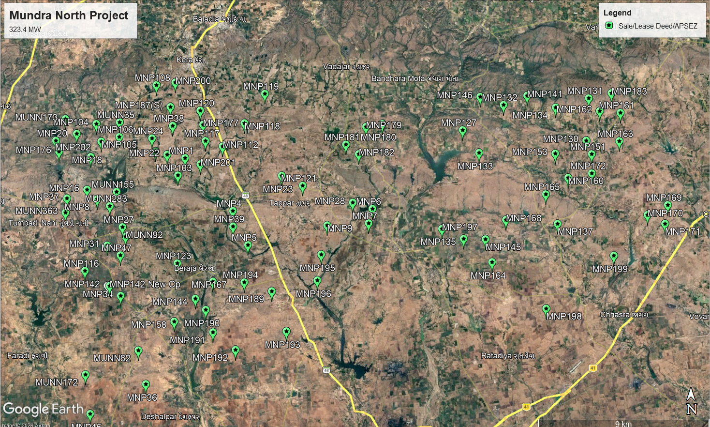

Mundra North: Site Layout
No. of Private Locations |  | 98
 | Acquired Locations (Registry Done) | 98

Slide 7
Overall S Curve
Gap Analysis
Progress Parameter | Weightage | Cumm. Plan | Cumm. Actual | Variance | Remarks for Variance
Engineering | 05% | 100% | 100% | 0%
Procurement | 35% | 90% | 88% | 2%
Construction | 60% | 76% | 75% | 2%
Total | 100% | 83% | 81% | 2%

Slide 8
Procurement & 3 month rolling plan for Supply Status
Sr No. | Packages | UOM | Scope | Ordering Completed | Delivered at Site up to Aug'26 | Balance to Deliver | Next 3 Month Rolling Plan
 |  |  |  |  |  |  | Sep-26 | Oct-26 | Nov-26
1 | WTG Set (N-H-DT) | Nos. | 98 | 98 | 49 | 49 | 4 | 4 | 3
2 | Blade | Nos. | 98 | 98 | 49 | 49 | 4 | 4 | 3
3 | Tower | Nos. | 98 | 98 | 49 | 49 | 4 | 4 | 3
4 | Transformer | Nos. | 98 | 98 | 98 | 0 | - | - | -
5 | HT Panel | Nos. | 98 | 98 | 98 | 0 | - | - | -
6 | 33 kV Counductor | Km | 1150 | 1150 | 1150 | 0 | - | - | -

Slide 9
Construction Progress Update
Activity | UOM | Scope | Completed | Balance | Preceding Month Aug’26 |  | Next 3 Month Rolling Plan |  |  | Completion Target
 |  |  |  |  | Plan | Actual | Sep-26 | Oct-26 | Nov-26
WTG Foundation | Nos | 98 | 94 | 4 | 6 | 2 | 4 |  |  | 30-Sep-26
USS Pre-cast Erection | Nos | 98 | 89 | 9 | 9 | 0 | 9 |  |  | 30-Sep-26
WTG Erection | Nos | 98 | 37 | 61 | 4 | 3 | 4 | 4 | 4 | 12-Jun-27
USS Erection | Nos | 98 | 63 | 35 | 2 | 9 | 2 | 8 | 8 | 28-Feb-27
33kV OH Line | Km | 345 | 157 | 188 | 4 | 15 | 9 | 28 | 35 | 30-Apr-27
WTG Commissioning (Trial Run) | Nos | 98 | 30 | 68 | 8 | 0 | 12 | 4 | 4 | 30-Jun-27

Slide 10
Major Milestone – Next 3 months
Sep-26 | Oct-26 | Nov-26
Milestone: Cum. Commissioning of 138.6 MW. | Milestone: Cum. Commissioning of 151.8 MW. | Milestone: Cum. Commissioning of 165 MW.

Slide 11
Mundra: Manpower Deployment Plan vs Actual
11

Slide 12
Major Critical Issues/Support desired – Mundra North
S.N. | Issues | Potential Impact | Root Cause of the Issue | Corrective Action | Action By |  | Current Status | Support Required
 |  |  |  |  | Whom | Date
1 | WTG Supply | Delay in project commissioning | Manufacturing delay | ANIL has shared the revised WTG dispatch schedule. | Project / ANIL | Ongoing | Project commissioning is deferred in revised AOP inline with WTG supply. | -

Slide 13
Thank You

