Slide 1


Battery Energy Storage Systems
Projects : FY 2026 – 27
10th Sep 26

Slide 2
PSS | Power | Energy | Dispatchable Energy
PSS-11 | 1080 MW | 2438 MWh | 2211 MWh
PSS-12 | 960 MW | 2167 MWh | 1965 MWh
PSS-10(B) | 600 MW | 1204 MWh | 1078 MWh
PSS-09 | 1080 MW | 2438 MWh | 2211 MWh
PSS-05(B)* | 1000 MW | 2258 MWh | 2041 MWh
PSS-08(B) | 420 MW | 843 MWh | 758 MWh
Total | 5140 MW | 11348 MWh | 10264 MWh
Note: * 06 IDT’s descoped (06*20MW = 120 MW reduced) Earlier Power: 1120 MW, Energy: 2529 MWh & Dispatchable Energy :2286 MWh.
Reduced capacities: Power: 120MW, Energy: 271 MW & Dispatchable Energy: 245 MWh

Slide 3
Salient Features
Project Capacity : 5140 MW / 11348 MWh (Dispatchable Power : 10263 MWh)
Capex NFA : Capex NFA cost INR 14758 16358 Cr. Initial proposal approved by CMN on
08-Dec-25 for PSS-11, 12, 10(B) & 03-Jan-26 for PSS-09, 05(B) & 08(B).
Revised NFAs approved on 04-Apr-26.
PPA Effective Date : Not applicable
Tariff : Merchant Capacity only
Project Location : Khavda RE Park, Gujarat
As per approved NFA_R1 (04-Apr-26) | INR (Crores)
Total | 16358
Hard Cost (Supply, Services & PMC) | 14090
Soft Cost (Pre-Ops, Financials & IDC) | 647
Land Cost | 1190
Contingency | 431
SPV | AGE27BL | AGE27CL | ARE35L | AGE27AL | ARE44L | ARE35L
PSS | 11 | 12 | 10(B) | 09 | 05(B) | 08(B)
Connectivity | 1060 | 950 | 600 | 1060 | 942.2 | 410
Land Lease (Years) | Lease: 40 Years Sub-lease: 29 Yr 11 Mo (SRPL) | Lease: 40 Years Sub-lease: 29 Yr 11 Mo (SRPL) | Lease: 40 Years Sub-lease: 29 Yr 11 Mo (SRPL) | Lease: 40 Years Sub-lease: 29 Yr 11 Mo (AGEL) | Lease: 40 Years Sub-lease: 29 Yr 11 Mo (AGEL/APL) | Lease: 40 Years Sub-lease: 29 Yr 11 Mo (AGEL)
Contractors | Cemindia / MSC /Akshar / Sunelec / Icecube / Synergy | Cemindia / MSC / Akshar / DP Consteel | Cemindia / Godhara / Green Revolution MSC/ Akshar / DP Consteel | Cemindia/ MSC / Akshar / Synergy | Cemindia/ MSC / Icecube / DP Consteel | Cemindia/ Shreeji / Sunelec / Synergy
3

Slide 4
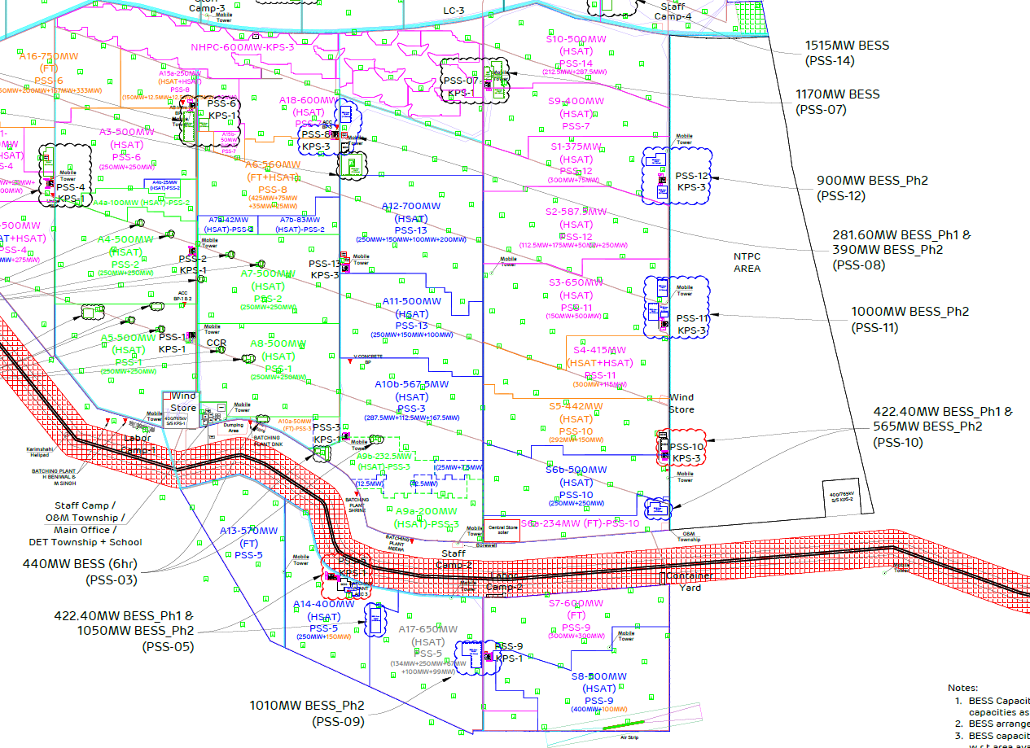
Overall Layout
BESS-08(B)
Plot No. | A18
Capacity | 420 MW / 843 MWh
Containers | 168 Nos
Land | 31.3 Acres
BESS-12
Plot No. | S5+S6
Capacity | 960 MW / 2167 MWh
Containers | 384 Nos
Land | 70.22 Acres (In 2 parcel)
BESS-10(B)
Plot No. | S13R
Capacity | 600 MW / 1204 MWh
Containers | 240 Nos
Land | 39.04 Acres
BESS-11
Plot No. | S8+S9
Capacity | 1080 MW / 2438 MWh
Containers | 432 Nos
Land | 69.1 Acres (In 3 Parcel)
BESS-09
Plot No. | A17
Capacity | 1080 MW / 2438 MWh
Containers | 432 Nos
Land | 70 Acres
BESS-05(B)
Plot No. | A17
Capacity | 1000 MW / 2258 MWh
Containers | 400 Nos
Land | 68.81 Acres (In 2 Parcel)
Air Strip

Slide 5
Commissioning Plan
COD | PSS-11 in MWh |  | PSS-12 in MWh |  | PSS-10(B) in MWh |  | PSS-09 in MWh |  | PSS-05(B) in MWh |  | PSS-08(B) in MWh |  | Total Capacity (MWh)
 | (CATL) |  | (CATL) |  | (Jinko) |  | (CATL) |  | (CATL) |  | (Greatpower)
 | MWh | Container | MWh | Container | MWh | Container | MWh | Container | MWh | Container | MWh | Container | MWh | Container
Jun-26
Jul-26
Aug-26 | 542 | 96 |  |  |  |  |  |  |  |  |  |  | 542 | 96
Sep-26 | 542 | 96 | 497 858 | 88 152 | 602 | 120 |  |  |  |  |  |  | 1039 1460 | 184 272
Oct-26 | 1355 | 240 | 813 | 144 | 602 | 120 | 542 | 96 |  |  | 241 | 48 | 3553 | 648
Nov-26 |  |  |  |  |  |  | 1896 | 336 | 271 | 48 | 241 | 48 | 2408 | 432
Dec-26 |  |  |  |  |  |  |  |  | 1716 | 304 | 361 | 72 | 2077 | 376
Jan-27 |  |  |  |  |  |  |  |  | 271 | 48 |  |  | 271 | 48
Feb-27
Total | 2438 | 432 | 2167 | 384 | 1204 | 240 | 2438 | 432 | 2258 | 400 | 843 | 168 | 11348 | 2056
Note : PSS11:
PSS12:
PSS10B:

Slide 6
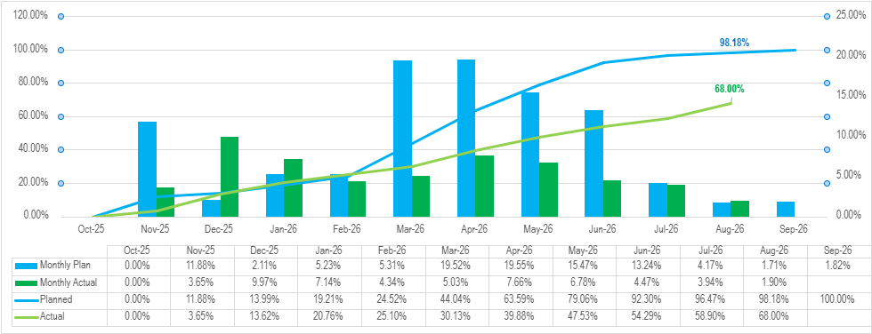
Physical Progress : PSS 11 S-Curve
Activity | Wtg. | FTM |  | Variance in Plan Vs Actual | Variance Remark & Mitigation/Action Plan
 |  | Plan | Actual
Statutory Approvals | 2% | 2% | 2% | 0% | Total approvals 18; 17 approvals are Completed; 1 post commissioning.
Engineering | 5% | 5% | 5% | 0% | Refer Slide no. 12
Ordering, Manufacturing & Supply | 38% | 38% | 37% | 1% | Battery container deliveries were delayed due to logistics delay.
Construction (Civil), Electrical, Integration & Commissioning | 55% | 53% | 24% | 29% | The difference between ‘Plan’ and ‘Actual’ is due to insufficient / delayed deployment of manpower & Container receipt at site. Termination of M/s Pratibha and additional allocation of PSS-11 to M/s Akshar led to temporary manpower constraints, impacting electrical work progress.
Total | 100% | 98% | 68% | 30% | Mitigation Plan: BOP Civil and ACDC manpower were augmented as per MOM commitments, Pratibha was terminated and replaced by Akshar, and battery containers were relocated to PSS-12 based on site readiness.

Slide 7
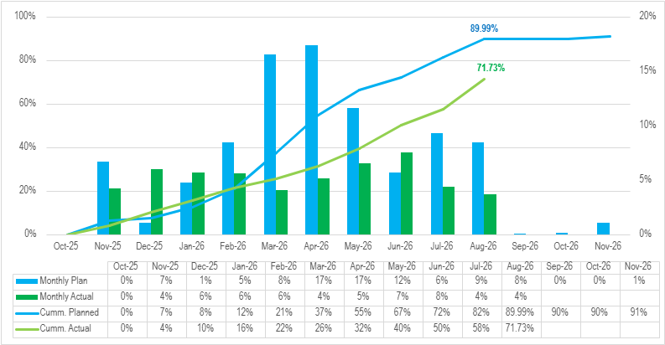
Physical Progress : PSS 12 S-Curve
Activity | Wtg. | FTM |  | Variance in Plan Vs Actual | Variance Remark & Mitigation/Action Plan
 |  | Plan | Actual
Statutory Approvals | 2% | 2% | 2% | 0% | Total approvals 18; 17 approvals are Completed; 1 post commissioning.
Engineering | 5% | 5% | 5% | 0% | Refer Slide no. 12
Ordering, Manufacturing & Supply | 38% | 38% | 37% | 0% | Battery container deliveries were delayed due to logistics delay.
Construction (Civil), Electrical, Integration & Commissioning | 55% | 46% | 27% | 19% | The difference between ‘Plan’ and ‘Actual’ is due to insufficient manpower deployment by the M/s MSC (BOP) contractor, along with the late mobilization of the M/s Akshar (AC DC) contractor & late Container receipt at site.
Total | 100% | 90% | 71% | 19% | Mitigation Plan: Expedite the efforts of the BOP Civil and ACDC contractors to increase manpower in line with the commitments in the signed MOM.

Slide 8
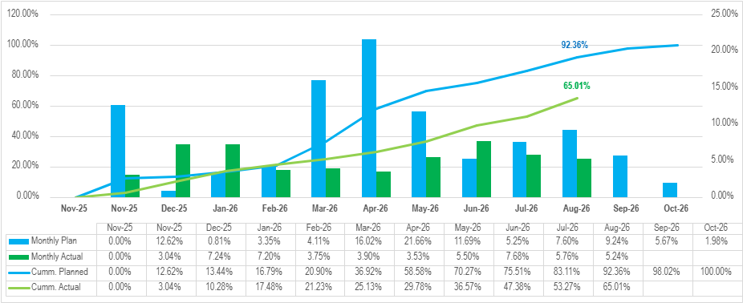
Physical Progress : PSS 10B S-Curve
Activity | Wtg. | FTM |  | Variance in Plan Vs Actual | Variance Remark & Mitigation/Action Plan
 |  | Plan | Actual
Statutory Approvals | 2% | 2% | 2% | 0% | Total approvals 18; 17 approvals are Completed; 1 post commissioning.
Engineering | 5% | 5% | 5% | 0% | Refer Slide no. 12
Ordering, Manufacturing & Supply | 38% | 38% | 36% | 2% | Battery container deliveries were delayed due to logistics delay.
Construction (Civil), Electrical, Integration & Commissioning | 55% | 47% | 22% | 25% | Due to delayed mobilization and insufficient manpower from the M/s Godara (BOP) contractor and M/s Akshar did not have front availability around IDTs. Delayed award of PSS-10B to M/s MSC and initial manpower shortages along with late container receipt at site led to a slight delay in project progress
Total | 100% | 92% | 65% | 27% | Mitigation Plan: Godhara was descoped and MSC was deployed from 01-Jul, with manpower increased to complete civil works by Aug-end and make fronts available for electrical activities.

Slide 9
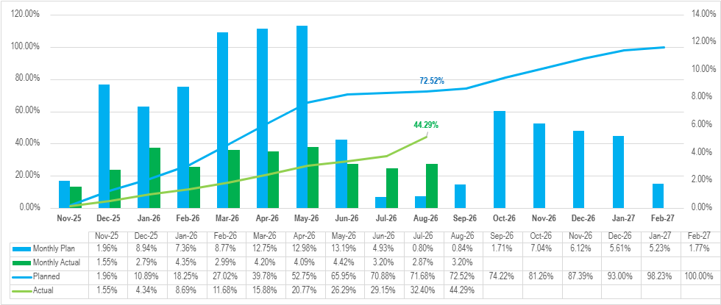
Physical Progress : PSS 9 S-Curve
Activity | Wtg. | FTM |  | Variance in Plan Vs Actual | Variance Remark & Mitigation/Action Plan
 |  | Plan | Actual
Statutory Approvals | 2% | 1.80% | 1.44% | 0.36% | Total approvals 18; 14 approvals are Completed, 3 In progress; 1 post commissioning.
Engineering | 5% | 5.00% | 5.00% | 0.00% | Refer Slide no. 12
Ordering, Manufacturing & Supply | 38% | 36.5% | 26.19% | 10.35% | Deliveries of Battery, PCS, EMS , MV Switchgear & Harmonic filters got delayed.
Construction (Civil), Electrical, Integration & Commissioning | 55% | 29.18% | 11.66% | 17.52% | The difference between ‘Plan’ and ‘Actual’ is due to delays in site execution and insufficient manpower deployment by the M/s MSC & M/s Akshar as this PSS was in our least priority.
Total | 100% | 72.5% | 44.3% | 28.2% | Mitigation Plan: Expedite the efforts of the BOP Civil and ACDC contractors to increase manpower in line with the commitments in the signed MOM.

Slide 10
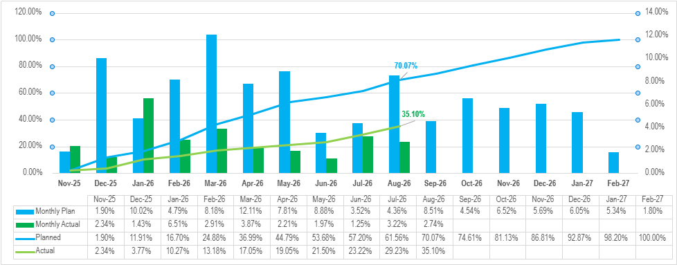
Physical Progress : PSS 5B S-Curve
Activity | Wtg. | FTM |  | Variance in Plan Vs Actual | Variance Remark & Mitigation/Action Plan
 |  | Plan | Actual
Statutory Approvals | 2% | 1.80% | 1.44% | 0.36% | Total approvals 18; 14 approvals are Completed, 3 In progress; 1 post commissioning.
Engineering | 5% | 5.00% | 5.00% | 0.00% | Refer Slide no. 12
Ordering, Manufacturing & Supply | 38% | 35.7% | 18.51% | 17.23% | Deliveries of Battery, PCS, EMS , Trafo, CSS, MV Switchgear & Harmonic filters got delayed.
Construction (Civil), Electrical, Integration & Commissioning | 55% | 27.53% | 10.24% | 17.29% | Insufficient manpower deployment by the M/s Shree Rajnagnechi. Delayed award of PSS-05B to M/s MSC and initial manpower shortages impacted civil progress, resulting in non-availability of work fronts for M/s Ice Cube and consequent delay in electrical works.
Total | 100% | 70.1% | 35.2% | 34.9% | Mitigation Plan: BOP Civil and ACDC manpower were augmented as per MOM commitments. Rajnagnechi was terminated and replaced by MSC. Work front availability for electrical vendors is expected to improve progressively with the completion of civil works

Slide 11
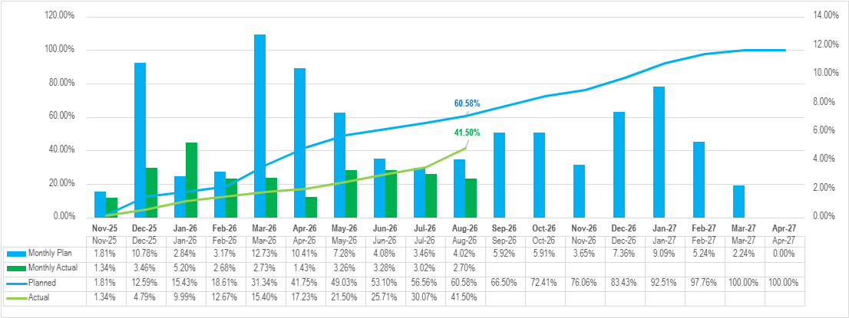
Physical Progress : PSS 8B S-Curve
Activity | Wtg. | FTM |  | Variance in Plan Vs Actual | Variance Remark & Mitigation/Action Plan
 |  | Plan | Actual
Statutory Approvals | 2% | 1.80% | 1.44% | 0.36% | Total approvals 18; 14 approvals are Completed, 3 In progress; 1 post commissioning.
Engineering | 5% | 5.00% | 5.00% | 0.00% | Refer Slide no. 12
Ordering, Manufacturing & Supply | 38% | 28.9% | 23.47% | 5.38% | Deliveries of Battery, PCS, EMS , Trafo, CSS, MV Switchgear & Harmonic filters got delayed
Construction (Civil), Electrical, Integration & Commissioning | 55% | 24.93% | 11.63% | 13.30% | Inadequate manpower deployment by M/s Shreeji and M/s SUNELEC. M/s Shreeji is targeted to complete civil works by 25-Sep, while M/s SUNELEC is augmenting manpower to improve progress.
Total | 100% | 60.6% | 41.5% | 19.0% | Mitigation Plan: Expedite the efforts of the BOP Civil and ACDC contractors to increase manpower in line with the commitments in the signed MOM.

Slide 12
Engineering Progress : PSS 11 / PSS 12 / PSS 10B/ PSS 09/ PSS08B/ PSS05B
Description | Overall Completion | Total Docs. | Overall Status up to Aug’26
 |  |  | Docs. Cum. Received | Documents Approved |  |  |  |  | Documents Under Review | Cum. Total approved | Approved % | Remarks
 |  |  |  | Cat I | Cat II | Cat III | Cat IV | Cat IV*
A | Dates | B | C | D | E | F | G | H | I | J = D + E + F + G + H | k = j / b
PSS-11 | 15-Oct-26 | 210 | 169 | 96 | 24 | 0 | 47 | 1 | 1 | 168 | 80% | -
PSS-12 | 15-Oct-26 | 200 | 137 | 87 | 4 | 0 | 45 | 1 | - | 137 | 69% | -
PSS-10B | 15-Oct-26 | 233 | 164 | 107 | 4 | 0 | 50 | 1 | 2 | 162 | 70% | -
PSS-08B | 15-Oct-26 | 239 | 136 | 84 | 5 | 2 | 42 | 2 | 1 | 135 | 56% | -
PSS-09 | 15-Oct-26 | 227 | 152 | 101 | 4 | 0 | 43 | 2 | 2 | 150 | 66% | -
PSS-05B | 15-Oct-26 | 223 | 142 | 89 | 5 | 0 | 47 | 1 | - | 142 | 64% | -
MDL Link: Phase-II_Master Log for AGEL_Battery_04Aug data
Cat I: Approved, Cat II: Approved with minor comments, Cat III: Not approved, Cat IV: For Information, Cat IV*:Incorporate comments and resubmit for information

Slide 13
Procurement Status: PSS 11, 12, 10B, 9, 05B & 08B

Slide 14
Procurement & Monthly Rolling Plan for Supply of Equipment – PSS 11
Sr. No. | Packages | Manufacturer | UOM | Scope | Ordering Completed | Balance Ordering | PO Number | PO Date | Expected Delivery at Site |  | Manufacturing Status |  | Delivered At Site | Forecast Delivery Schedule (Qty) |  | Remarks
 |  |  |  |  |  |  |  |  | Start | Finish | QAP Acceptance Date | MC Date |  | Sep-26 | Oct-26
1 | Battery Container | CATL | Nos. | 432 | 432 | 0 | 5310000957 | 16-Dec-25 | 10-May-26 25-Jun-26 14-Jul-26 | 01-Jul-26 15-Jul-26 07-Sep-26 05-Oct-26 | 26 Nov 25 | 11 Feb- 26 | 229 | 63 | 140 | FOB 63 containers :01-Aug FOB 140 containers :02-Aug
2 | PCS | Hopewind | Nos. | 432 | 432 | 0 | 5310000906 | 15-Dec-25 | 06-Jun-26 | 04-Aug-26 | 8-Jan-26 | 10-Jan-26 | 432 | Completed
3 | EMS | Emerson | Set | 1 | 1 | 0 | 4510020887 | 15-Dec-25 | 04-Jun-26 | 30-Jun-26 | same as of phase one (28/05/25) | - | 1
4 | Converter Transformer | Ornet | Nos. | 54 | 54 | 0 | 4510020943 | 17-Dec-25 | 27-Mar-26 | 30-May-26 | 25-Feb-26 | 28-Feb-26 | 54
5 | CSS | M/S Akshar | Nos. | 9 | 9 | 0 | 4510021229 | 16-Jan-26 | 20-May-26 | 10-Jun-26 | same as of phase one (27/05/25) | - | 9
6 | MV Switchgear | Trisquare | Nos. | 18 | 18 | 0 | 4510021080 | 30-Dec-25 | 07-May-26 | 12-Jun-26 | 07-Feb-26 | - | 18
7 | HT Cable | Diamond | Kms | 74 | 74 | 0 | 4510021080 | 18-Dec-25 | 11-Feb-26 | 30-Apr-26 | 12-Jan-26 | 15-Jan-26 | 74
8 | DC & LT Cables* | Diamond | Kms | 822 | 822 | 0 | 4510021279 | 19-Jan-26 | 28-Feb-26 | 30-Apr-26 | 12-Jan-26 | 15-Jan-26 | 822
9 | Control Cable | Gemscab | Kms | 140 | 140 | 0 | 4510021261 | 19-Jan-26 | 28-Feb-26 | 10-Mar-26 | 15-Jan-26 | 18-Jan-26 | 140
10 | SCADA Cable | M/s Delton & M/s Suyog | Kms | 294 | 294 | 0 | 4510021157 & 4510021163 | 8-Jan-26 | 28-Feb-26 | 15-May-26 | 8-Jan-26 | 11-Jan-26 | 294
11 | FO Cable | Paramount | Kms | 23 | 23 | 0 | 4510021089 | 2-Jan-26 | 15-Mar-26 | 30-Mar-26 | same as of phase one (14/05/25) | - | 23

Slide 15
Procurement & Monthly Rolling Plan for Supply of Equipment – PSS 12
Sr. No. | Packages | Manufacturer | UOM | Scope | Ordering Completed | Balance Ordering | PO Number | PO Date | Expected Delivery at Site |  | Manufacturing Status |  | Delivered At Site | Forecast Delivery Schedule (Qty) | Remarks
 |  |  |  |  |  |  |  |  | Start | Finish | QAP Acceptance Date | MC Date |  | Sep-26
1 | Battery Container | CATL | Nos. | 384 | 384 | 0 | 5310000958 | 16-Dec-25 | 25-May-26 01-Jul-26 1-Aug-26 20-Jul-26 15-Jul-26 | 25-Dec-26 31-Aug-26 1-Dec-26 01-Sep-26 23-Sep-26 | 26 Nov 25 | 11 Feb 26 | 319 | 65 | FOB 65 containers – 01-Aug
2 | PCS | Inova | Nos | 384 | 384 | 0 | 5310000905 | 13-Dec-25 | 13-Jun-26 | 29-Aug-26 | 7-Feb-26 | - | 384 | Completed
3 | EMS | Honeywell | Set | 1 | 1 | 0 | 4510020955 | 17-Dec-25 | 01-Jul-26 | 04-Aug-26 | 29-Jan-26 | - | 1
4 | Converter Transformer | Tesla | Nos. | 48 | 48 | 0 | 4510020942 | 17-Dec-25 | 03-Apr-26 | 20-Jun-26 | 7-Feb-26 | 9-Feb-26 | 48
5 | CSS | M/S Akshar | Nos. | 8 | 8 | 0 | 4510021230 | 16-Jan-26 | 01-Jun-26 | 10-Jul-26 | same as of phase one (27/05/25) | - | 8
6 | MV Switchgear | Trisquare | Nos. | 16 | 16 | 0 | 4510021081 | 30-Dec-25 | 15-Jun-26 | 05-Jul-26 | - | - | 16
7 | HT Cable | Paramount | Kms | 62 | 62 | 0 | 4510020968 | 18-Dec-25 | 7-Feb-26 | 9-Mar-26 | 15-Jan-26 | 17-Jan-26 | 62
8 | DC & LT Cables | APAR & DYNAMIC | Kms | 765 | 765 | 0 | 4510021281 & 4510021288 | 19-Jan-26 | 15-Jun-26 | 30-May-26 | 15-01-2026 & 23-01-26 | 15-Feb-26 | 765
9 | Control Cable | Gemscab | Kms | 124 | 124 | 0 | 4510021262 | 19-Jan-26 | 28-Feb-26 | 10-Mar-26 | 15-Jan-26 | 17-Jan-26 | 124
10 | SCADA Cable | M/s Delton & M/s Suyog | Kms | 262 | 262 | 0 | 4510021158 | 8-Jan-26 | 05-May-26 | 12-Jun-26 | 8-Jan-26 | 10-Jan-26 | 262
11 | FO Cable | Paramount | Kms | 20 | 20 | 0 | 4510021094 | 2-Jan-26 | 15-Mar-26 | 30-Mar-26 | same as of phase one (14/05/25) | - | 20

Slide 16
Procurement & Monthly Rolling Plan for Supply of Equipment – PSS 10B
Sr. No. | Packages | Manufacturer | UOM | Scope | Ordering Completed | Balance Ordering | PO Number | PO Date | Expected Delivery at Site |  | Manufacturing Status |  | Delivered At Site | Forecast Delivery Schedule (Qty) | Remarks
 |  |  |  |  |  |  |  |  | Start | Finish | QAP Acceptance Date | MC Date |  | Sep-26
1 | Battery Container | Jinko | Nos. | 240 | 240 | 0 | 5310000955 | 15-Dec-25 | 25-May-26 31-May-26 20-Jun-26 | 25-Jul-26 31-Jul-26 01-Aug-26 16-Aug-26 08-Sep-26 24-Sep-26 | 24 Nov 25 | 11 Feb 26 | 160 | 80 | FOB 80 containers – 01-Aug-26
2 | PCS | Inova | Nos | 240 | 240 | 0 | 5310000904 | 13-Dec-25 | 13-Jun-26 | 29-Aug-26 | 7-Feb-26 | 9-Feb-26 | 240 | Completed
3 | EMS | Adaptive | Set | 1 | 1 | 0 | 4510020886 | 17-Dec-25 | 18-Jun-26 | 16-Jun-26 | 21-May-25 | - | 1
4 | Converter Transformer | Tesla & Ornet | Nos. | 30 | 30 | 0 | 4510021010 & 4510021037 | 17-Dec-25 | 30-Apr-26 | 27-Jul-26 | 25-Feb-26 | 27-Feb-26 | 30
5 | CSS | M/S Akshar | Nos. | 5 | 5 | 0 | 4510021228 | 16-Jan-26 | 10-Jun-26 | 04-Aug-26 | same as of phase one (27/05/25) | 27-Feb-26 | 5
6 | MV Switchgear | Trisquare | Nos. | 10 | 10 | 0 | 4510021065 | 30-Dec-25 | 01-May-26 | 30-Jul-26 | Under approval (07-02-26) | 9-Feb-26 | 10
7 | HT Cable | PARAMOUNT & DYNAMIC | Kms | 62 | 62 | 0 | 4510020976 & 4510020977 | 18-Dec-25 | 12-Jun-26 | 15-Jun-26 | 12-Jan-26 | 14-Jan-26 | 62
8 | DC & LT Cables | PARAMOUNT & DYNAMIC | Kms | 480 | 480 | 0 | 4510021290 & 4510021287 | 19-Jan-26 | 28-Feb-26 | 10-Mar-26 | 07-02-26 & 23-01-26 | 9-Feb-26 | 480
9 | Control Cable | Gemscab | Kms | 78 | 78 | 0 | 4510021246 | 19-Jan-26 | 20-Feb-26 | 10-Mar-26 | 15-Jan-26 | 17-Jan-26 | 78
10 | SCADA Cable | M/s Delton & M/s Suyog | Kms | 166 | 166 | 0 | 4510021152 & 4510021150 | 8-Jan-26 | 20-Mar-26 | 12-Jun-26 | 8-Jan-26 | 10-Jan-26 | 166
11 | FO Cable | Paramount | Kms | 21 | 21 | 0 | 4510021085 | 2-Jan-26 | 15-Mar-26 | 30-Mar-26 | same as of phase one (14/05/25) | 10-Feb-26 | 21

Slide 17
Procurement & Monthly Rolling Plan for Supply of Equipment – PSS 09
Sr. No. | Packages | Manufacturer | UOM | Scope | Ordering Completed | Balance Ordering | PO Number | PO Date | Expected Delivery at Site |  | Manufacturing Status |  | Delivered At Site | Forecast Delivery Schedule |  |  | Remarks
 |  |  |  |  |  |  |  |  | Start | Finish | QAP Acceptance Date | MC Date |  | Sep-26 | Oct-26 | Nov-26
1 | Battery Container | CATL | Nos. | 432 | 432 | 0 | 5310000937 | 1-Jan-26 | 25-Sep-26 01-Oct-26 | 25-Mar-27 31-Oct-26 1-Jan-27 31-Oct-26 | 26 Nov 25 | 11 Feb 26 | - |  | 177 | 255 | FOB 97 containers : 04-Sep
2 | PCS | Inova | Nos. | 432 | 432 | 0 | 5310000934 | 3-Jan-26 | 25-Jun-26 01-Sep-26 | 25-Aug-26 31-Oct-26 17-Dec-26 04-Oct-26 | 7-Feb-26 | 10-Feb-26 | - | 288 | 144
3 | EMS | Honeywell | Set | 1 | 1 | 0 | 4510021128 | 2-Jan-26 | 06-Sep-26 | 16-May-26 31-Aug-26 1-Oct-26 31-Aug-26 30-Sep-26 | 29-Jan-26 | 30-Jan-26 | - | 1
4 | Converter Transformer | Ornet | Nos. | 54 | 54 | 0 | 4510021210 & 4510021241 | 13-Jan-26 | 25-Apr-26 01-May-26 01-Aug-26 | 27-May-26 30-May-26 31-Aug-26 20-Sep-26 | 25-Feb-26 | 26-Feb-26 | 53 | 1
5 | CSS | M/S Akshar | Nos. | 9 | 9 | 0 | 4510021227 | 16-Jan-26 | 16-Aug-26 | 28-Aug-26 | same as of phase one (27/05/25) | - | 9 | Completed
6 | MV Switchgear | Popular | Nos. | 18 | 18 | 0 | 4510021111 | 1-Jan-26 | 25-Aug-26 | 30-Apr-26 30-Jun-26 30-Aug-26 15-Oct-26 30-Sep-26 | same as of phase one (03/06/25) | - | 3 | 15
7 | HT Cable | Paramount | Kms | 80 | 80 | 0 | 4510021149 | 31-Dec-25 | 28-Feb-26 | 9-Mar-26 | 15-Jan-26 | 16-Jan-26 | 80 | Completed
8 | DC & LT Cables | Diamond | Kms | 962 | 822 | 0 | 4510021289 & 4510021286 | 19-Jan-26 | 28-Feb-26 | 15-Apr-26 | 12-Jan-26 | 15-Jan-26 | 962
9 | Control Cable | Gemscab | Kms | 140 | 140 | 0 | 4510021265 | 19-Jan-26 | 5-Apr-26 | 15-Apr-26 | 15-Jan-26 | 16-Jan-26 | 140
10 | SCADA Cable | M/s Delton & M/s Suyog | Kms | 295 | 295 | 0 | 4510021162 & 4510021167 | 8-Jan-26 | 15-Mar-26 | 15-Jun-26 | 15-Jan-26 | 16-Jan-26 | 295
11 | FO Cable | Paramount WestCoast | Kms | 23 | 23 | 0 | 4510021124 4510022323 | 3-Jan-26 | 25-Jun-26 | 25-Jun-26 | same as of phase one (14/05/25) | - | 23

Slide 18
Procurement & Monthly Rolling Plan for Supply of Equipment – PSS 05B
Sr. No. | Packages | Manufacturer | UOM | Scope | Ordering Completed | Balance Ordering | PO Number | PO Date | Expected Delivery at Site |  | Manufacturing Status |  | Delivered At Site | Forecast Delivery Schedule |  |  |  | Remarks
 |  |  |  |  |  |  |  |  | Start | Finish | QAP Acceptance Date | MC Date |  | Sep-26 | Oct-26 | Nov-26 | Dec-26
1 | Battery Container | CATL | Nos. | 448 400 | 448 400 | 0 | 5310000938 | 1-Jan-26 | 25-Oct-26 01-Aug-26 01-Oct-26 31-Oct-26 | 25-Feb-27 20-Nov-26 1-Jan-27 22-Dec-26 15-Dec-26 | 26 Nov 25 | 11 Feb 26 |  | - | 88 | 140 | 172
2 | PCS | Shenzen | Set | 56 400 | 56 400 | 0 | 5310000936 | 2-Jan-26 | 25-Sep-26 4-Oct-26 | 25-Nov-26 31-Dec-26 29-Nov-26 04-Nov-26 | 8-Jan-26 | - |  | 72 | 216 | 112
3 | EMS | Emerson | Set | 1 | 1 | 0 | 4510021125 | 2-Jan-26 | 15-Aug-26 31-Aug-26 03-Sep-26 07-Oct-26 | 25-Sep-26 1-Oct-26 03-Sep-26 30-Oct-26 | same as of phase one (28/05/25) | - |  | - | 1
4 | Converter Transformer | Tesla | Nos. | 57 51 | 57 51 | 0 | 4510021192 & 4510021248 | 13-Jan-26 | 30-May-26 01-Sep-26 | 30-Sep-26 | 7-Feb-26 | 9-Feb-26 | - | 51
5 | CSS | M/S Akshar | Nos. | 10 9 | 10 9 | 0 | 4510021226 | 16-Jan-26 | 10-Jun-26 01-Sep-26 | 25-Jul-26 30-Sep-26 | same as of phase one (27/05/25) | - | - | 9
6 | MV Switchgear | Symatic | Nos. | 20 18 | 20 18 | 0 | 4510021115 | 1-Jan-26 | 23-Jul-26 | 30-Sep-26 30-Aug-26 30-Sep-26 | same as of phase one (21/05/25) | - | - | 18
7 | HT Cable | Paramount & Diamond | Kms | 40 | 40 | 0 | 4510021151 | 31-Dec-25 | 31-Mar-26 | 15-Apr-26 | 15-Jan-26 | 17-Jan-26 | 40 | Completed
8 | DC & LT Cables | APAR & DYNAMIC | Kms | 1001 | 1001 | 0 | 4510021283 & 4510021285 | 19-Jan-26 | 15-Mar-26 | 30-May-26 | 15-01-2026 & 23-01-26 | 25-Jan-26 | 1001
9 | Control Cable | Gemscab | Kms | 146 | 146 | 0 | 4510021263 | 19-Jan-26 | 10-Mar-26 | 31-Mar-26 | 15-Jan-26 | 17-Jan-26 | 146
10 | SCADA Cable | M/s Delton & M/s Suyog | Kms | 295 | 295 | 0 | 4510021159 & 4510021165 | 8-Jan-26 | 18-May-26 | 04-Jul-26 | 8-Jan-26 | 10-Jan-26 | 295
11 | FO Cable | Paramount WestCoast | Kms | 23 | 23 | 0 | 4510021122 | 3-Jan-26 | 17-Jun-26 | 17-Jun-26 | same as of phase one (14/05/25) | - | 23

Slide 19
Procurement & Monthly Rolling Plan for Supply of Equipment – PSS 08B
Sr. No. | Packages | Manufacturer | UOM | Scope | Ordering Completed | Balance Ordering | PO Number | PO Date | Expected Delivery at Site |  | Manufacturing Status |  | Delivered At Site | Forecast Delivery Schedule |  |  | Remarks
 |  |  |  |  |  |  |  |  | Start | Finish | QAP Acceptance Date | MC Date |  | Sep-26 | Oct-26 | Nov-26
1 | Battery Container | GreatPower | Nos. | 168 | 168 | 0 | 5310000940 | 5-Jan-26 | 10-Sep-26 31-Oct-26 17-Dec-26 31-Aug-26 | 18-Nov-26 31-Dec-26 14-Jan-27 31-Oct-26 27-Nov-26 | 17 Nov 25 | 12 Mar 26 | - |  | 78 | 90 | FOB 17 container: 04-Sep
2 | PCS | Sineng | Set | 21 | 21 | 0 | 5310000935 | 2-Jan-26 | 25-Aug-26 15-Oct-26 Nov-26 24-Aug-26 | 25-Oct-26 15-Dec-26 Jan-27 04-Oct-26 | 8-Jan-26 | 10-Jan-26 | - | 72 | 96
3 | EMS | Emerson | Set | 1 | 1 | 0 | 4510021126 | 2-Jan-26 | 5-Oct-26 1-Dec-26 31-Aug-26 | 25-Oct-26 1-Dec-26 31-Aug-26 30-Sep-26 | same as of phase one (28/05/25) | - | - | 1
4 | Converter Transformer | Ornet | Nos. | 21 | 21 | 0 | 4510021222 | 13-Jan-26 | 22-Sep-26 01-Aug-26 | 30-Sep-26 24-Oct-26 31-Aug-26 30-Sep-26 | 25-Feb-26 | 27-Feb-26 | 14 | 7
5 | CSS | M/S Akshar | Nos. | 4 | 4 | 0 | 4510021225 | 16-Jan-26 | 25-Jul-26 15-Jul-26 15-Aug-26 05-Sep-26 | 30-Aug-26 15-Aug-26 31-Aug-26 05-Sep-26 | same as of phase one (27/05/25) | - | - | 4
6 | MV Switchgear | Symatic | Nos. | 7 | 7 | 0 | 4510021119 | 1-Jan-26 | 22-Sep-26 01-Jul-26 01-Aug-26 05-Sep-26 | 24-Oct-26 31-Jul-26 15-Aug-26 05-Sep-26 | same as of phase one (21/05/25) | - | 4 | 3 | -
7 | HT Cable | Diamond | Kms | 40 25 | 40 | 0 | 4510021119 | 31-Dec-25 | 10-Jul-26 | 10-Jul-26 | 12-Jan-26 | 14-Jan-26 | 20 | Completed
8 | DC & LT Cables | PARAMOUNT, Diamond | Kms | 480 | 480 | 0 | 4510021280 & 4510021284 | 19-Jan-26 | 18-May-26 | 31-Jul-26 | 07-02-26 & 23-01-26 | 9-Feb-26 | 37
9 | Control Cable | Gemscab | Kms | 55 | 55 | 0 | 4510021264 | 19-Jan-26 | 01-May-26 | 31-May-26 | 15-Jan-26 | 17-Jan-26 | 55
10 | SCADA Cable | M/s Delton & M/s Suyog | Kms | 150 | 150 | 0 | 4510021160 & 4510021166 | 8-Jan-26 | 18-May-26 | 20-Jun-26 30-Jun-26 | 8-Jan-26 | 10-Jan-26 | 150
11 | FO Cable | Paramount WestCoast | Kms | 18 | 18 | 0 | 4510021123 | 3-Jan-26 | 08-Jun-26 | 08-Jun-26 | same as of phase one (14/05/25) | - | 18

Slide 20
PSS-11, 12 & 10B Progress

Slide 21
Civil Construction Progress (Plan vs Actual) (PSS-11)
Link
 | Plan |  |  | Actual (80% plan achieved)
 | Actual (between 40% to 80% plan achieved) |  |  | Actual (below 40% plan achieved)

Slide 22
Electrical Plan Vs Actual Summary PSS 11
Link

Slide 23
Construction Progress (Plan VS Actual) (PSS-12)
Link
 | Plan |  |  | Actual (80% plan achieved)
 | Actual (between 40% to 80% plan achieved) |  |  | Actual (below 40% plan achieved)

Slide 24
Electrical Plan Vs Actual Summary PSS 12
Link

Slide 25
Construction Progress (Plan VS Actual) (PSS-10(B))
Link
 | Plan |  |  | Actual (80% plan achieved)
 | Actual (between 40% to 80% plan achieved) |  |  | Actual (below 40% plan achieved)

Slide 26
Electrical Plan Vs Actual Summary PSS 10B
Link

Slide 27
PSS-09, 5B & 8B Progress

Slide 28
Construction Progress (Plan VS Actual) (PSS-09)
Link
 | Plan |  |  | Actual (80% plan achieved)
 | Actual (between 40% to 80% plan achieved) |  |  | Actual (below 40% plan achieved)

Slide 29
Electrical Plan Vs Actual Summary PSS 09
Link

Slide 30
Construction Progress (Plan VS Actual) (PSS-05(B))
Link
 | Plan |  |  | Actual (80% plan achieved)
 | Actual (between 40% to 80% plan achieved) |  |  | Actual (below 40% plan achieved)
Note: * 06 IDTs descoped. Accordingly, 06 PCS, 01 SGR , MCR & CSS are reduced

Slide 31
Electrical Plan Vs Actual Summary PSS 05B
Link
Note: * 06 IDT’s descoped. Accordingly, 06 PCS, 01 SGR , MCR & CSS are reduced
Note: * 06 IDTs descoped. Accordingly, 15,763 RM, HT Cable Laying, 14,312 RM DC Cable laying, 47,053 RM LT Cable laying 48 Battery Containers & PCS, 6 CT & 1 CSS reduced.

Slide 32
Construction Progress (Plan VS Actual) (PSS-08(B))
Link
 | Plan |  |  | Actual (80% plan achieved)
 | Actual (between 40% to 80% plan achieved) |  |  | Actual (below 40% plan achieved)

Slide 33
Electrical Plan Vs Actual Summary PSS 08B
Link

Slide 34
Manpower & Mandays Status: PSS 11, 12, 10B, 9, 05B & 08B

Slide 35
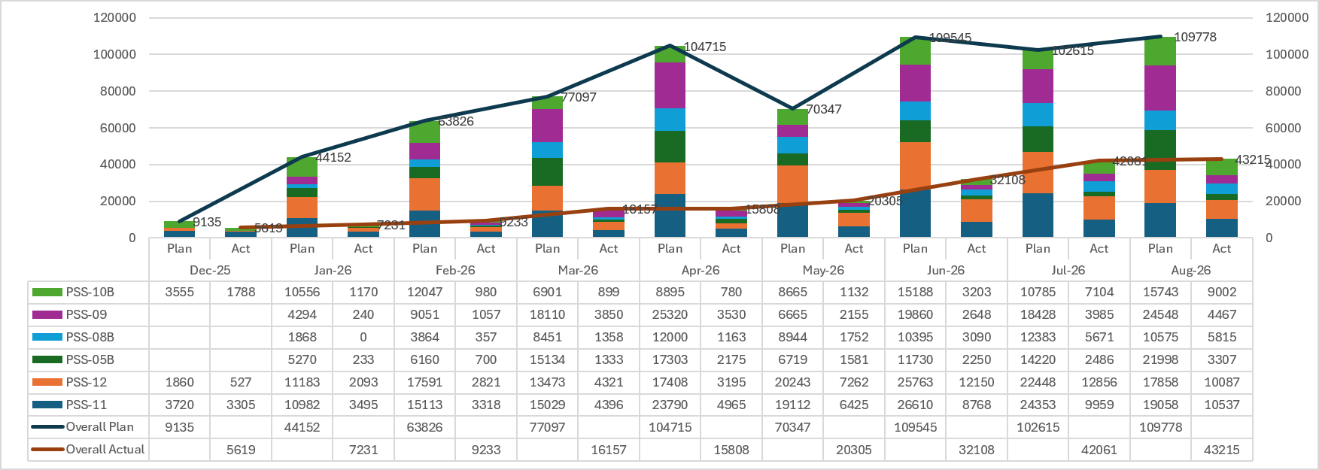
Mandays Deployment Plan vs Actual for Overall Project Execution- PSS 11, 12, 10B, 09, 08B & 05B
Note: Shortage of Contractor’s Manpower is impacting planned completion timelines. As a result, the work timelines will get extended.

Slide 36
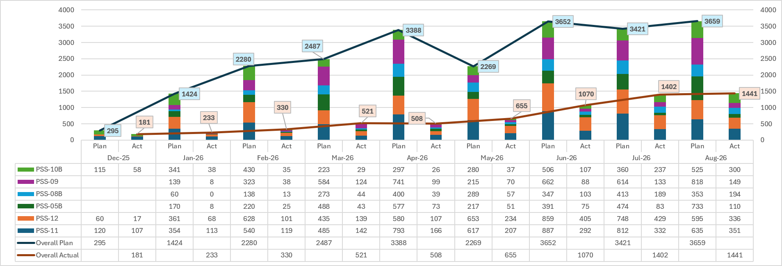
Manpower Deployment Plan vs Actual for Overall Project Execution- PSS 11, 12, 10B, 09, 08B & 05B
Note: Shortage of Contractor’s Manpower is impacting planned completion timelines. As a result, the work timelines will get extended.

Slide 37
Contractor Manpower Status PSS-11

Slide 38
Contractor Manpower Status (PSS-12)

Slide 39
Contractor Manpower Status ( PSS-10(B) )

Slide 40
Contractor Manpower Status (PSS-09)

Slide 41
Contractor Manpower Status PSS-05(B)

Slide 42
Contractor Manpower Status PSS-08(B)

Slide 43
Major Milestones – Next 3 months (PSS – 11, 12, 10B, 9, 5B, 8B)
Sept-26 | Oct-26 | Nov-26
Civil: Completion of BOP for PSS 11. 12, 10B, 08B, 05B & 09 Electrical: Progress of Electrical work for 11, 12, 10B, 05B, 08B & 09. Grid Study Completion of System Studies for PSS05B Approvals : PSS 09, 05 & 08B: Connectivity approval PSS 09, 05B & 08B: CON-V Delivery at Site: PSS 11 : Battery Container – 63 (CATL) PSS 12 : Battery Container – 65 (CATL) PSS 10B : Battery Container – 80 (Jinko) PSS 09 : PCS– 288 (Inova) PSS 05B : PCS– 72 (Shenzen) PSS 08B : Battery Container – 17 (GreatPower) PSS 08B : PCS– 72 (Shenzen) Integration, Pre-Commissioning & Commissioning: PSS 11 : 120 Containers (677 MWh) PSS 12 : 240 Containers (1355 MWh) PSS 10B : 120 Containers (602 MWh) | Electrical: Completion of Electrical works for 11, 12, & 10B. Progress of Electrical work for 05B, 08B & 09. Delivery at Site: PSS 11 : Battery Container - 140 CATL PSS 09 : Battery Container - 432 CATL PSS 09 : PCS - 144 Inova PSS 05B : Battery Container - 88 CATL PSS 05B : PCS - 216 Shenzen PSS 08B : Battery Container - 79 Great Power PSS 08B : PCS - 96 Shenzen Integration, Pre-Commissioning & Commissioning: PSS 11 : 192 Containers (1084 MWh) PSS 12 : 144 Containers (813 MWh) PSS 10B : 120 Containers (602 MWh) | Electrical: Completion of Electrical work for 05B, 08B & 09 Delivery at Site: PSS 05B: Battery Container - 140 (CATL) PSS 05B: PCS - 112 (Shenzen) PSS 08B: Battery Container - 72 (GreatPower) Integration, Pre-Commissioning & Commissioning: PSS 09 : 336 Containers (1896 MWh) PSS 08B :48 Containers (241 MWh) PSS 05B :48 Containers (271 MWh)

Slide 44
CRITICAL ISSUES FY 26-27
# | Issues | Potential Impact (Time & Cost) | Corrective Action(s) | Action By |  | Current Status | Support Required
 |  |  |  | Whom | Date
1 | Inadequate Manpower (Workmen) | Slow Progress of civil works | Regular coordination meetings are being conducted with the Contractors to closely monitor progress and ensure manpower mobilization is increased in line with the required levels. Warning letters have been issued to M/s MSC and M/s Shreeji, clearly stating that failure to complete the works as per contractual timelines will entitle the Adani team to execute the balance works at the Contractor’s Risk and Cost, in accordance with the contract provisions. In addition, alternate Vendors being identified. | Site Execution | - | Following are the Manpower available for PSS: MSC for PSS-11 40/70, PSS-12 42/50, PSS10B 20/32 PSS-09 165/722 & PSS-05B 125/724 Shreeji for PSS-08B 105/158 | -
2 | Completion of Grid Study & Ordering of Harmonic Filter | Can delay Commissioning | Meeting held with Senior Management of M/s Hitachi to expedite progress & completion of Grid Studies. Ordering of Harmonic Filters (once specifications are received) being expedited. | Engineering, SCM & Project Team | - | PSS 10B – Steady State and Power Quality Analysis completed. Specifications for Harmonic Filters received. Ordering Placed on 26-Mar. Deliveries on critical path. | -
3 | Delivery of Battery Containers | Can delay Commissioning | Proactive booking of vessels even for smaller quantity of containers so as to not impact commissioning timelines & reduce IDC. | TC & Logistic Team | -

Slide 45
Financial S Curve PSS – 11, 12, 10B, 9, 8B & 5B
 | FY-26 | Apr-26 | May-26 | Jun-26 | Jul-26 | Aug-26 | Sep-26 | Oct-26 | Nov-26 | Dec-26 | Jan-27 | Feb-27 | Mar-27 | Apr-27
Budgeted- cumulative | 1625 | 2110 | 2770 | 4474 | 5338 | 6080 | 7036 | 8780 | 11296 | 13404 | 14773 | 16132 | 16347 | 16358
Monthly Budgeted | - | 485 | 660 | 1,705 | 863 | 743 | 956 | 1,743 | 2,516 | 2,108 | 1,369 | 1,359 | 215 | 11
Actual Cumulative | 285 | 539 | 757 | 2531 | 4526 | 5951
Monthly Actual | - | 254 | 218 | 1775 | 1995 | 1425

Slide 46


Thank You

Slide 47
Ordering Status
PSS-11, 12 & 10(B)
47

Slide 48
Supply ordering Status (PSS-11, 12 & 10(B)) - Completed
SN | Equipment/ Package | Qty / Scope | Final / Revised Specifications Issue Date | Verified by Engineering consultant | TBER Date | Qualified Vendors | Receipt of Offer | Commercial NFA Submission | Release of PO / SO | Update
1 | Battery Container Package | 432 NOS 384 NOS 240 NOS | 30-Oct-25 | NA | 22 Nov 25 | Offers from Svolt, Jinko, Greatpower, Sunwoda, REPT, Narada Starcharge, Hyperstrong, Cospower Hithium, CATL Lishen, Saft, BYD | 11-Nov-25 | 11-Dec-25 | 16-Dec-25 | Order issued to CATL for PSS-11 & PSS-12 on 16-Dec-25 Order issued to Jinko for PSS-10(B) on 15-Dec-25
2 | PCS (Power Conversion System) | 432 NOS 384 NOS 240 NOS | 04-Nov 25 | NA | 18-Nov-25 | Offers from Sineng Hopewind, NR Electric Inovance, Soaring Sifang, Hoymiles | 14-Nov-25 | 06-Dec-25 | 15-Dec-25 | Order issued to Hopewind for PSS-11 on 15-Dec. Order issued to INOVA for PSS-12 & PSS-10(B) on 13-Dec-25
3 | EMS (Energy Management System) | 1 NOS 1 NOS 1 NOS | 01-Nov-25 | NA | 02-Dec-25 | Adaptive, Emerson, Schenider, Honeywell | 10-Nov-25 | 11-Dec-25 | 15-Dec-25 | Order issued to Emerson on 15-Dec. Order issued to Honeywell on 17-Dec. Order issued to Adaptive on 17-Dec
4 | Converter Transformer | 54 NOS 48 NOS 30 NOS | 21-Nov-25 | NA | 11-Dec-25 | Ornet, Silchar, Atlanta,Tesla, SSE | 06-Dec-25 | 15-Dec-25 | 17-Dec-25 | Order issued to Ornet on 17-Dec. Order issued to Tesla on 17-Dec. Order issued to Ornet on 17-Dec.
5 | CSS (Auxiliary Transformer) | 9 NOS 8 NOS 5 NOS | 21-Nov-25 | NA | 26-Dec-25 | ABB, Siemens, Schneider, Akshar, Trisquare, Voltamp, Sudhir, Rhine | 10-Dec-25 | 07-Jan-26 | 16-Jan-26 | Order released to M/s Akshar on 16-Jan-26.
6 | MV Switchgear | 18 NOS 16 NOS 10 NOS | 21-Nov-25 | NA | 20-Dec-25 | RFP: Trisquare, Symatic, Popular, Technocraft | Previous approved specs | 23-Dec-25 | 30-Dec-25 | Order issued to Trisquare on 30-Dec.
7 | LT Panel - ACDB | 54 NOS 48 NOS 30 NOS | 21-Nov-25 | NA | 20-Dec-25 | RFP: Akshar, Active, ECS, Swati, Prima, Trisquare, C&S, Narkhede | Received | 23-Dec-25 | 31-Dec-25 | Order issued to Prima Automation on 31-Dec-25 for PSS-11. Order issued to Active Engineers on 31-Dec-25 for PSS-12 & PSS-10(B).

Slide 49
Supply ordering Status (PSS-11, 12 & 10(B)) - Completed
SN | Equipment/ Package | Qty / Scope | Final / Revised Specifications Issue Date | Verified by Engineering consultant | TBER Date | Qualified Vendors | Receipt of Offer | Commercial NFA Submission | Release of PO / SO | Update
8 | HT Cable | 73.5 km 62 km 62 Km | 21-Nov-25 | NA | Previous TBER is valid | Havells, Paramount, V Marc, DICAB, UCL, Polycab,TCL | NA | 15-Dec-25 | 18-Dec-25 | Order issued to Diamond for PSS-11 on 18-Dec-25. Order issued to Paramount for PSS-12 on 18-Dec-25. Order issued to Diamond for PSS-10(B) on 18-Dec-25
9 | DC & LT Cables | 822 km 765 km 480 km | 21-Nov-25 | NA | 19-Dec-25 | Offers: PARAMOUNT, KEI, DIAMOND, VMARC, FINOLEX, DYNAMIC, GEMSCAB | 08-Dec-25 | 02-Jan-26 | 19-Jan-26 | Order issued to DIAMOND (PSS-11), APAR & DYNAMIC (PSS-12), PARAMOUNT & DYNAMIC (PSS-10(B)) dated 19-Jan-26.
10 | Control Cables | 140.4 km 124.8 km 78 km | 21-Nov-25 | NA | 19-Dec-25 | Offers: Delton, Diamond, Havells, Ravin, Special, Suyog, Polycab, Paramount, Gemscab, Dynamic, Chandresh | 06-Dec-25 | 02-Jan-26 | 19-Jan-26 | Order issued to GEMSCAB dated 19-Jan-26.
11 | SCADA Cable | 294 km 262 km 166 km | 21-Nov-25 | NA | 19-Dec-25 | Special, Paramount, Gemscab, Suyog, Delton, KEI | 18-Dec-25 | 02-Jan-26 | 08-Jan-26 | Order releases to M/s Delton & M/s Suyog dated 08-Jan-26.
12 | FO Cable | 23 km 20 km 21 km | R0: 21-Nov-25 R1: 04-Dec-25 | NA | Previous TBER is valid | Repeat order confirmation received | NA | 27-Dec-25 | 02-Jan-26 | Order issued to Paramount on 02-Jan-26
13 | Precast Supply (Monolithic Beam, Staircase, BOT and NIFPS) | 1008 NOS 896 NOS 570 NOS | 26-Nov-25 | NA | 10-Dec-25 22-Dec-25 30-Dec-25 04-Jan-26 | RFP: Buildcast, Sachi Precast, Sachi Agency, Shreeji, VAB, Fuji | 06-Dec-25 | 16-Jan-26 | 28-Jan-26 | Vendors finalized. Orders for Monolithic Beam & BOT released dated 15-Jan-26. Orders for NIFPS and Staircase for BCF, PCS & SGR released on 28-Jan.

Slide 50
Supply ordering Status (PSS-11, 12 & 10(B)) - Completed
SN | Equipment/ Package | Qty / Scope | Final / Revised Specifications Issue Date | Verified by Engineering consultant | TBER Date | Qualified Vendors | Receipt of Offer | Commercial NFA Submission | Release of PO / SO | Update
14 | Harmonic Filter | 8 SET 8 SET 8 SET | 24-Feb-26 13-Mar-26/ 12-Mar-26/ 07-Mar-26 | - | - |  | - | 03-Apr-26 | 07-Apr-26 | Order Released for PSS-10(B) on 26-Mar. HF sizing shared for PSS-11 on 13-Mar & PSS-12 on 12-Mar. Letter of award (LOA) released for PSS-11 & PSS-12 to Hitachi on 07-Apr.
15 | High Mast | 7 NOS 7 NOS 6 NOS | 20-Jan-26 | - | 30-Jan-26 | Pratibha, Akshar, Excel Infra, Sunlake, Ompech | 06-Feb-26 | 10-Feb-26 | 27-Feb-26 | Order issued to M/s Sunelec.
16 | Fire Protection, Detection & Alarm System Package incl of (Hooter, Fire extinguisher, Panel. ) | 1 LOT | 05-Mar-26 | - | 18-Apr-26 |  | - | - | 01-May-26 | TBER concluded on 18-Apr-26; LOA released to M/s APSNP on 01-May-26.
17 | Electrical Modification in existing PSS | 1 LOT | 07-Feb-26 16-Feb-26 | - | - |  | - | 01-Apr-26 | 06-Apr-26 | Letter of award (LOA) issued to M/s Trisquare for PSS-11 & PSS-10(B) on 06-Apr-26
18 | Structural modification works in existing PSS (Containerized solution) | 1 NOS 1 NOS - | 07-Feb-26 28-Feb-26 10-Mar-26 23-Mar-26 | - | 17-Apr-26 |  | - | 14-Feb-26 27-Feb-26 08-Mar-26 31-Mar-26 14-Apr-26 17-Apr-26 | 16-Feb-26 03-Mar-26 12-Mar-26 04-Apr-26 16-Apr-26 18-Apr-26 | LOA issued to M/s RV Enterprise dated 18-Apr-26

Slide 51
Supply ordering Status (PSS-11, 12 & 10(B)) - Completed
SN | Equipment/ Package | Qty / Scope | Final / Revised Specifications Issue Date | Verified by Engineering consultant | TBER Date | Qualified Vendors | Receipt of Offer | Commercial NFA Submission | Release of PO / SO | Update
19 | Security Porta Cabin | 3 NOS 2 NOS 1 NOS | 23-Jan-26 | - | - | Meta Steel Prefab | - | 11-Feb-26 | 24-Feb-26 | Commercial NFA approved. Order placed to Meta Steel Prefab on 24-Feb-26.
20 | Supply for FIT Kit with Hardware & Software | 1 LOT | 15-Jan-26 | - |  | Emerson, Honeywell, Adaptive |  | NA | PSS-11 & 10(B): 08-Feb-26 21-Feb-26 PSS-12: 08-Feb-26 19-Feb-26 28-Feb-26 03-Mar-26 | Supply of Kit not required, instead logistics, travel & lodging-boarding required. Commercial NFA considered along with EMS Package. Order placed for PSS-11 to Emerson on 21-Feb; PSS-10(B) to Adaptive on 17-Feb; Order for PSS-12 placed on Honeywell on 28-Feb 03-Mar.

Slide 52
Service ordering Status (PSS-11, 12 & 10(B)) - Completed
SN | Equipment/ Package | Qty / Scope | Final / Revised Specifications Issue Date | Verified by Engineering consultant | TBER Date | Qualified Vendors | Receipt of Offer | Commercial NFA Submission | Release of PO / SO | Update
1 | Engineering Consultancy Services | 1 LOT 1 LOT 1 LOT | 11-Nov-25 | NA | 15-Nov-25 | Fictner, Worley, Tractebel & TCE | 17-Nov-25 | 18-Nov-25 | 26-Nov-25 | Order placed to Worley for PSS-11, 12 & 10(B).
2 | ACDC Electrical works | 1 LOT 1 LOT 1 LOT | 27-Nov-25 | NA | 01-Jan-26 | Akshar | - | 10-Jan-26 | 17-Jan-26 | Order issued to M/s Pratibha for PSS-11 and M/s Akshar for PSS-12 & 10(B) dated 17-Jan-26.
3 | Grid Modelling & System Study | 1 LOT 1 LOT 1 LOT | 06-Nov-25 | NA | 15-Nov-25 | Hitachi | - | - | 24-Nov-25 | Order placed to M/s Hitachi
4 | Piling works | 32,750 m 28,444 m 21,336 m | 18-Nov-25 | NA | NA | Cemindia | - | - | 25-Nov-25 | Order placed to Cemindia
5 | Civil Works – BOP (Equip. foundations, HF, Roads-drains-fencing, Security cabin, Exist. PSS modification) | 1 LOT 1 LOT 1 LOT | 26-Nov-25 | NA | 22-Dec-25 | Shreeji, Himalaya, Rajaram&Sons, Rokane, Rathore, Nageshwar Infra, Vinayaka, HSB, DEK & Mavericks, SMP, RAVJI MANJI, NRUPUR, GODARA, DNC, MEERA, M S CHOUHAN | 10-Dec-25 | 02-Jan-26 | 30-Dec-25 | Oder issued to MS Chauhan for PSS-11 & PSS-12 on 30-Dec-25. Order issued to Godhara Infratech for PSS-10(B) on 30-Dec-25. Order issued to GP Project for Roads-Drain on 03-Jan-26
6 | Structural/PEB works | 486 MT 431 MT 270 MT | 26-Nov-25 | NA | 22-Dec-25 | RFP sent to BNAL(regret), DP Consteel, Vats group, Synergy thirlling ton | 12-Dec-25 | 23-Dec-25 | 03-Jan-26 | Oder issued to DP Consteel on 03-Jan-26
7 | Consultancy for FSPA & Fire NOC |  |  |  |  |  |  |  | 05-Jan-26 | Order for FSPA & Fire NOC consultancy placed on 05-Jan-26
8 | BESS Cloud & Integration with ENOC | 1 LOT | 16-Jan-26 |  | 30-Jan-26 12-Feb-26 | Dell, HP | - | 16-Feb-26 | 18-Feb-26 | Order issued dated 18-Feb to Dell.

Slide 53
Service ordering Status (PSS-11, 12 & 10(B)) - Completed
SN | Equipment/ Package | Qty / Scope | Final / Revised Specifications Issue Date | Verified by Engineering consultant | TBER Date | Qualified Vendors | Receipt of Offer | Commercial NFA Submission | Release of PO / SO | Update
9 | Transportation of Precast items (from Buildcast) | 1 LOT | NA | NA | NA | Adani Logistics | NA | NA | 17-Feb-26 | Order issued to Adani Logistics dated 17-Feb-26.
10 | Hiring for Survey team | 1 NOS | As per old specification | As per old specification | As per old specification | Vital Infratech | As per old specification | 04-Feb-26 | 04-Feb-26 | Order placed to Vital Infratech on 04-Feb-26.
11 | Farana/Crane for Stores | 6 NOS 6 NOS 3 NOS | 14-Jan-26 | - | - | - | 05-Feb-26 | 26-Feb-26 | 16-Feb-26 25-Feb-26 05-Mar-26 12-Mar-26 | Order issued to M/s SAFAR Cranes on 12-Mar-26.
12 | Mobile Lighting towers (MLT) | 3 NOS 2 NOS 2 NOS | 19-Jan-26 | - | 29-Jan-26 | Accurate Power | - | 10-Feb-26 | 16-Feb-26 | Order issued to Accurate Power dated 16-Feb-26.

Slide 54
Ordering Status
PSS-09, 05(B) & 08(B)

Slide 55
Supply ordering Status (PSS-09, 05(B) & 08(B)) - Completed
SN | Equipment/ Package | Qty / Scope | Final / Revised Specifications Issue Date | Verified by Engineering consultant | TBER Date | Qualified Vendors | Receipt of Offer | Commercial NFA Submission | Release of PO / SO | Update
1 | Battery Container Package | 432 NOS 448 NOS 168 NOS | 30-Oct-25 | NA | Previous TBER is valid | Offers from Svolt, Jinko, Greatpower, Sunwoda, REPT, Narada Starcharge, Hyperstrong, Cospower Hithium, CATL Lishen, Saft, BYD | - | 23-Dec-25 | 05-Jan-26 | Order issued to Xiamen Ampace Technology for PSS-09 & PSS-05(B) on 01-Jan-26. Order issued to GreatPower for PSS-08(B) on 05-Jan-26.
2 | PCS (Power Conversion System) | 432 NOS 448 NOS 168 NOS | 04-Nov 25 | NA | Previous TBER is valid | Offers from Sineng Hopewind, NR Electric Inovance, Soaring Sifang, Hoymiles | - | 16-Dec-25 | 02-Jan-26 | Order issued to INOVA Automation on 02-Jan-26 Order issued to SHENZEN Hope wind Energy for PSS-05(B) & PSS-08(B) on 02-Jan-26
3 | EMS (Energy Management System) | 1 NOS 1 NOS 1 NOS | 01-Nov-25 | NA | Previous TBER is valid | Adaptive, Emerson, Schenider, Honeywell | - | 17-Dec-25 | 02-Jan-26 | Order issued to Honeywell Automation for PSS-09 on 02-Jan-26 Order issued to Emerson for PSS-05(B) & PSS-08(B) on 02-Jan-26
4 | Converter Transformer | 54 NOS 56 NOS 21 NOS | 16-Dec-25 | NA | Previous TBER is valid | Ornet, Silchar, Atlanta,Tesla, SSE | - | 25-Dec-25 | 13-Jan-26 | Order for Convertor Transformer for PSS-09 & 05(B) released on 13-Jan-26. NFA approved for PSS-08(B), IMP Power based on type test approval, else Performance based to existing vendors.
5 | CSS (Auxiliary Transformer) | 9 NOS 10 NOS 4 NOS | 16-Dec-25 | NA | 26-Dec-25 | ABB, Siemens, Schneider, Akshar, Trisquare, Voltamp, Sudhir, Rhine | 10-Dec-25 | 07-Jan-26 | 16-Jan-26 | Order released to M/s Akshar on 16-Jan-26.
6 | MV Switchgear | 18 NOS 20 NOS 08 NOS | 16-Dec-25 | NA | 20-Dec-25 | RFP: Trisquare, Symatic, Popular, Technocraft | Previous approved specs | 23-Dec-25 | 01-Jan-26 | Order issued to Popular for PSS-09 on 01-Jan-26. Order issued to Symatic for PSS-05(B) and PSS-08(B) on 01-Jan-26
7 | LT Panel - ACDB | 54 NOS 56 NOS 21 NOS | 16-Dec-25 | NA | 20-Dec-25 | RFP: Akshar, Active, ECS, Swati, Prima, Trisquare, C&S, Narkhede | Received | 23-Dec-25 | 01-Jan-26 | Order issued to Prima Automation for PSS-09 & PSS-08(B). Order issued to Active Engineer for PSS-05(B) on 01-Jan-26

Slide 56
Supply ordering Status (PSS-09, 05(B) & 08(B)) - Completed
SN | Equipment/ Package | Qty / Scope | Final / Revised Specifications Issue Date | Verified by Engineering consultant | TBER Date | Qualified Vendors | Receipt of Offer | Commercial NFA Submission | Release of PO / SO | Update
8 | HT Cable | 80 km 171 km 40 km | 16-Dec-25 | NA | Previous TBER is valid | Havells, Paramount, V Marc, DICAB, UCL, Polycab,TCL | - | 15-Dec-25 | 31-Dec-25 | Order issued to Paramount for PSS-09 on 31-Dec-25. Order issued to Paramount & Diamond on 31-Dec-25 Order issued to Diamond for PSS-08(B) on 31-Dec-26
9 | DC & LT Cables | 962 km 1001 km 382 km | 16-Dec-25 | NA | Previous TBER is valid | Offers: PARAMOUNT, KEI, DIAMOND, VMARC, FINOLEX, DYNAMIC, GEMSCAB | - | 29-Dec-25 | 19-Jan-26 | Order issued to APAR & DYNAMIC (PSS-09), PARAMOUNT & DYNAMIC (PSS-05(B)), DIAMOND & DYNAMIC (PSS-08(B)) dated 19-Jan-26.
10 | Control Cables | 140.4 km 145.6 km 54.6 km | 16-Dec-25 | NA | Previous TBER is valid | Offers: Delton, Diamond, Havells, Ravin, Special, Suyog, Polycab, Paramount, Gemscab, Dynamic, Chandresh | - | 29-Dec-25 | 19-Jan-26 | Order issued to GEMSCAB dated 19-Jan-26.
11 | SCADA Cables | 295 km 295 km 150 km | 16-Dec-25 | NA | Previous TBER is valid | Special, Paramount, Gemscab, Suyog, Delton, KEI | - | 02-Jan-26 | 08-Jan-26 | Order releases to M/s Delton & M/s Suyog dated 08-Jan-26.
12 | FO Cable | 23 km 22.5 km 18 km | 16-Dec-25 | NA | Previous TBER is valid | Repeat order confirmation received | - | 26-Dec-25 | 03-Jan-26 | Order issued to Paramount on 03-Jan-26
13 | Precast Supply (Monolithic Beam, Staircase, BOT and NIFPS) | 1008 NOS 1046 NOS 393 NOS | 14-Dec-25 | NA | 30-Dec-25 | RFP: Buildcast, Sachi Precast, Sachi Agency, Shreeji, VAB, Fuji | - | 16-Jan-26 | 28-Jan-26 | Vendors finalized. Orders for Monolithic Beam & BOT released dated 15-Jan-26. All orders for PSS-08(B) released. Orders for NIFPS and Staircase for BCF, PCS & SGR released on 28-Jan.

Slide 57
Supply ordering Status (PSS-09, 05(B) & 08(B))
SN | Equipment/ Package | Qty / Scope | Final / Revised Specifications Issue Date | Verified by Engineering consultant | TBER Date | Qualified Vendors | Receipt of Offer | Commercial NFA Submission | Release of PO / SO | Update
14 | Harmonic Filter | 8 SET 12 SET 8 SET | 30-Mar-26 31-Mar-26 14-Apr-26 | - | - |  | - | 23-May-26 | 17-Apr-26 15-Apr-26 26-May-26 | Order issued to Clarient for PSS-09 on 17-Apr & PSS-05(B) on 15-Apr-26. LOA issued to Hitachi for PSS-08(B) on 26-May.
15 | High Mast | 7 NOS 7 NOS 6 NOS | 20-Jan-26 | - | 30-Jan-26 | Pratibha, Akshar, Excel Infra, Sunlake, Ompech | 06-Feb-26 | 10-Feb-26 | 27-Feb-26 | Order issued to M/s Sunelec.
16 | Fire Protection, Detection & Alarm System Package incl of (Hooter, Fire extinguisher, Panel. ) | 1 LOT | 05-Mar-26 | - | 18-Apr-26 |  | - | - | 01-May-26 | TBER concluded on 18-Apr-26; LOA released to M/s APSNP on 01-May-26.
17 | Electrical Modification in existing PSS | 1 LOT | 07-Feb-26 09-Feb-26 | - | - |  | - | 01-Apr-26 | 06-Apr-26 | Letter of award (LOA) issued to M/s Trisquare for PSS-05(B),08(B) & M/s Symatic for PSS-09, PSS-05(B) & 08(B) on 06-Apr-26
18 | Structural modification works in existing PSS (Containerized solution) | 1 NOS - - | 07-Feb-26 28-Feb-26 10-Mar-26 23-Mar-26 | - | 17-Apr-26 |  | - | 14-Feb-26 27-Feb-26 08-Mar-26 31-Mar-26 14-Apr-26 17-Apr-26 | 16-Feb-26 03-Mar-26 12-Mar-26 04-Apr-26 16-Apr-26 18-Apr-26 | LOA issued to M/s RV Enterprise dated 18-Apr-26

Slide 58
Supply ordering Status (PSS-09, 05(B) & 08(B)) - Completed
SN | Equipment/ Package | Qty / Scope | Final / Revised Specifications Issue Date | Verified by Engineering consultant | TBER Date | Qualified Vendors | Receipt of Offer | Commercial NFA Submission | Release of PO / SO | Update
19 | Security Porta Cabin | 1 NOS 2 NOS 1 NOS | 23-Jan-26 | - | - | Meta Steel Prefab | - | 11-Feb-26 | 24-Feb-26 | Commercial NFA approved. Order placed to Meta Steel Prefab on 24-Fb-26

Slide 59
Service ordering Status (PSS-09, 05(B) & 08(B)) - Completed
SN | Equipment/ Package | Qty / Scope | Final / Revised Specifications Issue Date | Verified by Engineering consultant | TBER Date | Qualified Vendors | Receipt of Offer | Commercial NFA Submission | Release of PO / SO | Update
1 | Engineering Consultancy Services | 1 LOT 1 LOT 1 LOT | 25-Dec-25 | NA | 31-Dec-25 | Fictner, Worley, Tractebel & TCE | 17-Nov-25 | 01-Jan-26 | 09-Jan-26 | Revised order according to itemized breakup released on 09-Jan-26 to Worley.
2 | ACDC Electrical works | 1 LOT 1 LOT 1 LOT | 27-Nov-25 | NA | 29-Nov-25 23-Dec-25 27-Dec-25 01-Jan-26 | Akshar | - | 10-Jan-26 | 07-Feb-26 | Order issued to M/s Ice Cube for PSS-05(B) dated 17-Jan-26. Order issued for PSS-09 & 08(B) dated 07-Feb-26.
3 | Grid Modelling & System Study | 1 LOT 1 LOT 1 LOT | 06-Nov-25 | NA | 15-Nov-25 | Hitachi | - | - | 24-Nov-25 | Order placed to M/s Hitachi
4 | Piling works | 41,447 m 47,321 m 17,786 m | 18-Nov-25 | NA | NA | Cemindia | - | - | 25-Nov-25 | Order placed to Cemindia
5 | Civil Works – BOP (Equip. foundations, HF, Roads-drains-fencing, Security cabin, Exist. PSS modification) | 1 LOT 1 LOT 1 LOT | 26-Nov-25 | NA | 22-Dec-25 | Shreeji, Himalaya, Rajaram&Sons, Rokane, Rathore, Nageshwar Infra, Vinayaka, HSB, DEK & Mavericks, SMP, RAVJI MANJI, NRUPUR, GODARA, DNC, MEERA, M S CHOUHAN | 10-Dec-25 | 02-Jan-26 | PSS-09 31-Dec-25 PSS-05(B) 31-Jan-26 PSS-08(B) 03-Jan-26 | Order issued to MS Chauhan for PSS 09 on 31-Dec-25. Order issued to Rajnagnechi for PSS-05(B) on 31-Dec-25. Order issued to Shreeji Construction for PSS-08(B) on 03-Jan-26. Order issued for Roads-Drains to Odhav Enterprise for PSS-09 & PSS-08(B on 03-Jan-26. Order issued for Roads-Drains to Vaibhav Enterprise on 03-Jan-26.
6 | Structural/PEB works | 489 MT 511 MT 194 MT | 26-Nov-25 | NA | 22-Dec-25 | RFP sent to BNAL(regret), DP Consteel, Vats group, Synergy thirlling ton | 12-Dec-25 | 23-Dec-25 | 06-Feb-26 | Order issued to M/s Synergy for PSS-09, 05(B) & 08(B) on 06-Feb.
7 | Consultancy for FSPA & Fire NOC |  |  |  |  |  |  |  | 05-Jan-26 | Order for FSPA & Fire NOC consultancy placed on 05-Jan-26

Slide 60
Service ordering Status (PSS-09, 05(B) & 08(B)) - Completed
SN | Equipment/ Package | Qty / Scope | Final / Revised Specifications Issue Date | Verified by Engineering consultant | TBER Date | Qualified Vendors | Receipt of Offer | Commercial NFA Submission | Release of PO / SO | Update
8 | Transportation of Precast items (from Buildcast) | 1 LOT | NA | NA | NA | Adani Logistics | NA | NA | 17-Feb-26 | Order issued to Adani Logistics dated 17-Feb-26.
9 | Hiring for Survey team | 1 NOS | As per old specification | As per old specification | As per old specification | Vital Infratech | As per old specification | 23-Feb-26 | 05-Mar-26 | Order issued to M/s Vital Infratech on 05-Mar.
10 | Farana/Crane for Stores | 6 NOS 6 NOS 3 NOS | 14-Jan-26 | - | - | - | 05-Feb-26 | 26-Feb-26 | 16-Feb-26 25-Feb-26 05-Mar-26 12-Mar-26 | Order issued to M/s SAFAR Cranes on 12-Mar-26.
11 | Mobile Lighting towers (MLT) | 2 NOS 2 NOS 2 NOS | 19-Jan-26 | - | 29-Jan-26 | Accurate Power | - | 10-Feb-26 | 16-Feb-26 | Order issued to Accurate Power dated 16-Feb-26.

Slide 61
Statutory & Other approvals
PSS-11, 12 & 10(B)

Slide 62
Statutory and Other Approvals (PSS-11, 12 & 10(B))
SN | Activity Name | Responsible | Approval Authority | Baseline Start | Baseline Finish | Actual/ Forecast Start | Actual/ Forecast Finish | Remarks
1 | CLRA - Contract Labor Regulation & Abolition Act | Site IR Team | Govt. of Gujrat (Dept of Labor) | 30-Nov-25 | 13-Jan-26 | 09-Dec-25 | 13-Jan-26 05-Feb-26 30-Apr-26 May-26 Jun-26 Jul-26 | Deemed Approved.
2 | Fire Safety Plan Approval (FSPA) | Project Team | Regional Fire Officer | 15-Dec-25 | 31-Jan-26 | 17-Dec-25 | -NA- | CPO's in-person meeting with Fire officer at their Rajkot office conducted on 25-Jun, FSPA and Fire NOC will not be required.
3 | Project Import Registration | TC Team | Commissioner of Customs, Kandla | 26-Nov-25 | 25-Dec-25 | 08-Dec-25 | 25-Dec 31-Jan 28-Feb 15-Mar 27-Mar 25-Apr 04-May 13-May 18-May 21-May-26 | Approval from Customs, Mundra received on 21-May.
4 | Project Insurance | Group Insurance Team | -N.A.- | - | - | 24-Feb-26 | 01-May-26 12-May-26 23-May-26 01-Jun-26 | Project Insurance policy issued on 01-Jun.

Slide 63
Statutory and Other Approvals (PSS-11, 12 & 10(B))
SN | Activity Name | Responsible | Approval Authority | Baseline Start | Baseline Finish | Actual/ Forecast Start | Actual/ Forecast Finish | Remarks
5 | Approval of Grid Connectivity | Asset Commissioning + BD HO Team and Delhi Office | CTU | 20-Nov-25 | 30-Nov-25 | 05-Dec-25 | 05-Aug-26 | In-principal grant received on 20-Jul. Final grant received on 05-Aug.
6 | Metering Scheme approval | Engineering + Asset Commissioning Team | RLDC | 23-Feb-26 | 20-Mar-26 | 20-Jul-26 | 06-Aug-26 | Metering scheme approved on 06-Aug.
7 | Connectivity Agreement (Con VI) | Asset Commissioning, Engineering and Delhi Office | CTU & WRLDC | 18-Feb-26 | 20-Mar-26 | 09-May-26 | 8-Aug-26 | Priority wise: PSS-11 > PSS-12 ~ PSS-10(B)
8 | PTCC | Asset Commissioning & Projects | CEA, Department of Telecommunications & Indian Railways & Defense | 01-Feb-26 | 24-Mar-26 | 01-Feb-26 | 24-Jun-26 | Final approval received on 24-Jun for PSS-11 & 12 and 18-Jun for PSS-10(B).
9 | Intimation to Labor Inspector | Site IR Team | Govt. of Gujrat (Dept of Labor) | Post Commissioning | Post Commissioning | Post Commissioning | Post Commissioning | Intimation to Labor Inspector needs to be sent post Commissioning.
* Dates are considered on a very aggressive completion path as PSS-11, 12 & 10(B) is on top priority.

Slide 64
Statutory & Other approvals
PSS-09, 05(B) & 08(B)

Slide 65
Statutory and Other Approvals (PSS-09, 05(B) & 08(B))
SN | Activity Name | Responsible | Approval Authority | Baseline Start | Baseline Finish | Actual/ Forecast Start | Actual/ Forecast Finish | Remarks
1 | CLRA - Contract Labor Regulation & Abolition Act | Site IR Team | Govt. of Gujrat (Dept of Labor) | 25-Dec-25 | 07-Feb-26 | 25-Dec-25 | 07-Feb-26 30-Apr-26 May-26 Jun-26 Jul-26 | Deemed Approved.
2 | Implementation Support Agreement (ISA) | BD Team | Internal | 26-Dec-25 | 24-Jan-26 | 26-Dec-25 | 04-Aug | RPT approval received on 21-Jul. ISA signed-off on 04-Aug.
3 | Fire Safety Plan Approval (FSPA) | Project Team | Regional Fire Officer | 01-Jan-26 | 15-Feb-26 | 01-Jan-26 | -NA- | CPO's in-person meeting with Fire officer at their Rajkot office conducted on 25-Jun, FSPA and Fire NOC will not be required.
4 | Project Import Registration | TC Team | Commissioner of Customs, Kandla | 24-Jan-26 | 22-Feb-26 | 24-Jan-26 | 10-Aug | Application submitted on 05-Jun. Approval received on 10-Aug.
5 | Project Insurance | Group Insurance Team | -N.A.- | - | - | 24-Feb-26 | 19-Aug | Payment completed. NFA approved on 08-Aug. Policy cover letter issued dated 19-Aug.

Slide 66
Statutory and Other Approvals (PSS-09, 05(B) & 08(B))
SN | Activity Name | Responsible | Approval Authority | Baseline Start | Baseline Finish | Actual/ Forecast Start | Actual/ Forecast Finish | Remarks
6 | Approval of Grid Connectivity | Asset Commissioning + BD HO Team and Delhi Office | CTU | 30-Dec-25 | 09-Jan-26 | 05-Dec-25 | 10-Sep-26 | PSS09:In-principal grant received on 20-Jul. Final grant received on 14-Aug. PSS08B: In-principal grant received on 23-Jul. Final grant received on 21-Aug. PSS05B: In-principal grant received on 23-Jul. (1 of 2). Final grant received on 21-Aug. Balance approval expected by 10-Sep.
7 | Metering Scheme approval | Engineering + Asset Commissioning Team | RLDC | 26-Apr-26 | 25-May-26 | 30-Apr-26 30-May-26 20-Jun-26 20-Jul-26 | 25-May-26 30-Jun-26 15-Jul-26 10-Aug-26 11-Sep-26 | PSS09: Metering scheme approval request submitted on 22-Jul. Expected approval by 11-Sep. PSS08B: Metering scheme application to be submitted after SLD update for MW. PSS05B: Metering scheme approval to be initiated after balance application in-principal connectivity approval.
8 | Connectivity Agreement (Con VI) | Asset Commissioning, Engineering and Delhi Office | CTU & WRLDC | 09-Apr-26 | 18-May-26 | 09-Apr 20-Apr 27-Jun-26 16-Jun-26 | 18-May-26 25-Jul-26 to 26-Aug-26 14-Aug-26 25-Oct-26 | Priority wise: PSS-08(B) > PSS-09 > PSS-05(B)
9 | PTCC | Asset Commissioning & Projects | CEA, Department of Telecommunications & Indian Railways & Defense | 25-Mar-26 | 22-May-26 | 01-Feb-26 | 24-Jun-26 | Final approval received on 22-Jun for PSS-09 & 05(B) and 18-Jun for PSS-08(B).
10 | Intimation to Labor Inspector | Site IR Team | Govt. of Gujrat (Dept of Labor) | Post Commissioning | Post Commissioning | Post Commissioning | Post Commissioning | Intimation to Labor Inspector needs to be send post Commissioning.

Slide 67
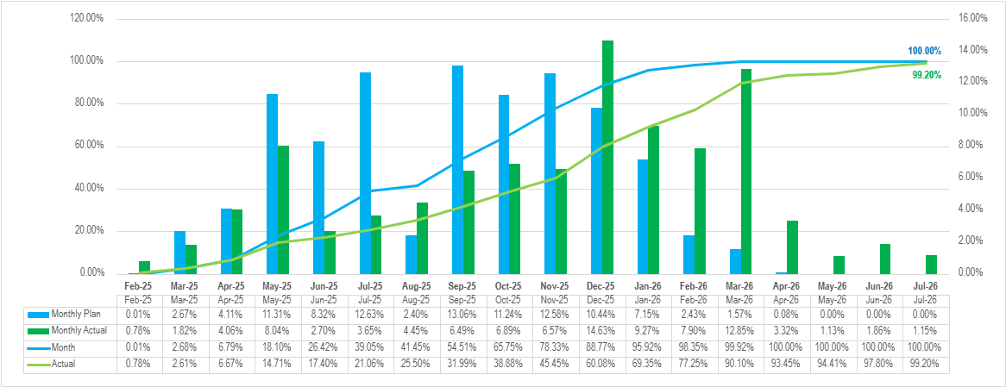
Physical Progress : PSS 10A S-Curve
Activity | Wtg. | FTM |  | Variance in Plan Vs Actual | Variance Remark & Mitigation/Action Plan
 |  | Plan | Actual
Statutory Approvals | 2% | 2% | 2% | 0.06% | Balance approval (Factory License)
Engineering | 5% | 5% | 5% | 0.00% | Completed
Ordering, Manufacturing & Supply | 38% | 38% | 38% | 0.00% | Completed.
Construction (Civil), Electrical, Integration & Commissioning | 55% | 55% | 54.30% | 0.70% | Contract Closure is pending.
Total | 100% | 100% | 99.2% | 0.8% | Mitigation Plan: Expedite the pending delivery of battery containers and accelerate associated activities, including cable termination, integration for remaining containers.

Slide 68
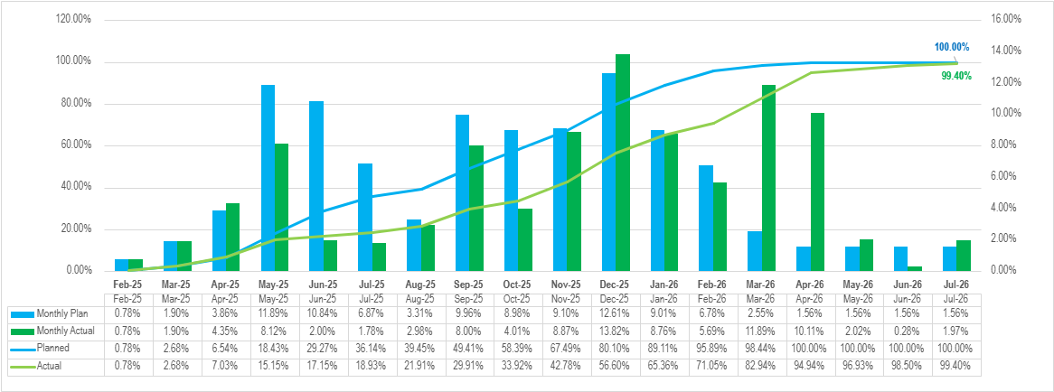
Physical Progress : PSS 5A S-Curve
Activity | Wtg. | FTM |  | Variance in Plan Vs Actual | Variance Remark & Mitigation/Action Plan
 |  | Plan | Actual
Statutory Approvals | 2% | 2% | 2% | 0.06% | Balance approval (Factory License)
Engineering | 5% | 5% | 5% | 0.00% | Completed
Ordering, Manufacturing & Supply | 38% | 38% | 38% | 0.00% | Completed
Construction (Civil), Electrical, Integration & Commissioning | 55% | 55% | 54.50% | 0.50% | Contract Closure is pending.
Total | 100% | 100% | 99.4% | 0.6%

Slide 69
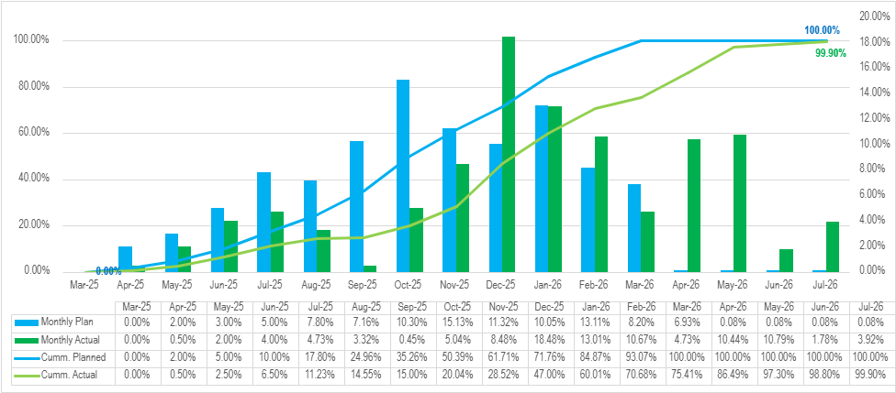
Physical Progress : PSS 8A S-Curve
Activity | Wtg. | FTM |  | Variance in Plan Vs Actual | Variance Remark & Mitigation/Action Plan
 |  | Plan | Actual
Statutory Approvals | 2% | 2% | 2% | 0.06% | Balance approval (Factory License)
Engineering | 5% | 5% | 5% | 0.00% | Completed
Ordering, Manufacturing & Supply | 38% | 38% | 38% | 0.00% | Completed
Construction (Civil), Electrical, Integration & Commissioning | 55% | 55% | 54.99% | 0.01% | Contract Closure is pending.
Total | 100% | 100% | 99.9% | 0.1%

