Slide 1
Introduction
This Project Presents
Film Management System.
It has 3 Phases :
Console Application
WPF Application
MVC
It Contains Functionalities.
Film Details
Create Film
Search Film
Modify Film
Remove Film
Film Summary (View)
Language Details
Category Details
Actor Details

Slide 2
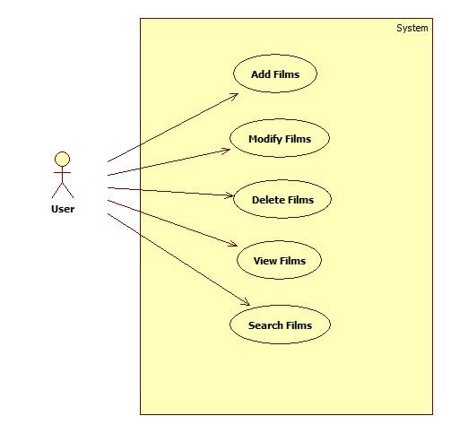
Use Case Diagram

Slide 3
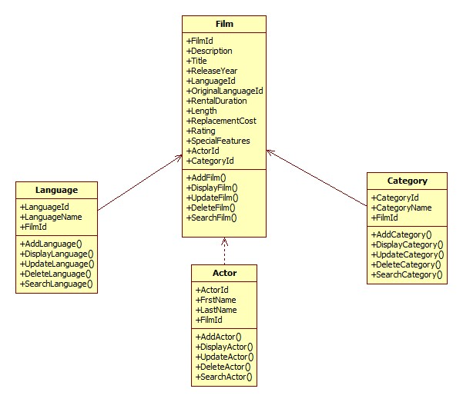
Class Diagram

Slide 4
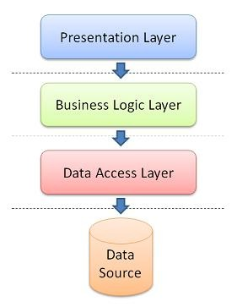
Architecture of Console And WPF

Slide 5
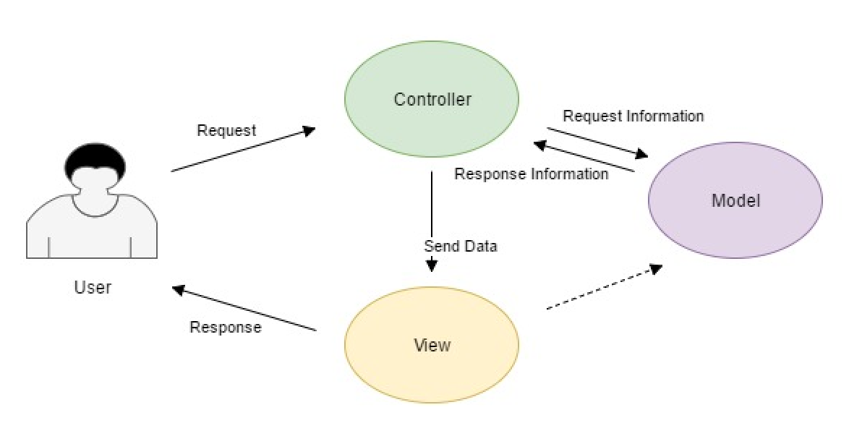
Architecture of MVC

Slide 6
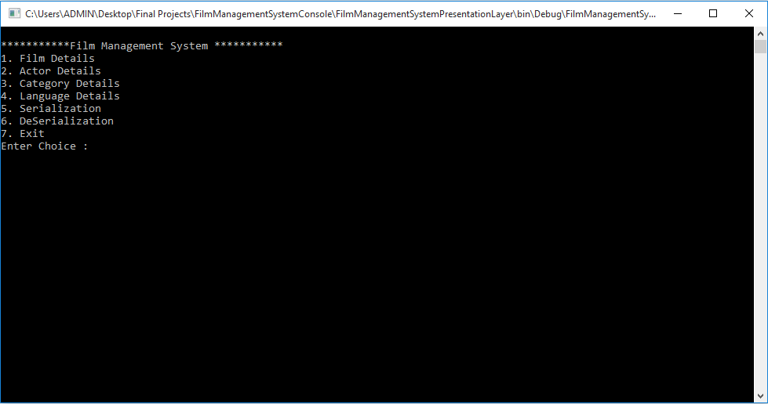
Phase 1 - Screenshots

Slide 7
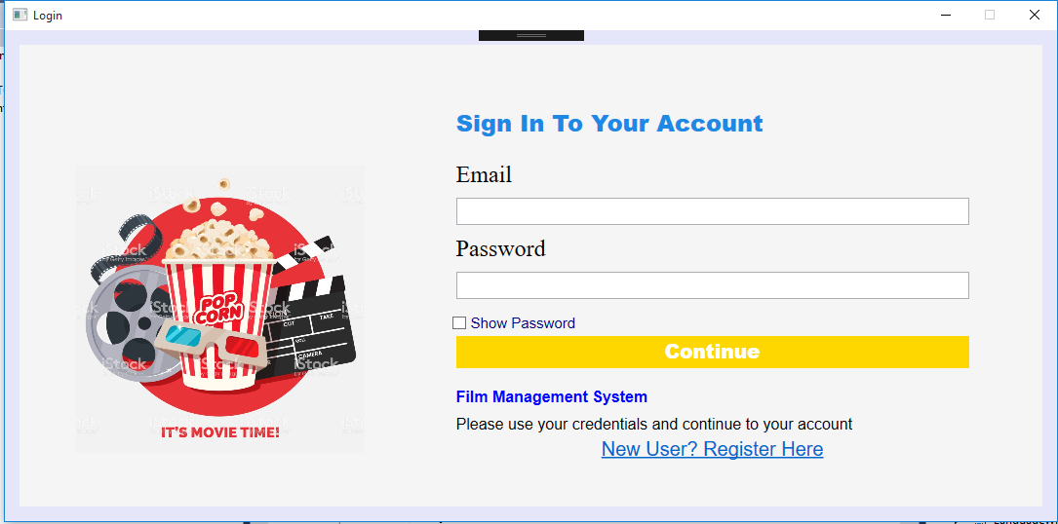
Phase 2 - Screenshots

Slide 8
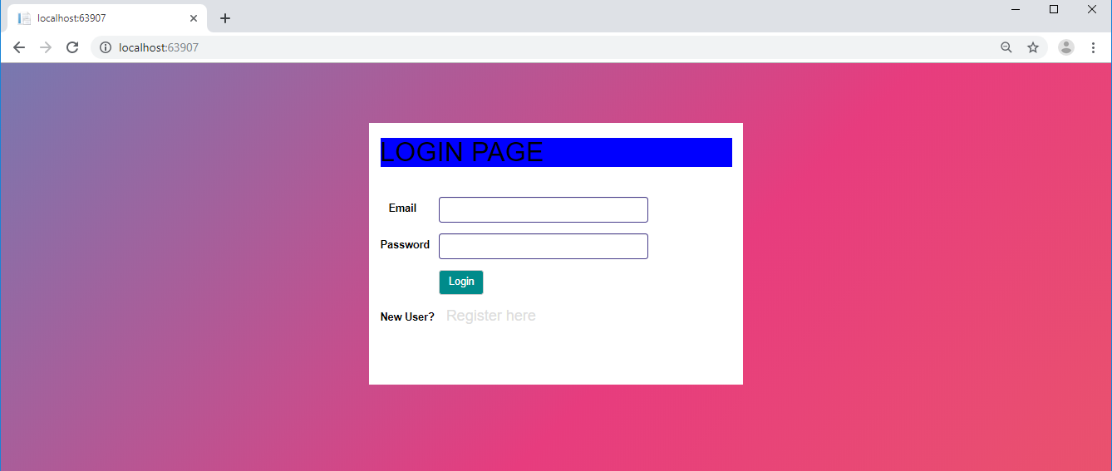
Phase 3 - Screenshots

Slide 9
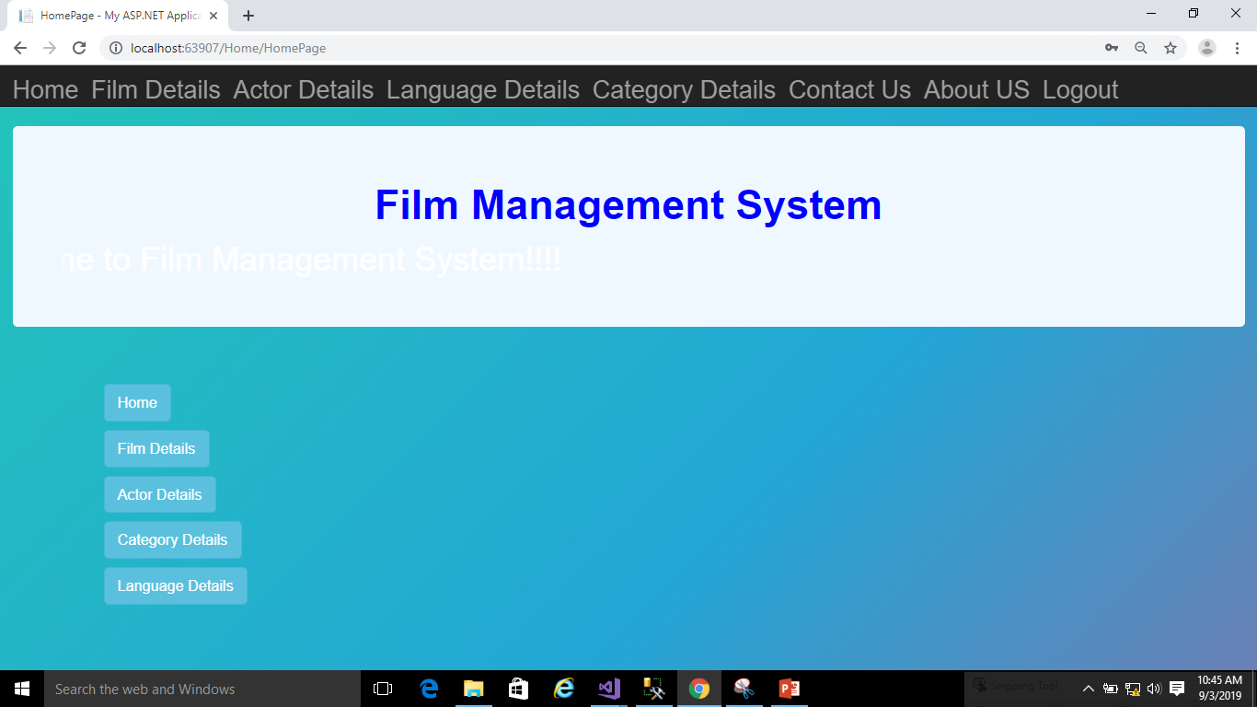

Slide 10
Future Enhancement
More Dynamic With Bootstrap features.
Testing Methods.
More Improvement of UI
Modify Project with better approach with more graphics

Slide 11
Thanks

