Slide 1
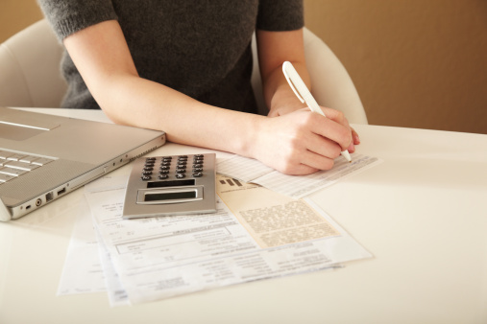

Payment Tracker -a perfect analysis
Guided by: Team Members:
K . Mohan Krishna sir M. Niharika - 19BQ1A05C5
K. Gnana Sai Praveen - 19BQ1A0591
M. Bhaskar Charan -19BQ1A05C8
E. Mohit Reddy -20BQ5A0507

Slide 2

Problem Statement:
Now a days spending money is quite common,
but without having a idea of expenditures makes
a uncontrol of spending money on expenditures
more than it’s enough and leads to a financial
problem of a family or a person

Slide 3

Solution:
So to overcome this situation they can store
their info in this application and can get their perfect
analysis in the form of graph , so that they get the
graphical representation and it is easier to edit and
re-organize for later studying and also helps to be more
cautious about their savings . Moreover ,it saves our time ,
energy and confusion which may leads to clumsiness.

Slide 4
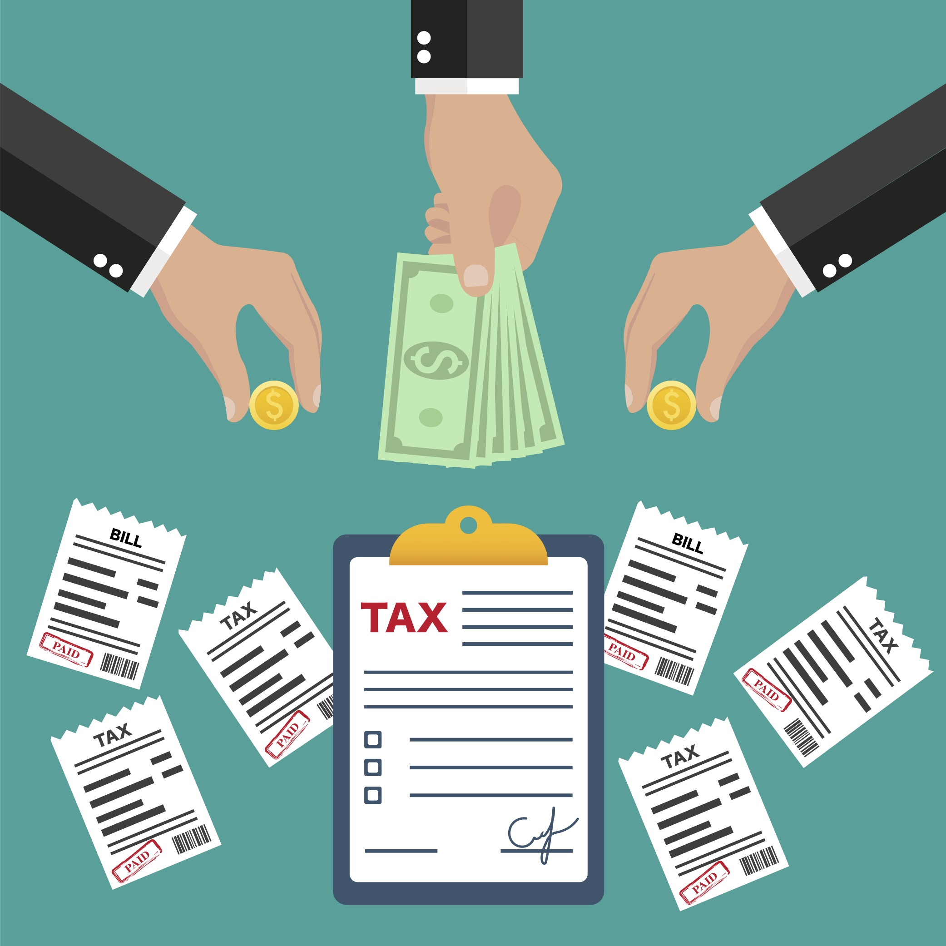
Description:
1)Keeping a daily record of their expenses by tracking improves the financial health of their budget.
2)In this application they can have multiple accounts and can also use
For multiple purposes ,like about travelling , studies ,groceries etc..
3)Payment tracking makes business forecasting easier.
4)It prepare you for Tax Season.

Slide 5
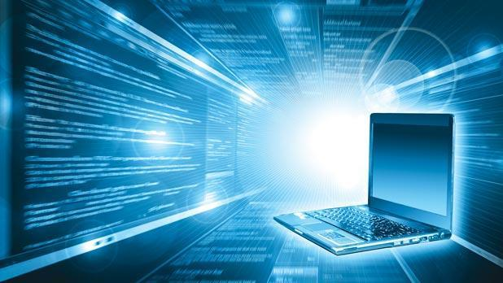
Requirements
Hardware: Software:
*CPU *jdk of latest version
*RAM *jfreechart-1.0.19
*Keyboard *jcommon-1.0.23
*Mouse
*Monitor

Slide 6
Modules we used:
*Swings containers
*Swing controls
*Files handling(to store data)
* jfreechart (to display in graph mode)
Present status of project:
*FINISHED

Slide 7
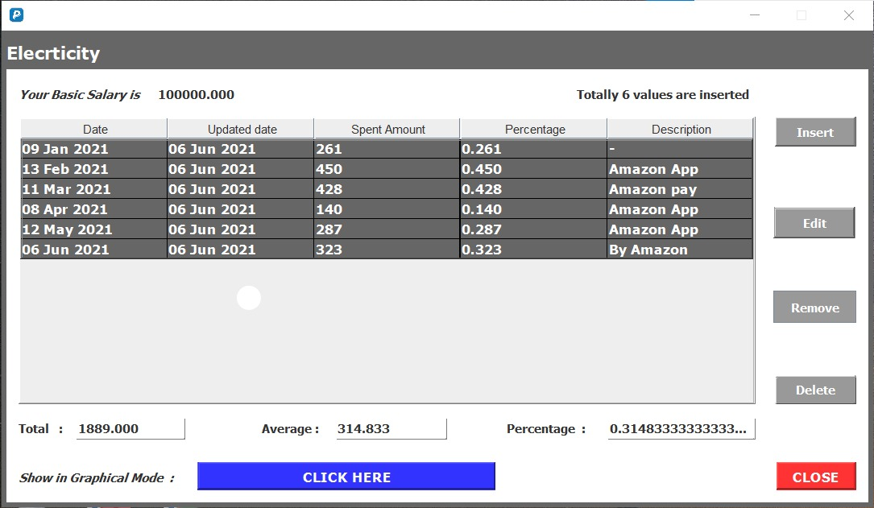
Output of this project:
Data of particular payment in
Table Format

Slide 8
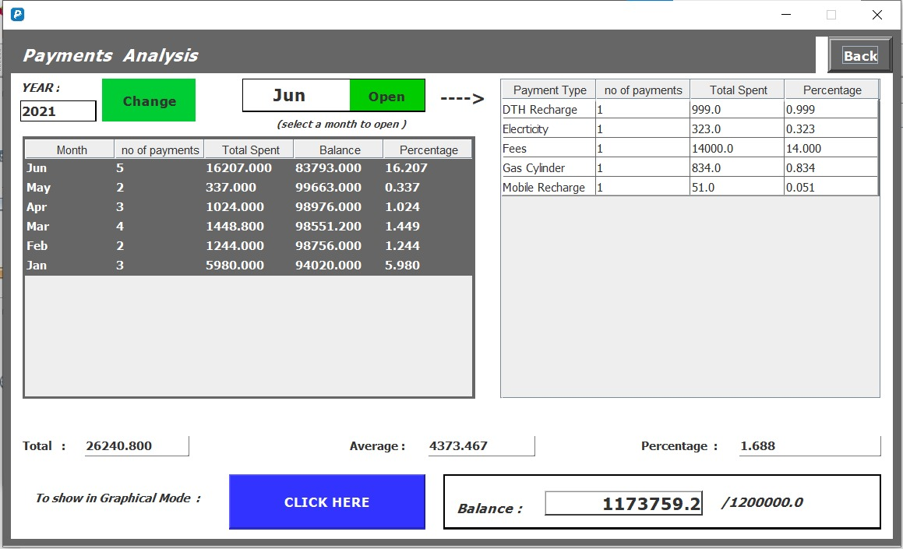
Analysis of the data

Slide 9
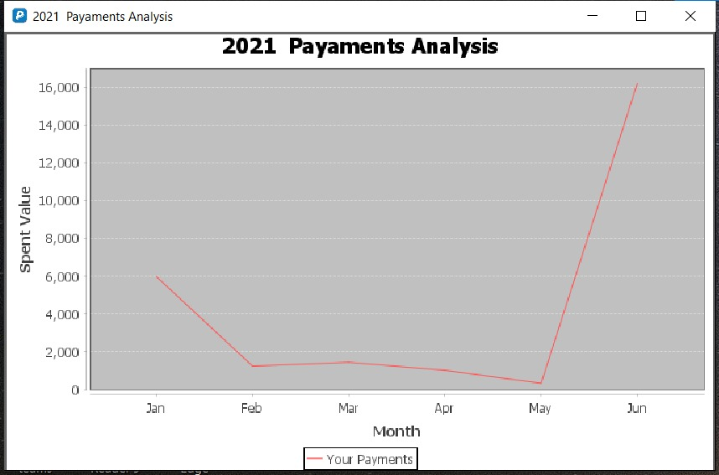
Graphical
Representation

Slide 10
Conclusion:
Track your payments , stick to a budget , save
money . It’s that simple

Slide 11


