Slide 1
Building a RAG with Gen AI
Praveen Kishore G

Slide 2
What are we building today?
A chat model that can help us answer questions from an annual letter.

Slide 3
Journey
Building a basic chatbot
Limitations of LLMs
RAG Architecture
Embeddings
Build an annual letter chatbot

Slide 4
LLMs
Advanced AI models designed to understand and generate human-like text by leveraging deep learning techniques and vast datasets.
They have billions of parameters, enabling them to capture complex patterns in language.
Trained on diverse datasets to achieve a broad understanding of language.
Benefits:
A single model can be used for different tasks
Fine tuning requires minimal data
Performance increases with more data and parameters

Slide 5
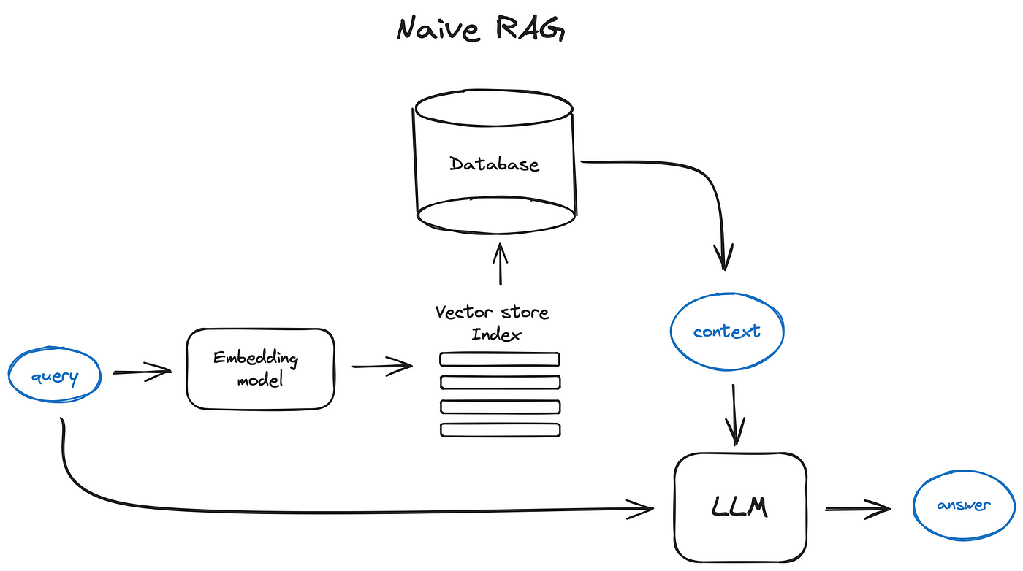
RAG Architecture

Slide 6
Evaluation
Precision
Total number of documents retrieved that are relevant/Total number of documents that are retrieved.
Recall
Total number of documents retrieved that are relevant/Total number of relevant documents in the database.
Mean Reciprocal Rank:
Measures how high the relevant document appears in the search. Useful where users prioritize top results.

