Slide 1
STUDENT DROP-OUT RATES IN INDIA

Slide 2


Slide 3
A B S T R A C T
Students' dropouts are a serious problem for students, society, and policy makers. It In turn effects the growth of nation economically and the future development of the nation. predictive modeling using machine learning algorithms has a great potential in developing early warning systems to identify students at risk of dropping out in advance and help them. In this study, we use the SVM and random forests in machine learning to predict students at risk of dropping out. The data used in this study are the samples of xxxx high school students from the 2004-2019 Ministry of Human Resource and Development(MHRD), which is a national system for educational administration information connected through the Internet with around xxxx elementary and secondary schools, xx city/provincial offices of education, and the Ministry of Education in India.

Slide 4


Slide 5


Slide 6
Our predictive model will show an excellent performance in predicting student’s dropouts in terms of various performance metrics for binary classification.
The results of our study demonstrate the benefit of using machine learning with students' big data in education.
We briefly overview machine learning in general and the SVM, random forests model and present the various performance metrics to evaluate our predictive model.

Slide 7
Introduction
A significant number of student experience various types of difficulties in adapting to their school life.
“At-risk students” who drop out of schools due to such difficulties either adopt antisocial behaviors or fall into the lowest bracket in the labor market, which subsequently adds to experiencing difficulties in adapting to the society.
According to the Indian Ministry of Education and the MHRD, 15% to 20% of Indian students give up studying (drop out of schools) on account of difficulties in adapting to school life.

Slide 8


Slide 9
Research Methodology
Predictive modeling using machine learning with big data has been successfully applied in other areas including business and public health, and has a great potential for building efficient early warning systems to identify potential high school dropouts.
This study uses the SVM and random forests model in machine learning with the data on attendances, student activities, and learning activities during classes stored at the Ministry of Human Resources and Development (MHRD) in India to predict high-school students' dropouts.
The trained predictive model allows for early identification of at-risk students early on, preventing them from dropping out through appropriate intervention.

Slide 10
Literature review
Chung et al. (2013) introduces separate definitions for out-of-school youths and students at risk of dropping out.
“Out-of-school youths” are defined as school-aged youths under 19 who do not attend schools.
Even though they generally overlap with school dropouts, the category includes “preschoolers” who have not entered mandatory education institutions, “mid-program dropouts” who drop out after entering the schools, and “pre-entrance dropouts” who do not advance to a higher level institution statistics.

Slide 11
On the other hand, “at-risk youths” refers to youths who are exposed to personal and environmental risks, likely to experience behavioral or psychological problems and find it difficult to achieve normal development without appropriate educational intervention.
This group of youths reports high risks of running away from home, dropout, unemployment, violence, prostitution, substance abuse, and other misconducts, crimes, as well as psychological disorders such as depression, anxiety, and suicide (Khu et al., 2005).
While not all out-of-school youths become at risk youths, their likeliness to become one is high.
For this reason, it may be crucial whether a youth stays inside school or not.

Slide 12


Slide 13


Slide 14
Previous studies have examined risk indicators for dropouts. Balfanz, Herzog, and Mac Iver (2007) used longitudinal data for 13,000 students from 1996 to 2004 and found that students who were frequently absent, marked unsatisfactory behavior scores, failed in math, and failed in English were 68%, 56%, 54%, and 42% less likely to graduate than others.

Slide 15
Burke (2015) used samples of 6118 students who entered ninth grade in Oregon school district in 2007–2008 and found that attending fewer than 80% of days in eighth grade, attending fewer than 80% of days in ninth grade, GPA below 2.0 in eighth grade, and GPA below 2.0 in ninth grade were key indicators for dropouts.

Slide 16
National High School Center offered guidance on developing an early warning systems and also recommended to use attendance, behavior, and course performance as key indicators (Therriault, Heppen, O'Cummings, Fryer, & Johnson, 2010).
In 2002, MetLife (2002) asked American high school students whether they considered dropping out at least once and why. Of the respondents, 76% answered that they considered dropping out because “school is boring.” Moreover, 42% of the respondents said that they are “not learning enough at school.”

Slide 17
In the 1980 of high school and beyond 10th grader cohort survey, the determinant reasons are that are as follows: (Ekstrom, 1986).
Cause for Dropout | Percentage
do not like schools | 33%
grades are poor | 33%
due to employment | 19%
marriage | 18%
do not get along with teachers | 15%

Slide 18
In the 1998 of national education longitudinal study 8th grader cohort survey, the determinant reasons are as follows: (Jordan, McPartland, & Lara, 1999).
Cause for Dropout | Percentage
Do not like schools | 51%
Failed courses | 44%
Do not get along with teachers | 34%
Cannot keep up with classes | 31%
Feel that they do not belong in schools | 25%

Slide 19
In the 2005 of nonrepresentative sample of dropouts survey, the determinant reasons are as follows: (Bridgeland, Dilulio Jr, & Morison, 2006).
Cause for Dropout | Percentage
has no interest in classes | 47%
cannot keep up with classes due to too much absence | 43%
spend much time with people not interested in schools | 42%
too much freedom and not enough regulation in life | 38%
failed courses | 35%

Slide 20
In Korea, Yoon, Ryu, and Kim (2010) conducted an in-depth analysis of dropouts on 12,280 elementary school dropouts, 14,572 middle school dropouts, and 34,305 high school dropouts by investigating the reasons for dropouts through expert panels, workshops, and the educational information system, surveys, and expert surveys.
In the lists of the detailed causes of secondary school student's dropout, the largest share of respondents answered as follows:

Slide 21
Cause for Dropout | Percentage
poor academic performance or dislike of studying | 34.8%
preparation for school qualification exam | 8.8%
overseas language training | 8.1%
financial distress, emotional disorders, physical disorders, and other diseases | 4.2%
family problems | 3.2%
strict school rules | 2.5%
residential instability | 2.4%
running away from home | 1.5%
alternative education | 1.3%
poor relationship with friends and teachers | 0.7%

Slide 22
A brief overview of machine learning
Predictive Modeling is a set of techniques of building and using models to make predictions based on patterns extracted from data.
With the increase in computing power and available big data, predictive modeling has been successfully applied in various fields.
For example, predictive modeling assists doctors to diagnose a disease based on previous patients' data, and helps a company to predict customers' preferences based on past purchased items.
The biggest threat to the generalizability of a model is a overfitting in which a model fit too much noise in the data. To avoid overfitting, machine learning split a given data set into training and testing dataset, and also use cross-validation.

Slide 23
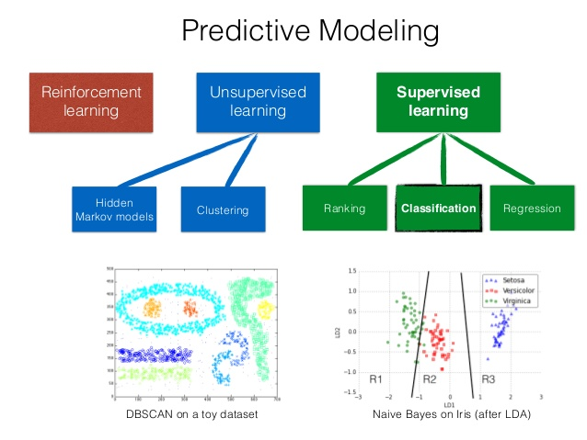

Slide 24
Supervised and unsupervised learning :
Machine learning is a set of algorithms that are able to learn from a dataset (Goodfellow, Bengio, & Courville, 2016).
Typically, the learning in machine learning falls into two categories: the supervised and unsupervised learning.
In the supervised learning, the machine learning algorithms learn the relationship between descriptive features (or predictors) and target feature (or outcome) in a dataset.
Using the trained model from the supervised learning, we wish to accurately predict the outcome of future observations (prediction) or to better understand the relationship between the outcome and predictors (inference).

Slide 25
In unsupervised learning, the machine learning algorithms learn the structure of the dataset.
Using the trained model from the unsupervised learning, we wish to discover the underlying structure of the data instead of predicting the target feature.
For example, in a market segmentation, researchers are interested in identifying distinct groups of customers based on multiple characteristics of customers with the hope for targeted marketing.
The dataset used for the unsupervised learning is often called an unlabeled data because the dataset does not contain the target feature.
K-means clustering, mixture models, hierarchical clustering, and neural networks are the examples of the models used for unsupervised learning.

Slide 26
Because the machine learning algorithms never see the testing dataset during the training process, the performance of the trained model on the testing dataset is considered as the estimates for the performance of the model for the future dataset.
The biggest threat to the generalization of the trained model to the new data is the overfitting. When the predictive model predicts well the outcome in the training dataset, but not the one in the testing dataset, the predictive model is said to overfit the training dataset.

Slide 27
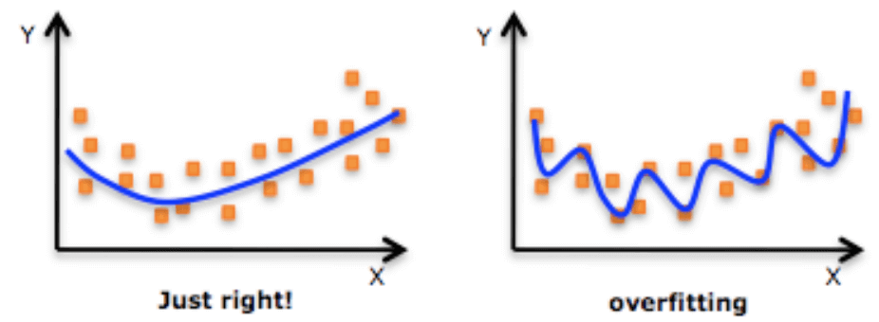

Slide 28
Sample outputs of our model’s are as follows :

Slide 29
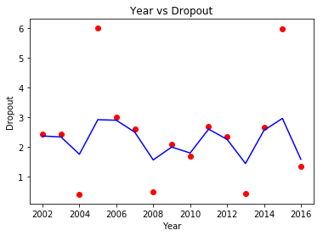

Slide 30
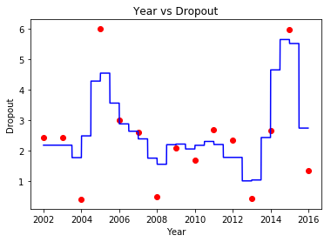

Slide 31
Thank You !

