Slide 1

Brain Squeezes
Group 5
Jayasurya Vemuri (11697685)
Sai Prakash Swami (11708218)
Bharat Chowdary Potluri (11711711)
Chiranjeevi Uppala (11693069)
Niranjan Sai Rajulapati (11678634)
Vyshnav Poojari (11699109)
Praveen Kumar Suggula (11726959)

Slide 2
Agenda
Introduction
Tools and Technologies
Project Architecture
Project Demo
Code walkthrough
DevOps Integration
Future enhancements
Conclusion

Slide 3
Introduction
Project Name: Brain Squeezes
FOR students and employees WHO are seeking to find solutions for their real-world problems, THE Brain Squeezes project is a web-based application operating across all kind of browsers in different types of companion devices (mobile, tablets and laptops) THAT provides users with queries or seeking assistance can post their questions in text, audio and video formats, while others can view these questions and offer support and earn points and ranks for every valid answer and can get pay from admin. UNLIKE other service providers (like stack overflow), OUR website providing additional features like assistance in text, audio, video format, one to one video calling feature to resolve queries by scheduling a meetings, chat bot, notification services in our application.
GitHub Link: https://github.com/PraveenSuggula/Brain-Squeezes/ Live URL: https://brainsqueezesui.azurewebsites.net/login

Slide 4




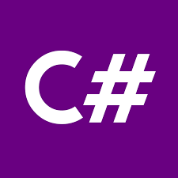


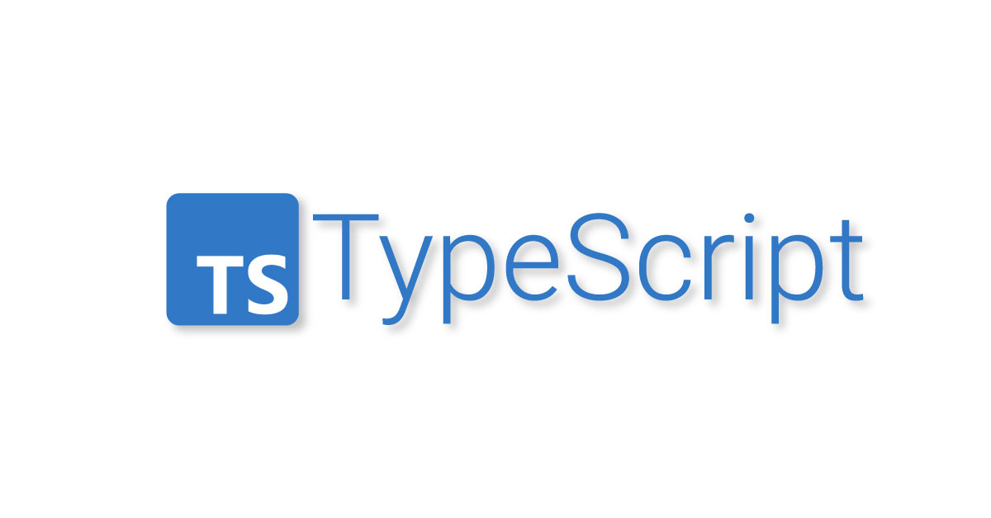


Tools and Technologies
Frameworks
Languages
Platform/IDE’s
Database
MS SQL
SSMS
Backend
User Interface
Cloud
Azure Portal

Slide 5
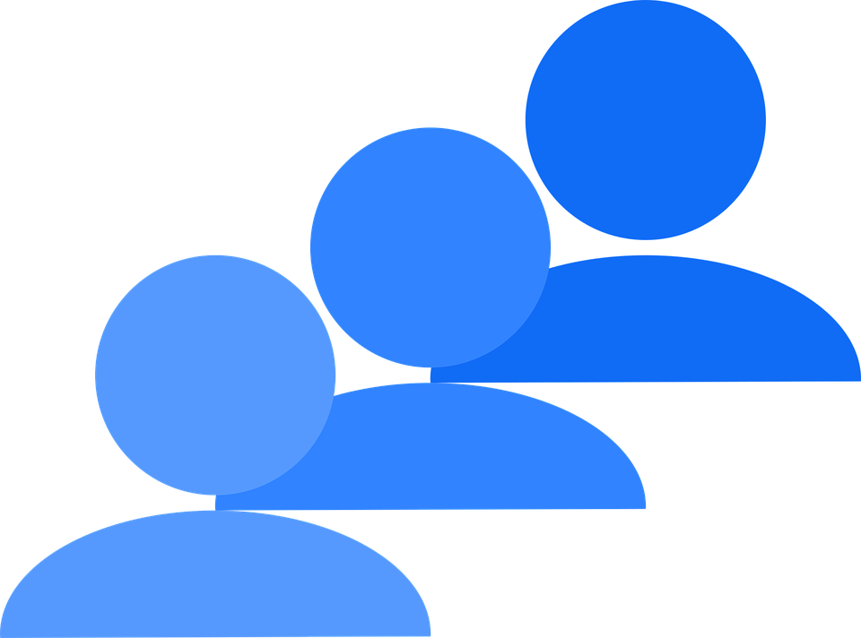


Project Architecture
By this architecture, we retrieved the advantage of monolithic architecture which in terms of simple design, easy maintenance, low network latency and easy deployment. Along with this, we also achieved microservice architecture advantages like scalability with internal Load balancer which is configured in Kubernetes.
By this architecture we can serve our application in cross platforms or single operating system with different versions which will helps when our different packages or frameworks in our application need to compatible with different OS or OS Versions.
Segregation of API from UI with Private IP will gives more security to our database. SQL server only interacts with API private IP which cannot be directly accessible with browser.
Virtual Network <->
← Public Subnet
Private Subnet →
End Users
Kubernetes
Virtual Machine (Public IP)
Virtual Machine (Private IP)
Windows OS
Linux OS
Docker 1
Docker 2
Frontend Project (View)
Backend Project (Controllers and Models)
Fig: Combination of Monolithic and Distributed Architecture more likely a 3 tier architecture.

Slide 6

Future Architecture plan
Virtual Network <->
Virtual Machine (Public IP)
Virtual Machine (Private IP)
End Users
Web app (Frontend)
Dotnet App (Backend)
Kubernetes Cluster
Docker 1
Pod 1
Pod n
Node 1
View
Questions Service (M-C)
Questions Service (M-C)
Application Gateway
Pod 1
Pod n
Node 2
Mobile app (Frontend)
Answers Service (M-C)
Answers Service (M-C)
Load Balancer
Docker 2
View
Pod 1
Pod n
Node n
File upload Service (M-C)
File upload Service (M-C)
This architecture is a combination of monolithic UI and distributed (SOA) based API projects achieved by microservices. By this architecture, we achieved all of advantages of multi architecture discussed in above example along with code or service reusability and less resource utilization.

Slide 7
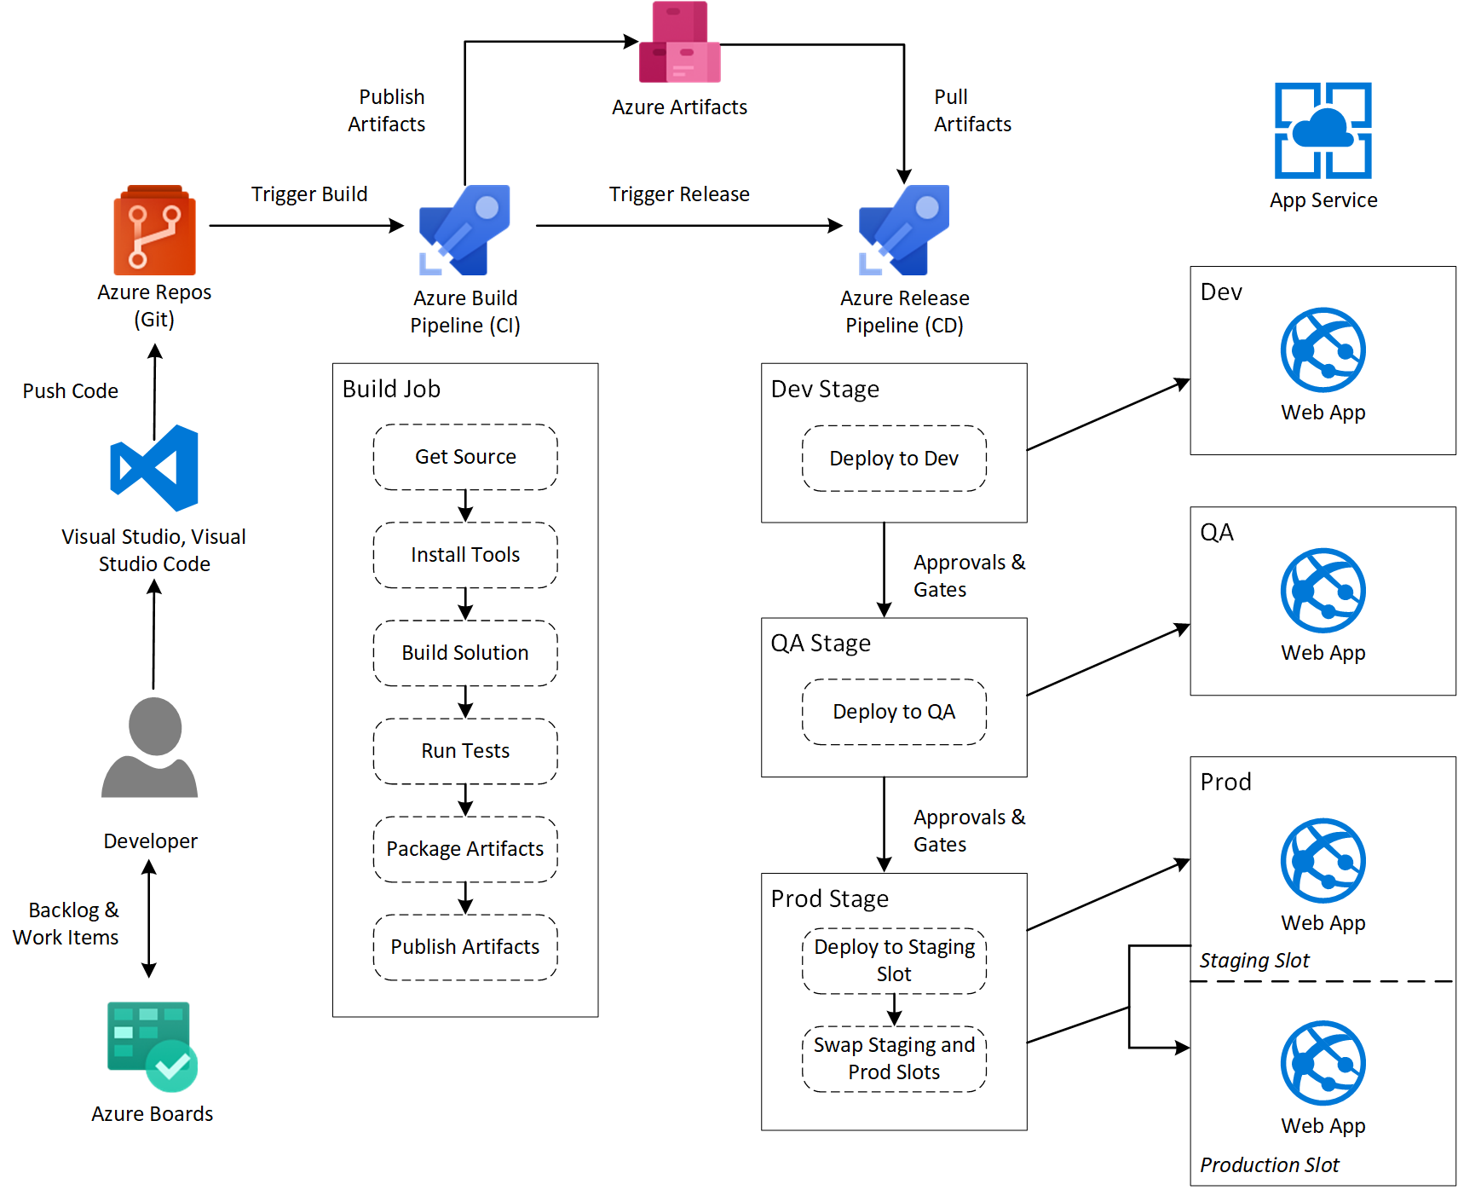
Azure DevOps Integration

Slide 8
Any Queries?

Slide 9
Thank You.

