Slide 1
FUTURE-STATE SOLUTION DESIGN
CONFIDENTIAL · ILLUSTRATIVE
Private Banking Meeting Orchestration
A single intelligent booking experience that turns ten manual steps into one action — engineered on Microsoft Power Platform, Graph and Azure.
Prepared for Executive Stakeholders · Technology Leadership · Enterprise Architecture Review Board
Power Platform
Microsoft Graph
Azure · Entra ID
Notes:
Set the frame: this is a future-state solution design for modernising how Relationship Managers book customer meetings. Built entirely on Microsoft technologies. Audience is exec, technology leadership and the architecture review board.

Slide 2
CONTENTS
What this design covers
01
Executive summary & business value
02
Current state — as-is process & pain
03
Future state — operating model & journeys
04
User experience — Power Apps CodeApp
05
Options, solution & integration architecture
06
Sequence flows & Power Automate orchestration
07
Graph usage & lightweight Dynamics 365
08
Security, NFRs, delivery & roadmap
Notes:
Walk the arc: we start with the business case, show the current pain, then the target state, the UX, and progressively deeper technical layers, closing on security, NFRs and roadmap.

Slide 3
01 · EXECUTIVE SUMMARY
From ten manual steps to one click
PROBLEM
VISION
Booking one meeting takes ~10 manual steps and 6–8 emails across RMs, Executive Assistants, Reception, Catering and Housekeeping — slow, error-prone and invisible to the business.
The RM performs a single task — open the app, enter a few details, press Create Meeting . Availability, options, booking, notifications and audit all happen automatically.
SOLUTION
VALUE
A Power Apps CodeApp front end, Microsoft Graph for availability, and Power Automate for event-driven orchestration — with Outlook as the scheduling source of truth and Dynamics kept deliberately lightweight.
RM administration collapses, booking cycle time drops from days to minutes, manual emails disappear, and every meeting becomes consistent, auditable and AI-ready.
Notes:
The one-slide story for executives. Problem: fragmented, manual, slow. Vision: one action. Solution: Power Platform orchestration on top of Outlook as source of truth. Value: RM time back, faster booking, better CX.

Slide 4
01 · BUSINESS VALUE
The value case
Directional estimates — to be baselined and confirmed during discovery.
30–40%est.
2–5 days→ mins
6–8 → 0
Reduced RM administration
Manual emails eliminated
Hours per RM per week returned to servicing customers.
Faster booking cycle
Per meeting, replaced by automated notifications.
Time from request to confirmed meeting.
~90%est.
+10 ptsest.
100%
Visibility & auditability
Reduced human error
Improved customer experience
Every booking tracked end-to-end; AI-ready data foundation.
Double-bookings, missed handoffs and rework.
Branded self-service booking; CSAT uplift.
Notes:
Metrics are placeholders — the client fills these from baseline data. Frame each as a benefit hypothesis to be validated in discovery. Note future AI readiness as a strategic option, not a day-one cost.

Slide 5
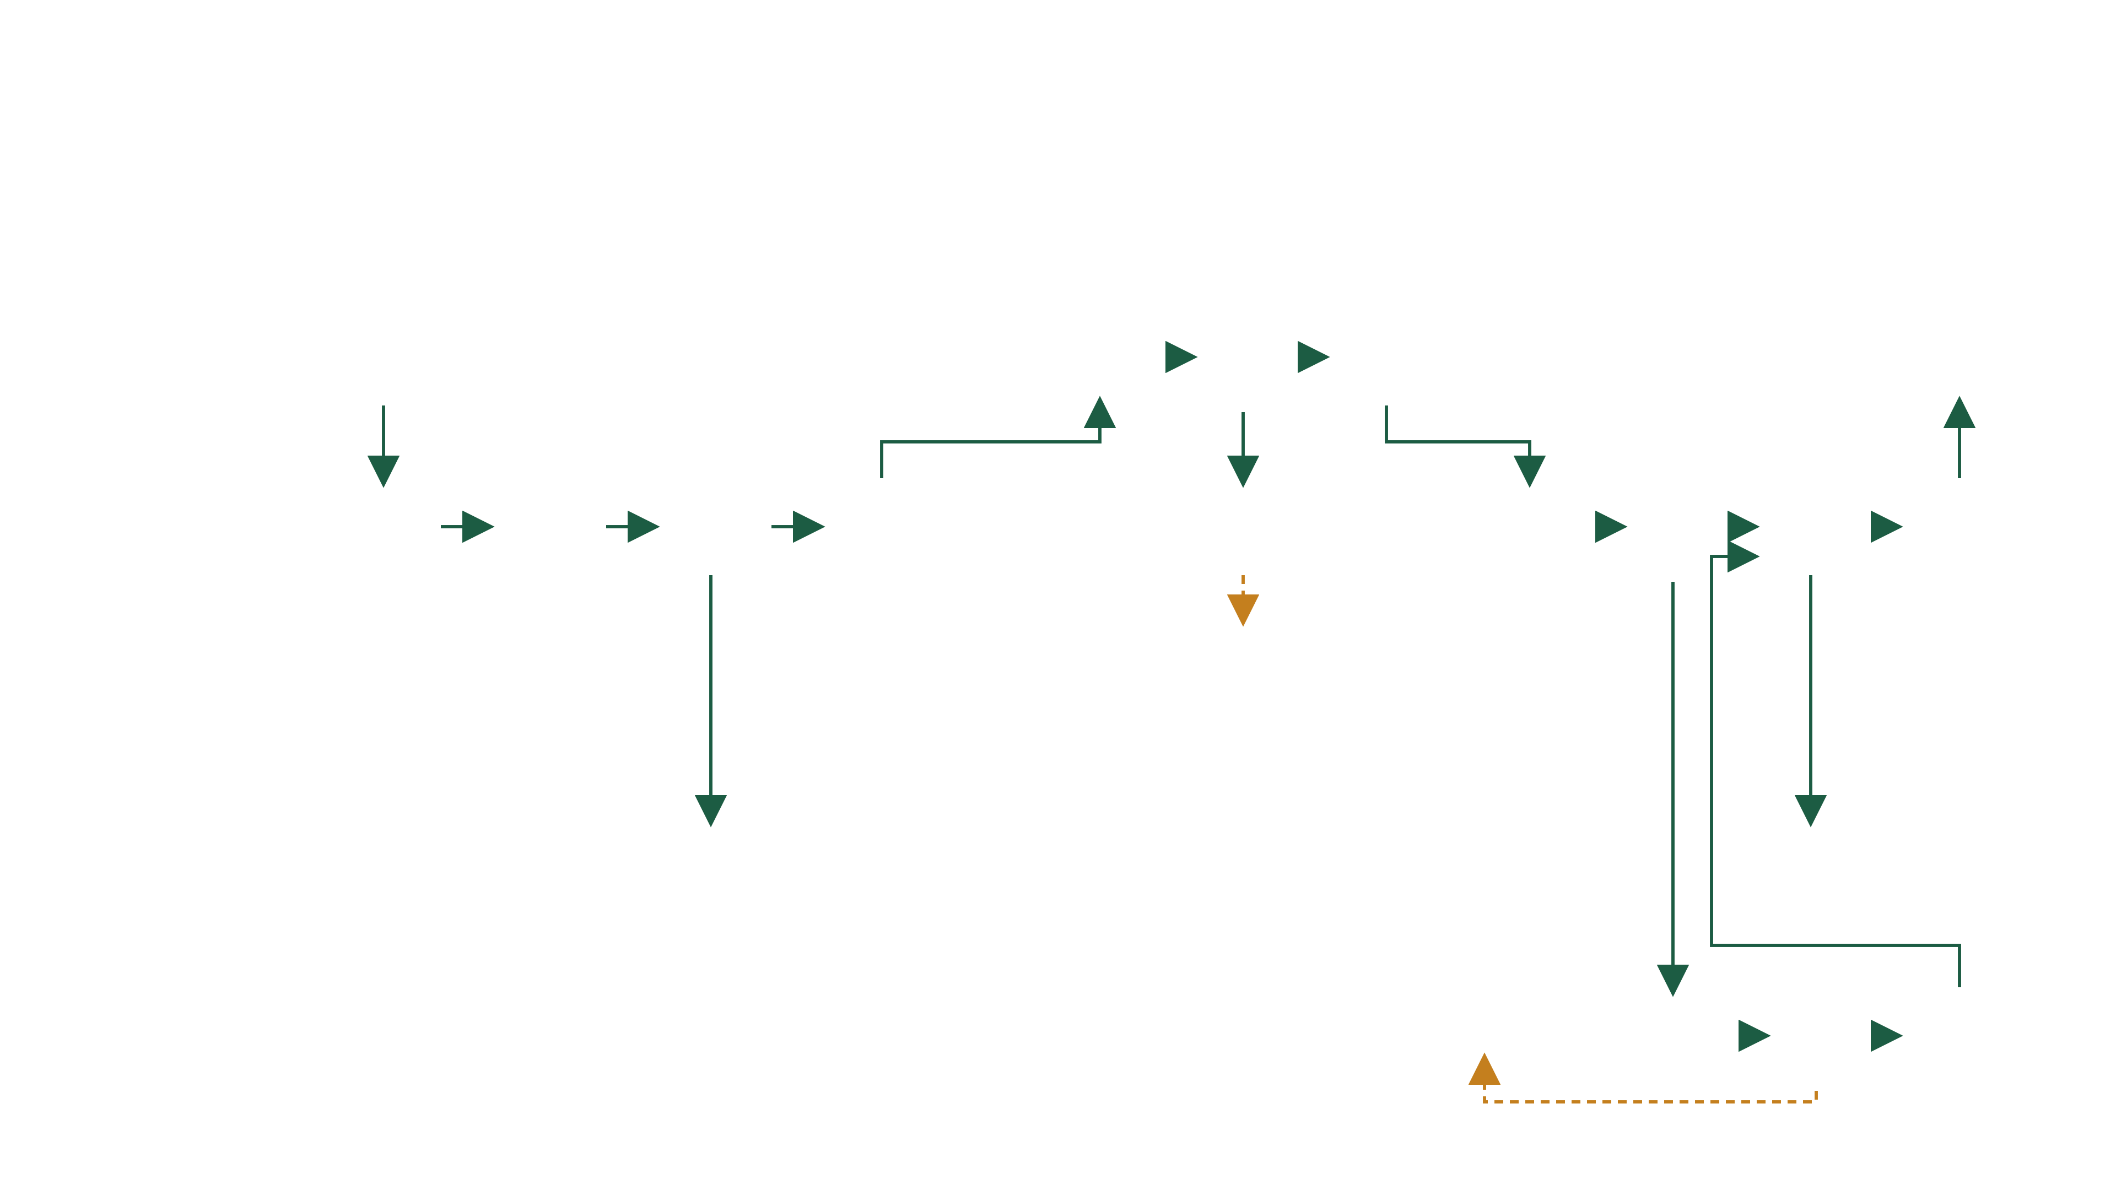
02 · CURRENT STATE
As-is booking process — swimlane with decisions
10 steps · 3–4 teams
3 decisions
2 rework loops
INITIATION
AVAILABILITY
ATTENDANCE
PARTNER · IF REQUIRED
CONFIRMATION
1
6
7
10
Customer
Requests meeting
Receives 3 available dates
Able to attend?
Yes
Informs bank of chosen date
Accepts invite → Outlook calendar
✉ MAIL
No
2
3
Checks type, room & internal attendee availability
4
5
Emails 3 proposed dates
!
8
9
Emails Outlook invite to customer
Identifies who to meet · CRM/ARR review
Creates 3 PROV Outlook invites + room
Deletes all 3 PROV meetings
Deletes irrelevant dates · removes PROV
Known to partner?
No
Creates internal CRM invite
Relationship Mgr
✉ MAIL
✉ MAIL
Yes · ✉ EA
↺
Restart → step 4 · new dates
Team Assistant
Catering & FOH
Accepts all 3 PROV CRM holds
Accepts CRM invite
Exec Assistants · Partners
↺
Email EA to check if partner is available
Partner available?
Yes
Emails RM to add partner to invite
Restart → step 4 · re-provision
No
✉ MAIL
◇ decision
— — rework loop
! exception step
○ supporting action
✉ manual email
6–8 emails per booking · 3–5× provisional invites created & mostly deleted
*Vanilla = customer meeting without a partner; prospect meetings require a partner. RMs/ARMs organise all AR & customer meetings; Team Assistant handles lunches, intermediaries & complex meetings only.
Notes:
This is the true as-is, decisions and all — ten core steps across four active teams (Team Assistant sits in the lane but only handles lunches, intermediaries and complex meetings). Three decision points and two rework loops are the story: if the customer can't make any of the three dates the RM deletes all provisional holds and restarts at step 4; if the partner isn't available the flow also restarts at step 4. Known-to-partner short-circuits the partner phase — No creates the CRM invite directly, Yes emails the EA to check the partner. Every diamond is a place the process can stall or repeat; every envelope is a manual email. That fragility is what the future state removes.

Slide 6
02 · CURRENT STATE
Where the current process breaks down
EFFICIENCY
EXPERIENCE
GOVERNANCE
Duplicate effort & re-keying
Manual calendar & room checks
Delays waiting on replies
RM time lost to admin
Slow, inconsistent journeys
Repeated capture of preferences
No branded self-service
Poor first impression
No end-to-end visibility
Limited auditability
Human error & missed handoffs
Weak reporting foundation
Notes:
Group the pain into three lenses the board cares about: efficiency, experience, governance. The right column reframes it as the cost of the status quo — placeholder figures the client baselines.

Slide 7
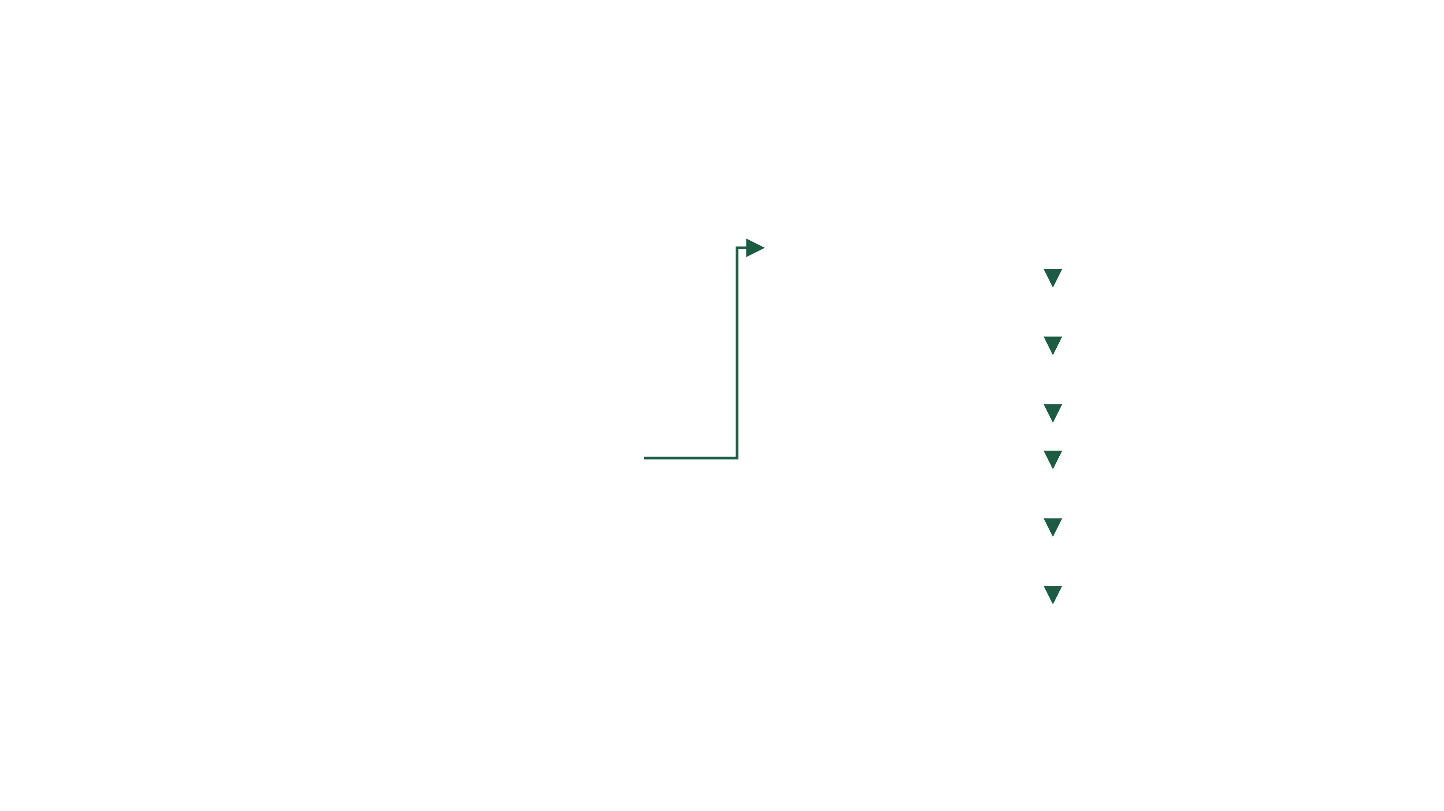
03 · FUTURE STATE
One action, AI-assisted — end to end
As-is · 12 handoffs · 6–8 emails · days
→
To-be · 1 action · AI-drafted · minutes
1
Gr
Availability resolved
Graph free/busy + ranked rooms across all attendees
2
AI
AI recommends slot & drafts invite
Azure OpenAI proposes the best room + time and a house-style message
3
Web
Booking link to customer
RELATIONSHIP MANAGER
Tokenised, single-use — three options to pick from
Enter details & press
Fl
async — customer chooses a slot · state held in Dataverse
Power Automate
4
＋ Create Meeting
Event-driven orchestration
Ol
Event + room created
One Graph call — room as resource attendee
5
Tm
Everyone notified
Teams to RM · email to Catering, Reception, Housekeeping
6
D3
Record closed
Booking state & audit written to Dataverse
AI drafts, RM approves
One consistent SOP
Outlook = source of truth
One Dataverse write
Notes:
Read left to right, then down. The RM performs one action; Power Automate runs the numbered sequence. Step 2 is the AI assist — Azure OpenAI recommends the best room and time and drafts the invitation in one house style, which the RM approves in the same sitting. The async band is the customer's selection. Outlook stays the source of truth; Dataverse takes one write at the end.

Slide 8
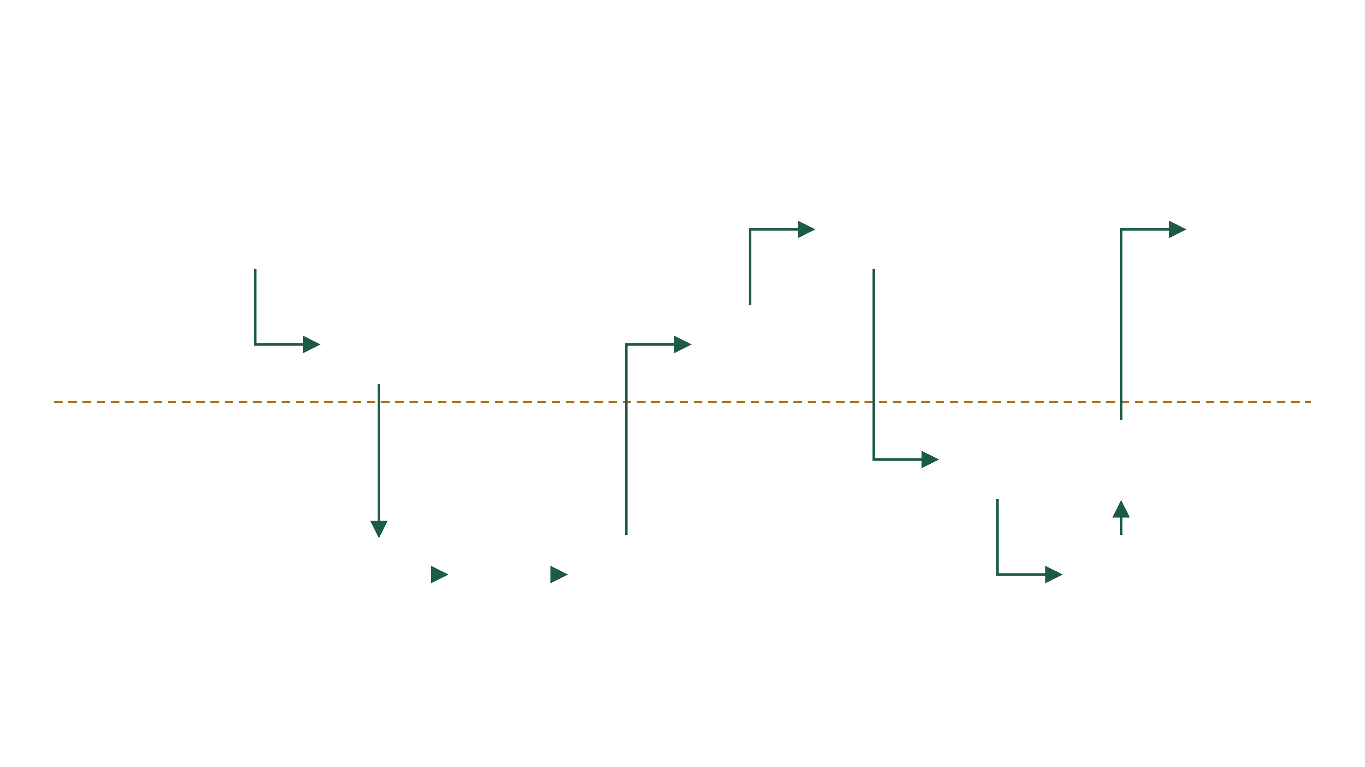
03 · FUTURE STATE
To-be service blueprint — AI-assisted
AI recommends & drafts
0 manual emails
partner auto-included
REQUEST
CREATE
AVAILABILITY
AI ASSIST
REVIEW
SELECT
TRIGGER
FULFIL
CONFIRM
1
6
10
Customer
Asks the RM
Picks a slot — one tap
Instant confirmation
Booking page
2
5
Relationship Mgr · app
Enters details · Create Meeting
RM reviews · sends link
Code app
Code app
LINE OF VISIBILITY — customers & RMs never see below
7
9
Automation · Power Automate
Validated trigger fires
Notify ops · write audit
Power Automate
Flow · Dataverse
AUTO
3
4
8
Checks CRM partner flag · auto-includes partner
Availability + rooms resolved
Recommends slot · drafts invite
Event + room created
Systems · Graph · AI · Dataverse
Dataverse · Graph
Graph
Azure OpenAI
Graph · Outlook
numbered path — one booking, end to end · chip = component doing the work · dashed — line of visibility
Notes:
Same swimlane grammar as the as-is slide. Follow the numbered path — ten steps, three of them customer touches. Step 4 is the AI assist: once Graph resolves availability, Azure OpenAI recommends the best slot and drafts the invitation, and the RM reviews before the link goes out. The tech chip on each step names the component. An automated CRM partner-flag check auto-includes the partner as an attendee — the manual EA email and rework loop from the as-is are gone. The orange line of visibility marks everything customers and RMs never see.

Slide 9
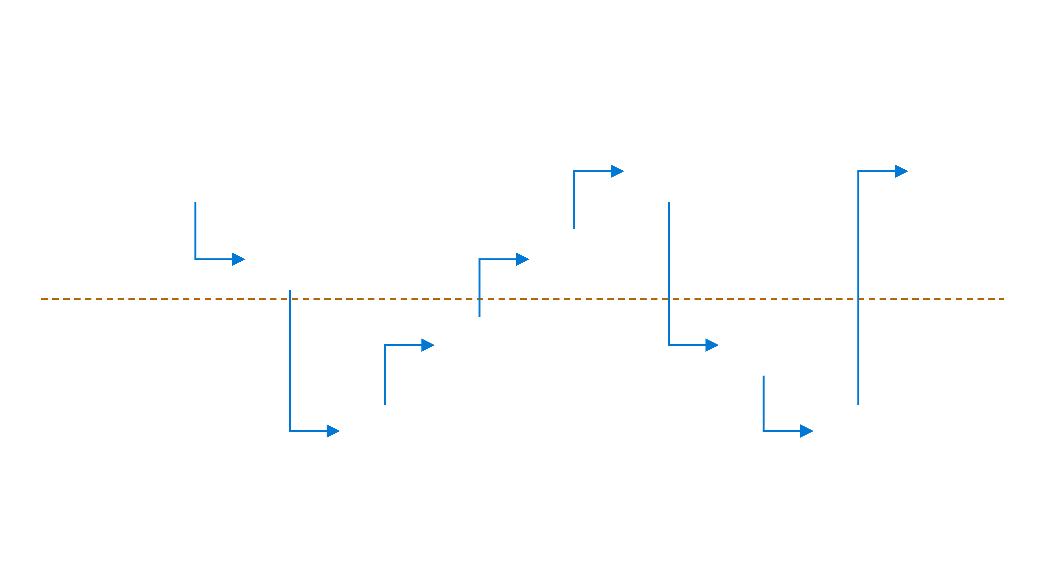
03 · FUTURE STATE — THE CHALLENGE
Native-only to-be — what we get with zero build
admin config only
no net-new licence
~65% of the value
REQUEST
ASK COPILOT
AVAILABILITY
DRAFT
OFFER
SELECT
BOOK
NOTIFY
CONFIRM
1
5
7
Customer
Asks the RM
Votes for a time — one click, no login
Calendar invite lands
Poll · Bookings
2
4
Relationship Mgr · Outlook
“Find me an hour with the client next week”
Reviews · sends times to the client
Copilot in Outlook
Scheduling poll
LINE OF VISIBILITY
AUTO
AUTO
Product behaviour · Copilot · Bookings
Ranks times · drafts invite & agenda from the thread
Poll closes · event + Teams link created
Copilot
Outlook
3
6
Systems · Exchange · Purview
Internal free/busy + Room Finder
Ops mailbox is an attendee · Purview logs it
Exchange
Exchange · Purview
WHAT IS LEFT OVER
Room is manual
Partner rule is memory
Fan-out is an inbox
Audit is mailbox-level
The only work a build would buy us
Copilot can suggest a room but nothing enforces one for a client visit
No CRM read — the RM has to remember the joint-coverage flag
Ops see the invite; catering, security and comms stay human tasks
Purview proves an event existed, not why the meeting was booked
same grammar as the previous slide · 7 steps instead of 10 · nothing here is built — it is all switched on
Notes:
This slide exists to challenge our own recommendation. Same swimlane grammar as the previous slide so you can compare step for step. Everything here is admin configuration only — no code, no flows, no Dataverse. Copilot in Outlook finds the time and drafts the invite; an Outlook scheduling poll or a Bookings page lets the customer choose; the event, the Teams link and the confirmation are all product behaviour. An ops shared mailbox added as an attendee gets the fan-out for free, and Purview logs the mailbox activity. Be honest with the room: this genuinely removes most of the as-is pain — the 12 handoffs collapse to a poll, the emails largely disappear, and it costs nothing because Copilot is already deployed. The four boxes at the bottom are what is left over, and the real question for us is whether those four are worth a bespoke build or whether they can be absorbed by process and discipline.

Slide 10
03 · FUTURE STATE
Exception handling — no dead ends
Every failure path the as-is leaves to email & rework is detected, handled, and owned
⌛
Customer picks no slot / link expires
⚠
Partner not available
▢
No room available
TRIGGER — BOOKING LINK UNUSED PAST ITS TTL
TRIGGER — EA / PARTNER-AVAILABILITY CHECK RETURNS NO
TRIGGER — GRAPH ROOM-LIST RETURNS NO FREE RESOURCE
Automated response — Flow auto-reminds the customer, then re-notifies the RM to re-propose — provisional holds auto-released, nothing left dangling
Automated response — RM notified with the conflict and offered the next-best slots from the same Graph availability set — no manual re-check loop
Automated response — Flow widens the search (nearby rooms / next slots) and flags virtual-only as a fallback option
Human fallback · RM re-triggers with new dates
Human fallback · RM re-books or proceeds without partner
Human fallback · RM selects alternate or virtual
↩
Attendee declines after booking
⊘
CRM lookup / partner flag missing
TRIGGER — OUTLOOK DECLINE EVENT RECEIVED
TRIGGER — DYNAMICS RECORD INCOMPLETE
Automated response — Flow re-opens the booking record, re-runs availability and notifies the RM — audit trail preserved
Automated response — Flow proceeds on the vanilla path and prompts the RM to confirm partner status before send — never silently skips
PRINCIPLE
Detect → respond → always a named human fallback.
Provisional holds auto-release, state lives in Dataverse, and every exception is logged for audit — no silent failures, no dangling calendar entries.
Human fallback · RM re-orchestrates in one action
Human fallback · RM confirms; data-quality task raised
Notes:
This is the process-excellence answer to every what-if. The as-is dies on these: a customer who can't make any date, a partner who's unavailable, no room, a late decline. In the future state none of them is a dead end — the flow detects the exception, responds automatically, and there is always a named human fallback so nothing stalls silently. The last row matters for governance: incomplete CRM data never causes a silent skip; the RM is always prompted.

Slide 11
04 · USER EXPERIENCE — CLICK TO EXPLORE
Power Apps CodeApp — Meeting Orchestrator
React + TypeScript · Power Platform hosted · Entra SSO
Ap
Meeting Orchestrator
CodeApp
Rachel Adeyemi · RM
RA
Dashboard
Good morning, Rachel
＋ New meeting
New Meeting
Here's your meeting activity
Suggested Slots
4
9
2
18 m
Meeting Details
Awaiting customer
Booked this week
Need attention
Avg. time to book
Timeline
Recent meetings
History
Portfolio review — H. Okonkwo
Confirmed
Partner attending · Boardroom, Floor 12
Onboarding — The Vasquez Trust
Sent
Awaiting customer selection
Estate planning — D. Bianchi
Draft
Meeting room TBC
Customer Booking ↗
Confirmation
Notes:
This is a live, clickable prototype of the Power Apps CodeApp — a React/TypeScript code-first app hosted on Power Platform. Click the rail to move between the eight screens, or follow the primary buttons through the RM flow: Dashboard, New Meeting, Suggested Slots, the customer-facing Booking Page, Confirmation, Timeline and History. Encourage the audience to click through it.

Slide 12
05 · OPTIONS CONSIDERED
Buy before build — why not out-of-the-box
Microsoft Bookings
Scheduling poll (Outlook)
Power Pages portal
Native + Copilot
Code app + flows
ZERO BUILD
SELECTED
Multi-attendee free/busy
◐
✓
✕
✓
✓
Staff pools only
Attendee voting
Custom build
Copilot + poll
Graph findMeetingTimes
Meeting-room reservation
✕
✕
✕
◐
✓
Not supported
Not supported
Custom build
Manual Room Finder
Room as resource attendee
Partner logic from CRM
✕
✕
◐
✕
✓
Heavy to build
RM memory
Dataverse partner flag
White-glove branded UX
◐
✕
✓
◐
✓
Limited theming
Outlook UI
Bookings theming
Static Web App
Ops fan-out & audit
◐
✕
✓
◐
✓
Via flow trigger
Ops mailbox on invite
Power Automate
Licensing footprint
✓
✓
✕
✓
◐
In Microsoft 365
In Microsoft 365
Capacity licences
Already owned
Premium — RM/EA only
Verdict — native + Copilot is now a serious contender: it clears five of six criteria at some level, for nothing. The build is only justified by the two it cannot do — the CRM-driven partner rule and enforced rooms — plus case-level audit. If those are worth less than the build, we should not build.
Notes:
Buy before build — be direct with the board. The scheduling engine itself is out-of-the-box: findMeetingTimes is the product feature. Bookings and scheduling polls were assessed and fail on rooms, multi-attendee sets and the CRM-driven partner condition. The custom surface is deliberately thin. Bookings plus a flow trigger remains a legitimate phase-0 pilot for the ops fan-out alone.

Slide 13
05 · SOLUTION ARCHITECTURE
High-level logical architecture
EXPERIENCE LAYER
Ap
Power Apps CodeApp
Web
Customer Booking Page
RM experience (React/TS)
Azure Static Web App — tokenised
Id
ORCHESTRATION, INTEGRATION & AI
Entra ID
Fl
Power Automate
Gr
Microsoft Graph API
AI
Azure OpenAI
SSO · RBAC · Conditional Access spanning all layers
Event-driven flows
Availability & scheduling
Recommend & draft — assist only
SYSTEMS OF RECORD & CHANNELS
Ol
Rm
D3
Tm
Exchange Online
Room mailboxes
Dynamics 365
Teams & email
Outlook — source of truth
Places service
Customer · partner flag · booking table
Ops notifications
Mo
Azure Monitor
App Insights · logs · alerts
Notes:
High-level logical architecture, layered. Experience at the top, Entra spanning identity across everything, orchestration in the middle, Graph as the integration boundary, systems of record below with Outlook as source of truth, and cross-cutting observability. Product tiles use Microsoft platform components.

Slide 14
05 · INTEGRATION ARCHITECTURE
End-to-end data flow
Ap
→
Gr
→
Ol
→
AI
CodeApp
Graph
Outlook
Azure OpenAI
① Create meeting request
② getSchedule · findMeetingTimes · rooms
③ Reads live calendars
④ Ranks slots · drafts invite — RM reviews
Web
→
⇉
Ol
Fl
⑦ Event + room (one call)
Booking page
Power Automate
⑤ Selects slot — Static Web App
⑥ Orchestrates all actions
D3
⑧ Dataverse audit + ⑨ notify
Outlook is authoritative — no calendar duplication
Graph is the single integration boundary
One Dataverse write — state & audit
Notes:
Follow the numbered data flow. Key architectural principles are called out at the bottom: Outlook is authoritative, Graph is the only integration boundary, and Dynamics receives a write only at the end — a thin audit record, never workflow state.

Slide 15
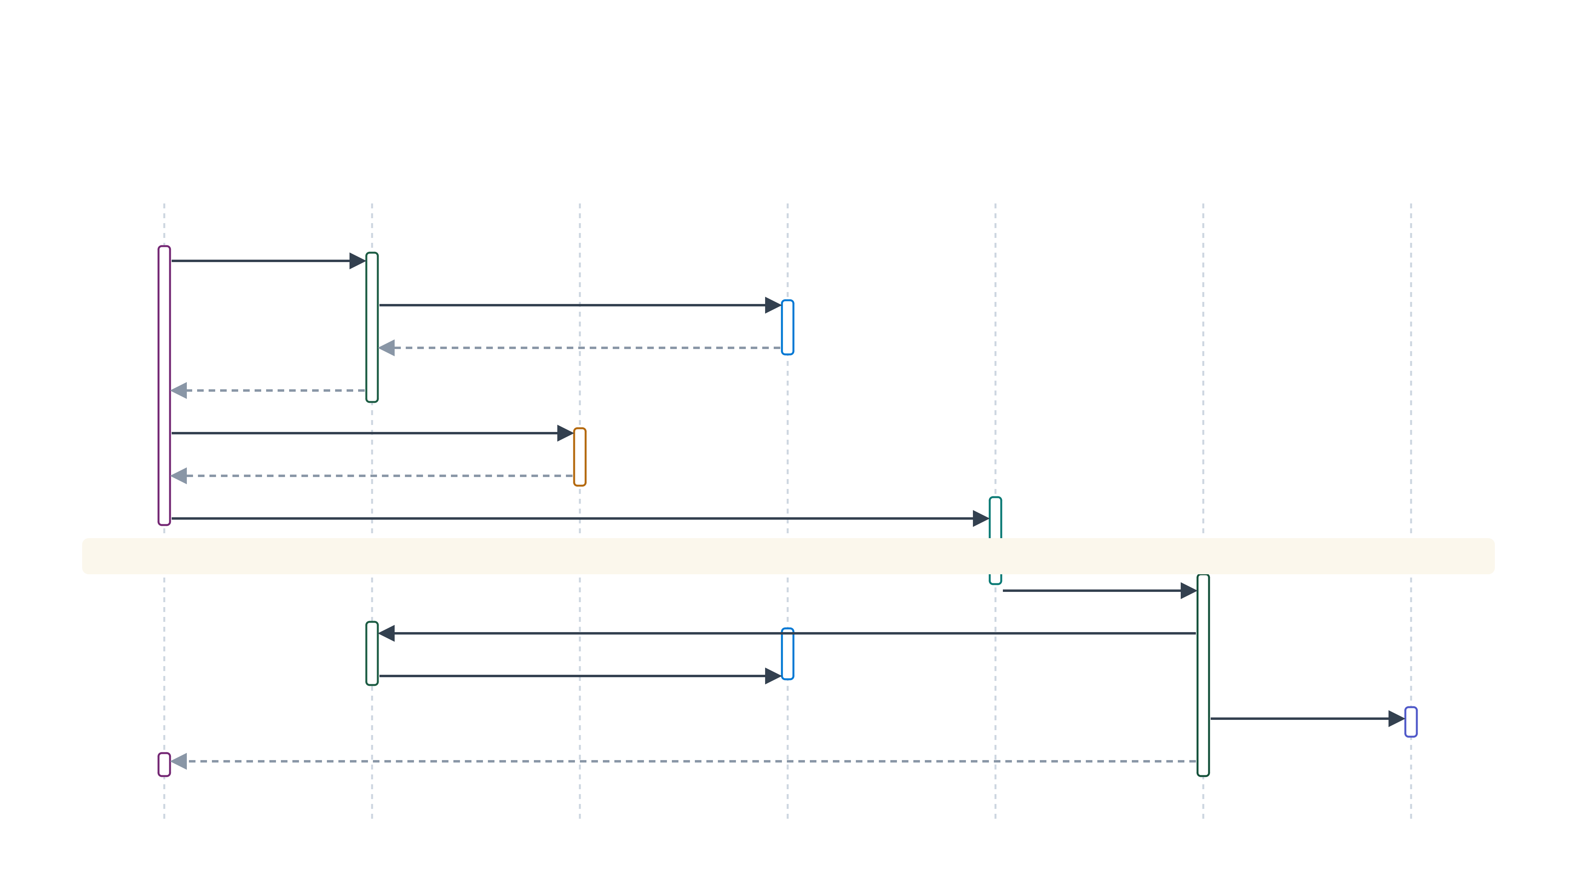
06 · SEQUENCE FLOW
Creation → AI assist → booking → confirmation
solid — call · dashed — response
RM · Code App
Microsoft Graph
Azure OpenAI
Exchange Online
Customer
Power Automate
Ops · Dataverse
1 · findMeetingTimes · getSchedule — delegated
2 · read free/busy · room lists
3 · availability
4 · ranked slots + rooms
5 · recommend best slot · draft invite
6 · recommendation + draft
7 · RM reviews · sends tokenised link
async — awaiting customer selection · booking state held in one Dataverse table
8 · selects slot — validated HTTP trigger
9 · create event — room as resource attendee
10 · event · invites · room reserved
11 · notify ops (Teams · mail) · write audit
12 · confirmation surfaced to RM & customer
Notes:
Full UML sequence with the AI step in place. After Graph returns ranked slots (msg 4), the app calls Azure OpenAI to recommend the best slot and draft the invitation (msgs 5–6); the RM reviews and sends (msg 7). The AI call sits in the RM's synchronous session, before send — never in the async transactional path below the wait band. Event creation is one Graph call with the room as a resource attendee.

Slide 16
06 · POWER AUTOMATE ORCHESTRATION
Deterministic, resilient orchestration flow
TRIGGER
PARALLEL NOTIFICATIONS
EXCEPTION HANDLING
Customer selects slot — validated HTTP trigger
Teams message to RM · email to Catering, Reception, Housekeeping — all in one parallel branch, no sequential waits.
Try / catch scope with run-after failure paths. Any failed action raises an alert and a compensating action.
↓
Create event — room as resource attendee
Update Dataverse booking record
CONDITION
Partner required? → EA checks, RM adds partner
RETRIES
APPROVALS (OPTIONAL)
↓ parallel
Exponential-backoff retry policy on all connector calls; idempotency keys prevent duplicate events.
EA approval only where a Partner is required — a single, targeted human step, not a chain of emails.
Write Dynamics audit record
PRINCIPLE
AI assists the RM before send; the transactional path stays fully deterministic and auditable.
Notes:
The orchestration in detail. One trigger, deterministic actions, a condition for the partner path, and a try/catch scope with retry policy for resilience. Notifications fan out in parallel. Everything here is deterministic — no AI in the critical path. Audit is the final step.

Slide 17
07 · GRAPH & DYNAMICS 365
Standard Graph, deliberately thin Dynamics
Gr
Microsoft Graph usage
D3
Dynamics 365 — lightweight by design
/calendar/getSchedule
Per the Head of Technology's directive, Dynamics is not a workflow engine. It holds only:
Free/busy across all attendees
① Customer lookup
/me/findMeetingTimes
② Partner flag
Ranked slots — delegated, called from the RM's session
/places · room lists
③ One booking table — state & audit (Dataverse)
Available rooms by location & type
/events · attendees
Create invite & manage attendees
✕ No workflow logic · No calendar copy
Notes:
Two decisions the architecture board will scrutinise. Left: exactly how Graph is used — standard endpoints, nothing exotic. Right: why Dynamics stays lightweight — the Head of Technology's explicit constraint. Dynamics holds customer data and a thin audit record, never workflow.

Slide 18
07 · DATA LAYER — DATAVERSE
A deliberately thin data model
Five msol_ tables — orchestration state & audit only. Outlook owns the calendar; Dynamics owns the customer.
Meeting
Proposed slot
Room
msol_meeting · aggregate root
msol_proposedslot · N:1 → Meeting
msol_room · reference data
Subject
text
Start / End
datetime
Name
text
Customer
→ Contact
Rank
int
Resource mailbox
email
Meeting type
◆ choice
Room
→ Room
Location
◆ choice
Duration
int
Availability
◆ choice
Capacity
int
Status
◆ choice
AI score
decimal
Active
bool
Partner required
bool
Confirmed slot
→ Slot
Owning RM
→ User
Outlook event id
text
Booking token
secret
Meeting attendee
Orchestration event
msol_meetingattendee · N:1 → Meeting
msol_orchestrationevent · audit trail
Name / Email
text
Event type
◆ choice
Attendee type
◆ choice
Timestamp
datetime
Required
bool
Source / Outcome
◆ choice
Response
◆ choice
Detail
memo
🔒 immutable · restrict-delete
◆ global choice set
→ lookup / FK
Cascade-delete children · Contact & User are platform tables
Notes:
This is the data model that backs the thin-Dynamics principle from the previous slide. Five custom msol_ tables hold orchestration state and audit only — Outlook stays the calendar system of record, Dynamics owns the customer. Meeting is the aggregate root; ProposedSlot, MeetingAttendee and OrchestrationEvent hang off it. OrchestrationEvent is an immutable audit trail with restrict-delete. Room is bookable-resource reference data. Standard system columns and global choice sets are omitted for space — the full field-level schema is in the accompanying reference.

Slide 19
08 · SECURITY & IDENTITY
Security by design, private-banking grade
Id
Role-based access
Secrets & identities
RM · Executive Assistant · Operations · Administrator roles with least-privilege scopes.
Service-principal connections via connection references; secrets in environment variables backed by Azure Key Vault.
Microsoft Entra ID
Single sign-on for RMs and staff. Conditional Access enforces device compliance and location policy. Customers use single-use, expiring tokenised booking links, validated before any flow runs.
Least-privilege Graph
Audit & compliance
Scoped delegated + application permissions; no broad mailbox access.
End-to-end audit logging, data residency, retention and DLP aligned to financial-services regulation.
Notes:
Security by design for a private bank. Entra ID is the backbone. Emphasise least-privilege Graph scopes, RBAC by persona, managed identities for flows, secrets in Key Vault, full audit logging, and compliance controls appropriate to private banking.

Slide 20
08 · NON-FUNCTIONAL REQUIREMENTS
Non-functional requirements
Performance
Availability
Security
Slot suggestions in < 5 s; async orchestration off the UI thread.
99.9% target on Microsoft 365 & Power Platform SLAs.
Entra, least privilege, encryption in transit & at rest.
Resilience
Supportability
Maintainability
Retries, idempotency, compensating actions on failure.
Low-code flows; clear run history for L1/L2 support.
Minimal custom code; ALM via managed solutions & pipelines.
Monitoring
Logging
Disaster recovery
Azure Monitor · App Insights · flow analytics & alerts.
Structured, correlated logs across all components.
Geo-redundant M365/Azure; documented RPO/RTO — TBC.
Notes:
The NFR scorecard. Targets are placeholders for the client's own SLAs. The point is coverage — every quality attribute the review board expects, mapped to a concrete platform capability.

Slide 21
08 · LICENSING & ALM
Licensing, environments & ALM
LICENSING FOOTPRINT
ENVIRONMENTS & ALM
Power Apps Premium NET NEW
Environments
The only net-new licence — scoped to RM & EA personas, not the whole bank.
Dev → Test → Prod managed environments; production locked to service-principal deployments.
Power Automate
Managed solutions
Flows run within the app licence at MVP scale; no per-flow licences.
Connection references + environment variables; nothing rewired by hand between environments.
Microsoft Graph
Pipelines
No additional cost — included with Microsoft 365.
Power Platform pipelines for promotion; source-controlled code app.
Dataverse
DLP policies
One booking table within existing Dynamics 365 capacity.
Business / non-business connector groups enforced per environment.
Azure Static Web Apps
Observability
Booking page on free/standard tier — no servers, no VMs.
App Insights wired per environment; flow run history for L1/L2.
No new infrastructure — SaaS and serverless only
Notes:
One net-new licence line — Power Apps premium for booking personas only. Everything else rides existing Microsoft 365, Dynamics and near-free Azure. Right side is the delivery governance the review board expects: environments, managed solutions, pipelines, DLP.

Slide 22
08 · RISKS & ASSUMPTIONS
Risks, assumptions & dependencies
RISKS → MITIGATIONS
ASSUMPTIONS
Microsoft 365 E3/E5 with Exchange Online in place
Room mailboxes & room lists already configured
Dynamics 365 licensed as the customer master
Entra Conditional Access policies in force
Graph throttling at scale
→ Batched getSchedule, cached room lists, exponential back-off on all connector calls.
Booking-link abuse
→ Single-use, expiring tokenised links; trigger validated before any action runs; rate limiting.
Licence cost creep
DEPENDENCIES
→ Premium licences scoped to RM/EA personas; usage reviewed quarterly.
Room-mailbox data hygiene (capacity, location)
Dataverse environment capacity approval
Corporate DLP policy sign-off
EA & ops adoption
→ Ops teams receive notifications, they never operate the app; training limited to RMs.
Notes:
Standard RAID coverage. Each risk carries a concrete mitigation. Assumptions and dependencies are what discovery must validate before the ARB signs off.

Slide 23
AI ASSIST · IN THE DESIGN
AI in the loop — recommend & draft, RM approves
Human-in-the-loop
The problem it solves — every RM books in their own style; there is no SOP. This standardises room, timing and tone without slowing anyone down.
①
②
③
Best room & timing
Drafts the invitation
RM reviews & sends
Ranks the Graph availability results — capacity, location, attendee load, RM travel — and recommends the single best option with a one-line rationale.
Writes the customer-facing message in one approved house style — a consistent SOP for every RM, in seconds, not a blank page.
Human stays in control — the RM edits or approves in one click. Nothing leaves the bank unread.
WHERE IT RUNS
GROUNDING
HUMAN-IN-THE-LOOP
LICENSING
One Azure OpenAI action inside the existing Power Automate flow — no new app, no new service.
Prompted with the Graph availability data & the approved message template — no model training, no customer data retained.
Draft only — the RM always reviews. No autonomous sends, no decisions made without sign-off.
Pay-as-you-go Azure OpenAI tokens — pennies per booking; no per-seat AI licence.
Deterministic core stays intact — AI only recommends & drafts, never decides or sends.
Notes:
Frame this as the lowest-effort, highest-consistency AI step — deliberately not autonomous. It solves a real problem the board will recognise: every RM handles bookings in their own style, with no SOP. One Azure OpenAI action in the flow recommends the best room and time, then drafts the invitation in one approved house style. The RM reviews and sends. No new infrastructure, human-in-the-loop, pennies per booking.

Slide 24
08 · FUTURE ROADMAP
Where value is genuine, add AI — carefully
NOW · MVP
NEXT · EXPERIENCE
LATER · AI, WHERE IT PAYS
Deterministic core
Depth & reach
Copilot & intelligence
One-click booking
Graph availability & rooms
Power Automate orchestration
Teams & ops notifications
Lightweight Dynamics audit
Mobile experience
Deeper Teams integration
Analytics dashboard
Reporting & insights
Email intent detection
AI meeting summaries
Room & catering prediction
Predictive scheduling
Copilot for RM questions
AI augments people at the edges — it never runs the deterministic, auditable workflow.
Notes:
Roadmap in three horizons. Now is the deterministic MVP. Next deepens the experience. Later introduces AI — but only where it adds genuine value, and always outside the deterministic transaction path. This directly answers the brief's AI-strategy challenge.

Slide 25
IN SUMMARY
The Relationship Manager does one thing. Microsoft does the rest.
A single Create Meeting action, orchestrated across Graph, Outlook, Power Automate and Teams — faster, consistent, auditable, and ready for AI when the value is real.
Next step · Discovery to baseline metrics
Confirm scope with Architecture Review Board
MVP delivery on Power Platform
Notes:
Close on the single idea: the RM does one thing, everything else is orchestrated. Recap the value and state the next step — a discovery phase to baseline the placeholder metrics and confirm scope.

