Slide 1
MEETING ORCHESTRATION · PRIVATE BANK
20 minutes · for endorsement of direction
Why we are building this as a code app
Relationship Managers already have the data they need to book a client meeting. What they do not have is one place to do it. This is the case for the build, how fast we can move, and where the experience goes next.
Power Platform code app
Copilot Studio
Microsoft Graph
Dynamics 365
Head of Customer Journeys · Head of Banking and direct reports
Notes:
Twenty minutes. Frame it plainly: we are not asking for money or a decision today, we are asking whether you agree with the direction. Three things to land — the RM problem is a joined-up-experience problem, not a missing-data problem; a code app is the right build for it and we can show why; and we can move quickly because of how code apps are built. Say up front that what they will see demoed later is deliberately plain, and slide 8 shows where the UX goes.

Slide 2
01 · THE PROBLEM
The data is not missing. It is not joined.
Every fact needed to arrange a client meeting already exists in a Microsoft system we own. The RM is the thing holding them together.
MANY RELATIONSHIPS
FOUR PLACES TO LOOK
THE REAL GAP
One RM, a book of clients
Dynamics, Outlook, rooms, an EA
No streamlined experience
Each with a different partner, sensitivity and meeting rhythm. Nothing about the booking flow knows any of that.
The client record, three or four diaries, a room, and a partner's availability that arrives by email.
Provisional invites created and deleted, chased by hand. Consistency depends on who is doing it.
~40 min
hands-on time to arrange one client meeting today TO BASELINE WITH THE RM TEAMS
× volume
client meetings booked across the bank each year ANNUAL FIGURE TO CONFIRM — THIS IS THE MULTIPLIER
Notes:
Two minutes. The key sentence is the headline: the data is not missing, it is not joined. An RM carries many relationships; for one meeting they need the client record from Dynamics, three or four diaries from Outlook, a room, and sometimes a partner's availability from an EA. None of that is hard to find. All of it is a different screen. Today the RM is the integration layer, and that is what we are removing. The two numbers are the ones worth baselining before the build — say plainly that they are ours to confirm, not claims.

Slide 3
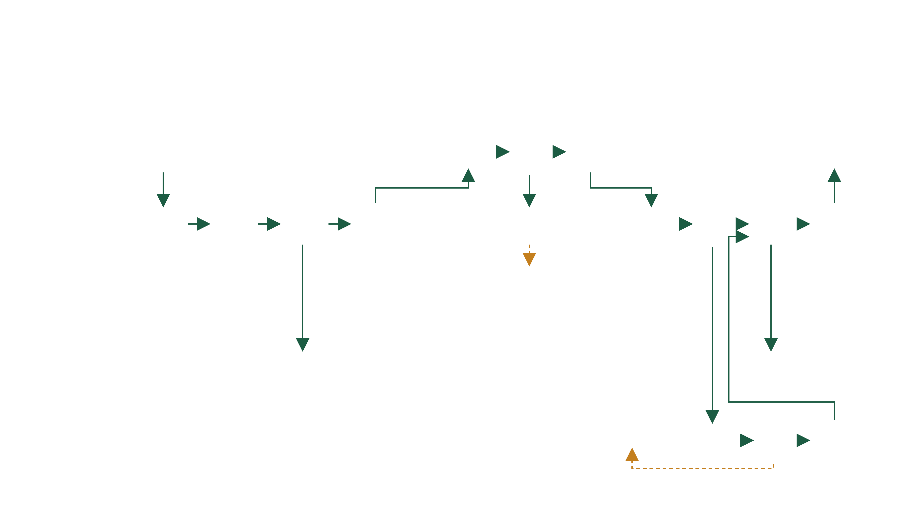
02 · CURRENT STATE — AS-IS
As-is booking process — swimlane with decisions
10 steps · 3–4 teams
3 decisions
2 rework loops
INITIATION
AVAILABILITY
ATTENDANCE
PARTNER · IF REQUIRED
CONFIRMATION
1
6
7
10
Customer
Requests meeting
Receives 3 available dates
Able to attend?
Yes
Informs bank of chosen date
Accepts invite → Outlook calendar
✉ MAIL
No
2
3
Checks type, room & internal attendee availability
4
5
Emails 3 proposed dates
!
8
9
Emails Outlook invite to customer
Identifies who to meet · CRM/ARR review
Creates 3 PROV Outlook invites + room
Deletes all 3 PROV meetings
Deletes irrelevant dates · removes PROV
Known to partner?
No
Creates internal CRM invite
Relationship Mgr
✉ MAIL
✉ MAIL
Yes · ✉ EA
↺
Restart → step 4 · new dates
Team Assistant
Catering & FOH
Accepts all 3 PROV CRM holds
Accepts CRM invite
Exec Assistants · Partners
↺
Email EA to check if partner is available
Partner available?
Yes
Emails RM to add partner to invite
Restart → step 4 · re-provision
No
✉ MAIL
◇ decision
— — rework loop
! exception step
○ supporting action
✉ manual email
6–8 emails per booking · 3–5× provisional invites created & mostly deleted
*Vanilla = customer meeting without a partner; prospect meetings require a partner. RMs/ARMs organise all AR & customer meetings; Team Assistant handles lunches, intermediaries & complex meetings only.
Notes:
This is the true as-is, decisions and all — ten core steps across four active teams (Team Assistant sits in the lane but only handles lunches, intermediaries and complex meetings). Three decision points and two rework loops are the story: if the customer can't make any of the three dates the RM deletes all provisional holds and restarts at step 4; if the partner isn't available the flow also restarts at step 4. Known-to-partner short-circuits the partner phase — No creates the CRM invite directly, Yes emails the EA to check the partner. Every diamond is a place the process can stall or repeat; every envelope is a manual email. That fragility is what the future state removes.

Slide 4
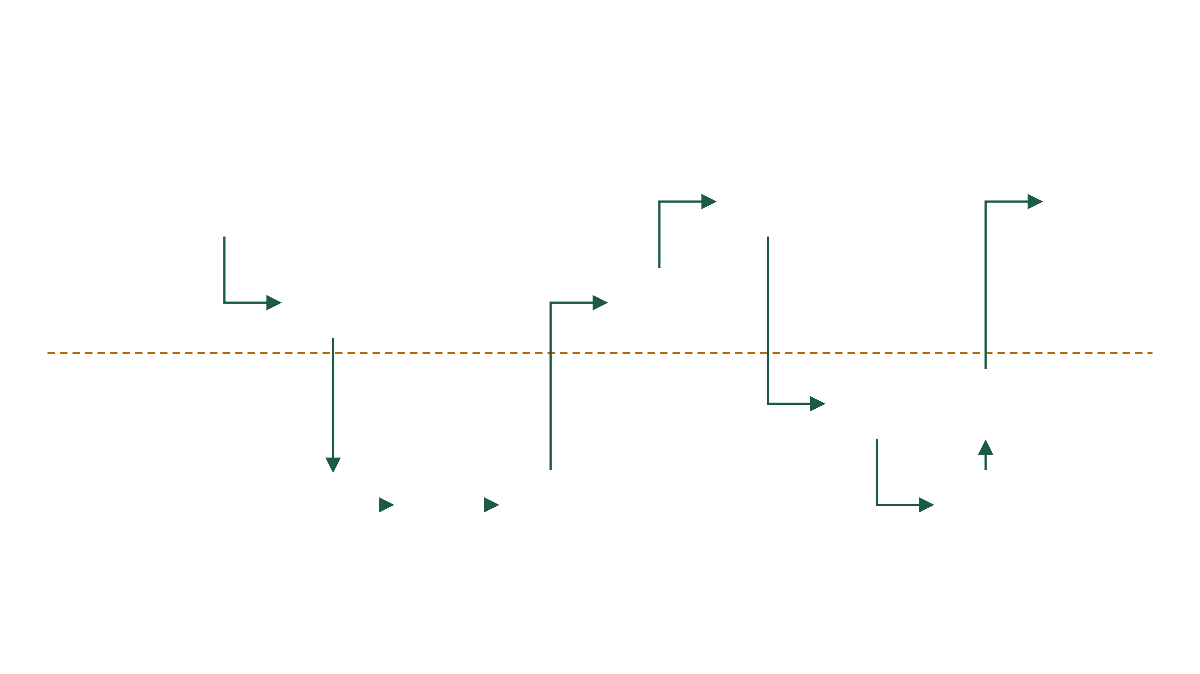
03 · TARGET STATE — TO-BE
To-be journey — one screen, assisted
Copilot Studio reads & drafts
0 manual emails
partner auto-included
REQUEST
CREATE
AVAILABILITY
COPILOT STUDIO
REVIEW
SELECT
TRIGGER
FULFIL
CONFIRM
1
6
10
Customer
Asks the RM
Picks a slot — one tap
Instant confirmation
Booking page
2
5
Relationship Mgr · app
Enters details · Create Meeting
RM reviews · sends link
Code app
Code app
LINE OF VISIBILITY — customers & RMs never see below
7
9
Automation · Power Automate
Validated trigger fires
Notify ops · write audit
Power Automate
Flow · Dataverse
AUTO
3
4
8
Systems · Graph · Copilot Studio · Dataverse
Checks CRM partner flag · auto-includes partner
Availability + rooms resolved
Reads request · drafts invite
Event + room created
Dataverse · Graph
Graph
Copilot Studio
Graph · Outlook
numbered path — one booking, end to end · chip = component doing the work · dashed — line of visibility
Notes:
Same swimlane grammar as the as-is slide. Follow the numbered path — ten steps, three of them customer touches. Step 4 is the Copilot Studio agent: it reads the client request, and once Graph has resolved availability it drafts the invitation in one house style. The RM reviews before anything goes out. The tech chip on each step names the component. An automated CRM partner-flag check auto-includes the partner as an attendee — the manual EA email and rework loop from the as-is are gone. The orange line of visibility marks everything customers and RMs never see.

Slide 5
03 · THE TECHNOLOGY CHOICE
We looked at doing nothing first
Same platform · same governance
OPTION
WHAT HAPPENS TO THE RM JOURNEY
SPEED TO CHANGE
REUSE ELSEWHERE
Do nothing
Finds a time, but knows nothing about the client, the partner or provisional holds. The RM still joins it up.
Bookings · findMeetingTimes
n/a
None to build on
Canvas app
Fine for a form. This flow has multi-step state, drafts and review gates — the part where canvas becomes hard to hold together.
Low-code, drag and drop
Fast at first, slow later
Copy and paste screens
Model-driven app
Strong for caseworking on records. The RM journey is a guided flow, not a form over a table.
Config-led
Tied to its tables
Dataverse-first
Code app
The journey is designed once, in full: real interaction, real state, one screen the RM never leaves.
CHOSEN
Same-day change
Shell reusable by other journeys
React in Power Platform
Nothing leaves the platform: same tenancy, same connectors, same DLP and audit as any Power Platform app.
Notes:
Four minutes, the technology decision. Be even-handed: we considered doing nothing first. Native Microsoft can find a time, but it cannot read the client relationship or hold provisional options, so the RM still does the joining. Canvas is quick to start and painful at this level of interaction and state — and it is not testable or reviewable the way our engineers work. Model-driven gives us Dataverse for free but the RM journey is not a form over a table; it is a guided flow. Code apps keep the Power Platform envelope — same tenancy, same connectors, same governance — and give us React, source control, code review and reuse. Land it as: same platform, better craft.

Slide 6
04 · ONE CORRECTION
Copilot Studio, not a bespoke AI service
Was: Azure OpenAI direct
CLIENT
CODE APP
COPILOT STUDIO AGENT
The email asking to meet
→
The RM's one screen
⇄
Reads the email · drafts the invite
Holds the flow, the review gates and the send.
Two jobs. No decisions, no sends.
UNCHANGED AROUND IT
Graph — availability & rooms
Power Automate — fulfilment
Dataverse — state & audit
Entra — identity
Nothing new to stand up
Inside existing governance
Changed without a release
No AI service to provision, key-manage or bill separately. One connector call from the app.
Same tenancy, DLP and audit trail the bank already approved for Power Platform.
Tone, topics and guardrails are maintained in Copilot Studio, not shipped as code.
Notes:
One correction to make, and it simplifies things. Earlier drafts of this design had a bespoke Azure OpenAI call in the flow. We are not doing that — the app talks to a Copilot Studio agent instead. Two jobs only: read the client's email and pull out the meeting intent, then draft the invitation in one house style. It never picks a time on its own and it never sends. Why the change: nothing new to stand up, it sits inside the Power Platform governance the bank already signed off, and the prompts and topics are maintained by the team rather than shipped as code. If asked about Azure OpenAI — it is still what runs underneath Copilot Studio; we just stop owning the plumbing.

Slide 7
05 · SPEED TO ITERATE
Wireframes to a clickable app in two weeks
Not a projection — this is where we already are. A code app is ordinary engineering, so the loop is short.
✓
✓
▸
○
WEEK 0
WEEK 2
NEXT · 4 WEEKS
THEN
As-is mapped, wireframed
Clickable app
In the tenant, wired up
Pilot with a handful of RMs
Sat with RMs, drew the journey, agreed the seven steps.
The whole flow, end to end, in the browser — what you will see today.
Graph, Copilot Studio and the flow connected, deployed through existing ALM.
Real bookings, weekly changes, measured against the baseline.
THE WEEKLY LOOP
WHY IT HOLDS UP
RM asks for a change
→
code, review, merge
→
Source control, code review and automated deployment — the same discipline as any other bank system, on the platform we already run.
deployed same day
Notes:
Three minutes, and this is the part that is genuinely different. Wireframes to a clickable app in two weeks — that already happened, it is not a projection. The reason is not heroics: it is that a code app is ordinary engineering. Changes go through source control and review, deploy through the pipeline we already use, and a change asked for in a session can be in front of the RM the same day. If the panel takes one thing away: we can bring them something to react to every week rather than every quarter.

Slide 8
06 · THE VISION
Where we take the experience
Today's demo UI is functional, not final
Good morning, Rachel
THREE TIMES THAT WORK
DRAFT TO THE CLIENT
EDITABLE
NEEDS ATTENTION
Tue 14 Apr · 10:00
BEST
Dear Mr Bianchi,
Everyone free · Sir Evelyn room · no travel for the client
Wed 15 Apr · 15:30
Thu 16 Apr · 09:00
TONE
Formal
Warm
Open on what needs you
Show the reasoning
Nothing sends itself
Not a blank form. The book, sorted by what is waiting on the RM.
Options come with why. The RM decides what the client sees.
Every word is the RM's to change before it leaves the bank.
If the technology team agrees on this shell, the frame, sign-in, CRM plumbing and review-gate pattern are reusable — the next journey starts at week two, not week zero.
THE SECOND PRIZE
Notes:
Be honest here first: the working app you will see is deliberately plain, because we spent the two weeks proving the flow, not the finish. This slide is where it goes. Three ideas — the RM lands on what needs them rather than a blank form; the app shows its reasoning when it proposes times so the RM stays in charge; and every draft is editable before anything leaves the bank. The second half of the ask is for the technology team: if we agree on this shell — the frame, the auth, the CRM plumbing, the review-gate pattern — the next journey starts at week two, not week zero.

Slide 9
07 · WHAT CHANGES
What the bank gets out of it
01
The RM stops being the integration layer
One screen instead of four systems and a mail thread. Time back for client conversations, not diary admin.
MEASURE 1
Minutes to book one meeting
Baselined with the RM teams before the pilot, measured the same way after. The honest number, not a modelled one.
02
The client experience stops depending on who they bank with
One clear message, times they can pick in a tap, and an instant confirmation — every time.
03
Consistency you can see
MEASURE 2
An unwritten process becomes a visible one, with a record of what was proposed, chosen and confirmed.
Client meetings booked per year
The multiplier. We need this figure from you — it is what turns minutes saved into a number worth acting on.
04
Assistants get their judgement work back
The provisioning and chasing goes; the exceptions that genuinely need a person stay with them.
We would rather commit to measuring these two than present a business case built on assumptions.
Notes:
Two minutes, and keep it honest. Lead with the qualitative — that is what this is really about. The RM stops being the integration layer. The client gets one clear message instead of a thread. Every booking looks the same regardless of who made it, and there is a record of what happened. Then the two numbers: we will baseline both before the pilot, and we would rather commit to measuring them than to a business case built on guesses.

Slide 10
08 · THE ASK
What you have asked us so far
Short answers, longer ones on request
“Why not just use Bookings?”
“Another app to maintain?”
“Does the AI decide anything?”
“What about the assistants?”
“Why not wait for the roadmap?”
It finds a slot. It cannot read the client relationship, hold three options, or bring the partner in.
Same tenancy, same pipeline, same support model as our other Power Platform apps.
No. It reads the email and drafts the words. The RM approves every time and every send.
Lunches, intermediaries and complex meetings stay with them. The repetitive provisioning goes.
Nothing on it joins Dynamics, diaries and rooms into one RM view. That gap is ours to close.
WHAT WE ARE ASKING FOR TODAY
If you agree, we pilot with a few RMs, baseline the two numbers, and come back with what actually happened.
Your endorsement of the direction — code app, Copilot Studio, this experience.
Notes:
Close on their objections rather than our summary. These five are the questions we have actually been asked, and the short answer to each. Then the ask, which is deliberately small: we are not asking for money or headcount today, only whether you agree with the direction — code app, Copilot Studio for reading and drafting, and this UX. If you do, we take it to pilot with a few RMs and come back with real numbers.

